Slide 1



Unit 15
OUR
HEALTH
Lesson 1 – Period 1

Slide 2



02
Activity 1
Look, listen and repeat.

Slide 3

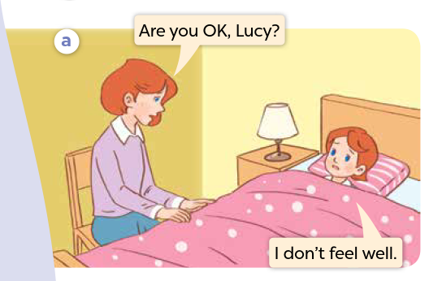



Look and say.
Notes:
Step 1: Ask pupils to look at Pictures a and b, and identify the characters and other details.

Slide 4
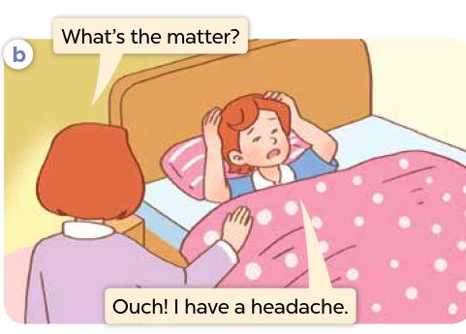
Look and say.
Notes:
Step 1: Ask pupils to look at Pictures a and b, and identify the characters and other details.

Slide 5

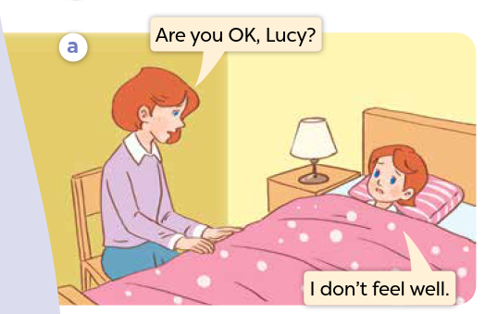

Listen and point.
Notes:
Step 2: Ask pupils to look at Picture a and b. Play the recording for them to listen to the entire conversation several times and point to the characters.

Slide 6
Listen, point and repeat.
Notes:
Step 3: Play the recording again, sentence by sentence, for pupils to listen and repeat individually and in chorus. Correct their pronunciation where necessary. Repeat the same procedure with Picture b.

Slide 7
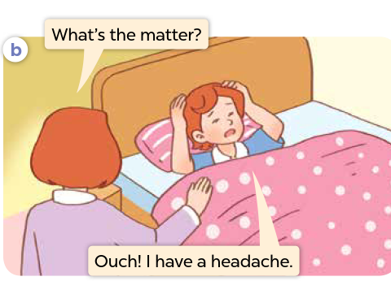
Listen, point and repeat.

Slide 8
03
Activity 2
Listen, point and say.

Slide 9
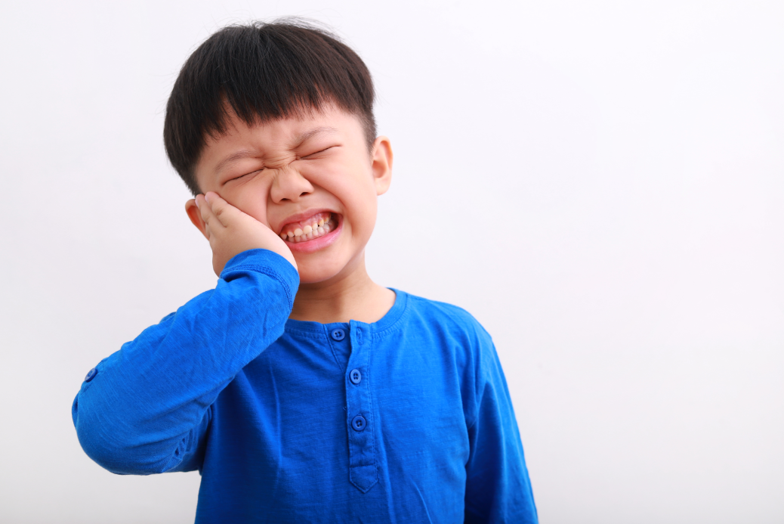
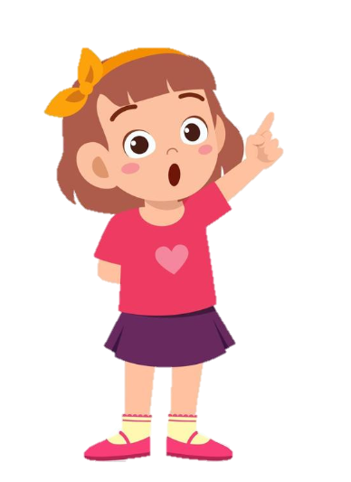
Listen and repeat.
I have a toothache.
What’s the matter?
Notes:
Step 2: Point at the question pattern What’s the matter? Read it aloud and have pupils repeat it several times. Repeat the procedure with the answer pattern I have ___.
Step 3: Point at Picture a and have pupils listen and repeat after the recording What’s the matter? - I have toothache. Repeat the same procedure with Pictures b, c and d.
Step 4: Divide the class into two groups to take turns repeating the question and the answer in Picture a until they feel confident. Repeat the same procedure with Pictures b, c and d.

Slide 10

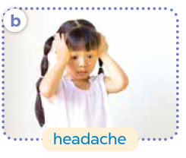
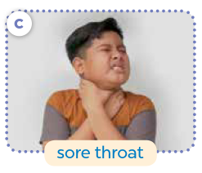
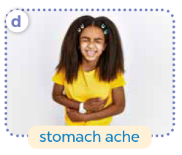
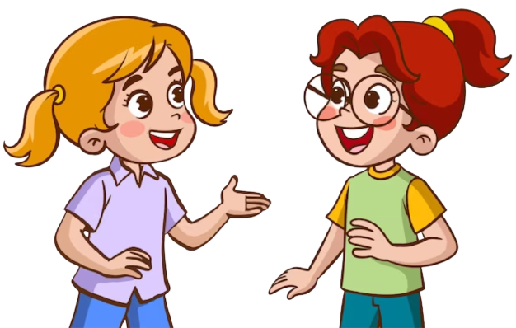
Ask and answer.
Notes:
Step 5: Put pupils in pairs and have them practise asking and answering questions using the pictures. Invite a few pairs to point at the pictures and say the questions and answers in front of the class. Give corrections and feedback where necessary.

Slide 11

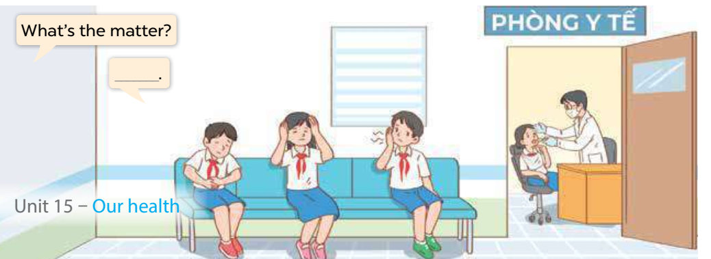

Ask and answer.
Notes:
Step 3: Have some pairs role-play by asking and answering questions about the health problems in the picture. Go around the classroom to observe and provide help.

