Slide 1









Table of Contents
Warm-up and Review
Activity 4: Listen and number.
Activity 5: Read and complete.
Activity 6: Let’s sing.
Fun corner and Wrap-up

Slide 2



01
Warm-up and Review

Slide 3



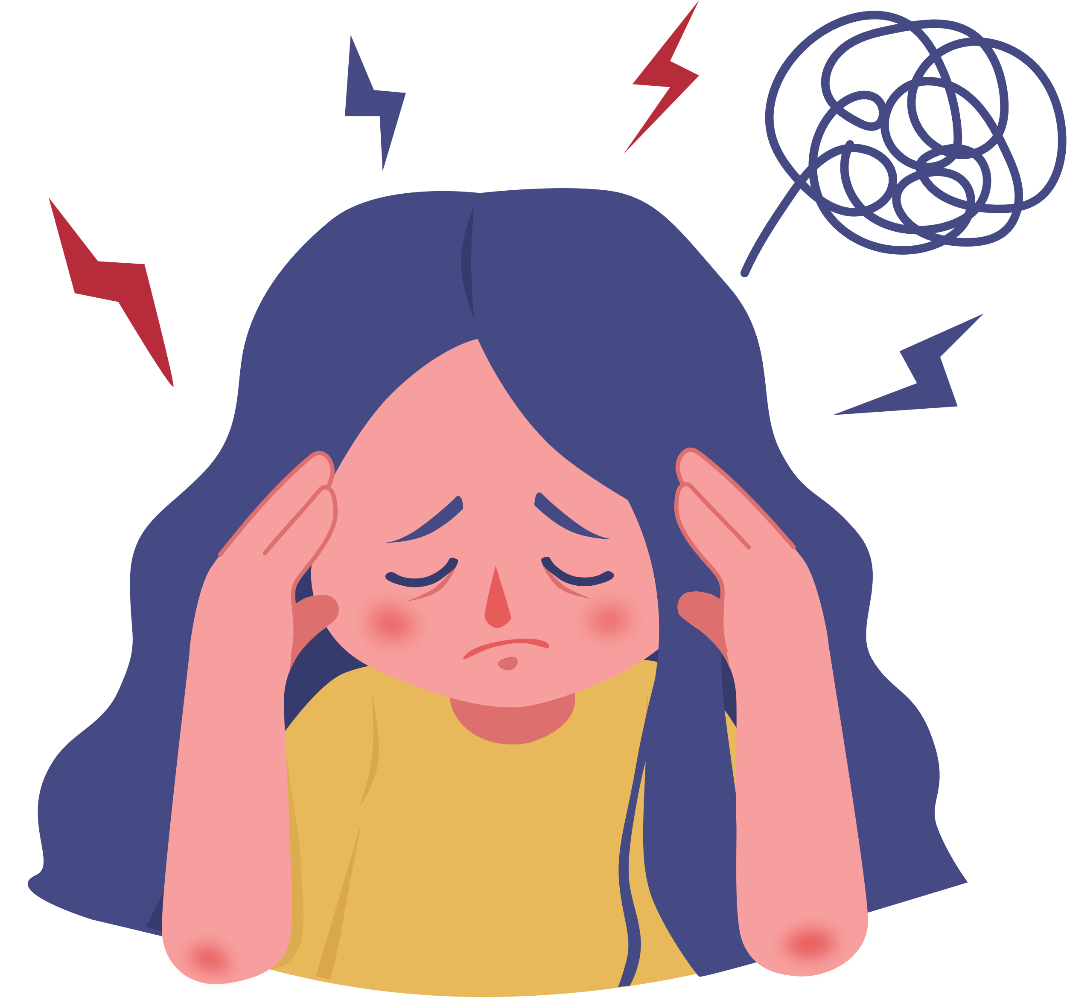
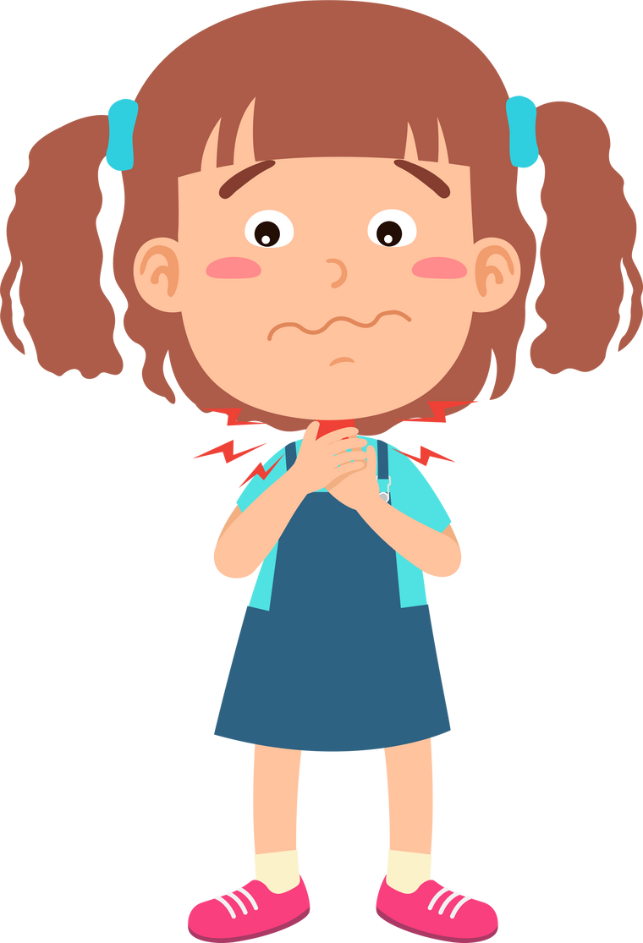
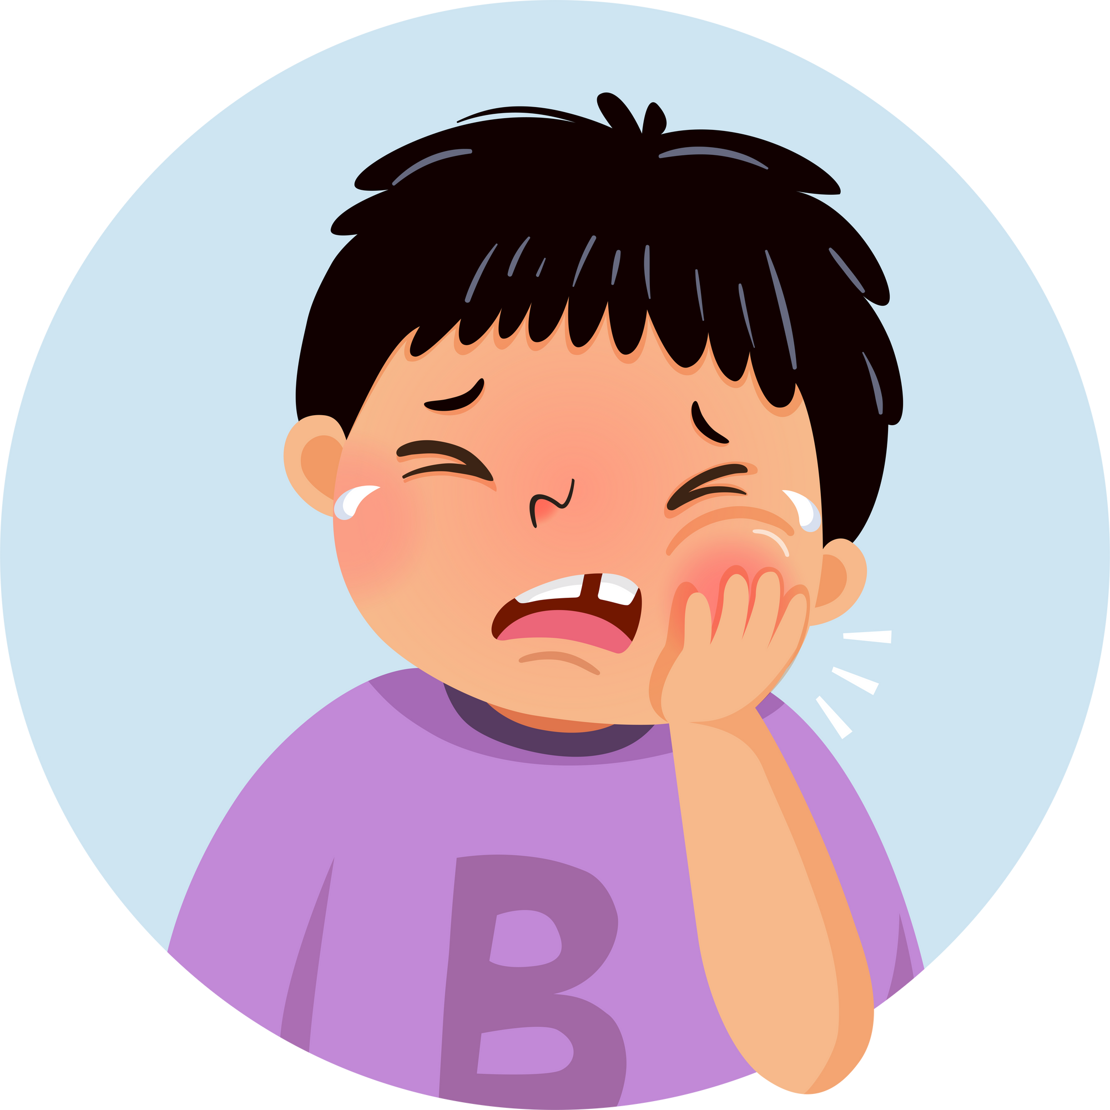
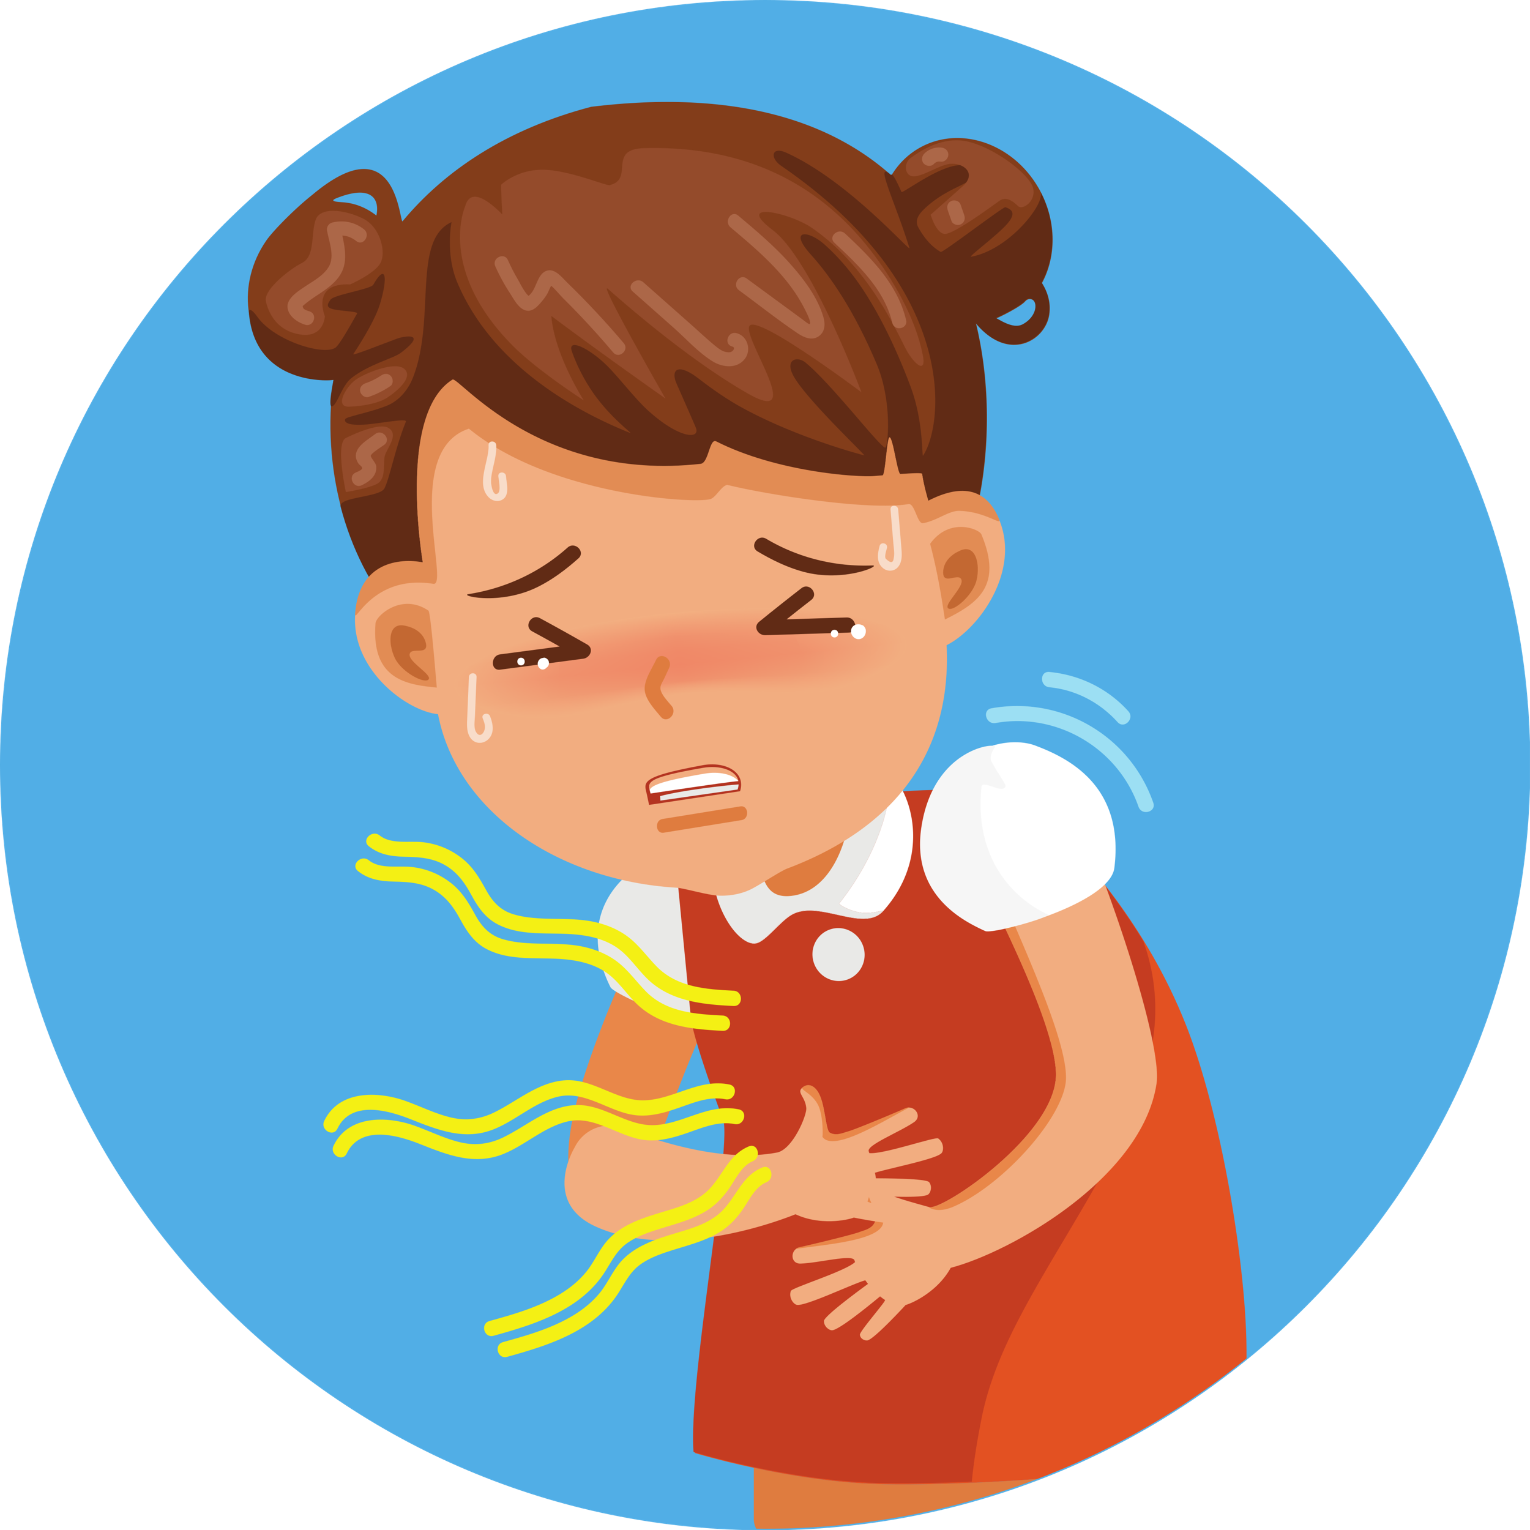
Let’s play Matching Game!

Slide 4
02
Activity 4
Listen and number.

Slide 5


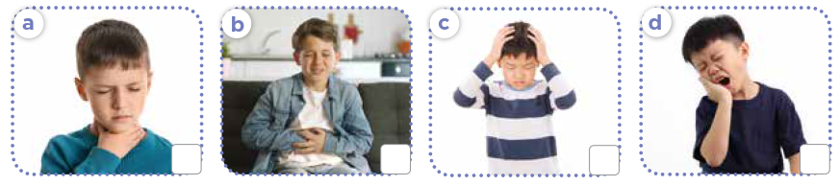


Look and answer.
Notes:
Step 1: Have pupils look at Activity 4. Ask them How many pictures are there? And What health problems can you see in each picture? Explain that they will write numbers 1 - 4 in the box of the picture in the order they hear.

Slide 6
03
Activity 5
Read and complete.

Slide 7


Read and complete.
1. I feel tired. I have a _________________ .
headache
Notes:
Step 2: Have pupils read the sentences in Question 1. Ask them what is missing in the sentence. Ask them to complete the gap by finding the information from the picture. Give the correct answer.

Slide 8
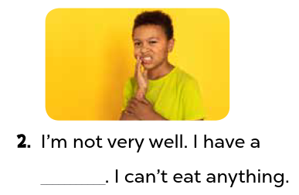
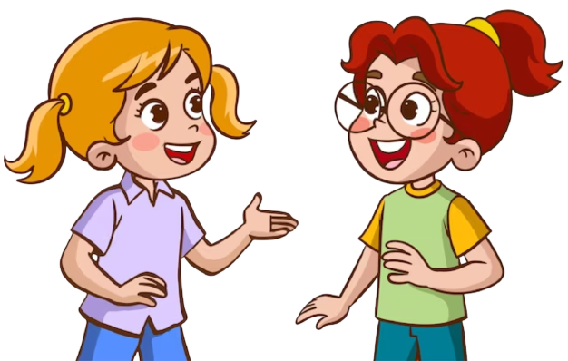
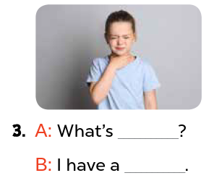
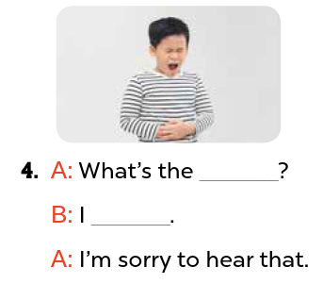
Read and complete.
Notes:
Step 3: Ask pupils to do the other questions in the same way individually, then in pairs for their peer-checks. Go around and give support if necessary.

Slide 9
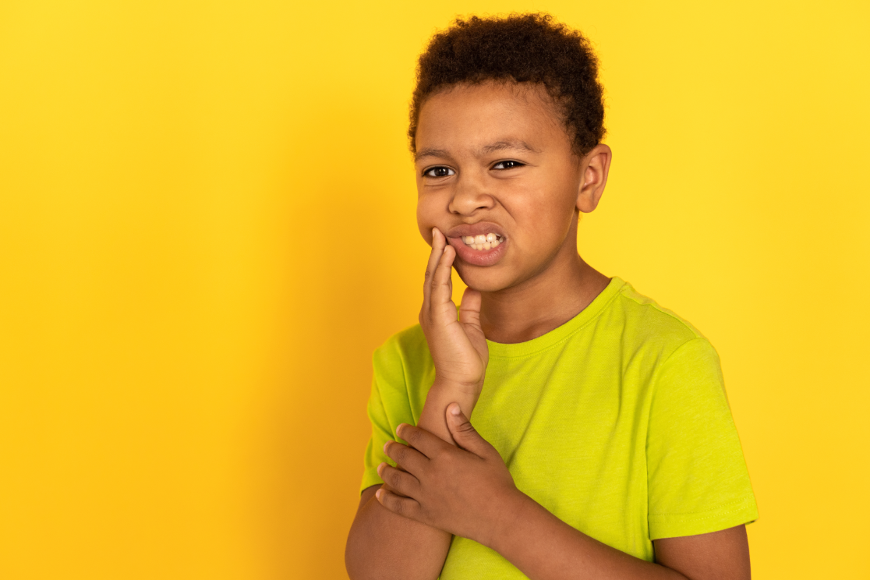
Read and complete.
2. I’m not very well.
I have a _____________ . I can’t eat anything.
toothache
Notes:
Step 4: Ask two pupils and two pairs to read the sentences aloud. Give feedback and corrections if necessary.

Slide 10
04
Activity 6
Let’s sing.

Slide 11

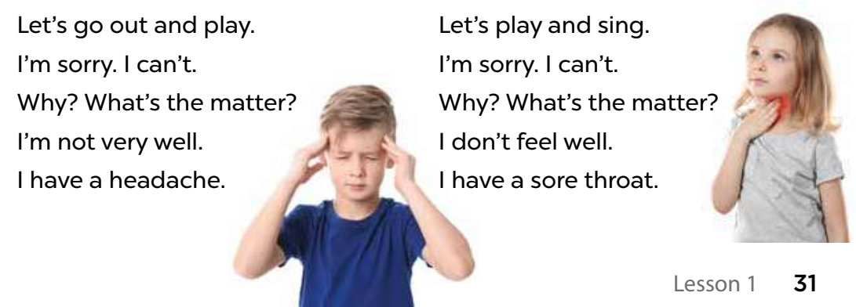

Read and give gestures.
Notes:
Step 1: Have pupils read the lyrics to familiarise themselves with the language. Check comprehension and give feedback.

