Slide 1



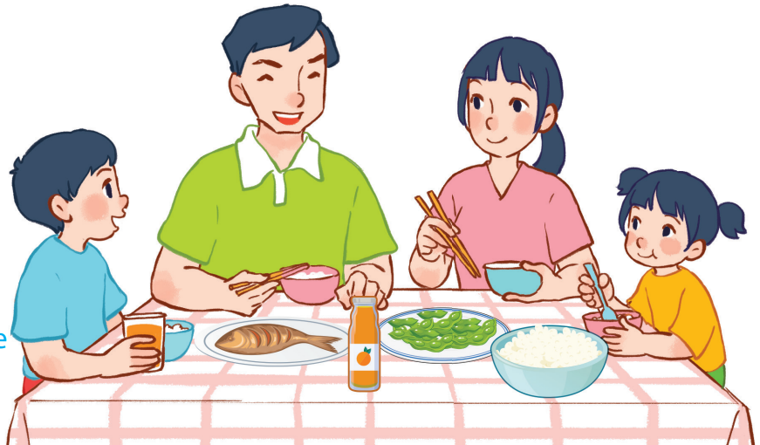
15
At the dining table
LESSON 1 – PERIOD 2

Slide 2
At the dining table
Warm-up
and review
Look, complete and read.
Fun corner
and wrap-up
Listen and tick.
Let’s sing.

Slide 3








FRUIT JUICE
Team A
Team B
Warm-up
and review
Notes:
Divide the class into 2 teams.
Each team chooses one jar mug of juice to go to the question. Have pupils look, read and choose the right option.
Click the score mug to get back to the menu for pupils to choose another question.
Pupils continue their turns until there is no mug left.

Slide 4

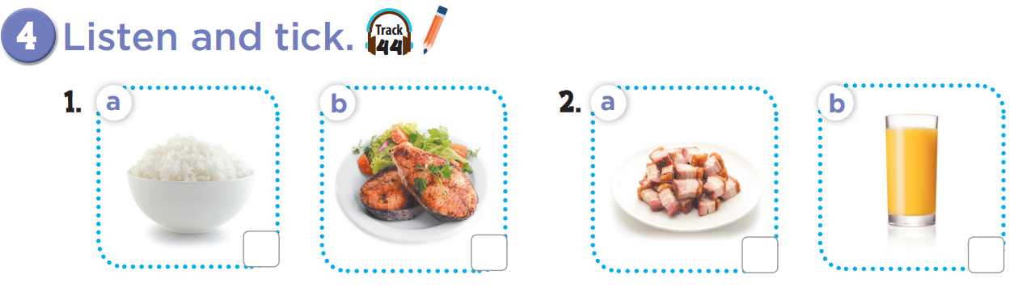

Slide 5
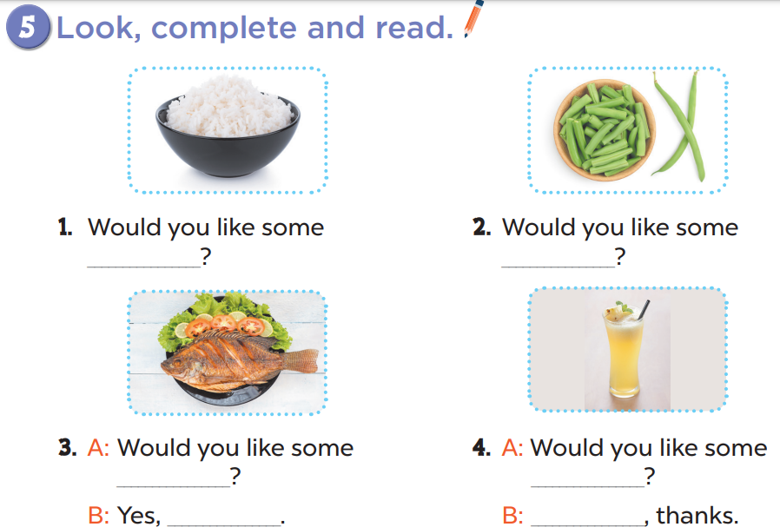
rice
beans
fish
juice
please
No

Slide 6
