Slide 1



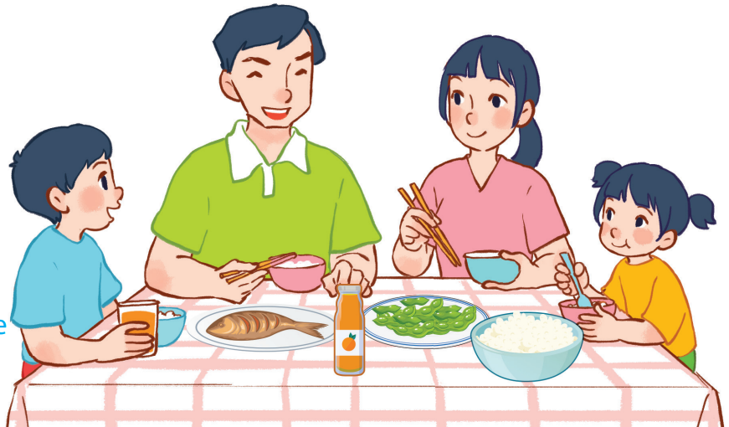
15
At the dining table
LESSON 2 – PERIOD 4

Slide 2
At the dining table
Warm-up
and review
Look, complete and read.
Fun corner
and wrap-up
Listen and number.
Let’s play.

Slide 3



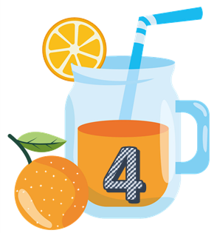




Team A
Team B
Warm-up
and review
Notes:
Divide the class into 2 teams..
Each team chooses one jar mug of juice to go to the question.
Have pupils look, read and choose the right option.
Click the ‘score’ mug to get back to the menu for pupils to choose another question.
Pupils continue their turns until there is no mug of juice left.
The team who gets the most points is the winner.

Slide 4












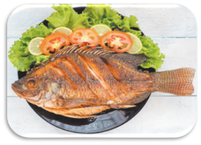
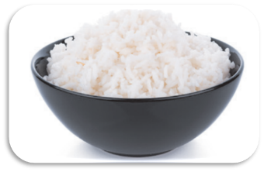
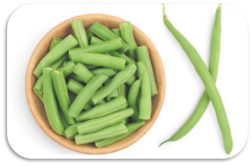
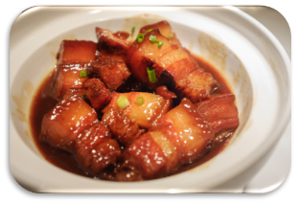

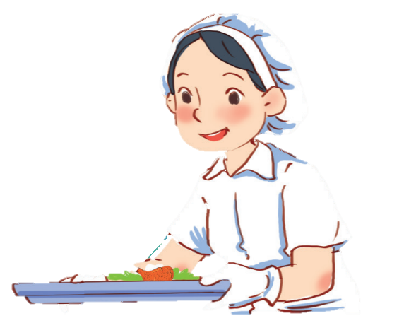


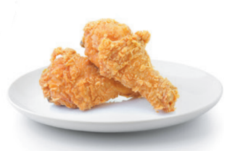
TIME
IS UP
I’d like some juice.
What would you like to drink?
30

Slide 5

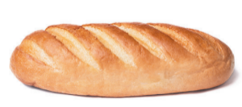
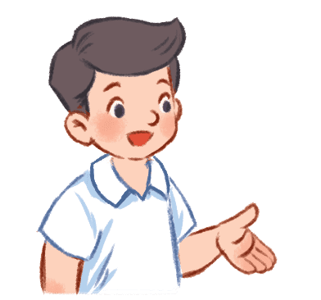

TIME
IS UP
I’d like some bread.
What would you like to eat?
50

Slide 6

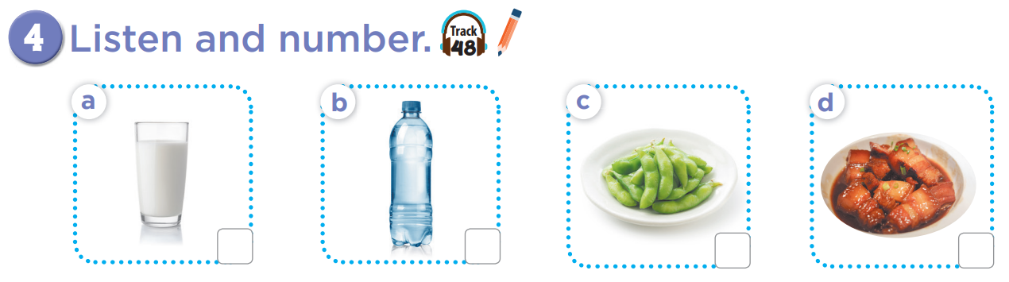

3
4
1
2

Slide 7
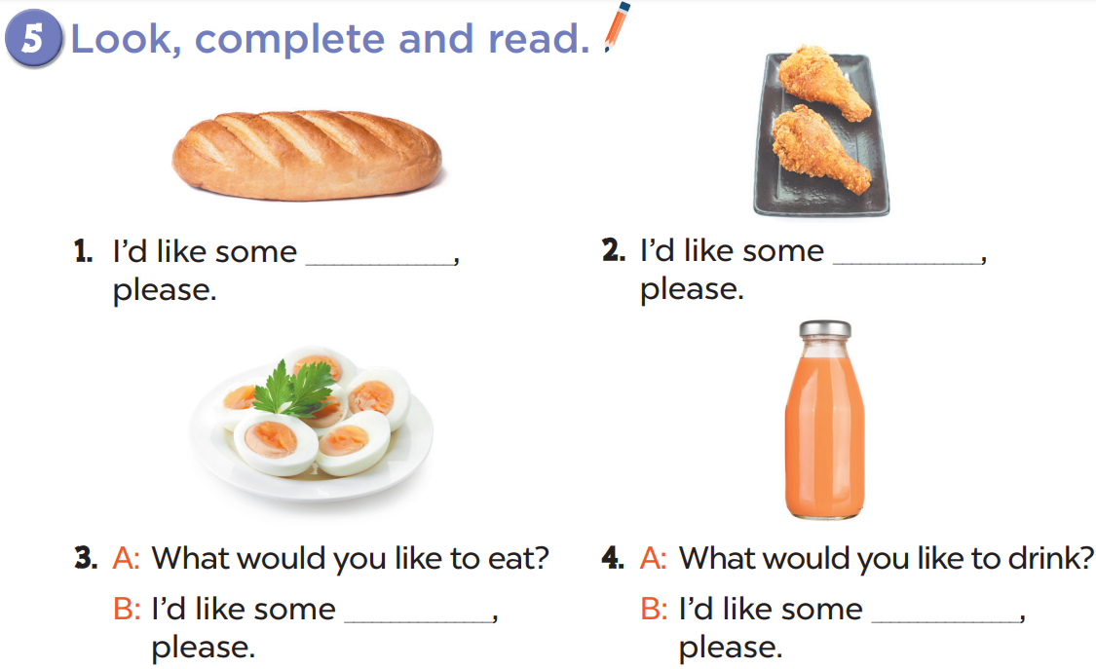
bread
chicken
eggs
juice

Slide 8
