Slide 1
REVIEW 3
Lesson 1

Slide 2
Table of contents
01
02
Warm-up and review
Listen and number.
04
Fun corner and wrap-up
03
Ask and answer.

Slide 3
Warm-up
Sing a song.
01

Slide 4
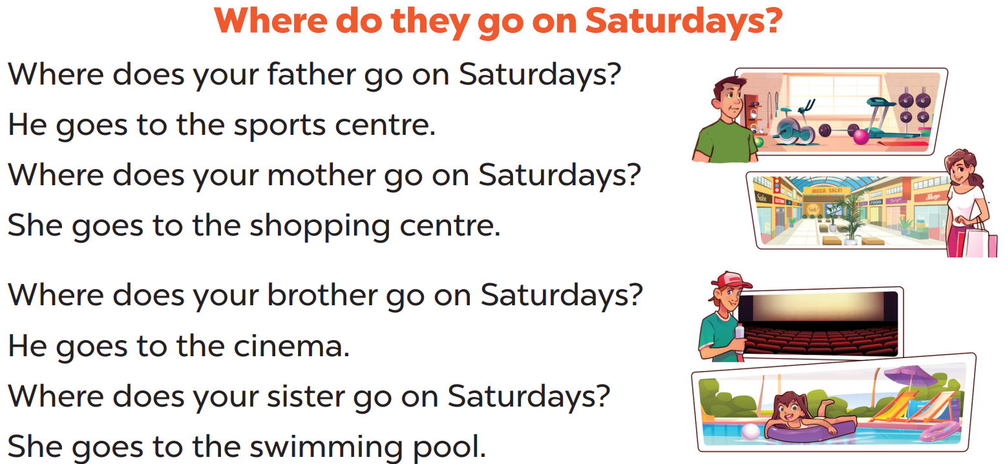
Notes:
Animation video: https://www.youtube.com/watch?v=brJK_Ke9Btw&list=PL8_ETpRL2xNay3h-a-vBjWhplE1wXFpSJ&index=31

Slide 5

Listen and number
02

Slide 6
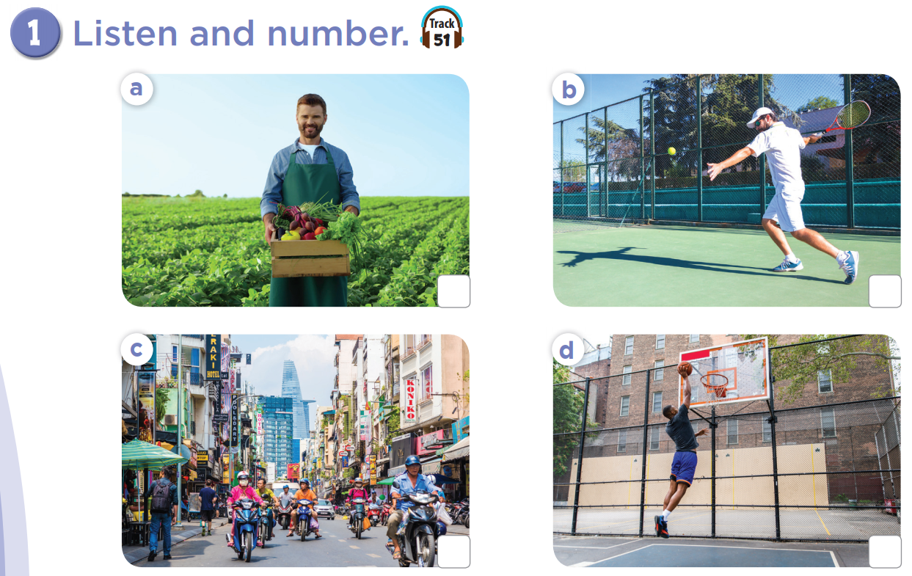


Slide 7
a farmer
play tennis
2
4
busy street
1
tall
3

Slide 8
Ask and answer.
03

Slide 9
