Slide 1


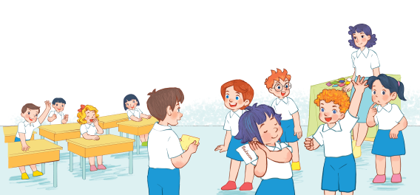
Review 3
PERIOD 2

Slide 2
REVIEW 3
Warm-up
and review
Read and complete.
Fun corner and wrap-up
Read and match.
Ask and answer.

Slide 3

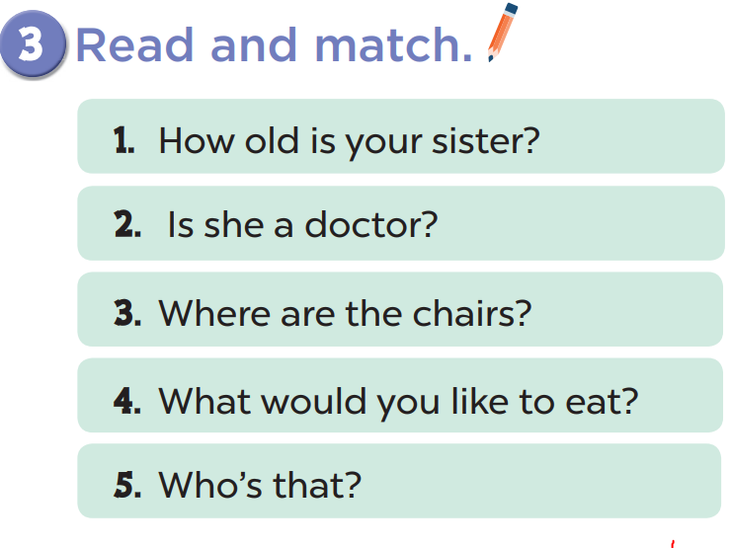
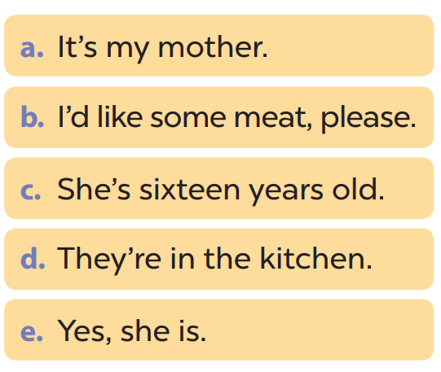


Slide 4
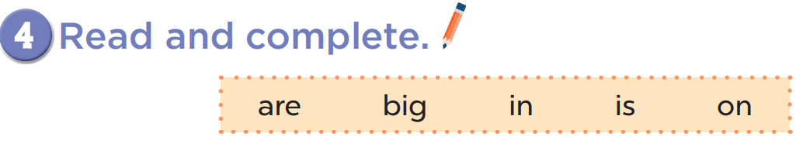
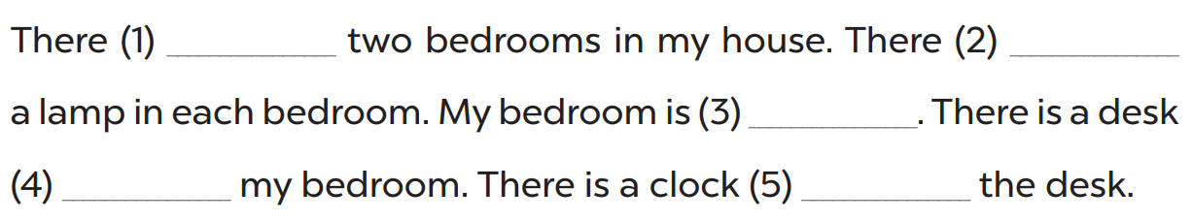
are
is
big
in
on

Slide 5
