Slide 1

Unit 16 Seasons and the weather
Lesson 1 - Period 1

Slide 2

02
Look, listen and repeat.

Slide 3
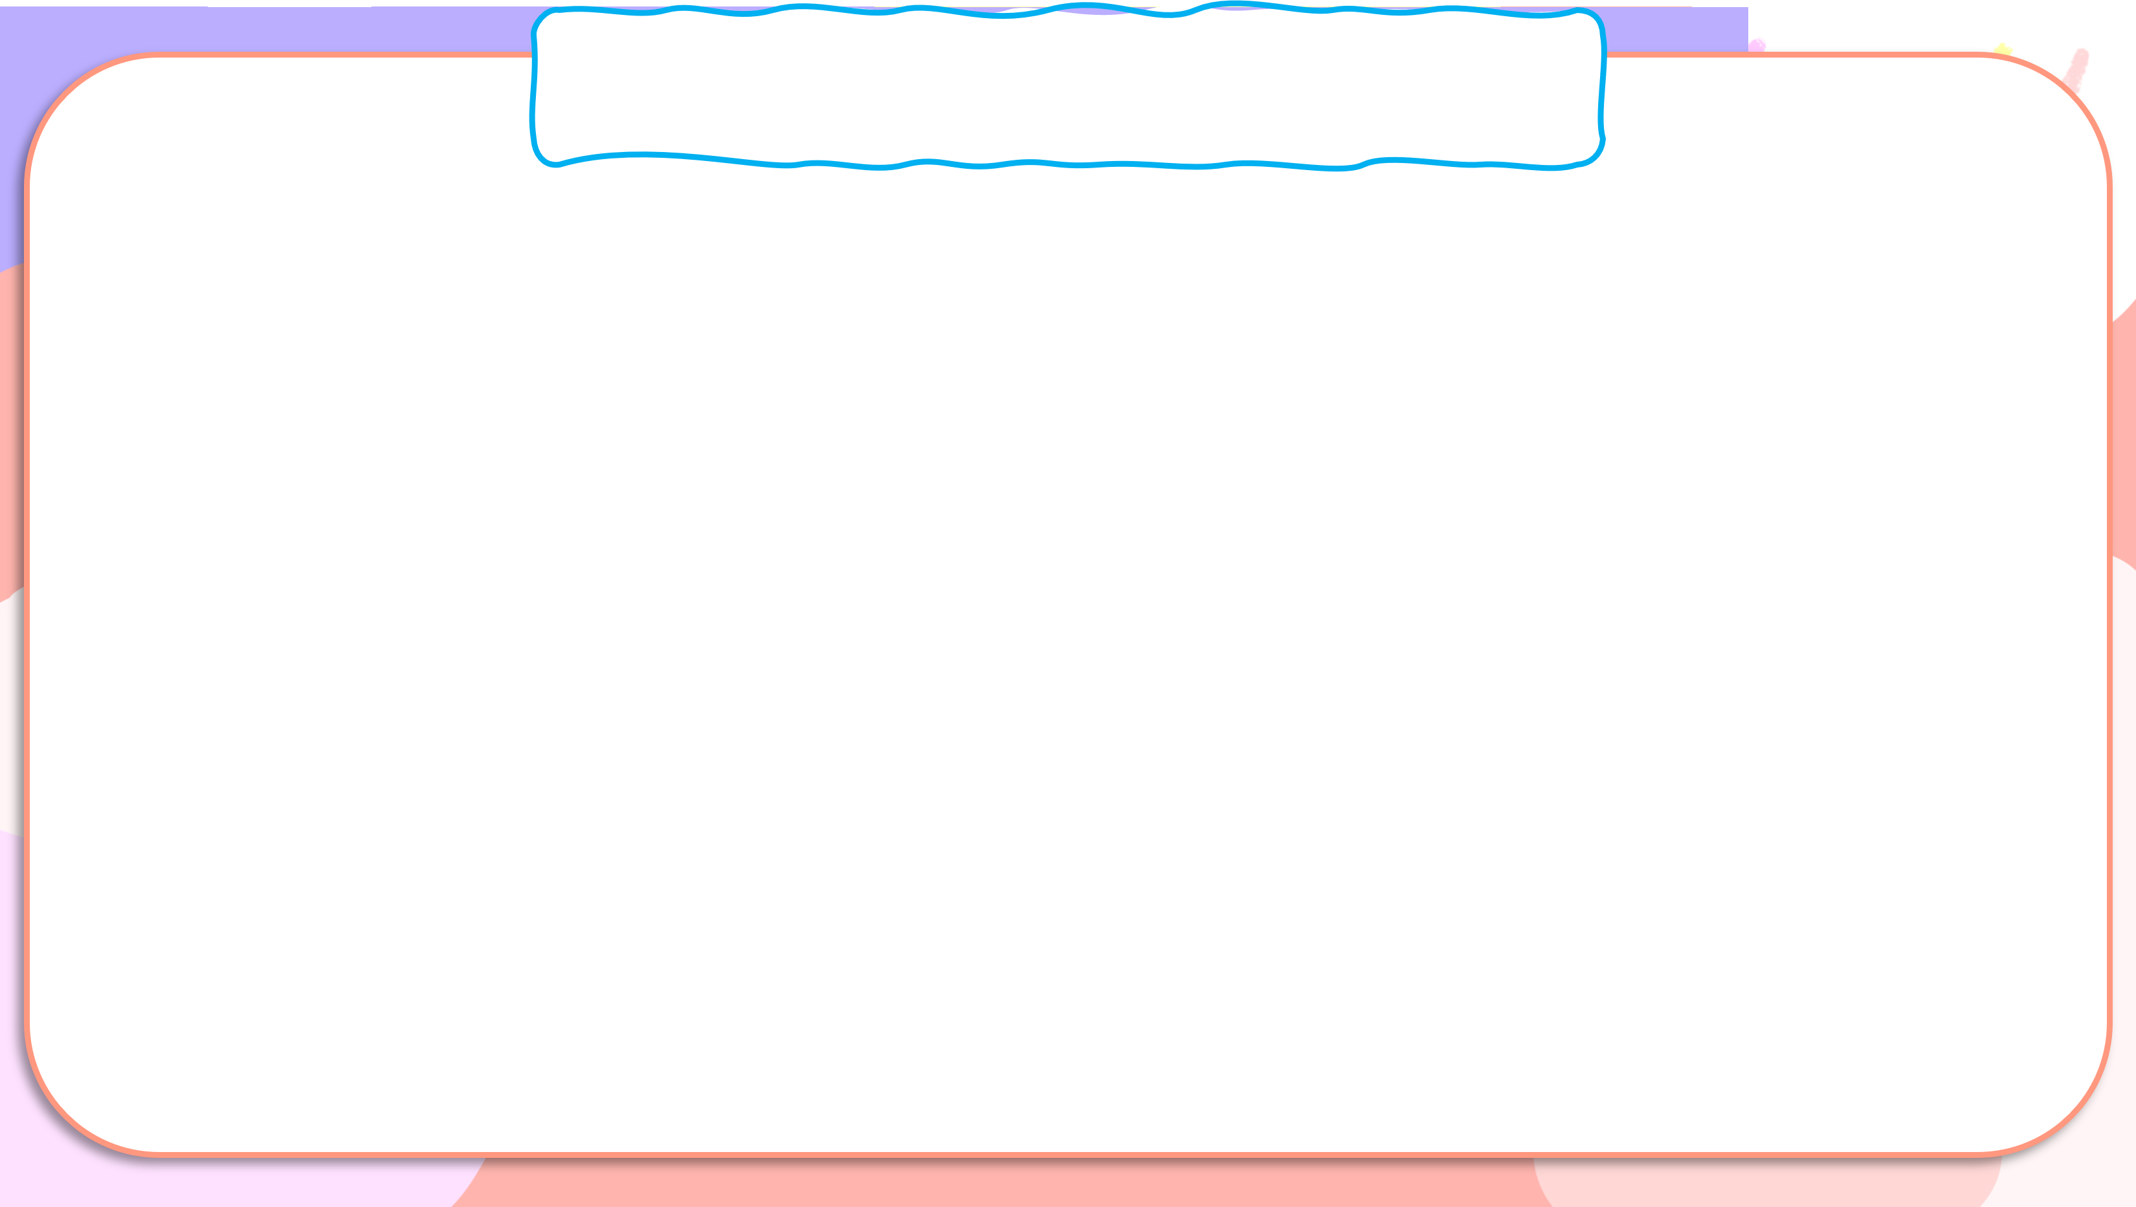
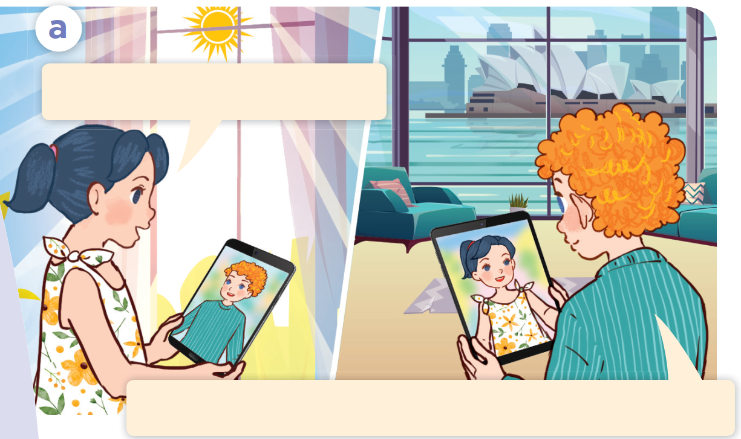
Look, listen and repeat.
Hi, Bill. Is it cold there?
Yes, it is. It’s winter in Sydney, you know.
Notes:
Nháy vào hội thoại để nghe lại âm thanh từng câu.

Slide 4

03
Listen, point and say.

Slide 5





How’s the weather in Ha Noi in ____?
summer / hot
autumn / cool
It’s ___.
winter / cold
spring / warm

Slide 6
04
Let’s talk.

Slide 7

Let’s talk.
How’s the weather in Ha Noi in _____?
_____.

