Slide 1


My pets
Lesson 1 - Period 1
16

Slide 2
1
2
3
Warm-up and review
4
5
Fun corner and wrap-up
Look, listen and repeat.
Listen, point and say.
Let’s talk.

Slide 3
1
Warm-up and review

Slide 4

Notes:
Sing the song from youtube - https://www.youtube.com/watch?v=pWepfJ-8XU0

Slide 5
2
Look, listen and repeat.

Slide 6

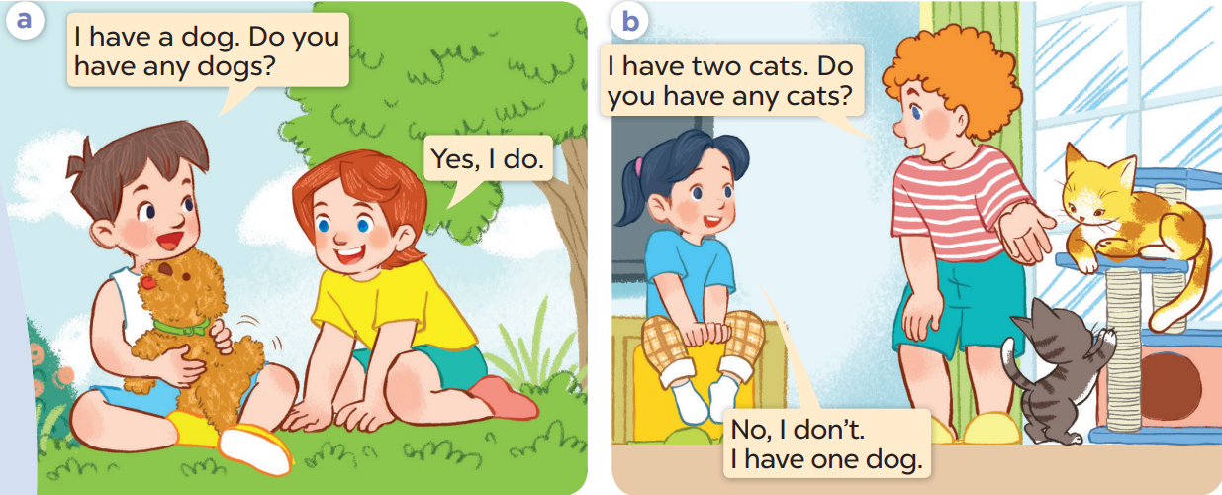
Listen again and repeat.

Slide 7
3
Listen, point and say.

Slide 8
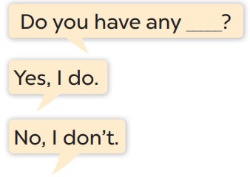
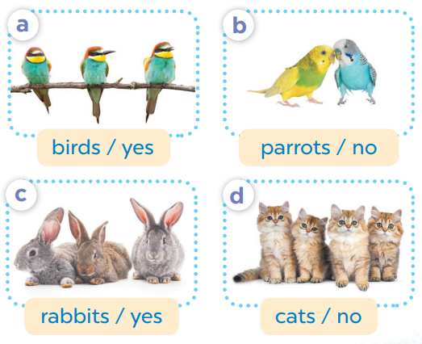

Slide 9
4
Let’s talk.

