Slide 1


My pets Lesson 1 - Period 2
16

Slide 2
2
Listen and tick.

Slide 3
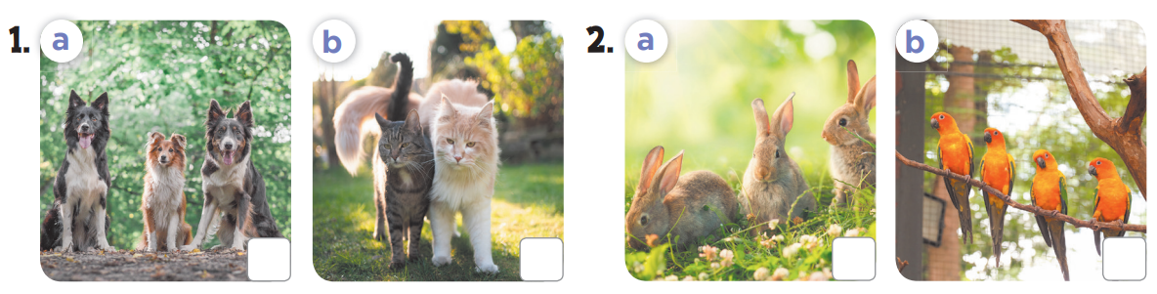


Slide 4
3
Look, complete and read.

Slide 5
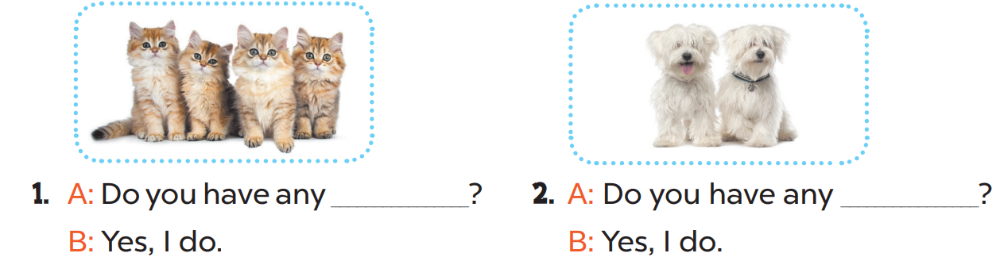
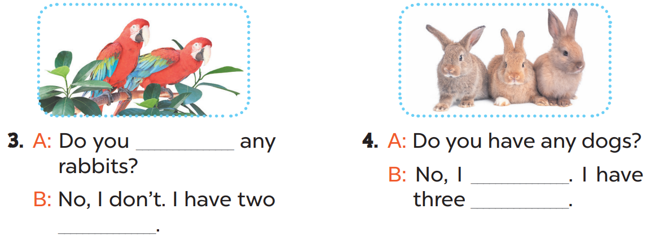
cats
dogs
have
don’t
rabbits
parrots

Slide 6
4
Let’s sing.

Slide 7
