Slide 1


My pets Lesson 2 - Period 3
16

Slide 2
1
Warm-up and review

Slide 3
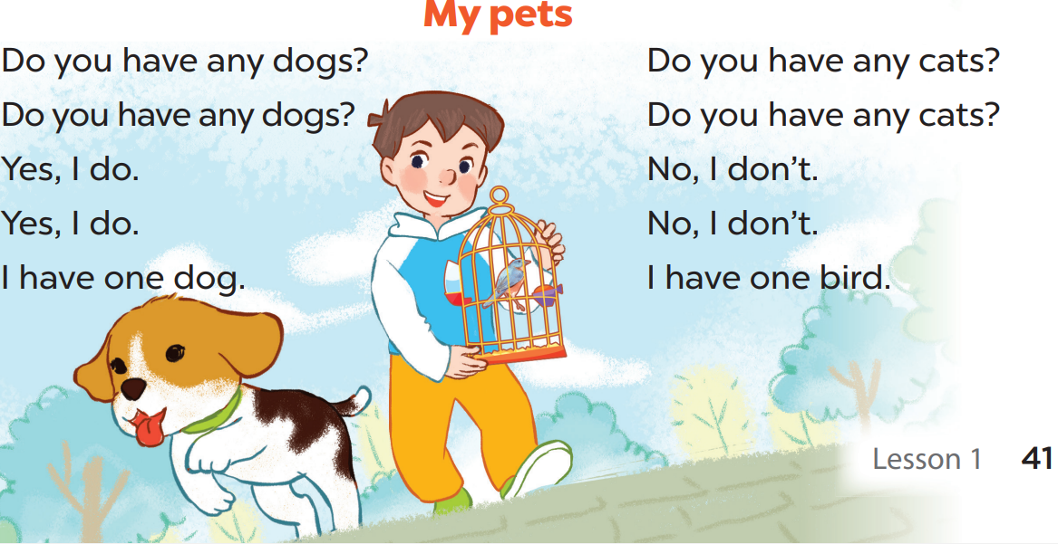

Slide 4
2
Look, listen and repeat.

Slide 5
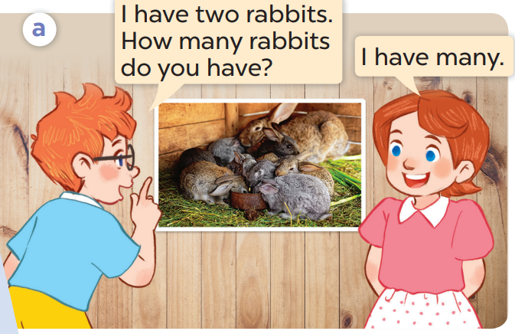
What pets does Ben have?
Now listen and repeat.
Who are they?
He has 2 rabbits.
They’re Ben and Lucy.

Slide 6
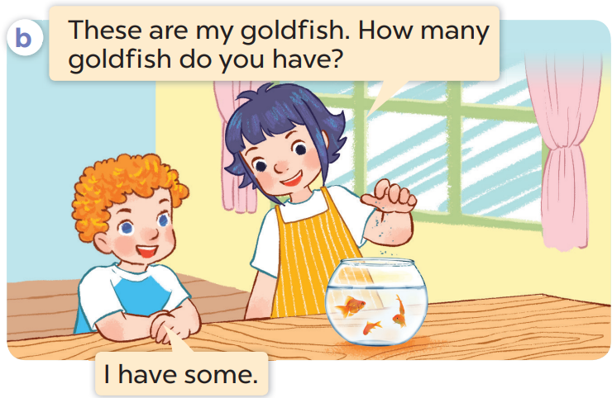
Whose goldfish are they?
What pets can you see?
Who are they?
I can see ….goldfish.
They are Linh’s
They’re Linh and Bill.

Slide 7

Listen again and repeat.

Slide 8
Work in pairs. Act and say

