Slide 1








Unit 14: STAYING HEALTHY
Lesson 3 - Period 5

Slide 2


Listen and repeat.
Does she 'eat ‘healthy 'fruit?
Notes:
Step 1: Have pupils look at the first question. Draw their attention to the stress on the words (e.g. eat, vegetables, every, day). Explain that they are the “content” (important) words in the question and need to be stressed. Check comprehension.
Step 2: Play the recording for pupils to listen to and repeat, in chorus and individually, until they feel confident. Correct their stress and pronunciation if necessary. Repeat Steps 1 and 2 with the second question.

Slide 3
Listen and repeat
Is your 'brother a 'strong 'swimmer?
Notes:
Step 1: Have pupils look at the first question. Draw their attention to the stress on the words (e.g. eat, vegetables, every, day). Explain that they are the “content” (important) words in the question and need to be stressed. Check comprehension.
Step 2: Play the recording for pupils to listen to and repeat, in chorus and individually, until they feel confident. Correct their stress and pronunciation if necessary. Repeat Steps 1 and 2 with the second question.

Slide 4


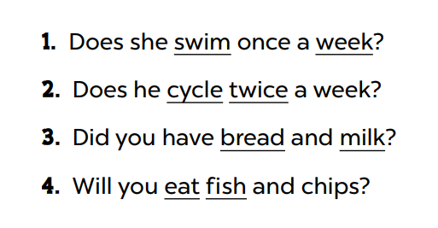


Look and say.
Notes:
Step 1: Draw pupils’ attention to the four sentences. Explain what pupils have to do. Check comprehension.

Slide 5



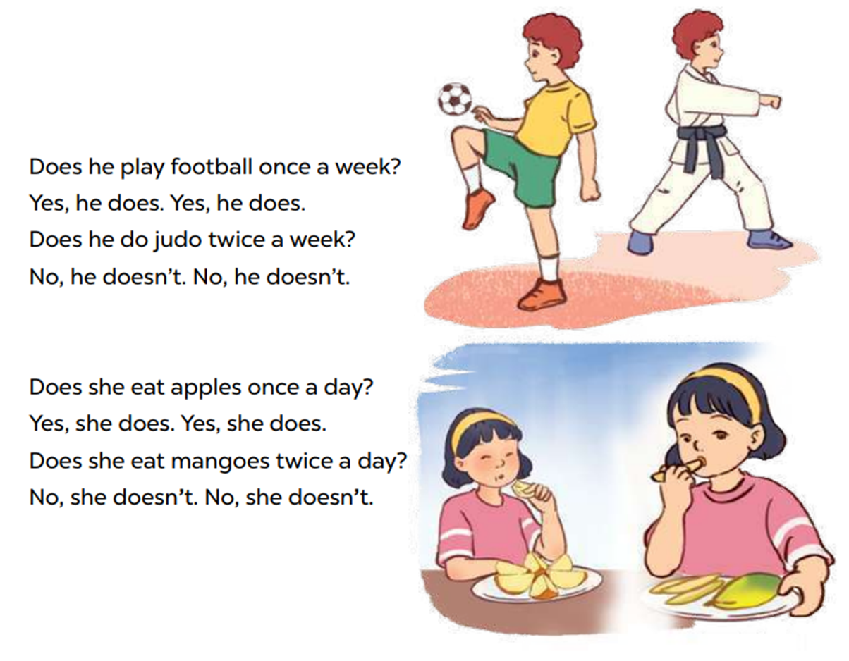


Look and read.
Notes:
Step 1: Have pupils read the lyrics of the chant. Then get them to look at the picture to reinforce their understanding. Check comprehension.

