Slide 1





UNIT 17
STORIES
FOR CHILDREN
Lesson 1 – Period 2

Slide 2











Table of Contents
Warm-up and Review
Listen and circle.
Read and complete.
Let’s play.
Fun corner and Wrap-up

Slide 3


01
Warm-up and review

Slide 4


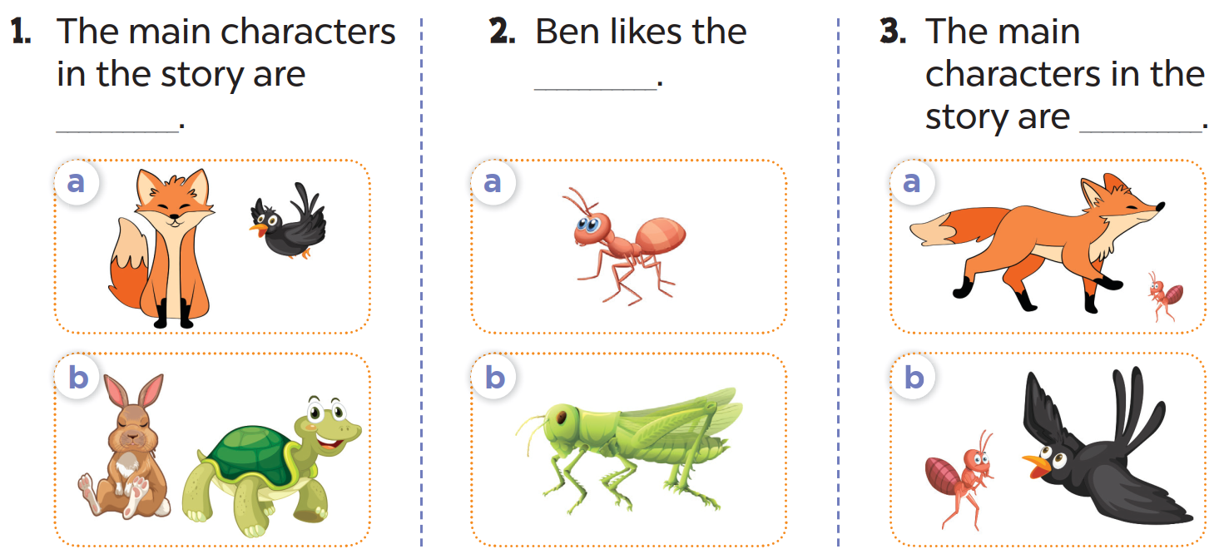
Look and answer.
crow
ant
fox
hare
tortoise
grasshopper

Slide 5
Listen and circle.

Slide 6
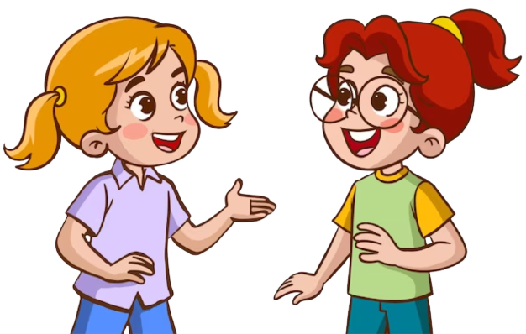
Ask and answer.

Slide 7

Let’s check the answers.

Slide 8
Listen and tell the story.

Slide 9



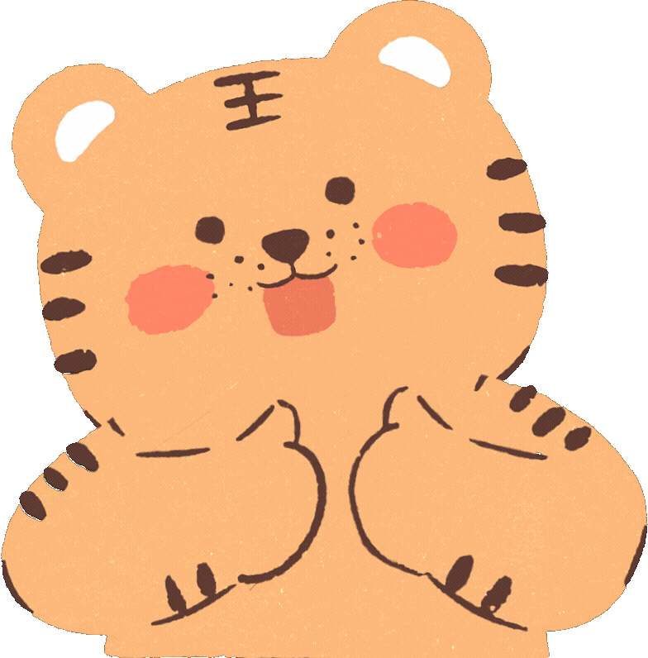



Slide 10
03
Read and complete.

Slide 11

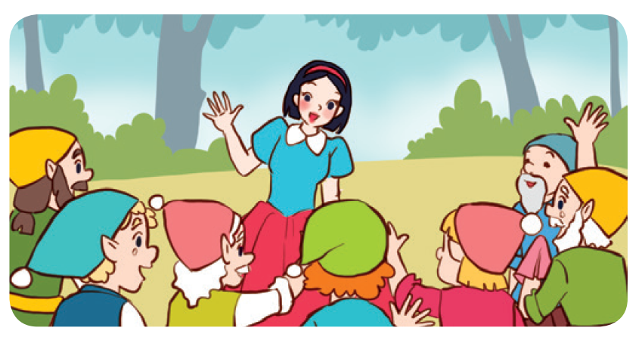
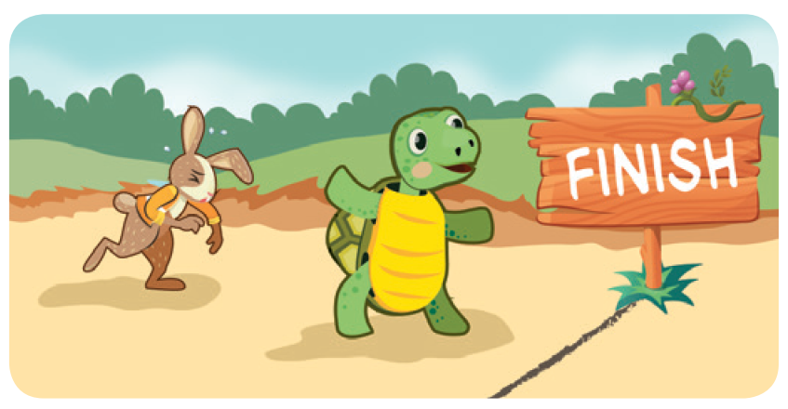
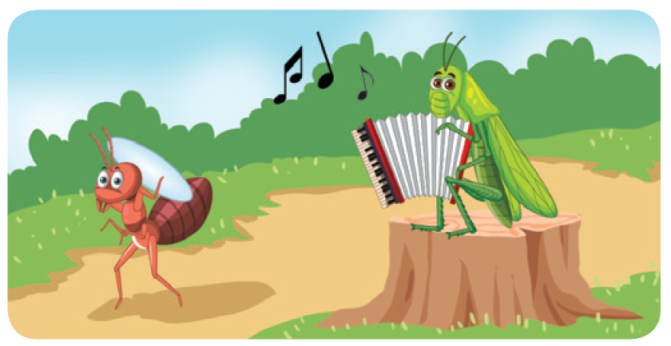
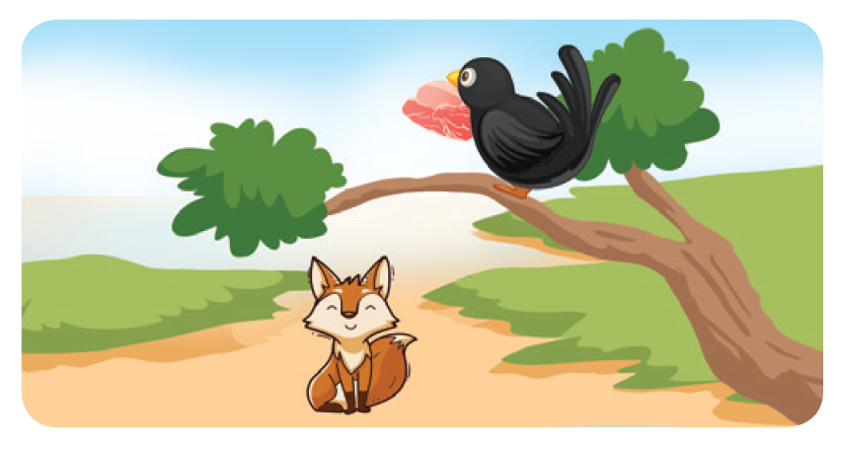
Look and say.
Snow White, the seven dwarfs
the tortoise, the hare
the ant, the grasshopper
the fox, the crow

Slide 12
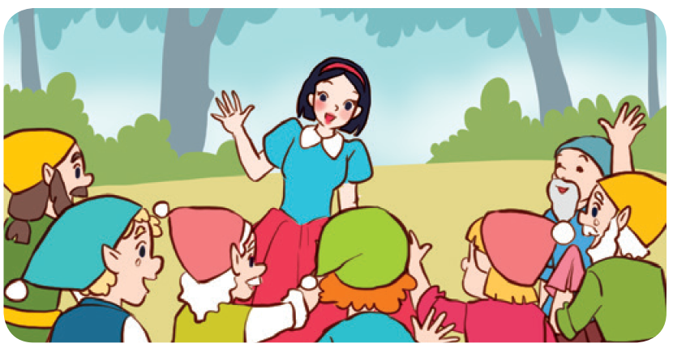
Read and complete.
1.
A: Look at the story.
Who are the main
characters?
B: They’re ______________
and the seven dwarfs.
Snow White

Slide 13
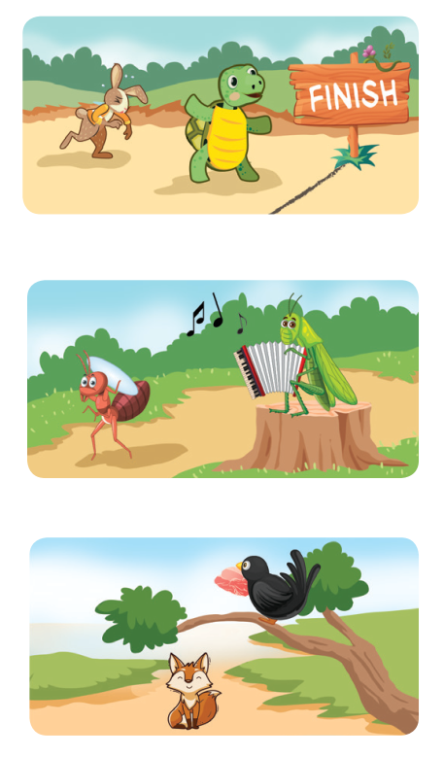
Read and complete.
2. A: Are the hare and the ___________ the main
characters in this story?
B: Yes, they are.
3. A: Are the ___________ and the grasshopper
the main characters in this story?
B: Yes, they are.
A: Which ___________ do you prefer?
B: I prefer the ant.
4. A: What story are you ___________?
B: I’m reading The Fox and the Crow.
A: Do you like the ___________ or the crow?
B: I like the fox.

Slide 14
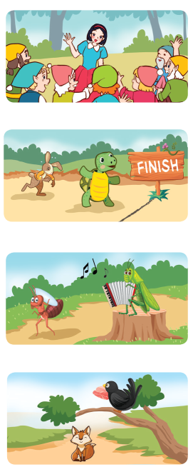
Work in pairs. One is A and the other is B.
1. A: Look at this story. Who are the main characters?
B: They’re ___________ and the seven dwarfs.
2. A: Are the hare and the ___________ the main
characters in this story?
B: Yes, they are.
3. A: Are the ___________ and the grasshopper
the main characters in this story?
B: Yes, they are.
A: Which ___________ do you prefer?
B: I prefer the ant.
4. A: What story are you ___________?
B: I’m reading The Fox and the Crow.
A: Do you like the ___________ or the crow?
B: I like the fox.

Slide 15
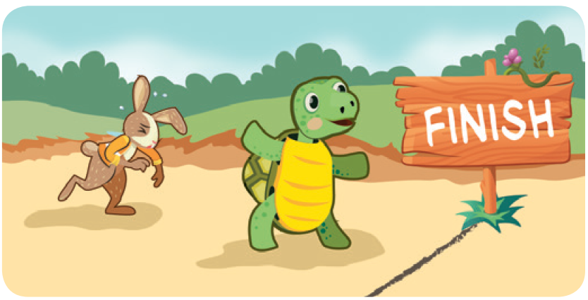
Read and complete.
2.
A: Are the hare and the ________ the main characters in this story?
B: Yes, they are.
tortoise

Slide 16
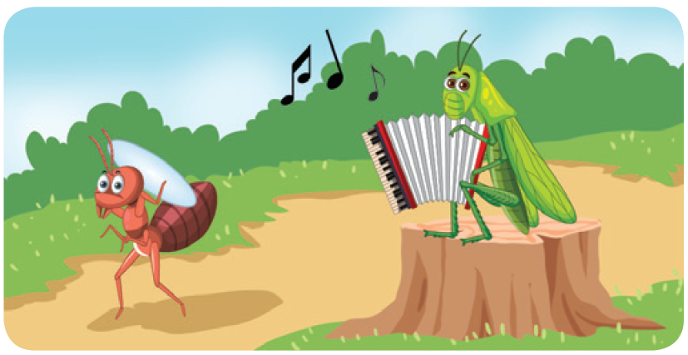
Read and complete.
3.
A: Are the _____ the grasshopper
are the main characters in this story.
B: Yes, they are.
A: Which ________________ do you prefer?
I prefer the ant.
ant
character
/ one

Slide 17
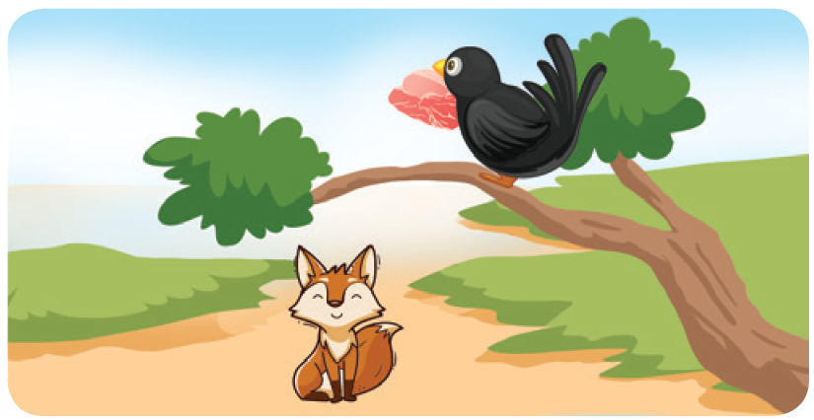
Read and complete.
4.
A: What story are you __________?
B: I’m reading The Fox and the Crow.
A: Do you like the ____ or the crow?
B: I like the fox.
reading
fox

Slide 19
04
Let’s play.

Slide 20


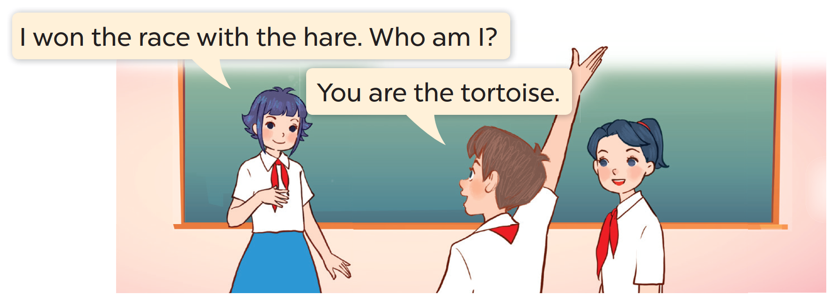
Listen and work in groups.
Who am I?
I won the race with the hare. Who am I?
You are the tortoise.

Slide 21




Score Board
Team 1
Team 5
Team 2
Team 6
Team 3
Team 7
Team 4
Team 8

Slide 22
Talk to your partner.
Who am I?
I won the race with the hare. Who am I?
You are the tortoise.

Slide 24
05
Fun corner and Wrap-up

Slide 25







Pictionary Game

Slide 26

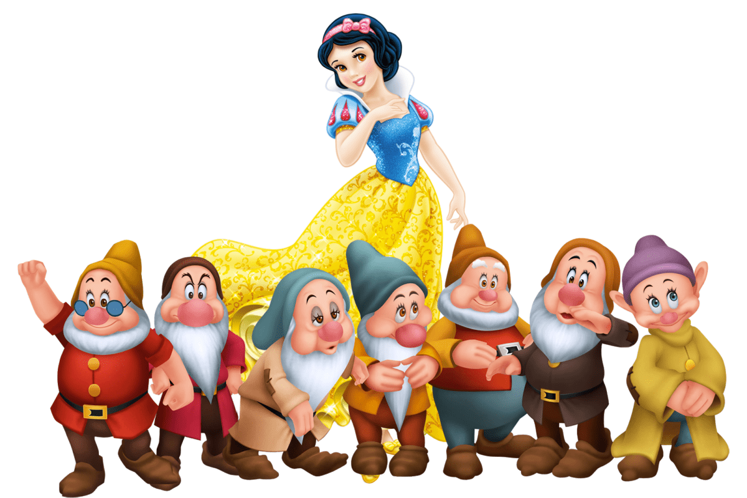


Snow White
Notes:
Whisper to the pupil. He/ She will draw a picture. Then click the “drawing pictures” symbol to show the answer.

Slide 27
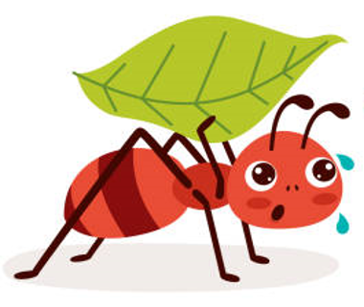
the ant

Slide 28
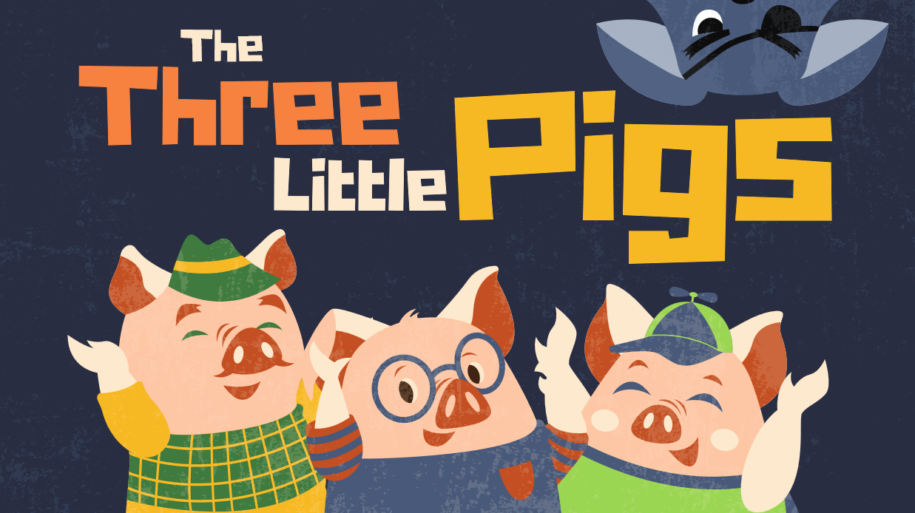
the pig

