Slide 1




Our toys
17
LESSON 1
Period 2

Slide 2
Warm-up and review
Warm-up and review
1
1
1
Game: A letter to Santa Claus

Slide 3

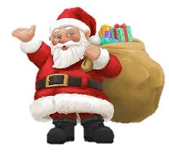



A Letter To The Santa Claus
Notes:
Step 1: Divide the class into 4 teams.
Step 2: Invite 1 pupil to go to the board, look at the picture, then say aloud what toy the boy wants for Christmas. The fastest pupil gets one points for his/her team.
Step 3: Encourage pupils to join in the game.
Step 4: Give points for pupils.

Slide 4
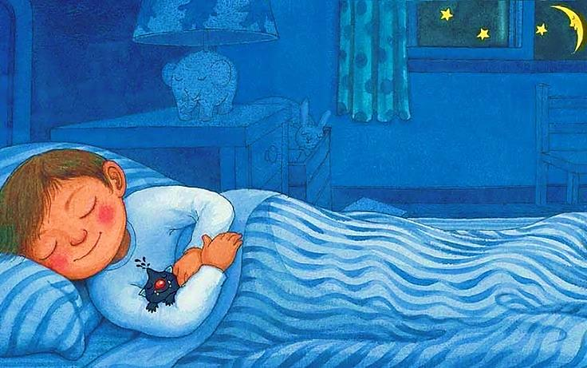

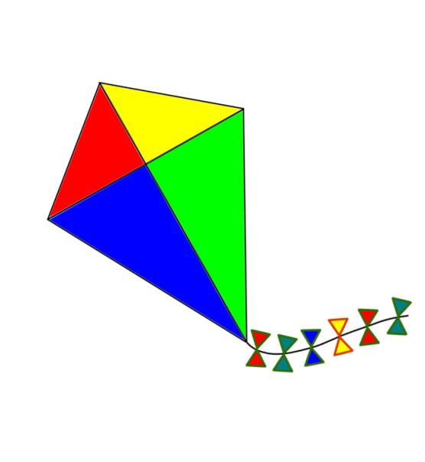
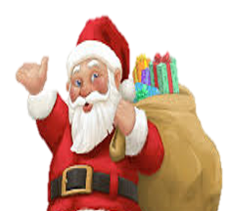


Click on the right letter
Dear Santa,
I want a
doll
Dear Santa,
I want a
train
Dear Santa,
I want a
kite
NEXT

Slide 5

Listen and number.
2
2

Slide 6
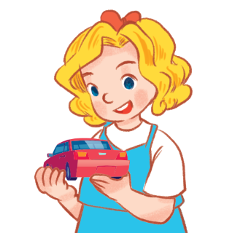
She has a car.

Slide 7

She has a kite.

Slide 8
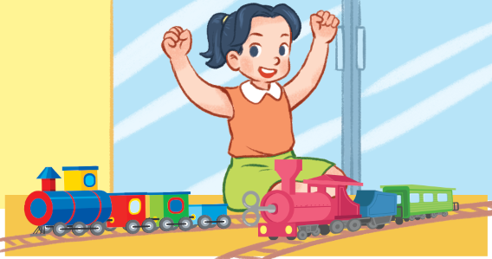
She has two trains.

Slide 9
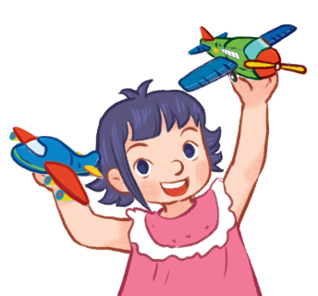
She has two planes.

Slide 10
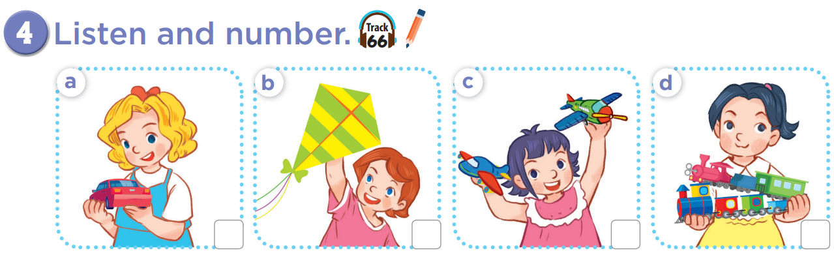

Slide 11
4
1
3
2

Slide 12


Listen and choose
Game time!!!
Notes:
Divide the class into four teams.
One pupil from each team comes to the board.
Ask pupils to listen to the recording, then choose the correct picture.
Who can choose the correct picture will have 2 points. The slower ones can have 1 point.

Slide 13
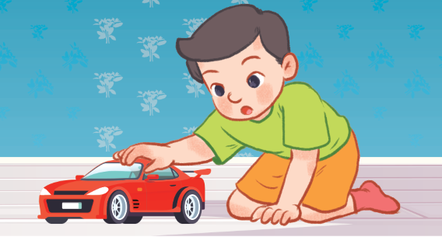
Listen and choose

Slide 14
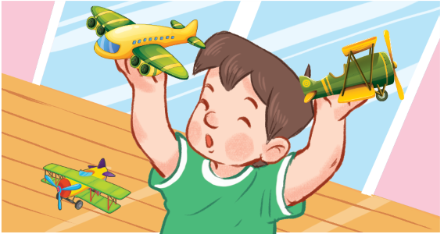
Listen and choose

Slide 15
Listen and choose

Slide 16
Listen and choose

Slide 17
Look, complete and read.
3
3

Slide 18
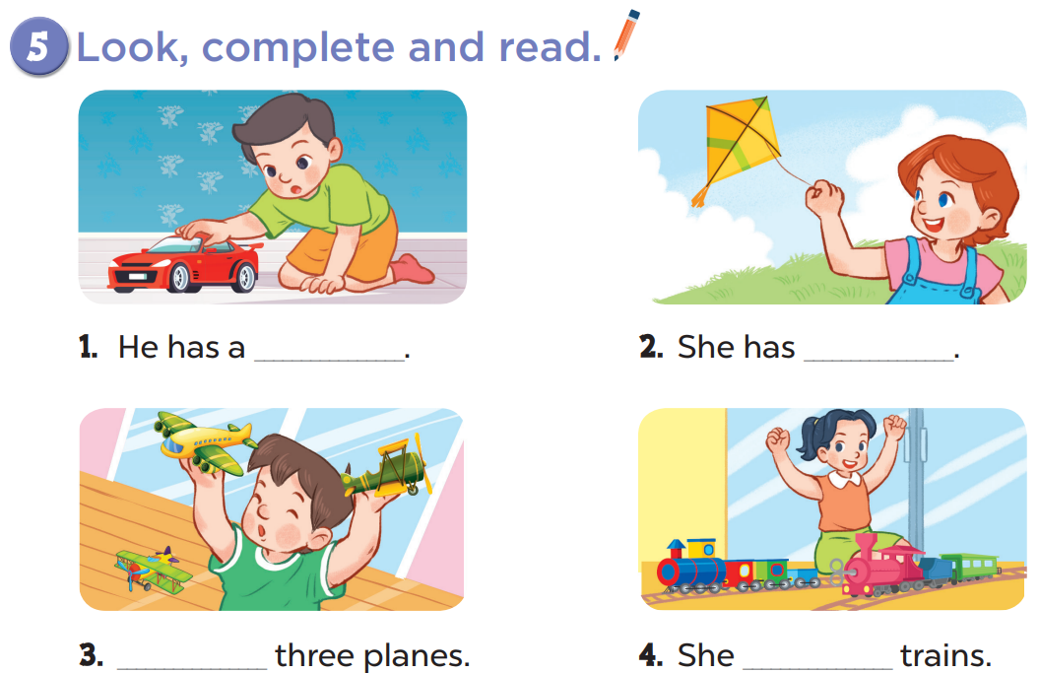

Slide 19
car
a kite
He has
has two

Slide 20
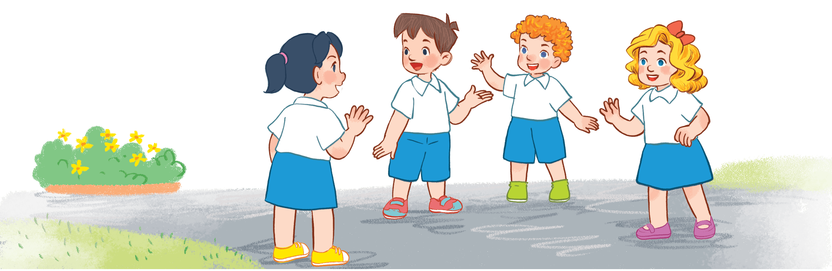
Game time!!!
Guessing game!
Notes:
Step 1: Divide the class into four teams.
Step 2: Invite each pupil from each team say aloud what you can see. The fastest and have correct answer has one point for team.
Step 3: Encourage pupils take part in the game.
Step 4: Give point for pupils.

Slide 21
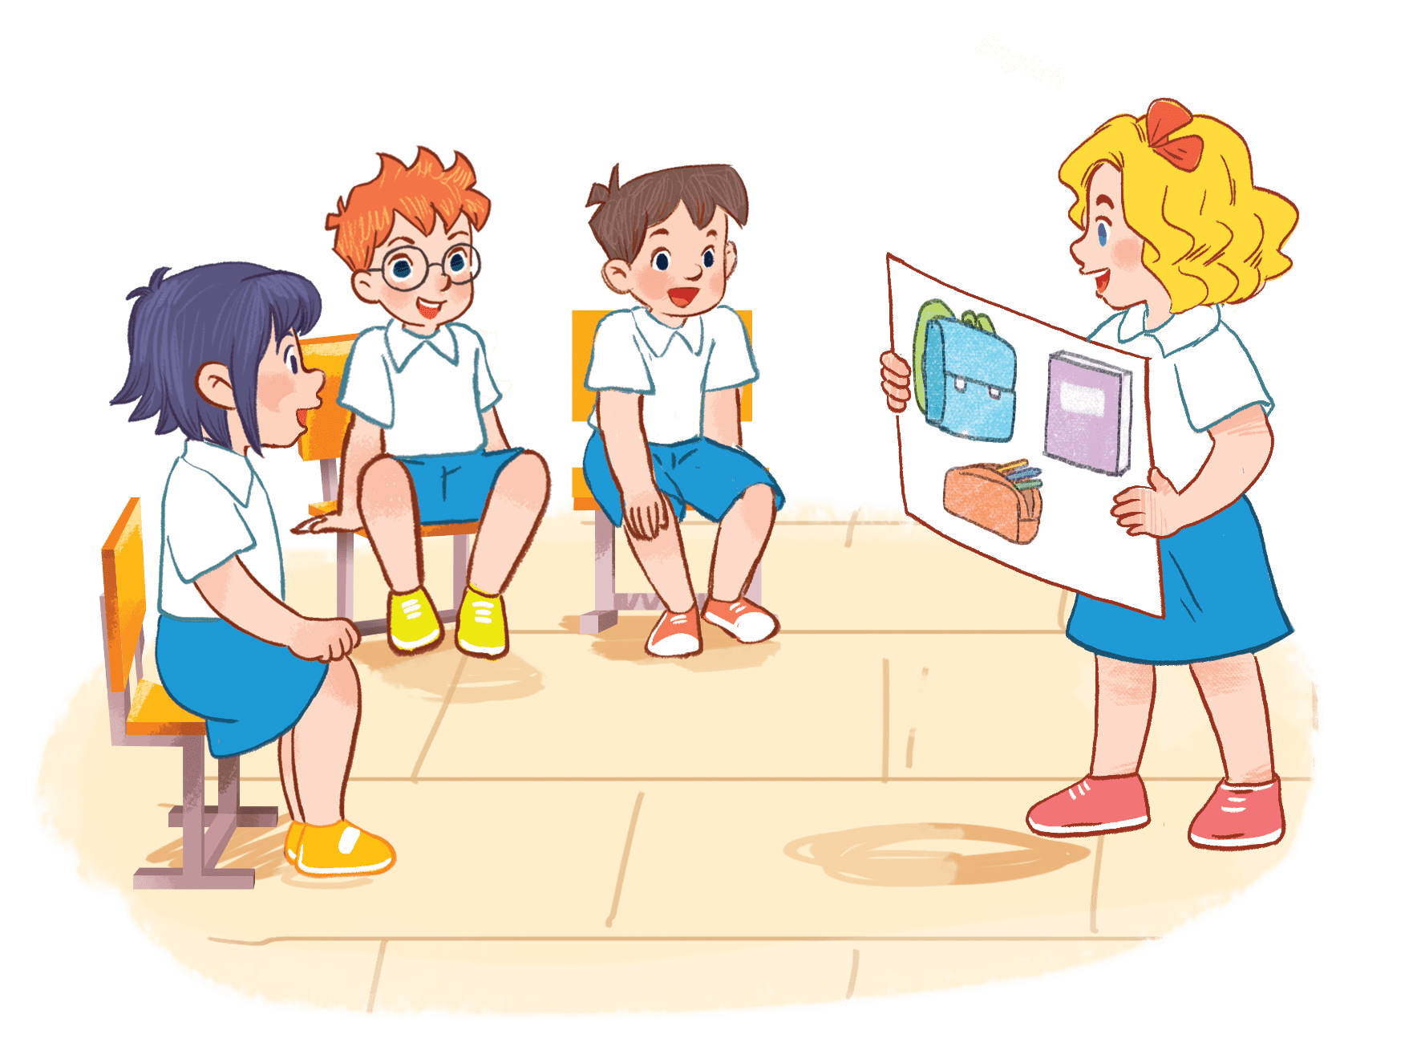
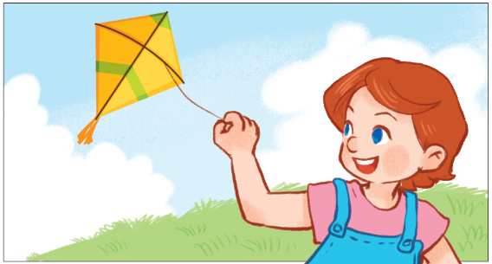
She has a kite.
Notes:
Step 1: Divide the class into four teams.
Step 2: Invite each pupil from each team to come to the front and say aloud what they can see. The fastest students with the correct answer will get points for their team.
Step 3: Encourage pupils to take part in the game.
Step 4: Give points for pupils.

Slide 22
He has a car.

Slide 23
He has three planes.

Slide 24
She has two trains.

Slide 25
She has a car.

Slide 26

Let’s sing.
4
4

Slide 27
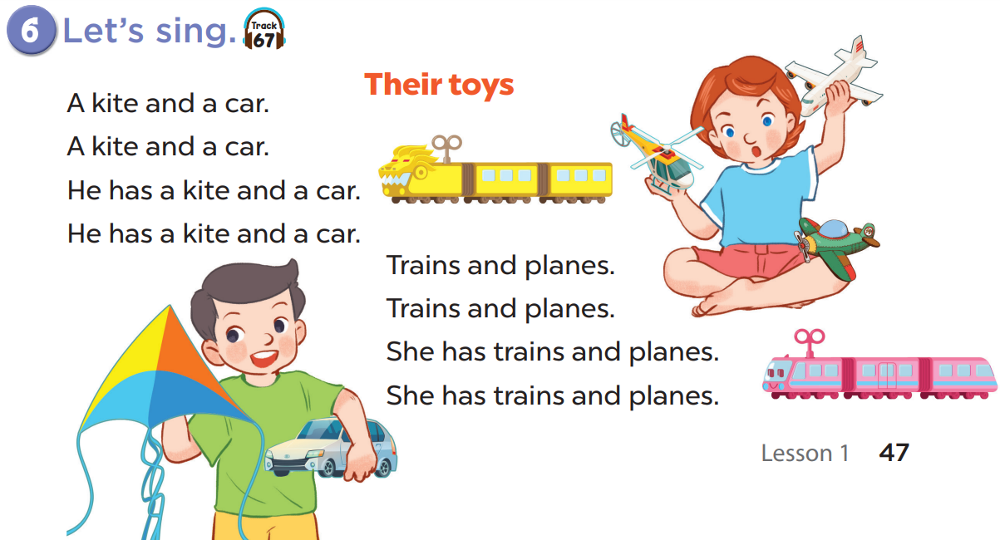

Slide 29
Moving time!!!
Sing and dance
Notes:
Step 1: Divide the class into 4 teams.
Step 2: Ask each team to stand up, then sing and dance. The team that sing and dance the most beautiful will get points.
Step 3: Encourage pupils to join in this activity.
Step 4: Give points for team.

