Slide 1
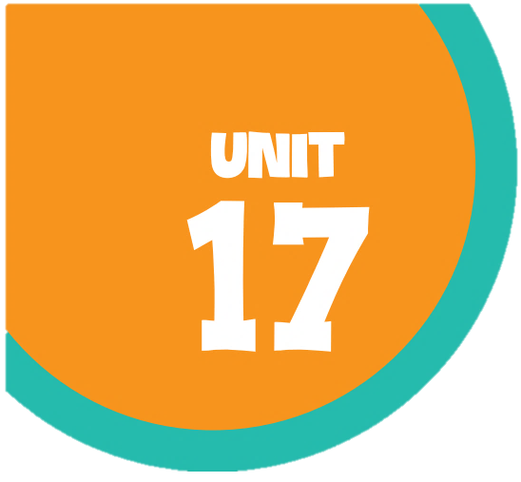
In the city
In the city
Lesson 1 - Period 2
Lesson 1 - Period 2

Slide 2
01
02
Warm-up and review
Listen and tick or cross.
Table of contents
03
04
Let’s sing!
Look, complete and read.
05
Fun corner and wrap-up

Slide 3
Warm-up
Race and slap the board.

Slide 4

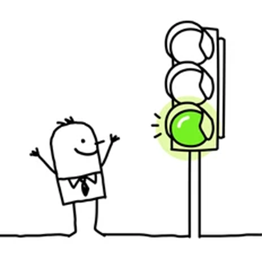









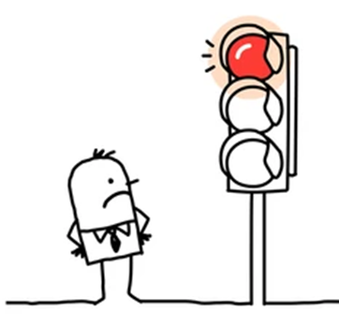


What does it say?

Slide 5






What does it say?

Slide 6
Listen and tick or cross.
02
Activity 4

Slide 7
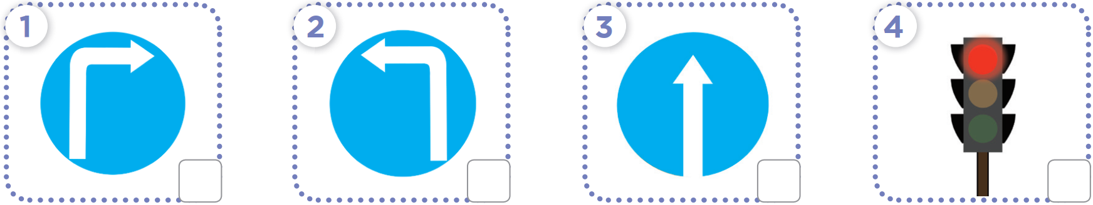
What does the sign say?

Slide 8


Listen and tick or cross.

Slide 9
Look, complete and read.
03
Activity 5

Slide 10
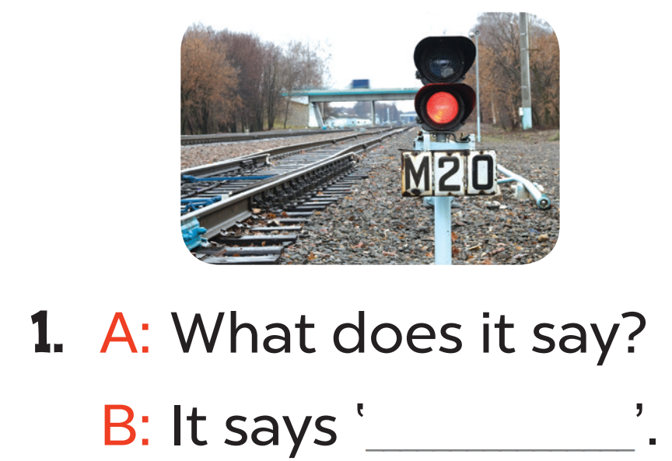
Read. What's the missing word?
stop

Slide 11
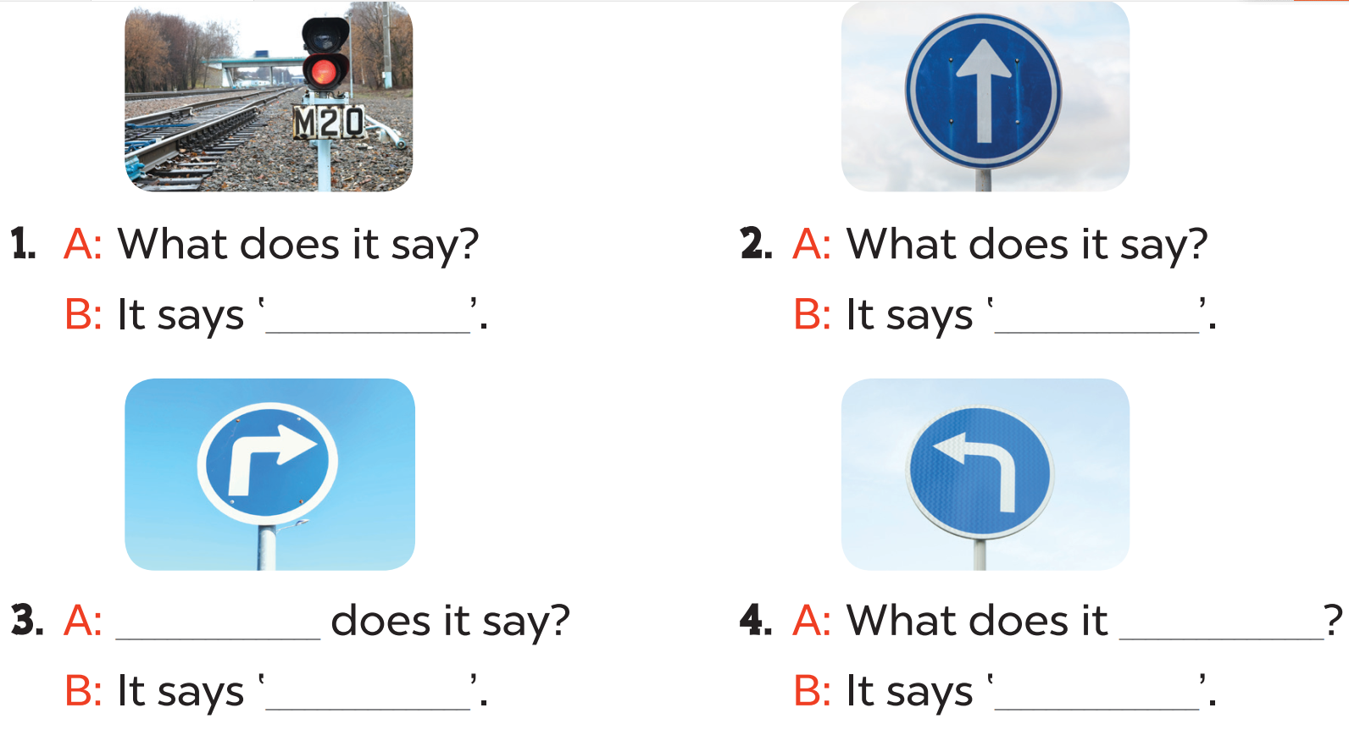
stop
go straight
What
say
turn right
turn left

Slide 12
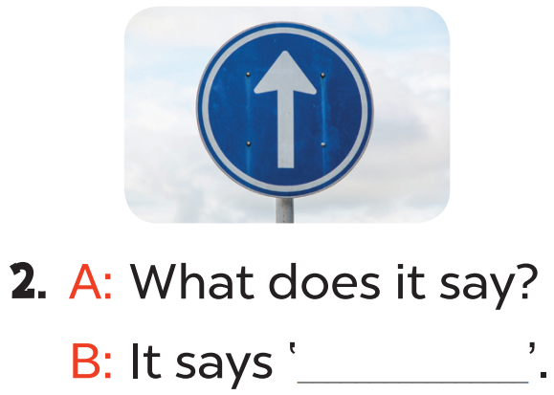
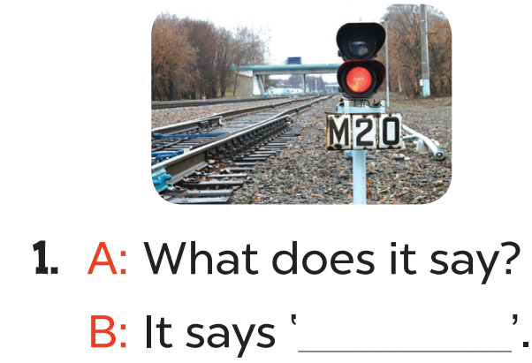
Read aloud.
stop
go straight

Slide 13
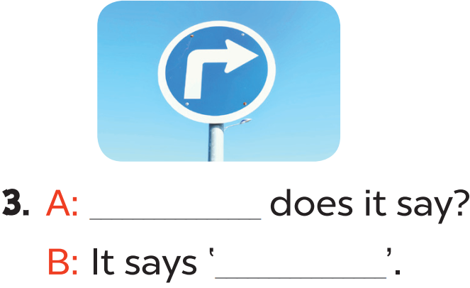
Act it out
What
turn right

Slide 14
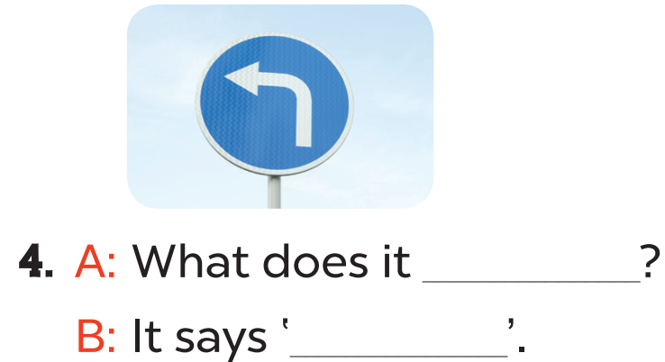
Act it out
say
turn left

Slide 15
Let’s sing.
04
Activity 6

Slide 16
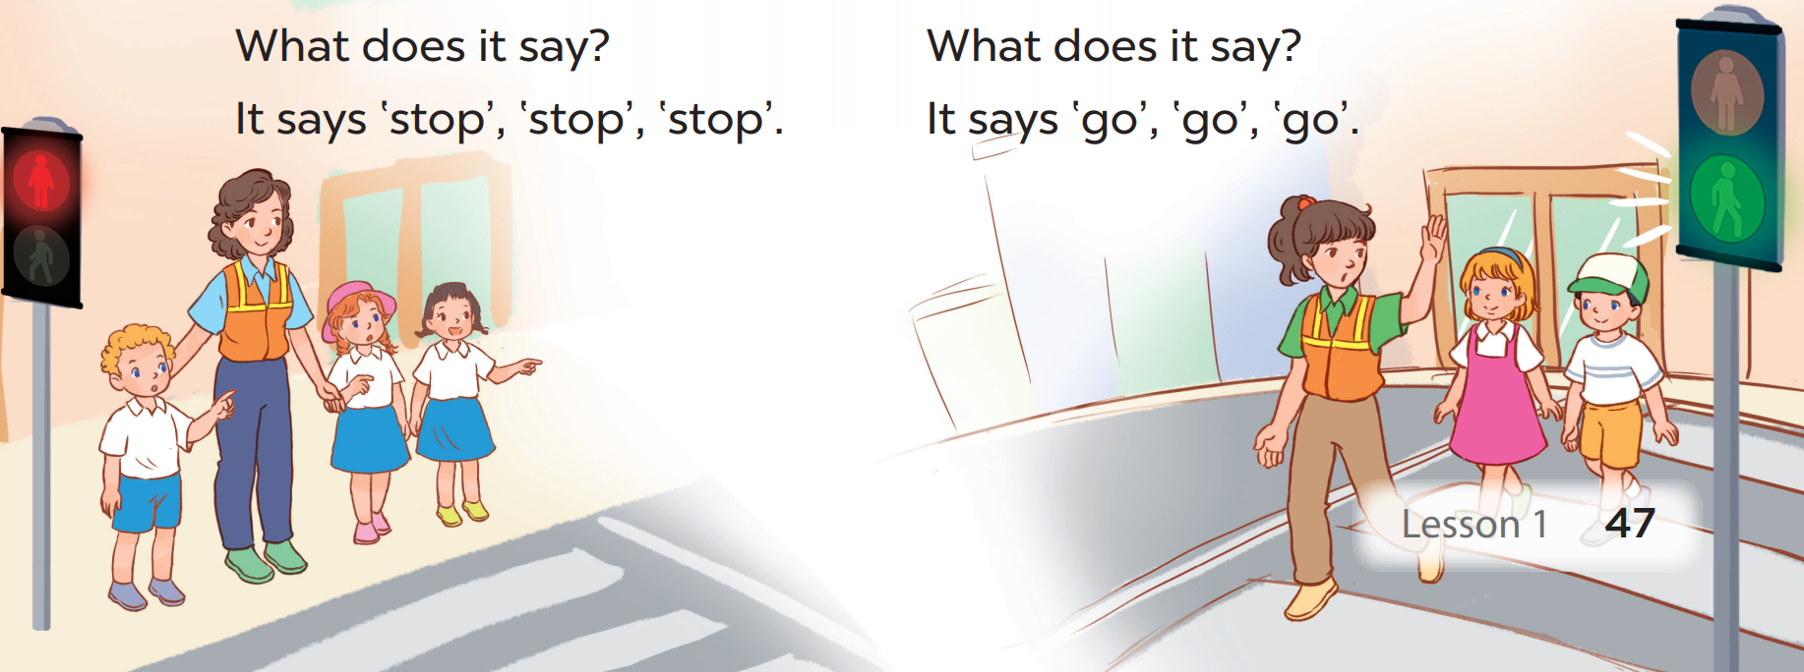
What are they doing?
What colour is the traffic light?
What does it say?

Slide 17
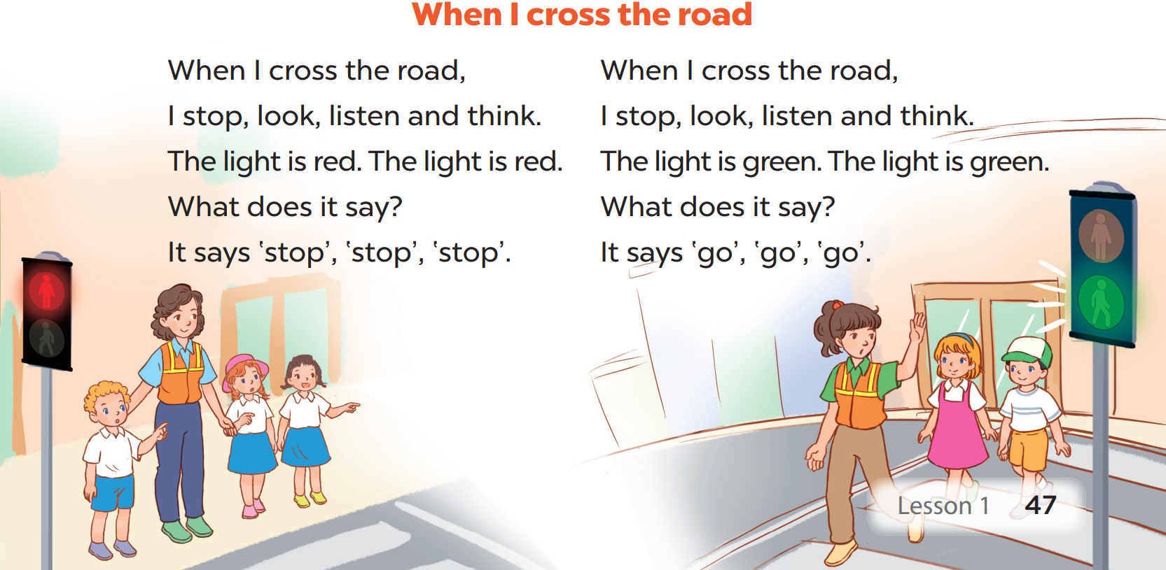
Read the lyrics.

Slide 18
Listen
Practise line by line.
Sing the song.

Slide 19



