Slide 1




Our toys
17
LESSON 2
Period 3

Slide 2
Contents
2
1
3
Look, listen and repeat.
Listen, point and say.
Warm-up and review
5
4
Let’s talk.
Fun corner and wrap-up

Slide 3
Warm-up and review
1
1
Game: Toys game

Slide 4
Look, listen and repeat.
2
2

Slide 5
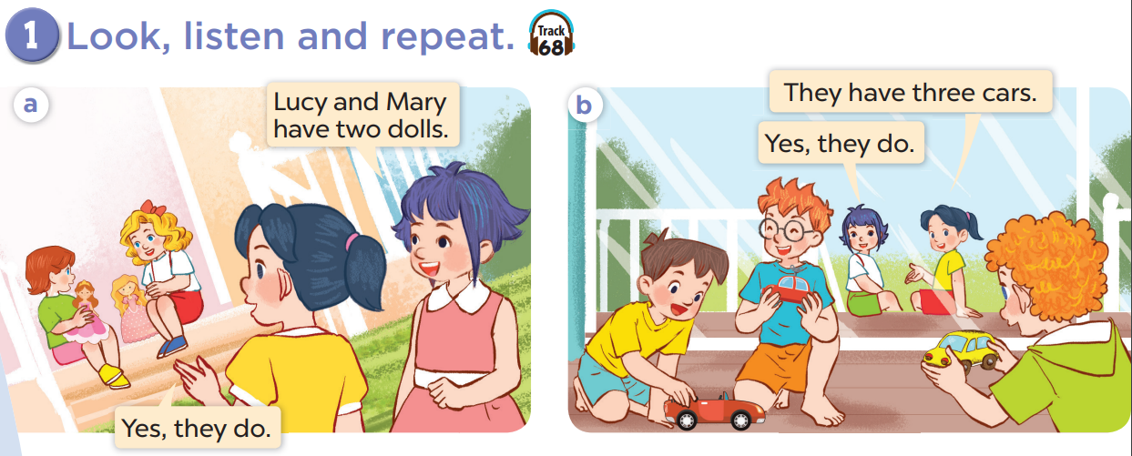

Slide 7
Listen, point and say.
3
3

Slide 8
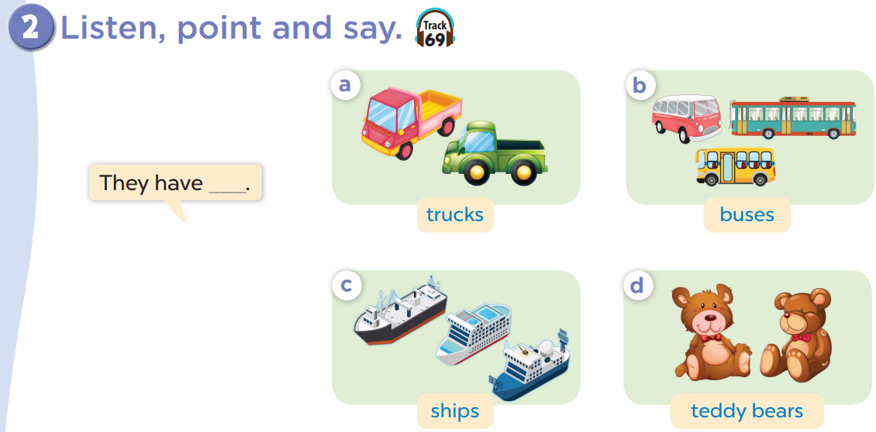

Slide 9


Slide 10

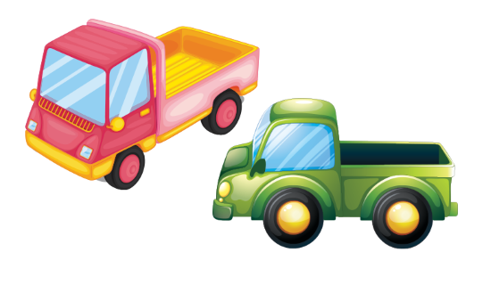
Listen and choose
Notes:
Step 1: Divide the class into four teams.
Step 2: Invite each pupil from each team to go to the board, listen to the recording then choose A or B. The fastest one with correct answer gets one point for their team.
Step 3: Encourage pupils to take part in the game.
Step 4: Give point for pupils.

Slide 11

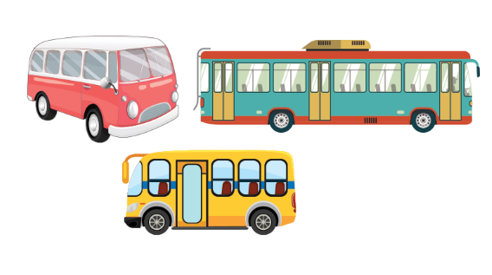
Listen and choose

Slide 12


Listen and choose

Slide 13
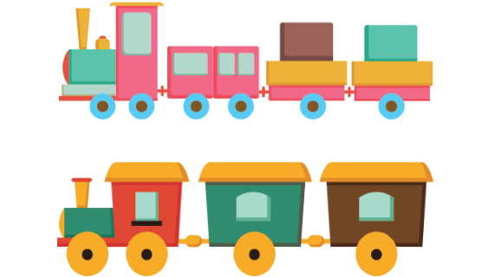
Listen and choose

Slide 14

Listen and choose

Slide 15
Listen and choose

Slide 16
Listen and choose

Slide 17
Listen and choose

Slide 18

Let’s talk
4
4

Slide 19
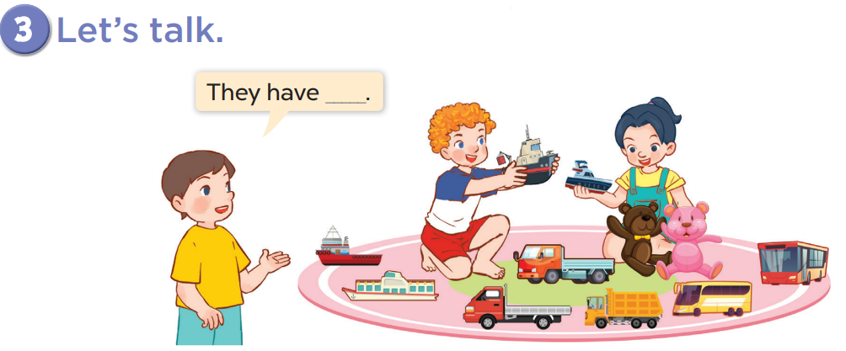

Slide 20


They have ____________.
three buses
+5

Slide 21
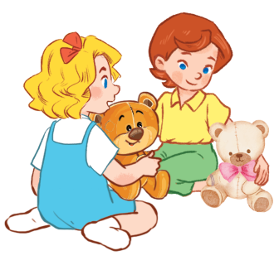
They have _________________.
two teddy bears
+3

