Slide 2
1
2
3
Warm-up and review
4
5
Fun corner and wrap-up
Look, listen and repeat.
Listen, point and say.
Let’s talk.

Slide 3

Travelling with Doraemon

Slide 4
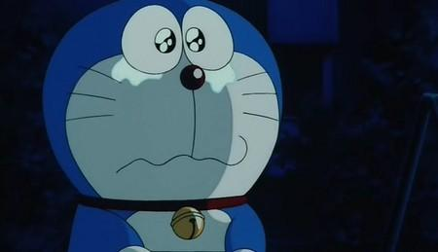
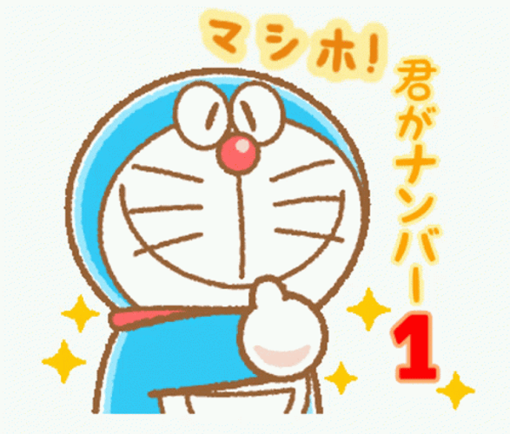
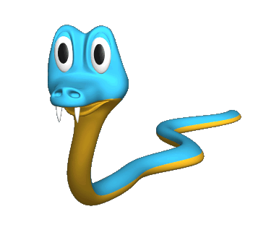
Pick the correct question.
A. What is the weather like yesterday?
B. What was the weather like yesterday?
A
B

Slide 5
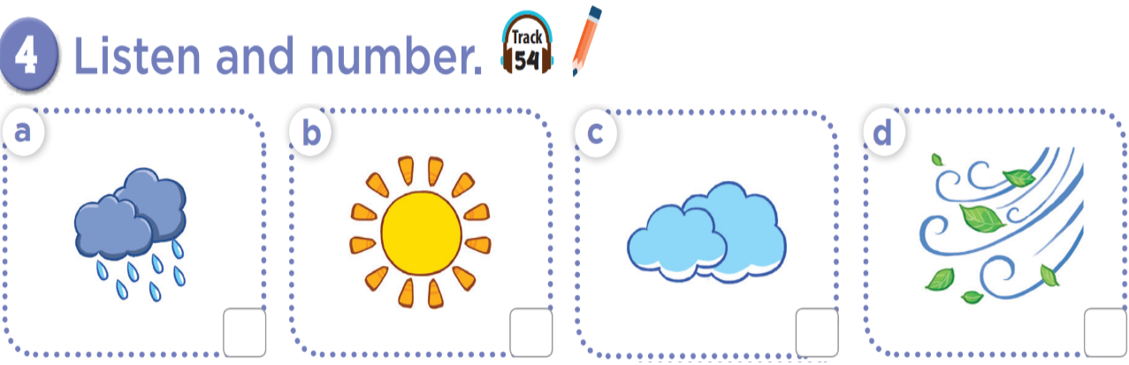

Slide 6
2
4
3
1

Slide 7
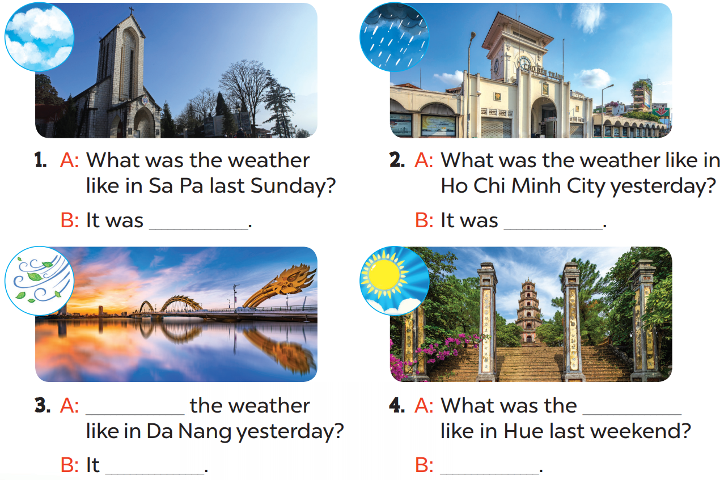

Slide 8
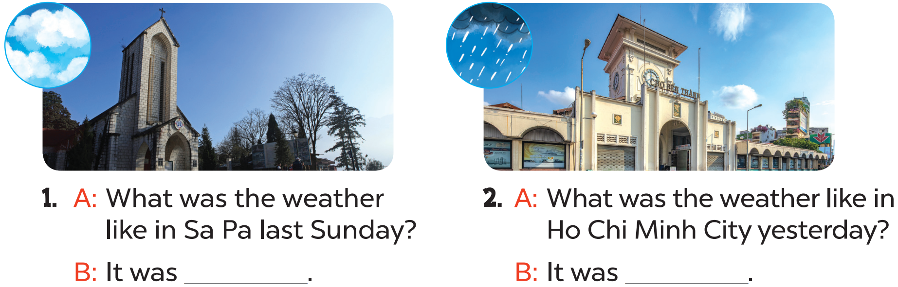
cloudy
rainy

Slide 9
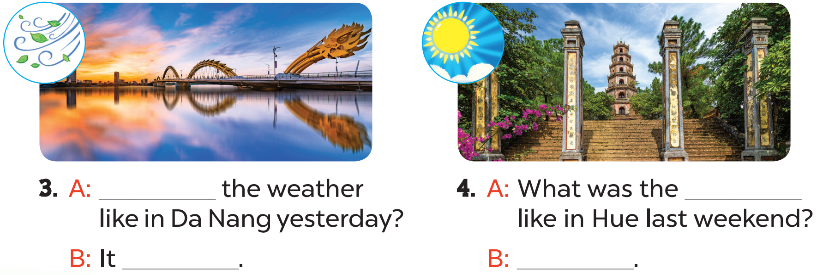
What was
weather
windy
It was sunny

Slide 10
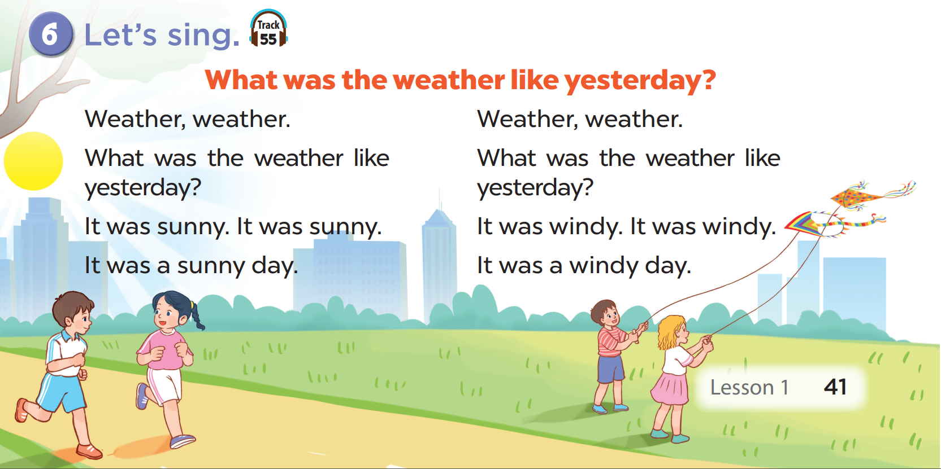

Slide 11
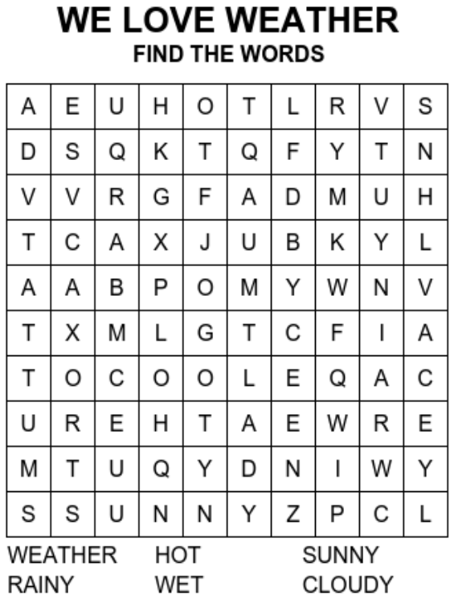
PLAY OFFLINE VERSION!

