Slide 2
1
2
3
Warm-up and review
4
5
Fun corner and wrap-up
Read and circle.
Let’s write.
Project

Slide 3
1
Warm-up and review

Slide 4
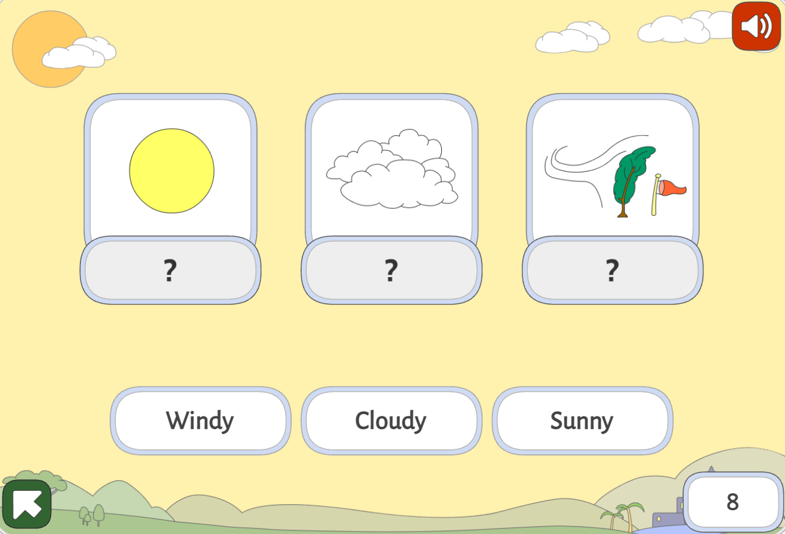
PLAY
A GAME!
Notes:
https://www.gamestolearnenglish.com/weather/

Slide 5
2
Read and circle.

Slide 6
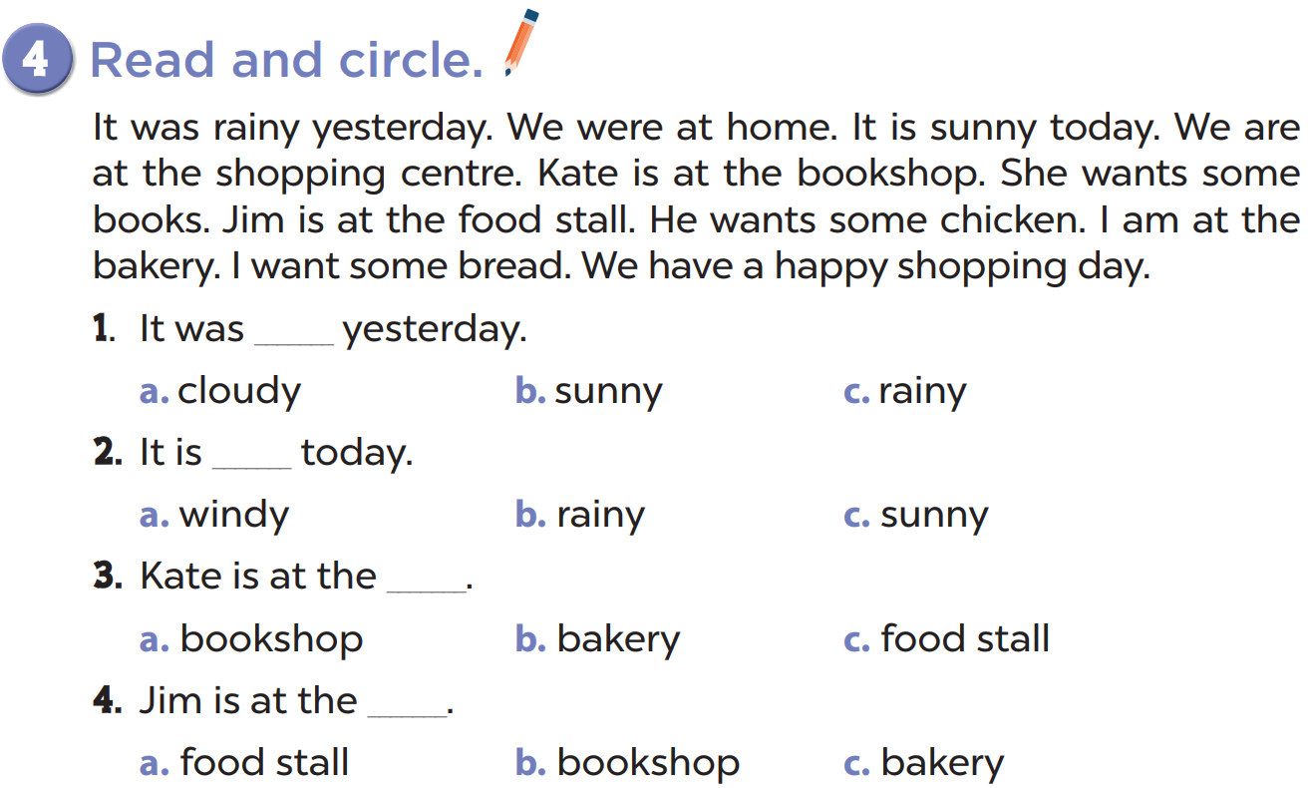

Slide 7
3
Let’s write.

Slide 8
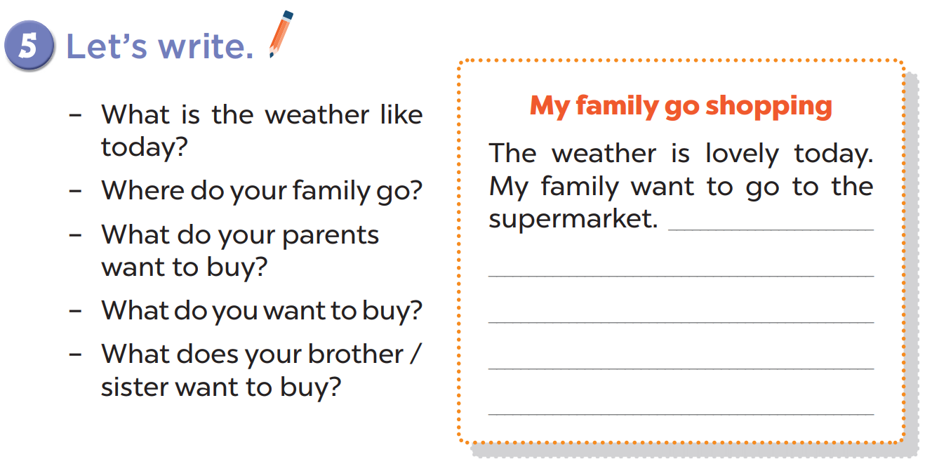

Slide 9
4
Project

Slide 10
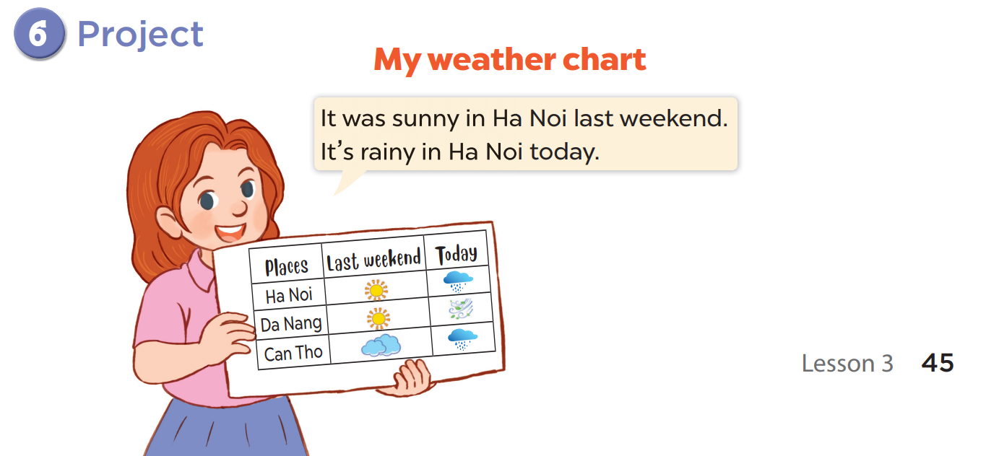

Slide 11
5
Fun corner and wrap-up

Slide 12
TONGUE TWISTER
Whether the weather is warm, whether the weather is hot, we have to put up with the weather, whether we like it or not.

