Slide 1



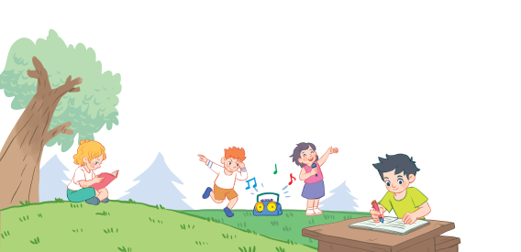
18
Period 2

Slide 2
Contents
1
Warm-up and review
2
3
4
Listen and tick.
Look, complete and read.
Let’s play.
5
Fun corner and wrap-up

Slide 3
1. Warm-up and review

Slide 4
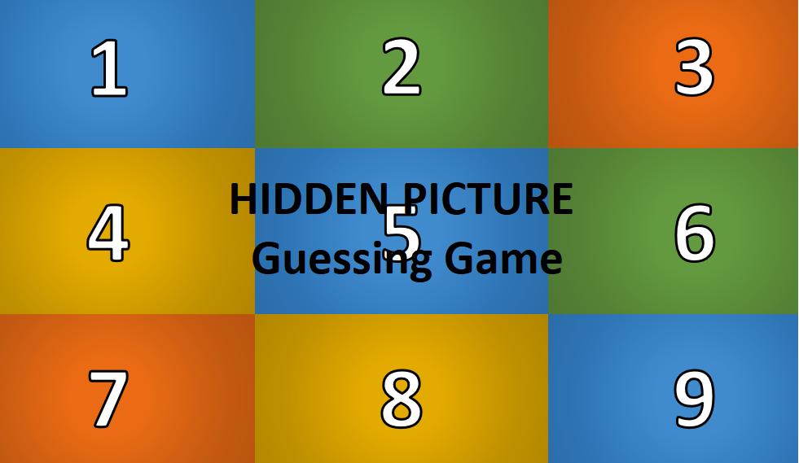
Notes:
GAME: Hidden Picture Guessing
Teacher asks pupils to choose the numbers to reveal and guess the pictures behind (words of activities in lesson 1 - period 1)

Slide 5

1
2
3
4
5
6
7
8
9
singing

Slide 6

1
2
3
4
5
6
7
8
9
reading

Slide 7
2. Listen and tick.

Slide 8
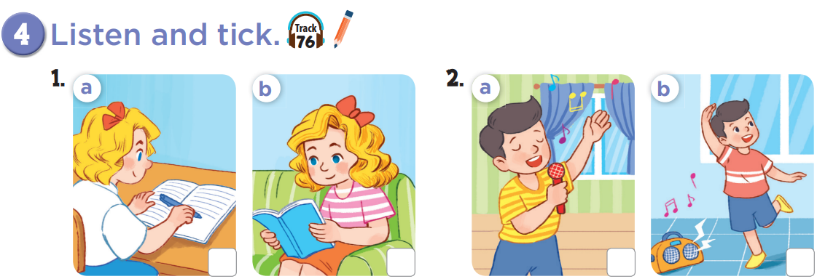

Slide 9
✓
✓

Slide 10




Game: Slap the board!
+1
I am writing.
+1
+2
+2
Notes:
Say the sentences 1 by 1 and follow the action when THE HAND pointed to each picture

Slide 11
Game: Slap the board!
+1
I am singing.
+1
+2
+2
Notes:
Say the sentences 1 by 1 and follow the action when THE HAND pointed to each picture

Slide 12
Game: Slap the board!
+1
I am dancing.
+1
+2
+2
Notes:
Say the sentences 1 by 1 and follow the action when THE HAND pointed to each picture

Slide 13
Game: Slap the board!
+1
I am reading.
+1
+2
+2
Notes:
Say the sentences 1 by 1 and follow the action when THE HAND pointed to each picture

Slide 14
3. Look, complete and read.

Slide 15
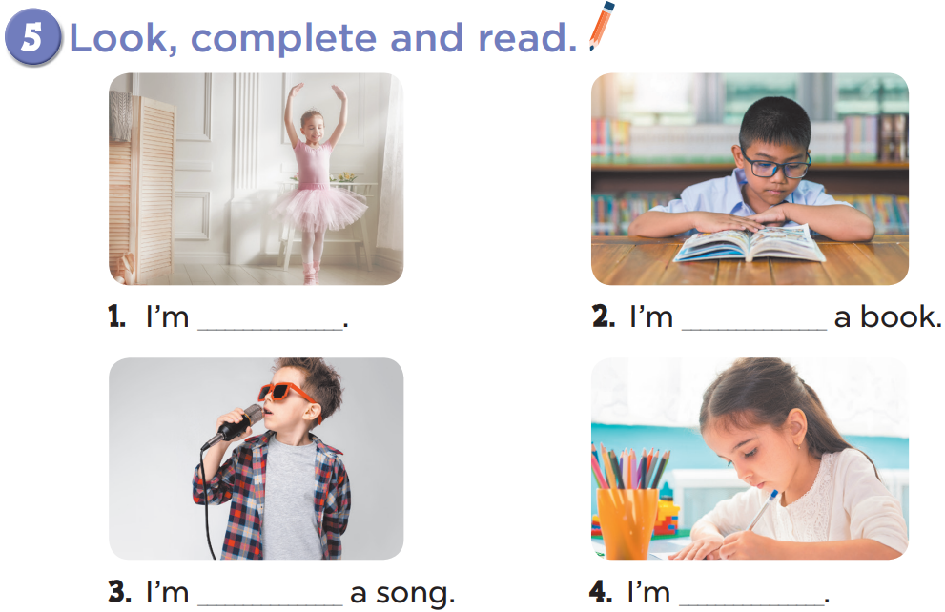

Slide 16
dancing
reading
singing
writing

Slide 17

GAME
Matching Pairs
Notes:
Game: Matching Pairs
Divide the class into two teams.
Each pupil from each team comes to the board, choose a card from the left, then choose one from the right.
If they match, he/she gets points for the team.

Slide 18


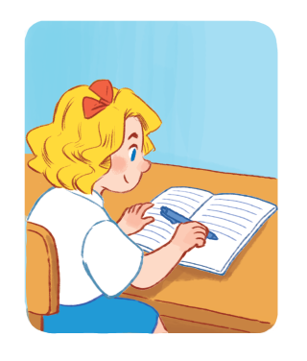


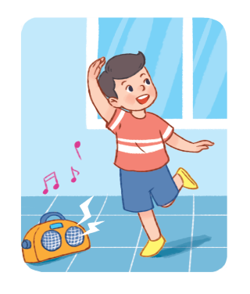
1
2
a
b
I am singing.
I am dancing.
3
4
c
d
I am writing.
I am reading.

Slide 19


You’re
You’re

Slide 20
4. Let’s play.

Slide 21
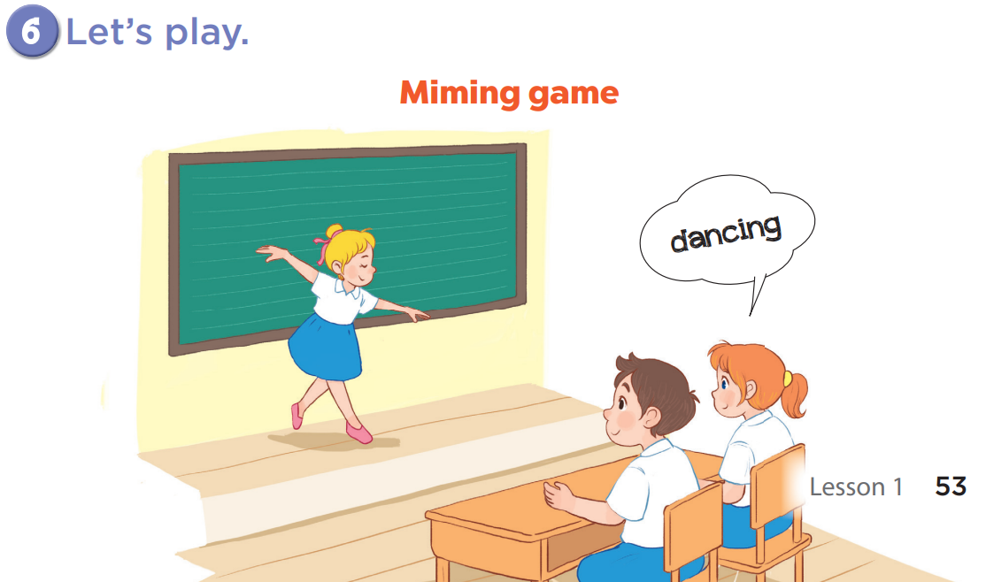

Slide 22
5. Fun corner and wrap-up

Slide 23

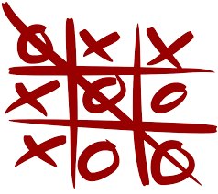
Game:
Tic-Tac-Toe
Notes:
Game: Tic Tac Toe
T divides class into 2 teams (BOYS and GIRLS).
T asks 2 members of each team to listen and write the words (activities) on the board.
The first one will choose the number and the circle or cross.

Slide 24

dancing
dancing
dancing

Slide 25

X
O
1
X
O
2
X
O
3
X
O
4
X
O
5
X
O
6
X
O
7
X
O
8
X
O
9
PLAY AGAIN
tekhnologic
Notes:
Click once to reveal a circle.
Click again to reveal a cross.
Click once more to show the pictures again.
Click play again to reset the board.

