Slide 1



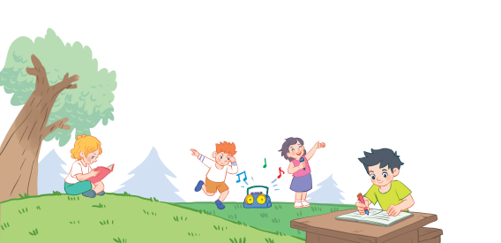
18
Period 6

Slide 2
Contents
1
Warm-up and review
2
3
4
Read and match.
Let’s write.
Project
5
Fun corner and wrap-up

Slide 3
1. Warm-up and review

Slide 4


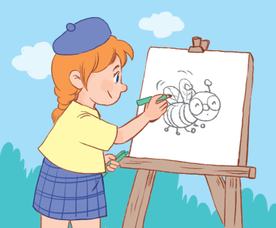
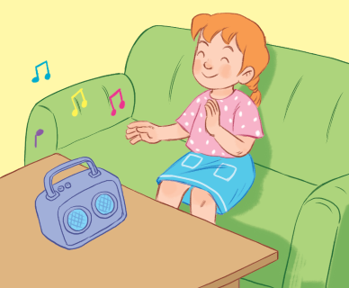
Notes:
Review:
T asks pupils to match the words with the pictures.

Slide 5
2. Read and match.

Slide 6
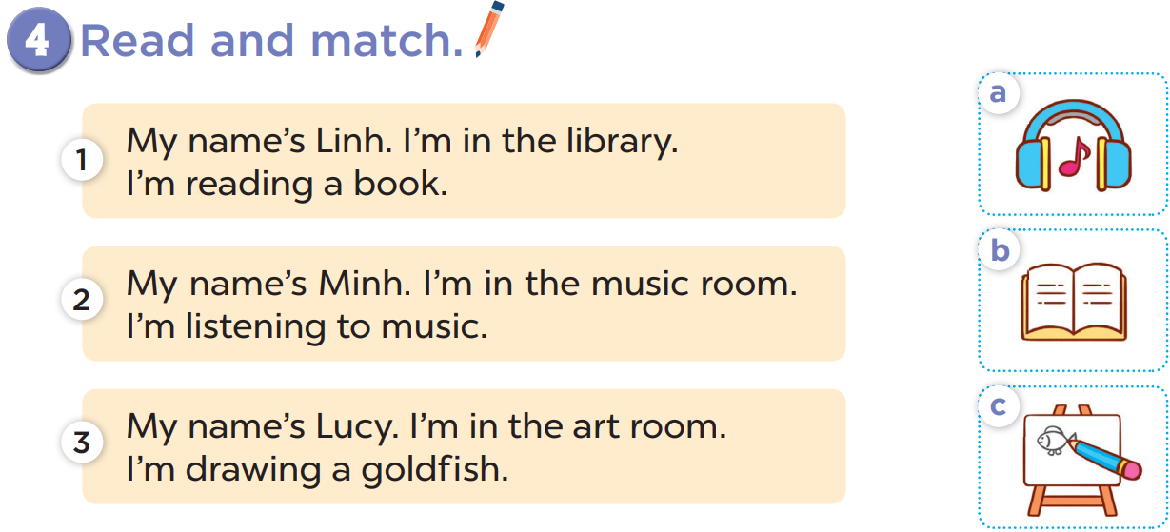

Slide 8
READ AND REMEMBER

Slide 9


Let’s choose and say!

Slide 10


Let’s choose and say!
1
2
3
4
5
6
7
8
Next
Notes:
Let’s choose and say!
Pupils choose a number then say the correct sentence.
Who can say it correctly will get points for the team. (ppt game).

Slide 11


My name is ___. I am in the library. I’m reading a book.
Linh
Minh

Slide 12
My name is ___. I am in the music room. I’m listening to music.
Linh
Minh

Slide 13
My name is ____. I am in the art room. I’m drawing a goldfish.
Nga
Lucy

Slide 14
3. Let’s write.

Slide 15
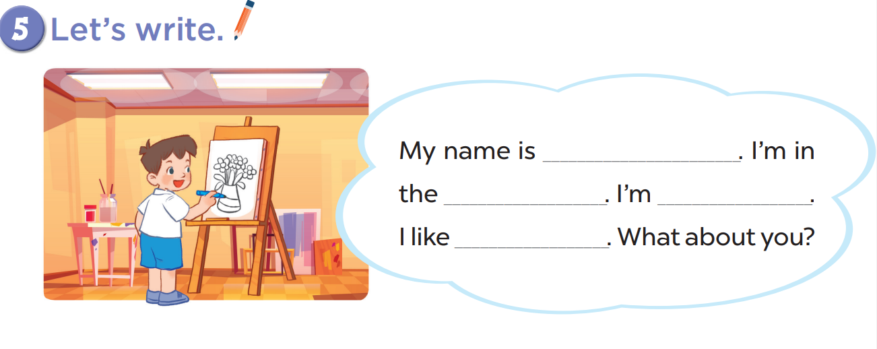

Slide 16

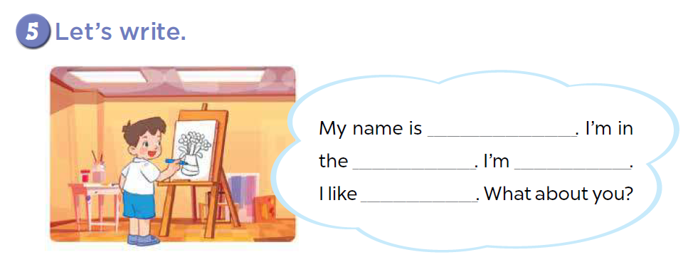
Come to the board and say!
Mary
library
reading
books

Slide 17

Come to the board and say!
Nam
music room
listening
music

Slide 18
4. Project

Slide 19
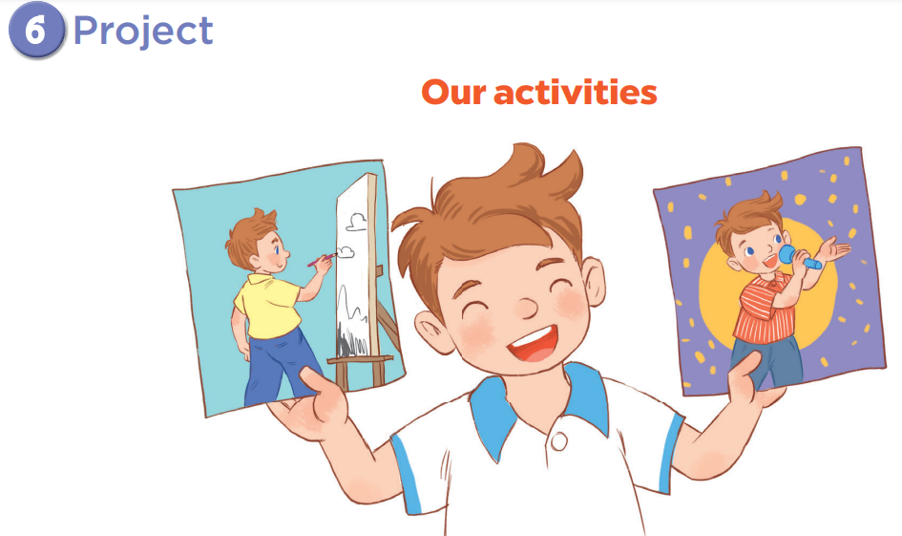

Slide 20
5. Fun corner and wrap-up

Slide 21
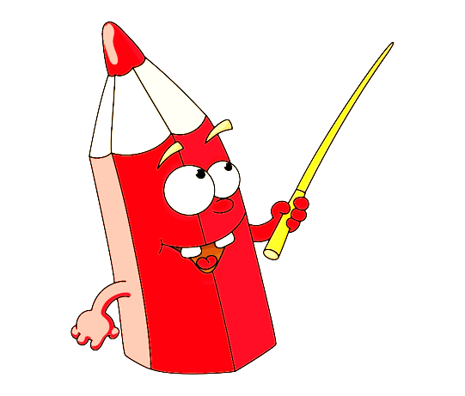


Game: Which is missing?
Notes:
Game: Which is missing?
T shows all the pictures and asks pupils to look at them carefully and find out which one is missing.
T shows again the pictures with one hidden and asks pupils to find out.

Slide 22


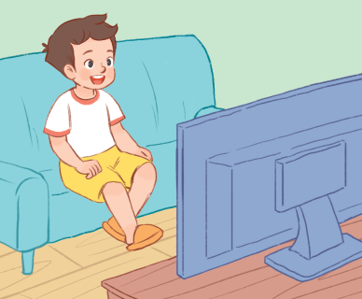
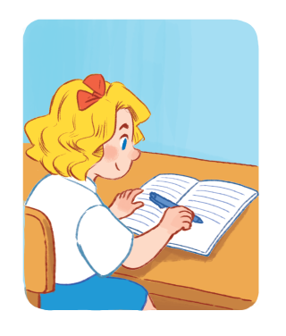


Slide 23
writing

Slide 24
playing
basketball

