Slide 1






Unit 13:
In the maths class
Lesson 3

Slide 2









Table of Contents
  Warm-up and review.
  Listen and repeat.
  Let’s talk.
  Let’s sing.
  Fun corner and wrap-up.

Slide 3




Warm-up and Review.

Slide 4









Game
MISSING LETTERS

Slide 5




What are missing letters?
F
O
_
_
T
E
E
N
I
R
A
R
U
R

Slide 6
What are missing letters?
_
_
F
T
E
E
N
F
I
T
I
S
I

Slide 7
What are missing letters?
T
_
_
R
T
E
E
N
K
I
H
I
R
I

Slide 8
What are missing letters?
E
L
E
V
_
_
E
L
E
M
E
N

Slide 9
THANK YOU
FOR
PLAYING!

Slide 10
Listen and repeat.

Slide 11

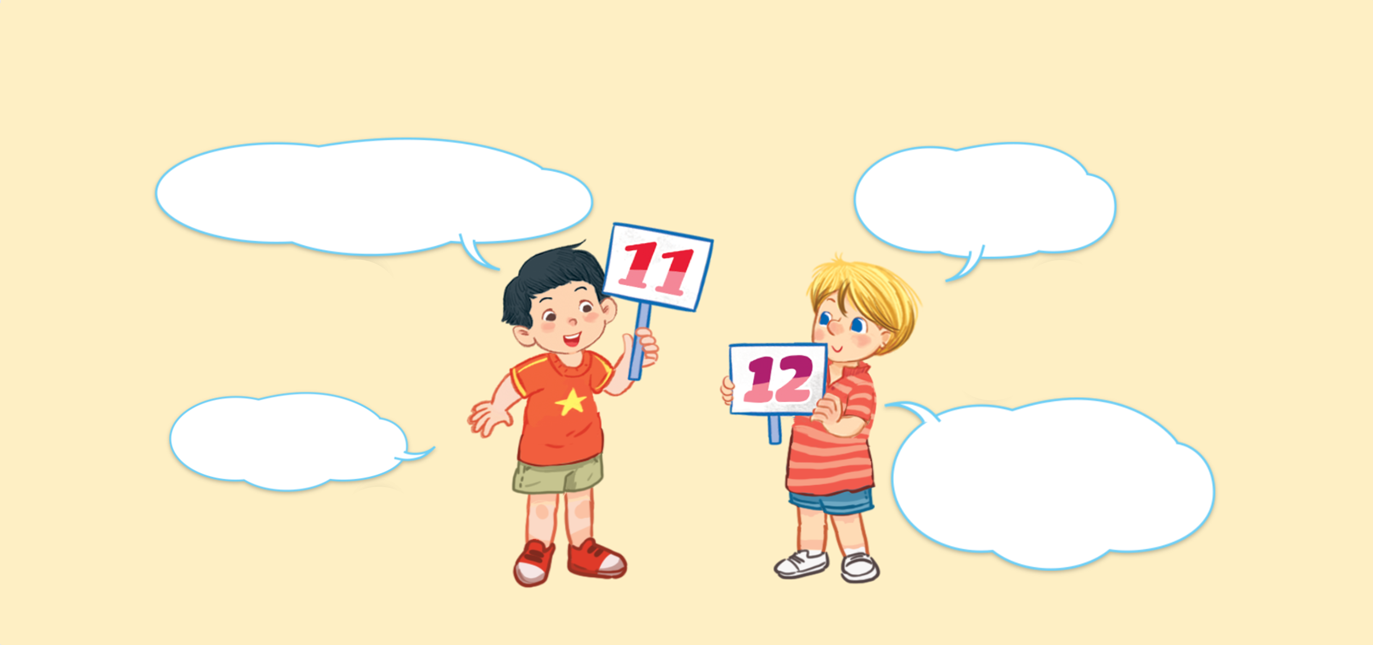


Look and say.
What number is it?
What number is it?
What number is it?
What number is it?
It’s eleven.
It’s eleven.
It’s eleven.
It’s eleven.
It’s twelve.
It’s twelve.
It’s twelve.
It’s twelve.
What number is it?
What number is it?
What number is it?
What number is it?

Slide 12

6. Listen and repeat.
What number is it?
What number is it?
What number is it?
What number is it?
It’s eleven.
It’s eleven.
It’s eleven.
It’s eleven.
It’s twelve.
It’s twelve.
It’s twelve.
It’s twelve.
What number is it?
What number is it?
What number is it?
What number is it?

Slide 13
Let’s talk.

Slide 14



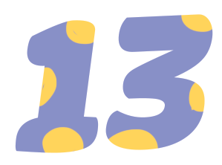
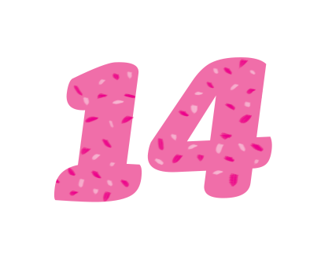



Look and say
What number ______?
.
______.
a
b
c
d

Slide 15
7. Let’s talk.
What number ______?
.
______.
a
b
c
d

Slide 16
Work in pairs.
What number ______?
.
______.
a
b
c
d

Slide 17
Let’s sing.

Slide 18

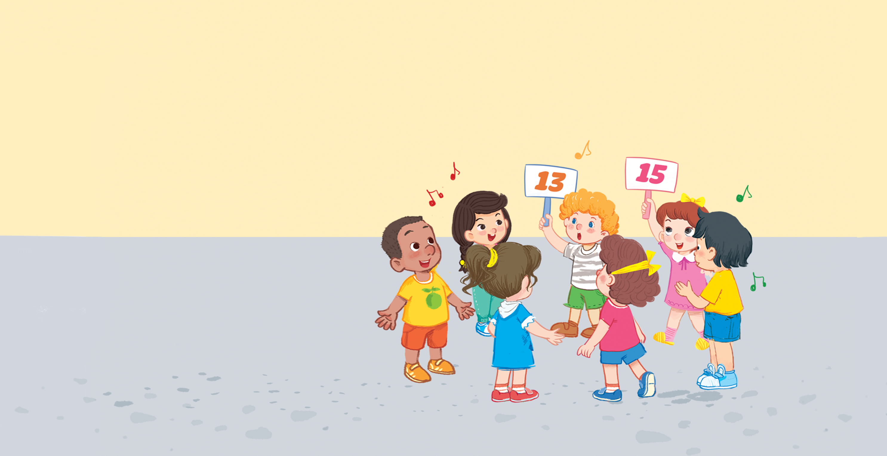


Look and say.

Slide 19
8. Let’s sing.
What number is it?
What number is it?
What number is it?
What number is it?
Eleven, twelve or thirteen.
Eleven, twelve or thirteen.
Eleven, twelve or thirteen.
Eleven, twelve or thirteen.
It’s thirteen.
It’s thirteen.
It’s thirteen.
It’s thirteen.
What number is it?
What number is it?
What number is it?
What number is it?
Thirteen, fourteen or fifteen.
Thirteen, fourteen or fifteen.
Thirteen, fourteen or fifteen.
Thirteen, fourteen or fifteen.
It’s fifteen.
It’s fifteen.
It’s fifteen.
It’s fifteen.

Slide 20
Work in groups.
What number is it?
Eleven, twelve or thirteen.
It’s thirteen.
What number is it?
Thirteen, fourteen or fifteen.
It’s fifteen.
Notes:
Step 5: Have pupils work in groups to make up actions for the song. Invite a few groups to perform the song for the class.

Slide 21
Fun corner and wrap-up.

Slide 22



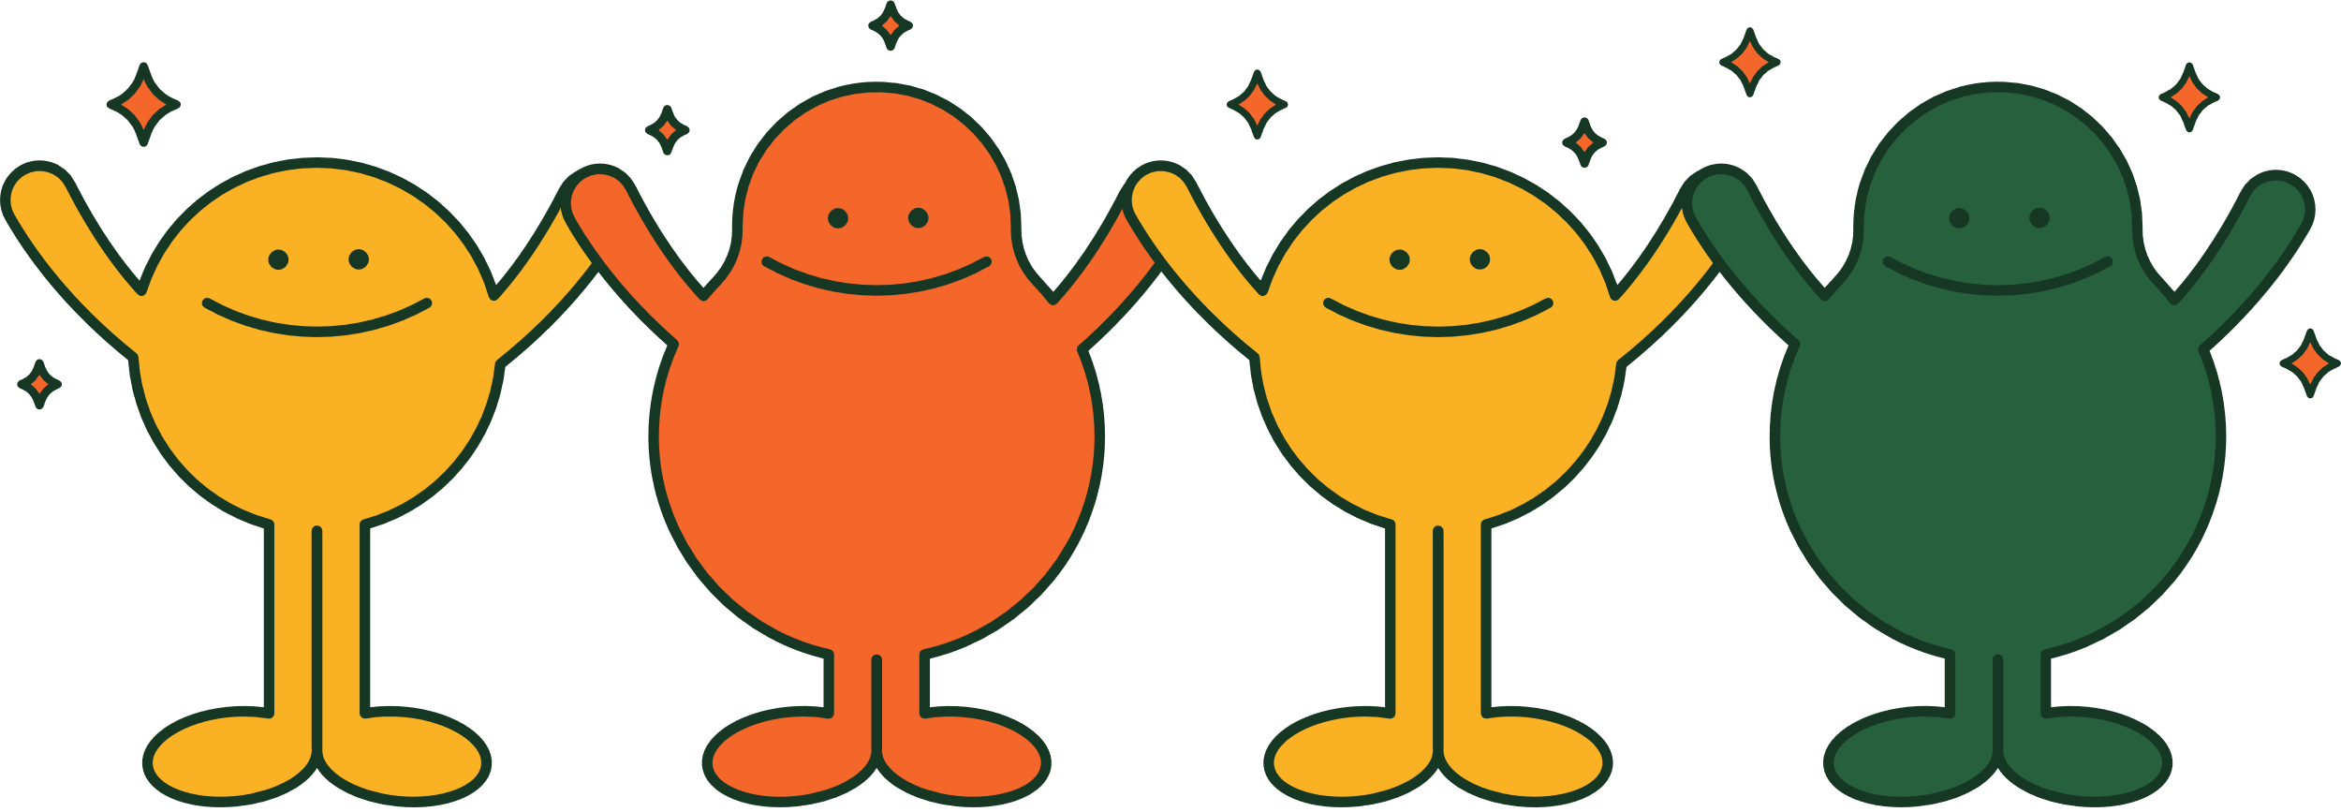
PLAY TIME
Bingo

Slide 23


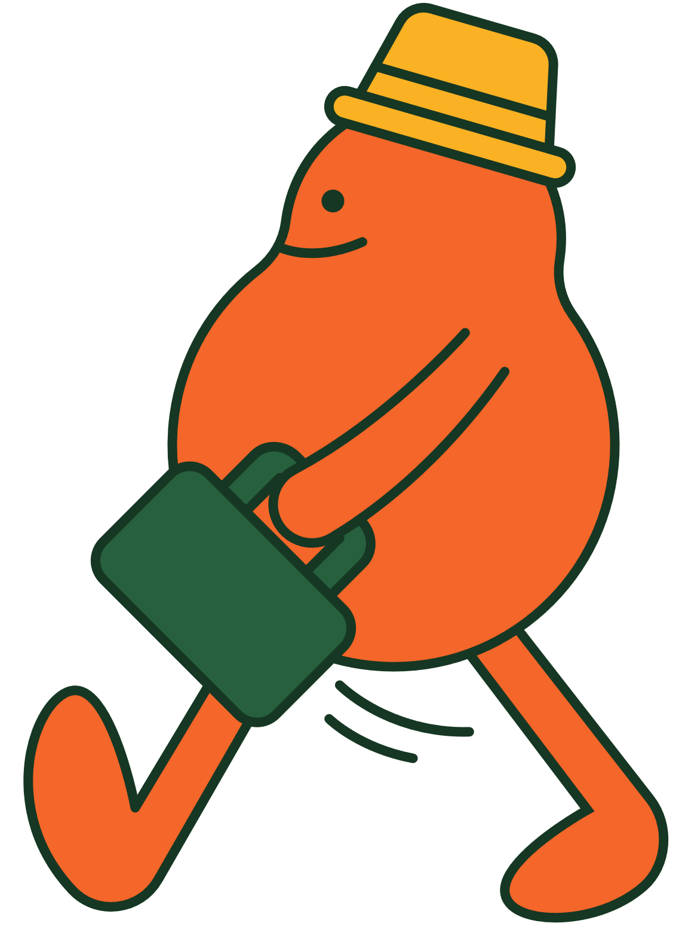
B
I
N
G
O
11
1
7
✗
13
15
8
9
10
4

Slide 24

Thank You
For Playing!

