Slide 2
1
2
3
Warm-up and review
4
5
Fun corner and wrap-up
Look, listen and repeat.
Listen, point and say.
Let’s talk.

Slide 3

Travelling with Doraemon

Slide 4
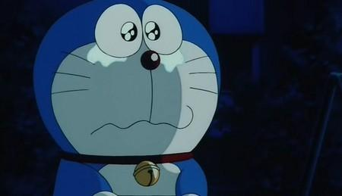
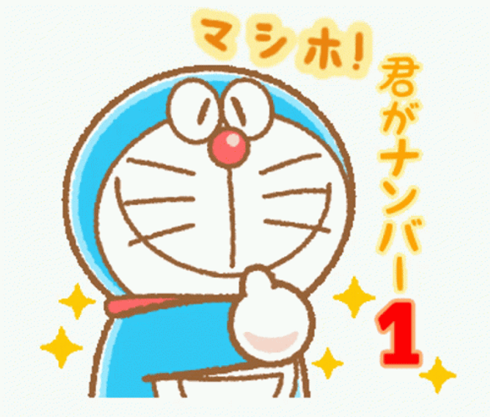
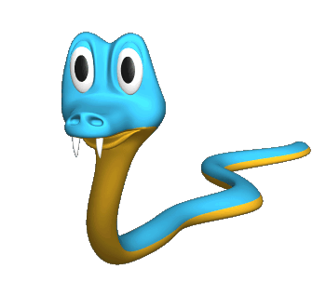
Pick the correct question.
A. What is the weather like yesterday?
B. What was the weather like yesterday?
A
B

Slide 5
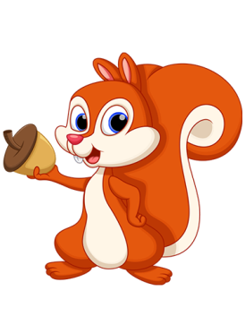
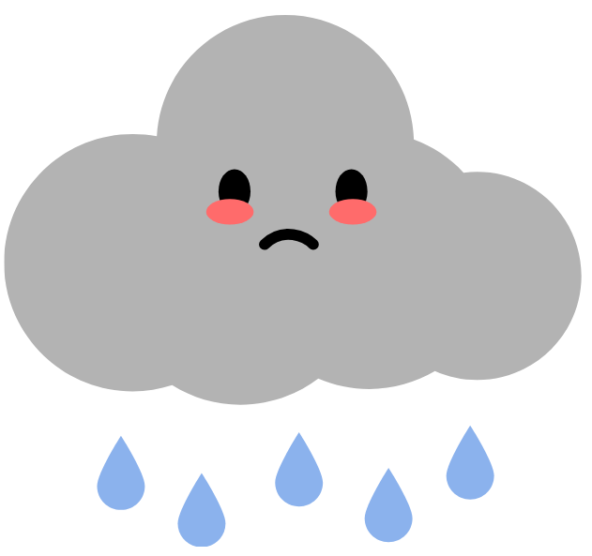
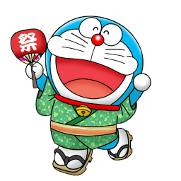
What was the weather like yesterday?
A. It was rainy.
B. It was sunny.
A
B

Slide 6
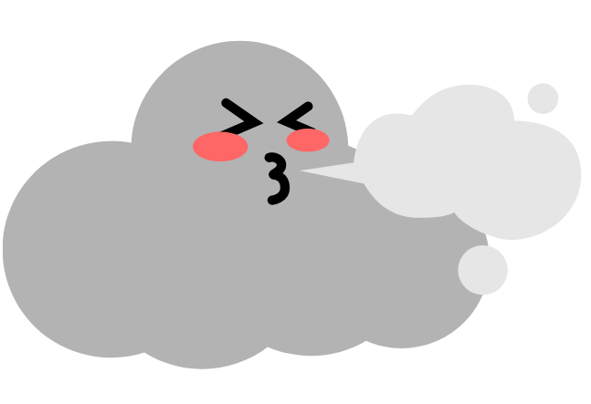
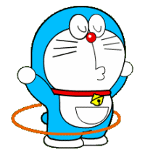
What was the weather like yesterday?
A. It was windy.
B. It was cloudy.
A
B

Slide 7
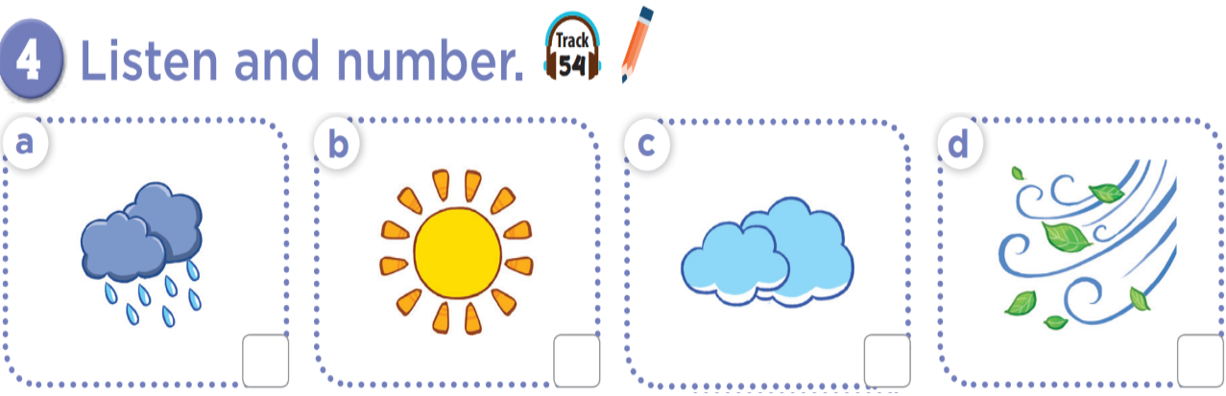

Slide 8
2
4
3
1

Slide 9
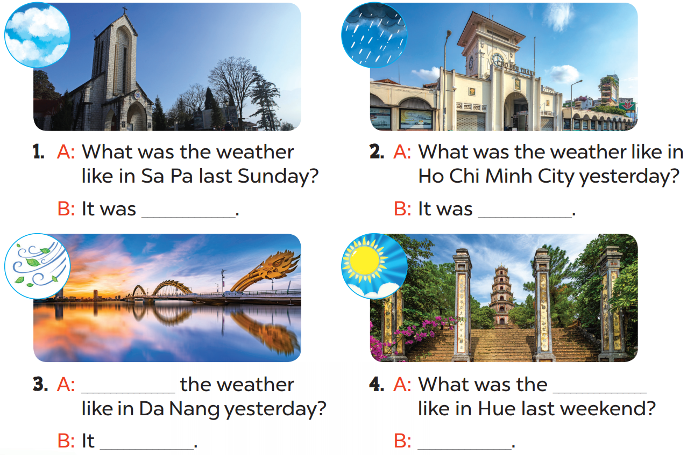

Slide 10
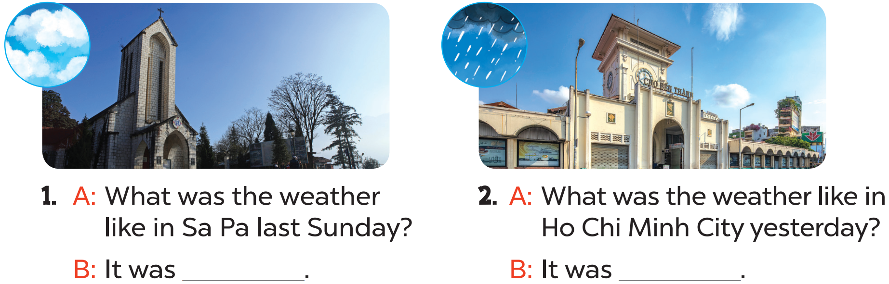
cloudy
rainy

Slide 11
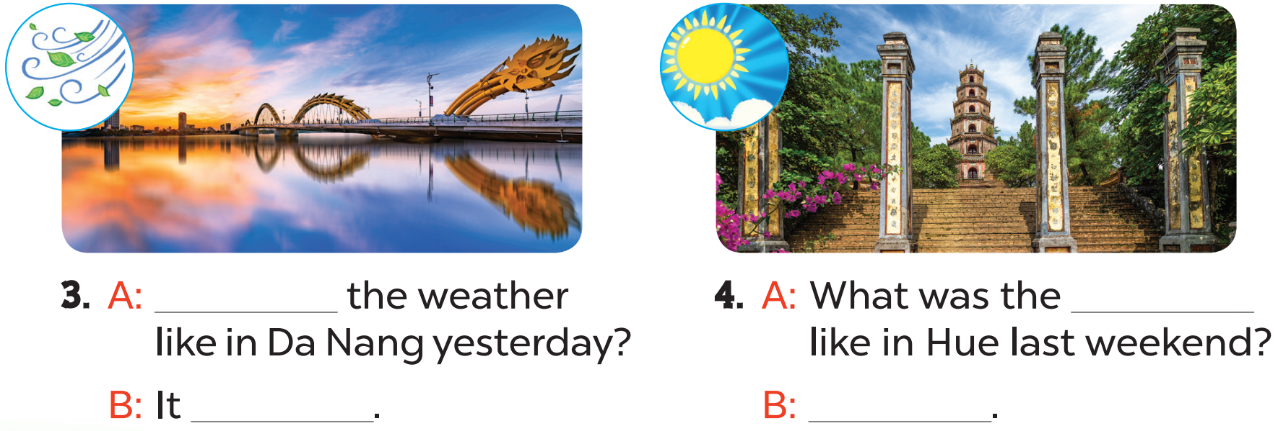
What was
weather
windy
It was sunny

Slide 12
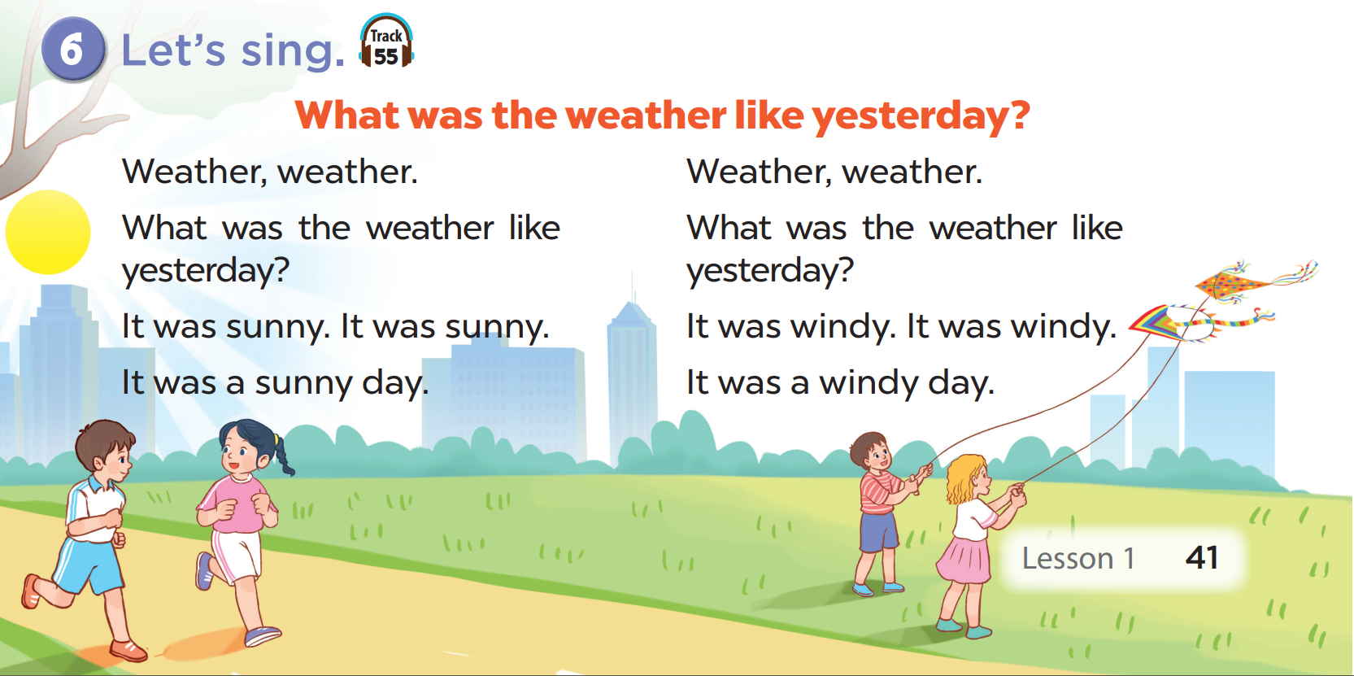

Slide 13
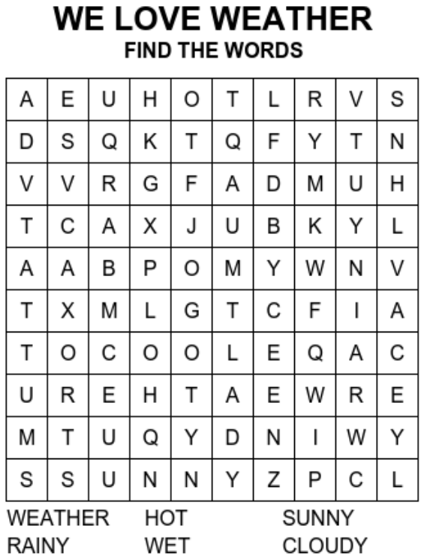
PLAY OFFLINE VERSION!

