Slide 1





Our toys
17
LESSON 3
Period 5

Slide 2
Contents
1
Warm-up and review
2
Listen and repeat.
3
Listen and circle.
4
Let’s chant.
5
Fun corner and wrap-up

Slide 3
Warm-up and review
1
1
Game: Chasing the thief

Slide 4




Notes:
Step 1: Divide the class into 4 teams.
Step 2: Invite 1 pupil to go to the board and look at the picture, then say aloud which one is missing.
Step 3: Encourage pupil to join in the game.
Step 4: Give points for pupils.

Slide 5









He wants to steal…
Click on the right option
Trains
Buses
Cars
TIME’S UP

Slide 6

He wants to steal…
Click on the right option
plane
car
doll
TIME’S UP

Slide 7

He wants to steal…
Click on the right option
doll
train
kite
TIME’S UP

Slide 8

He wants to steal…
Click on the right option
planes
trucks
buses
TIME’S UP

Slide 9




Slide 10
Listen and repeat.
2
2

Slide 11
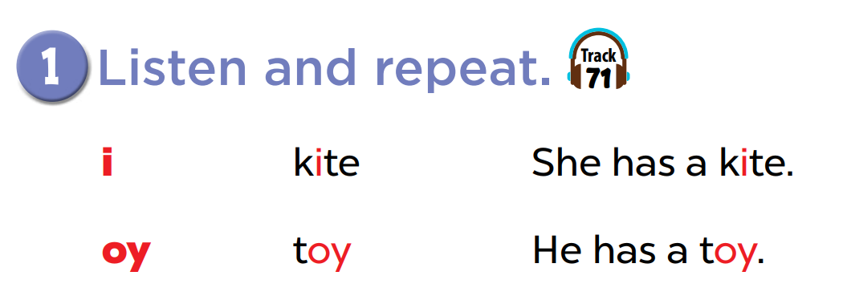

Slide 12
Listen and circle.
3
3

Slide 13
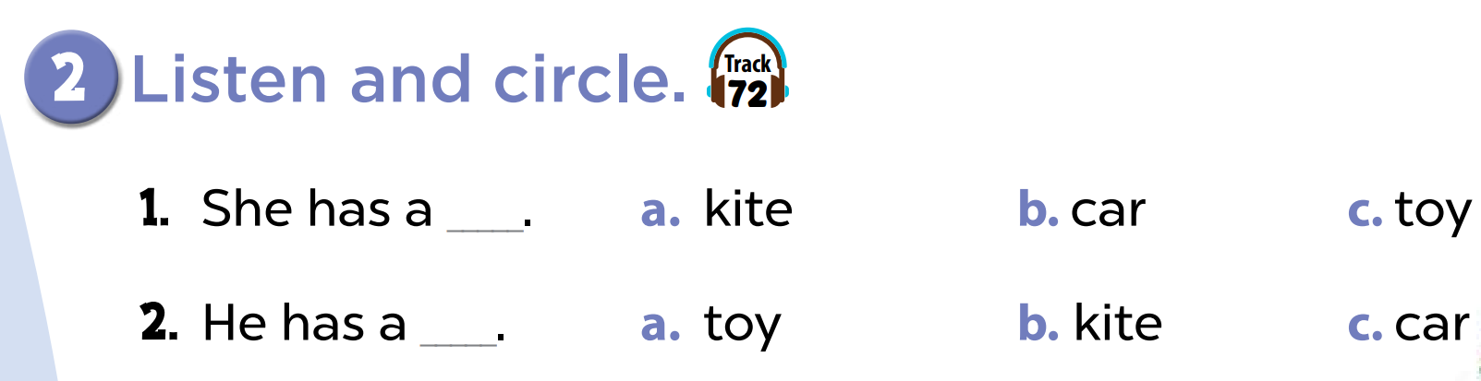

Slide 15


Listen and choose
She has _______.

Slide 16
Listen and choose
He has a ________.

Slide 17


Listen and choose
They have three _____.

Slide 18
Listen and choose
She has a _____.

Slide 19


Listen and choose
They have ____.

Slide 20

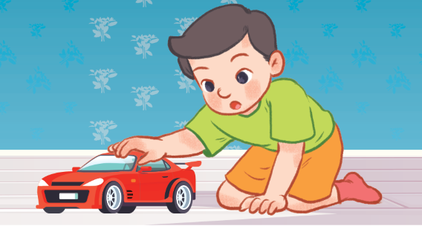
Listen and choose
He has ____.

Slide 21
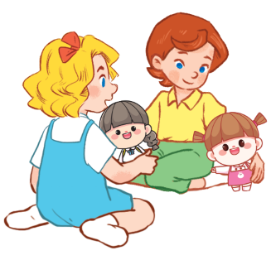
Listen and choose
They have two _____.

Slide 22

Let’s chant.
4
4

Slide 23
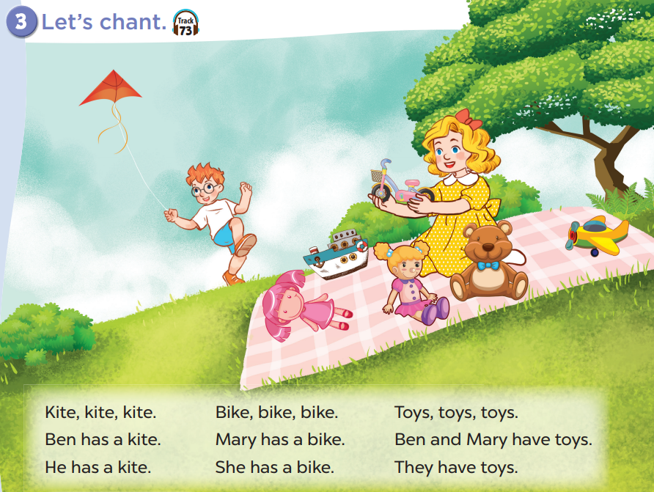

Slide 25
Fun corner and wrap-up
5
5

Slide 26

Guessing game
Notes:
Step 1: Divide the class into 2 teams.
Step 2: Invite each pupil from each team to look at the phonics words or pictures and say them aloud. The faster pupil with correct answer will get points for his/her team.
Step 3: Encourage pupils to practice speaking English.
Step 4: Give points for pupils.

