Slide 1
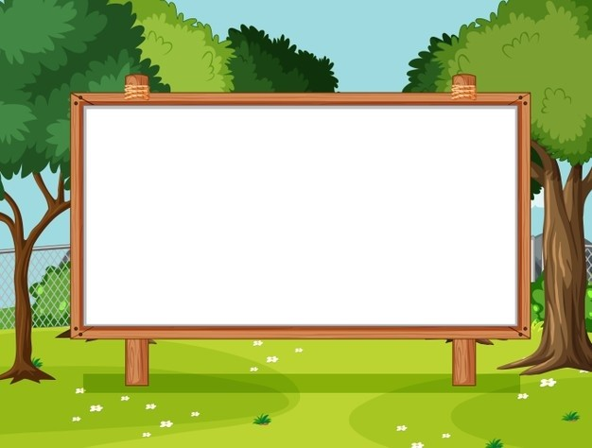
Unit 18
Means of transport
Lesson 3 - Period 5

Slide 2

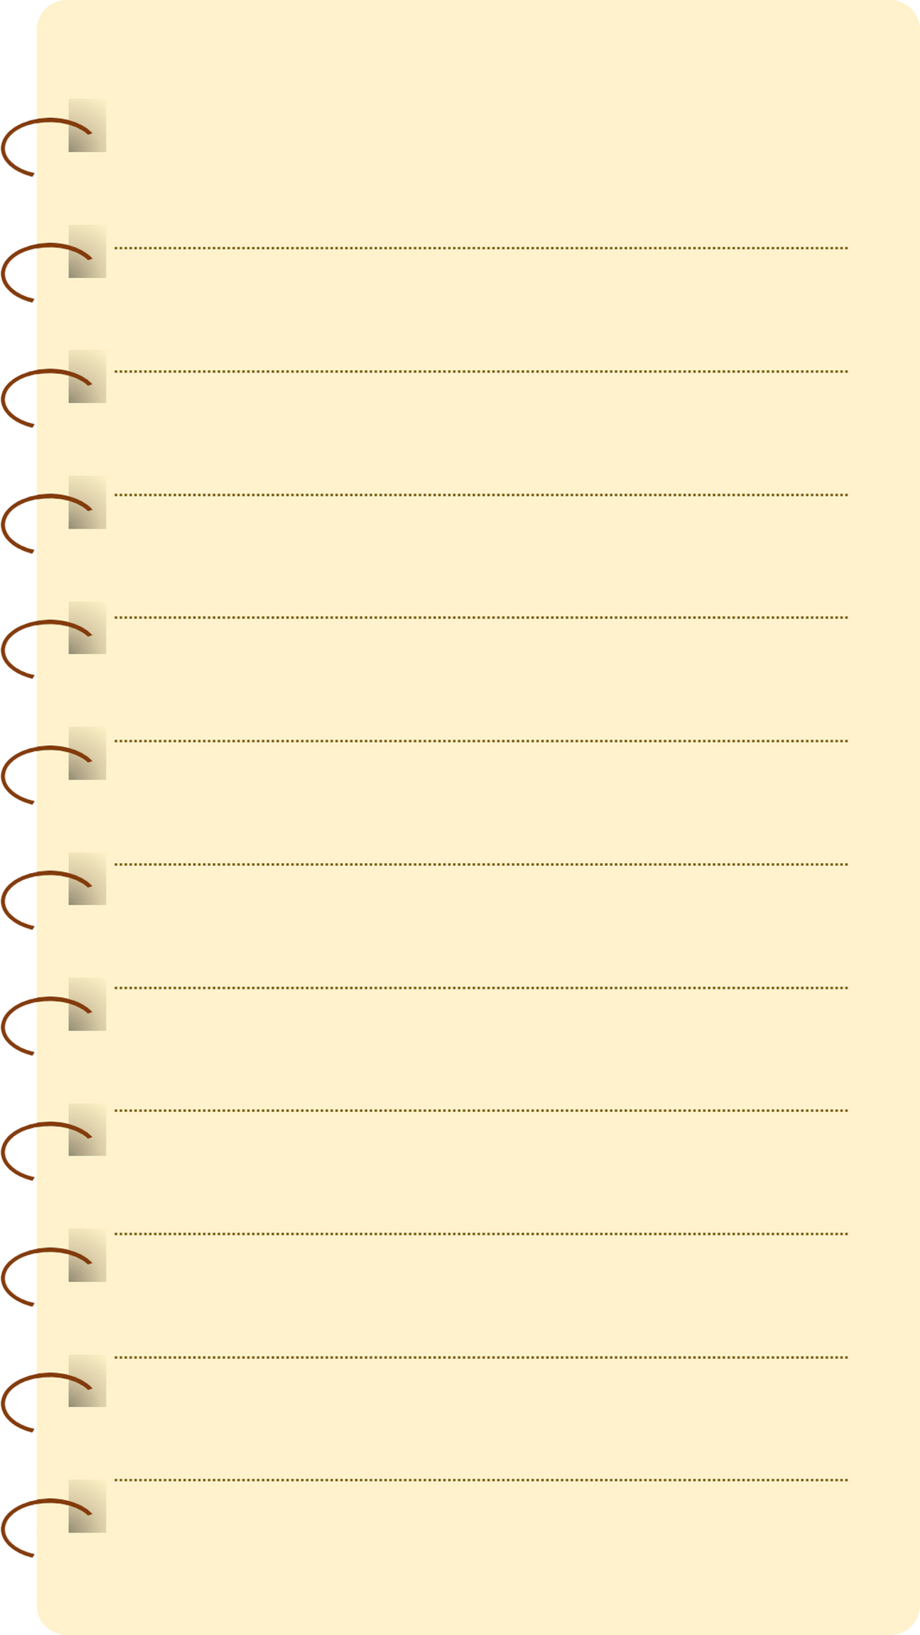
Table of contents
01
Warm-up and Review
02
Listen and repeat.
03
Listen and repeat. Pay attention to the intonation.
04
Let’s chant.
05
Fun corner and Wrap-up

Slide 3
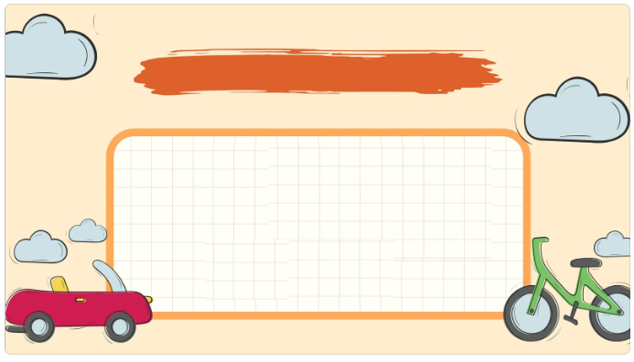
01
Warm-up and Review

Slide 4


Slide 5

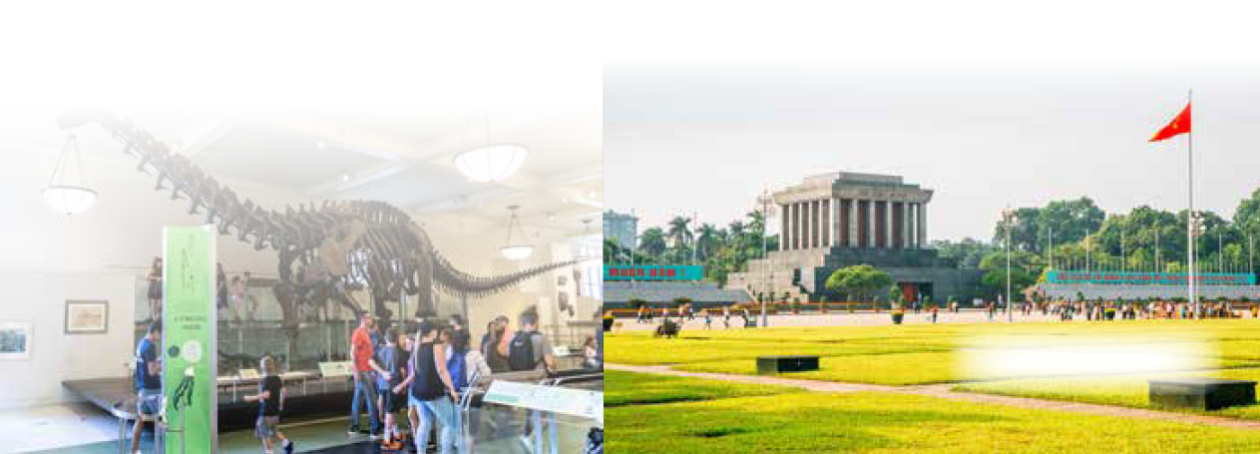
Let’s sing.
Where do you want to visit?
I want to visit somewhere.
Where do you want to visit?
I want to visit the museum.
That’s a great idea! Let’s go!
I want to visit somewhere.
Where do you want to visit?
I want to visit the square.
That’s a great idea! Let’s go!

Slide 6
02
Listen and repeat.

Slide 7

Listen and repeat.
Is it time for a trip?

Slide 8
Listen and repeat.
Is it far from here?

Slide 9
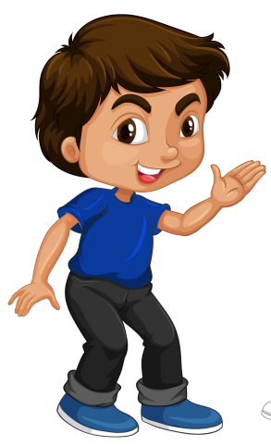
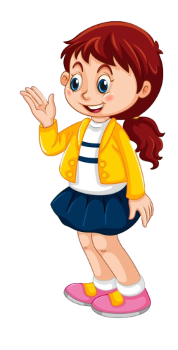
Listen and repeat.
Is it time for a trip?
Is it far from here?

Slide 10
03
Listen and repeat.
Pay attention to the intonation.

Slide 11
Read.
1. Would you like to go somewhere this morning?
2. Will we go to Golden Bridge?
3. Can I get there by bicycle?
4. Do you want to visit Hyde Park?

Slide 12
Listen and repeat.
Pay attention to the intonation.
Would you like to go somewhere this morning?

Slide 13
Listen and repeat.
Pay attention to the intonation.
2. Will we go to Golden Bridge?

Slide 14
Listen and repeat.
Pay attention to the intonation.
3. Can I get there by bicycle?

Slide 15
Listen and repeat.
Pay attention to the intonation.
4. Do you want to visit Hyde Park?

Slide 16
04
Let’s chant.

Slide 17

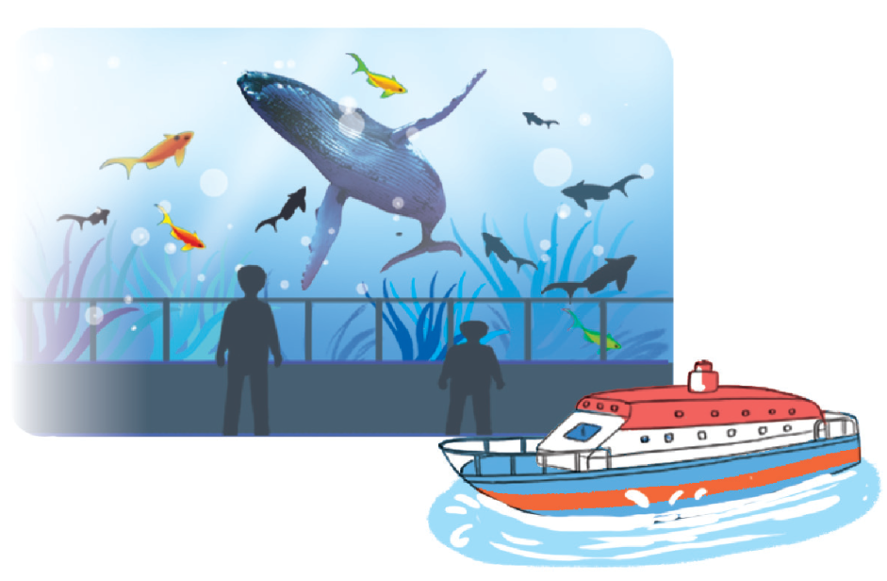
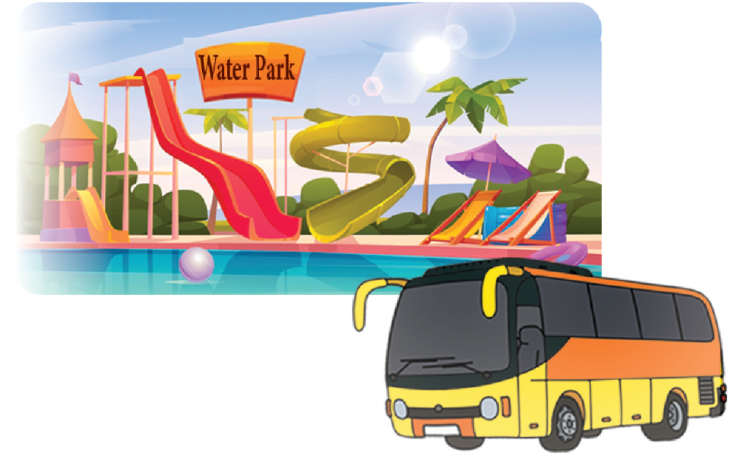
Let’s chant.
Will you visit the aquarium?
Yes, I will. Yes, I will.
Can you get there by boat?
Yes, I can. Yes, I can.
I can get there by boat.
Do you want to visit the water park?
Yes, I do. Yes, I do.
Can you get there by bicycle?
No, I can’t. No, I can’t.
I can get there by bus.

Slide 18
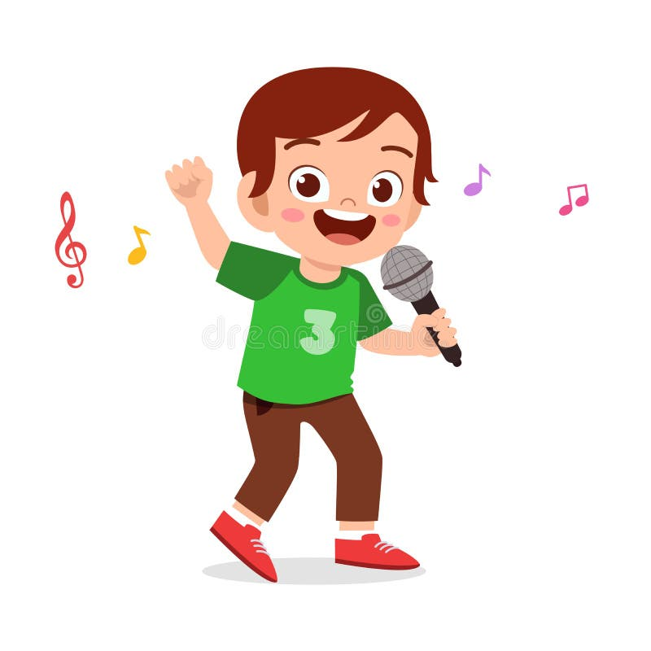
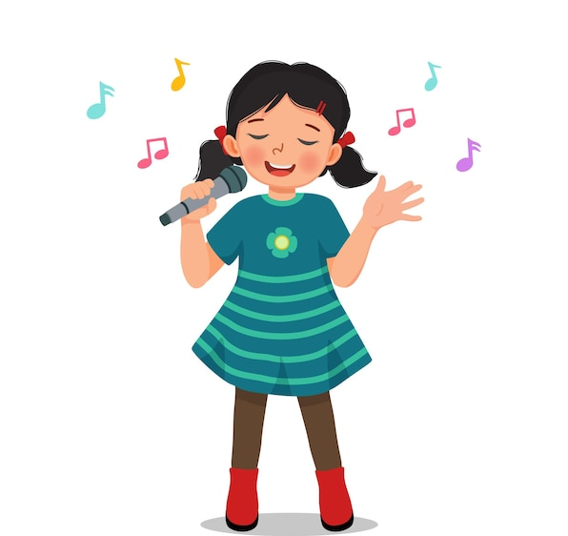
Let’s chant.
Will you visit the aquarium?
Yes, I will. Yes, I will.
Can you get there by boat?
Yes, I can. Yes, I can.
I can get there by boat.
Do you want to visit the water park?
Yes, I do. Yes, I do.
Can you get there by bicycle?
No, I can’t. No, I can’t.
I can get there by bus.

