Slide 1
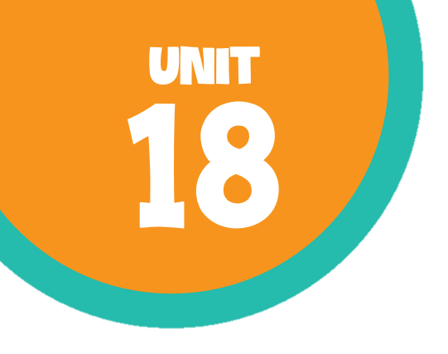
At the shopping centre Lesson 2 - Period 4

Slide 2
Table of contents
01
Warm-up and review
02
Listen and number.
03
04
Look, complete and read.
Let’s play.
05
Fun corner and wrap-up

Slide 3
01
Warm-up

Slide 4
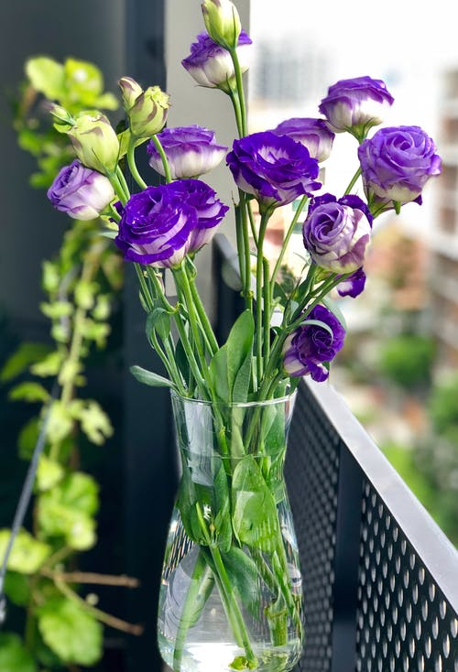

02
Listen and number.
Pupil’s book page 55

Slide 5
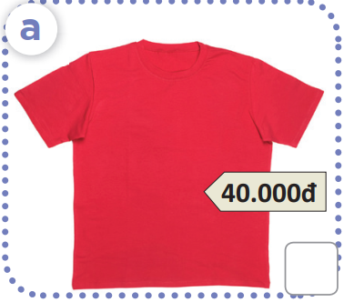
What is this?
How much is this?

Slide 6
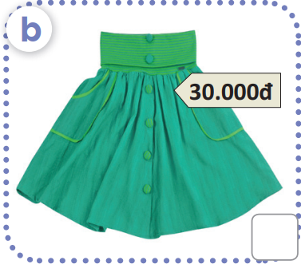
What is this?
How much is this?

Slide 7
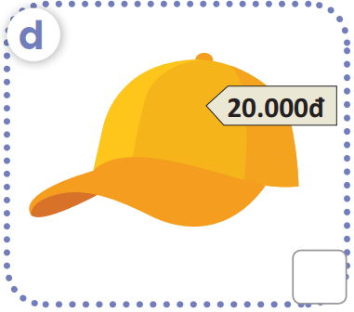
What is this?
How much is this?

Slide 8
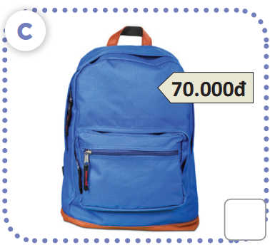
What is this?
How much is this?

Slide 9
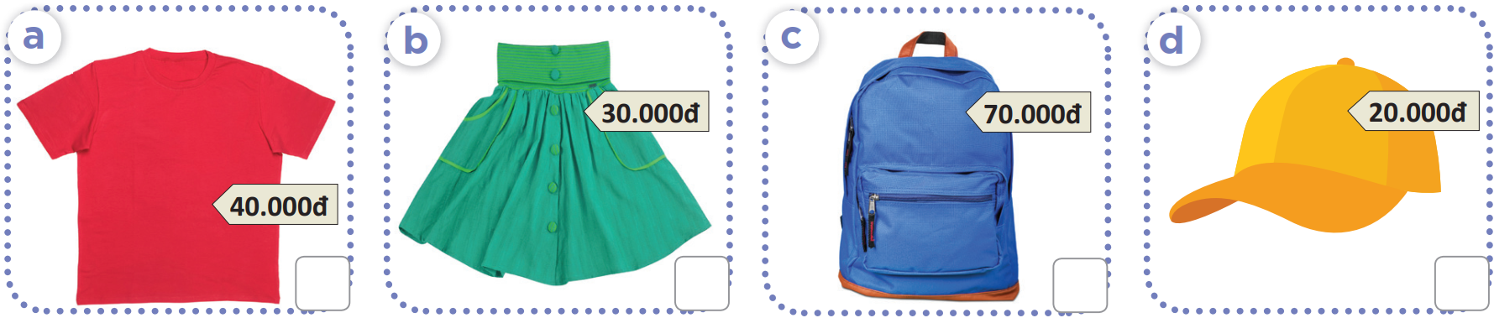
Work in pairs.
Ask and answer

Slide 10
2
4
1
3

Slide 11
03
Look, complete and read.

Slide 12
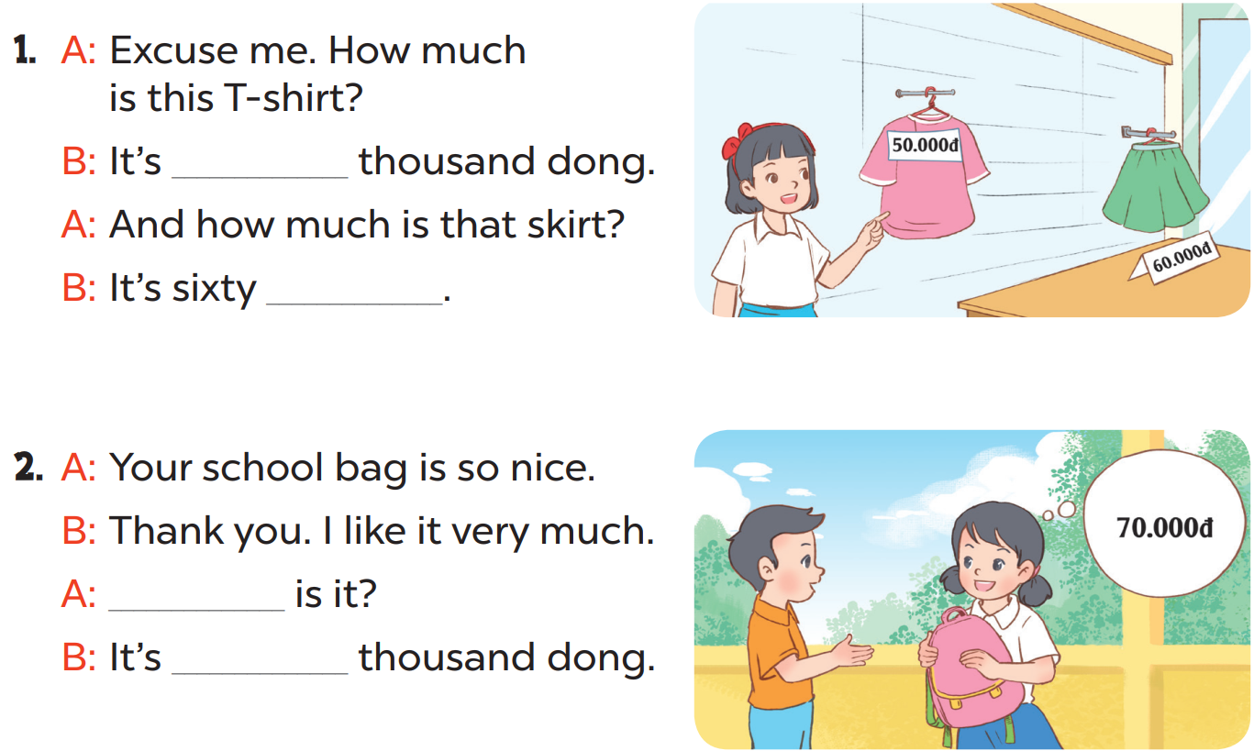
fifty
thousand dong
How much
seventy

Slide 13
04
Let’s play!

Slide 14

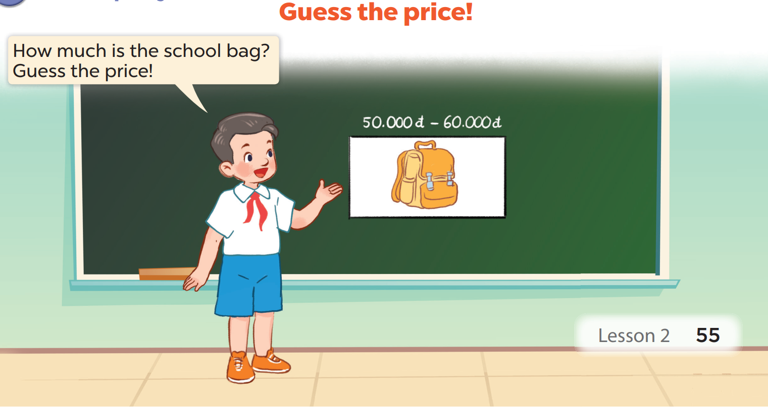
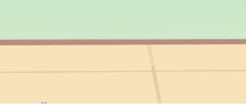

Slide 15
05
Fun corner

Slide 16

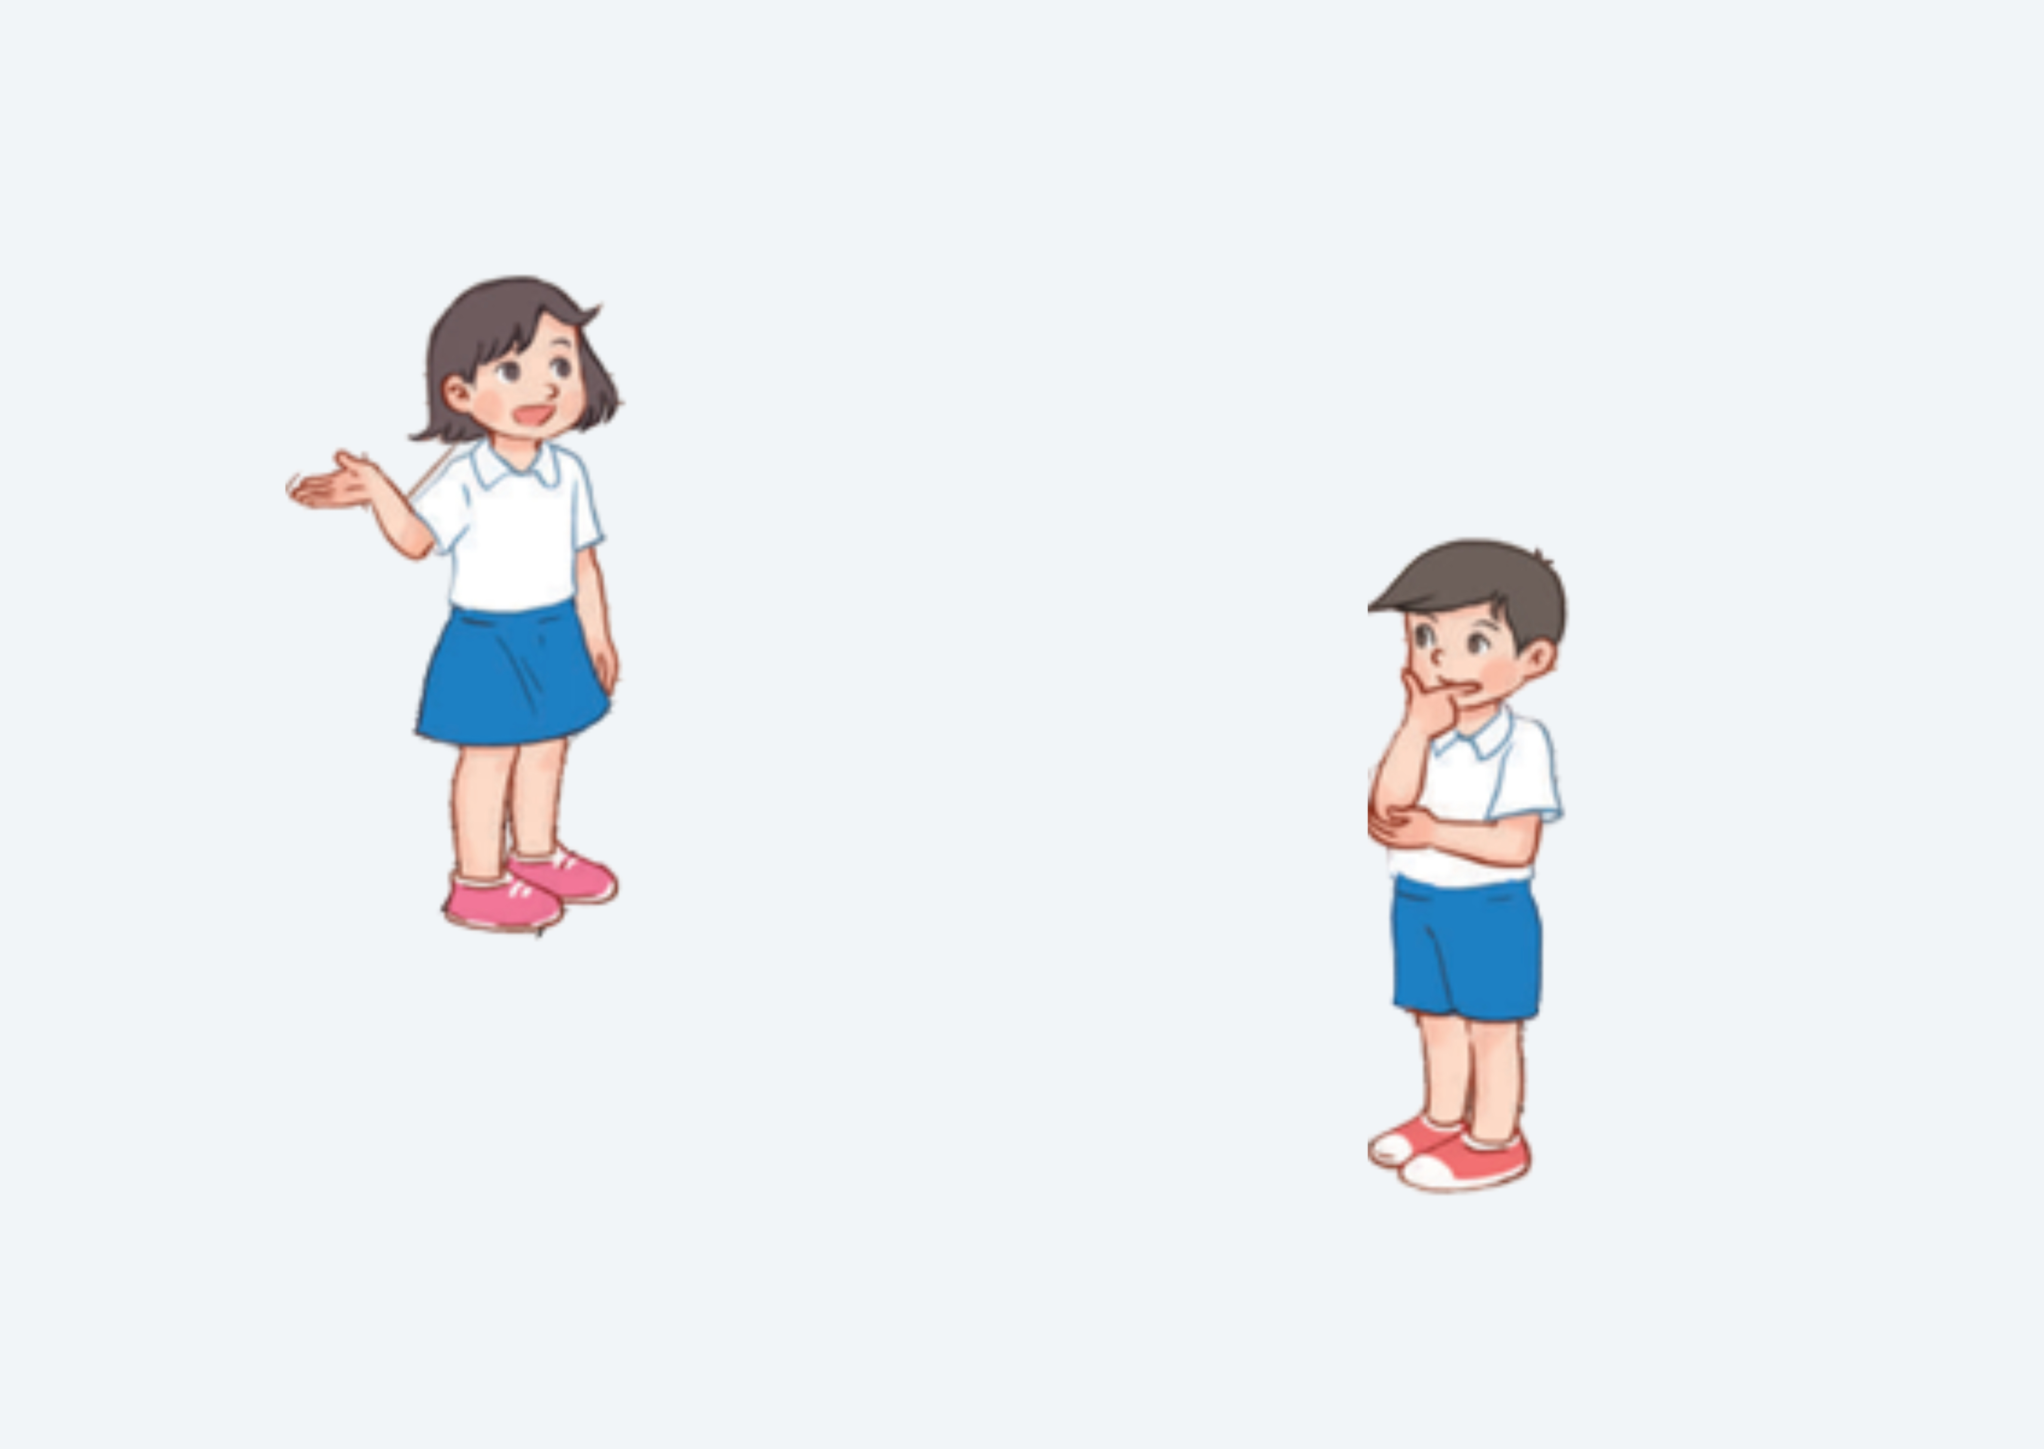

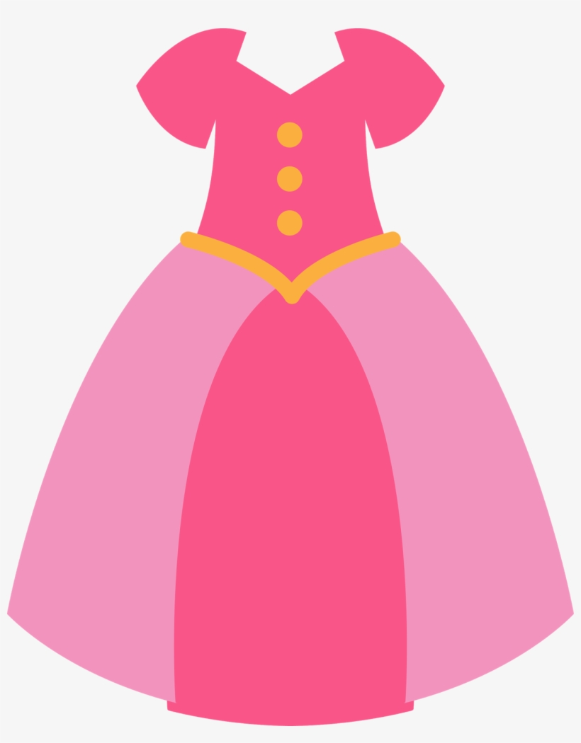
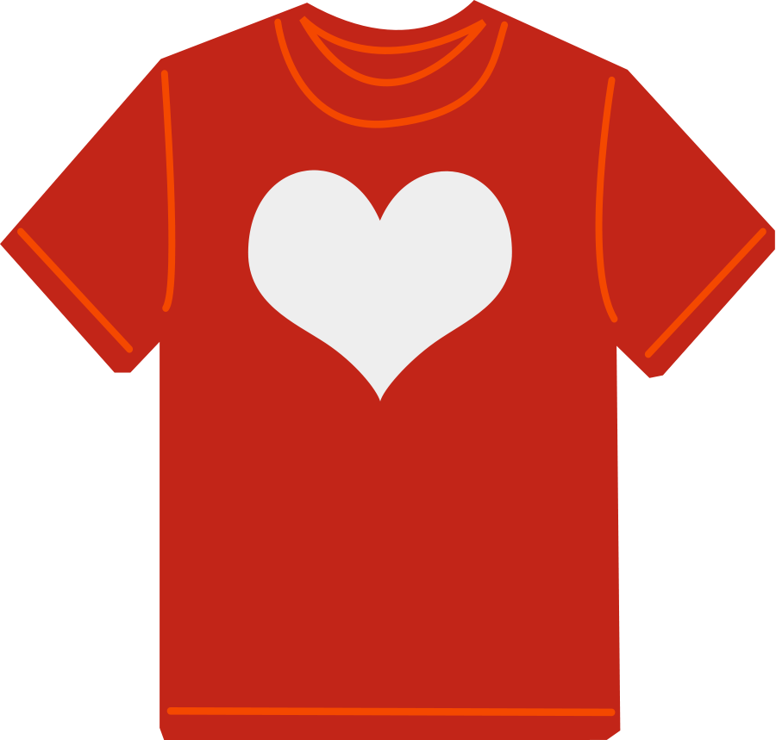
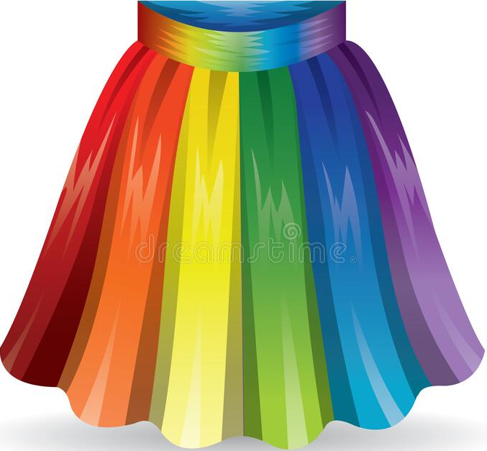
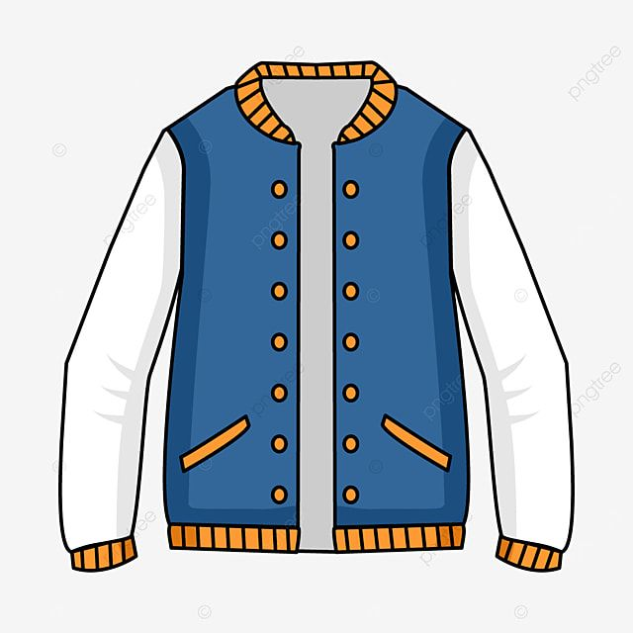




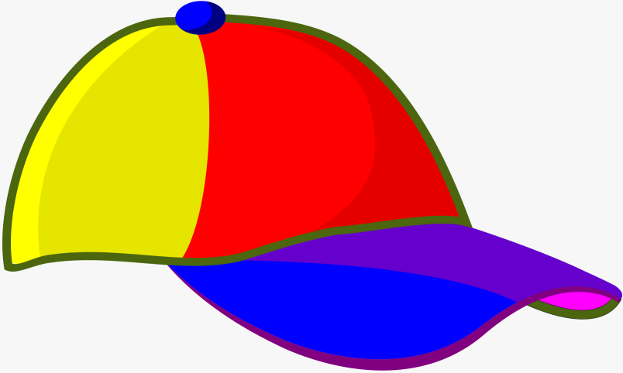
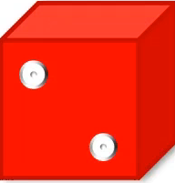

Shopping centre
40.000 đ
70.000 đ
50.000 đ
90.000 đ
30.000 đ
40.000 đ
80.000 đ
60.000 đ
It’s ninety thousand dong.
How much is the jacket?



Slide 17
Shopping centre
40.000 đ
70.000 đ
50.000 đ
90.000 đ
30.000 đ
40.000 đ
80.000 đ
60.000 đ
It’s forty thousand dong.
How much is the cap?



