Slide 1



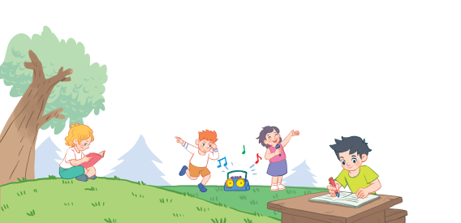
18
Period 5

Slide 2
Contents
1
Warm-up and review
2
3
4
Listen and repeat.
Listen and circle.
Let’s chant.
5
Fun corner and wrap-up

Slide 3
1. Warm-up and review

Slide 4
Activity:
Listen and say!

Slide 5
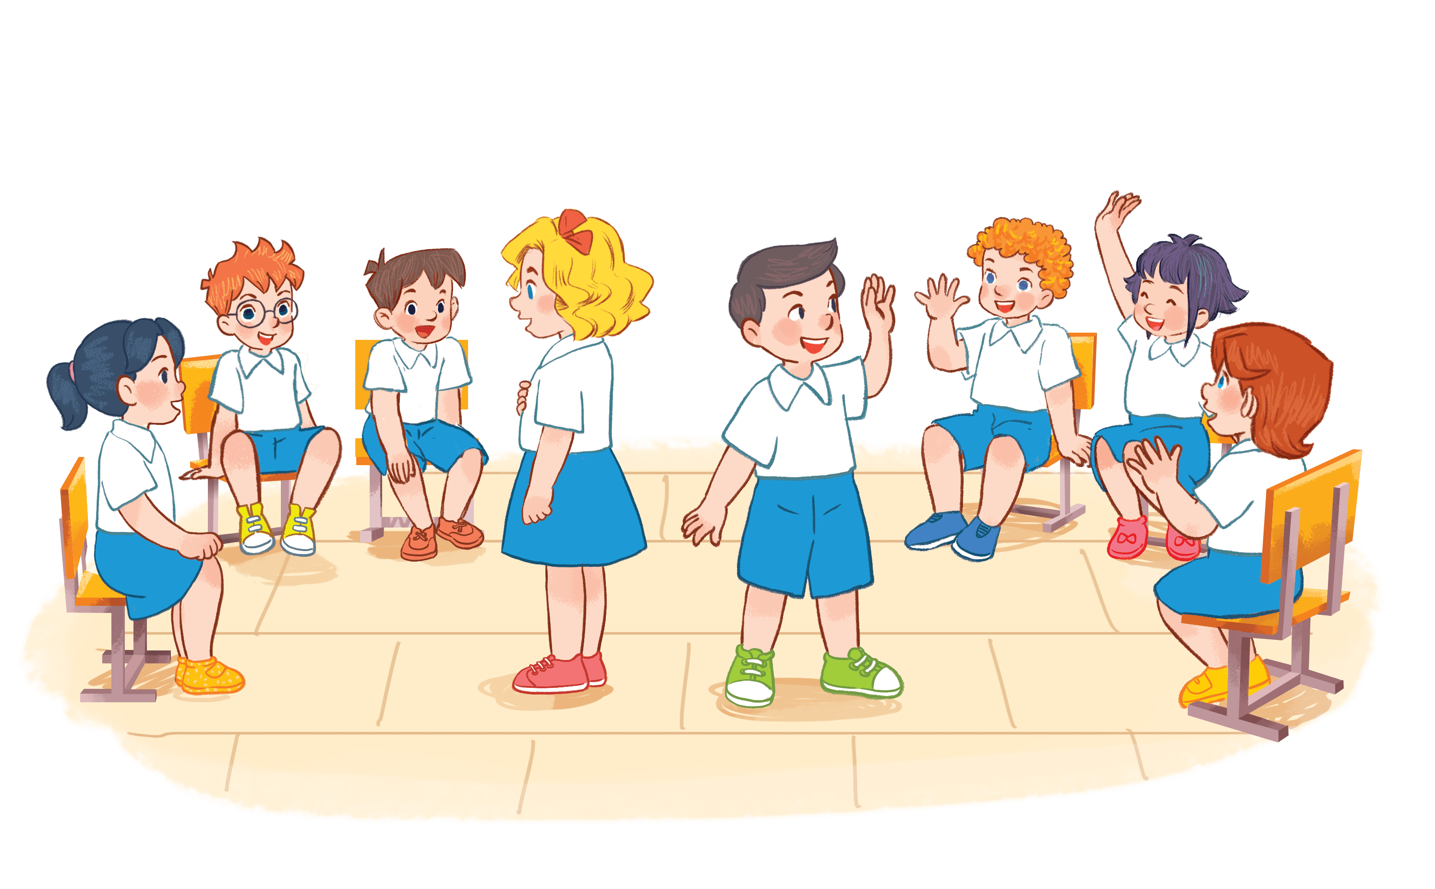


playing basketball.
I am playing basketball.
Notes:
Activity: Listen and say!
Pupils sit in a circle. Some pupils come in the middle and keep the pictures.
The others take turn saying a word, the one keeping the pictures raise their hands then say the whole sentence.
Who can make it will have points.

Slide 6
I am drawing a picture.
drawing a picture
Notes:
Activity:
-Pupils sit in circle. Some pupils come in the middle and keep pictures.
-The others around take turn say sentences, the one keeping the pictures raise their hands.

Slide 7
2. Listen and repeat.

Slide 8
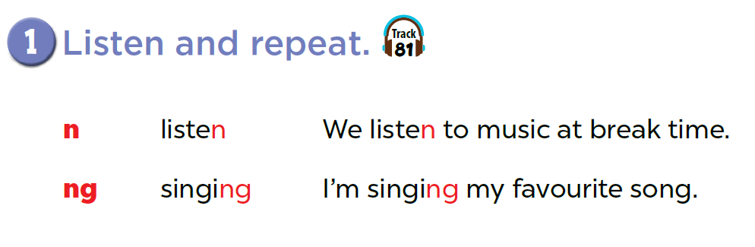

Slide 9

Game: Listen and choose!
n
listening
singing
ng
Notes:
T divides class into 2 teams: BOYS and GIRLS.
1 boy and 1 girl of each team come to the board, listen to the recording and choose the right words. (Pupils slap the words on the board)

Slide 10
Game: Listen and choose!
n
listening
singing
ng

Slide 11
3. Listen and circle.

Slide 12
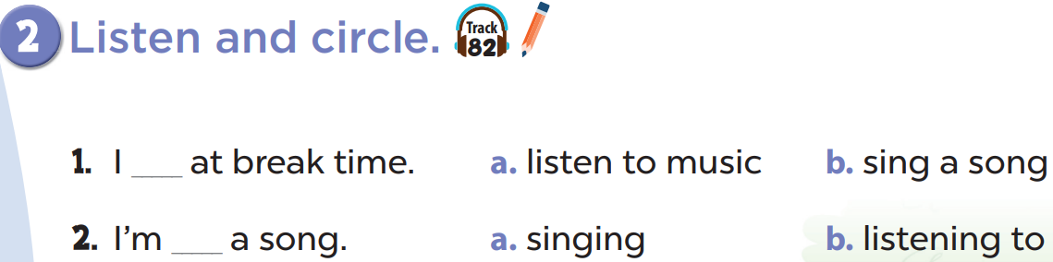

Slide 14

Game: Look and say

Slide 15
4. Let’s chant.

Slide 16
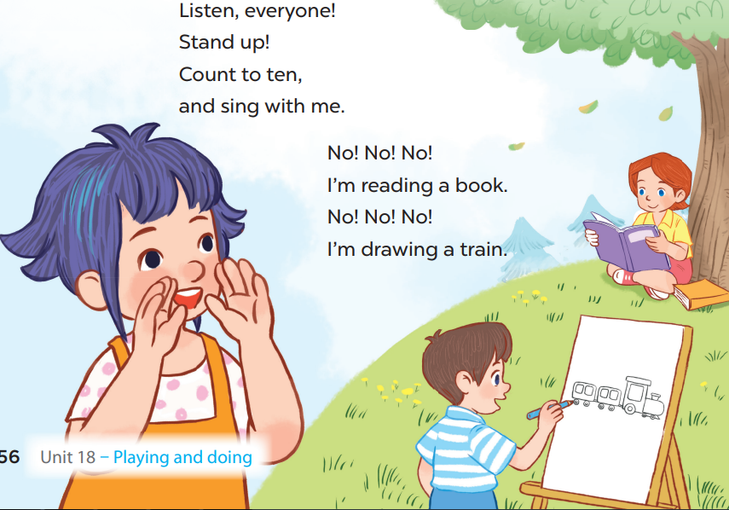

Slide 18
5. Fun corner and wrap-up

