Slide 1



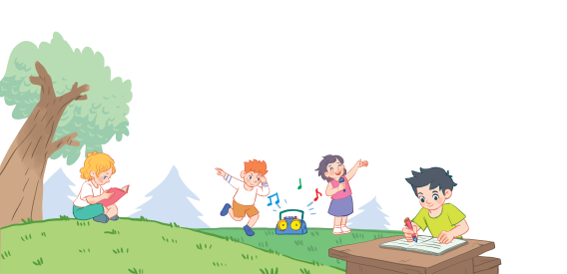
18
Period 6

Slide 2
Contents
1
Warm-up and review
2
3
4
Read and match.
Let’s write.
Project
5
Fun corner and wrap-up

Slide 3
1. Warm-up and review

Slide 4

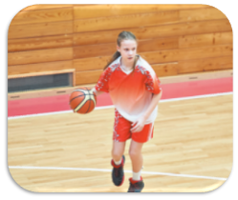
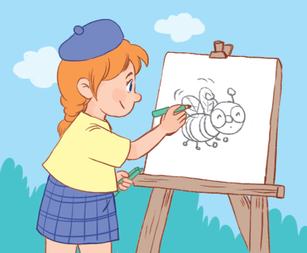
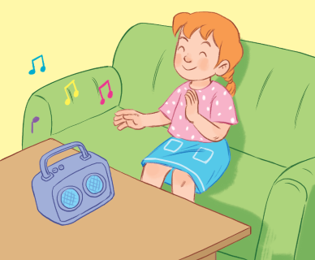
Notes:
Review:
T asks pupils to match the words with the pictures.

Slide 5


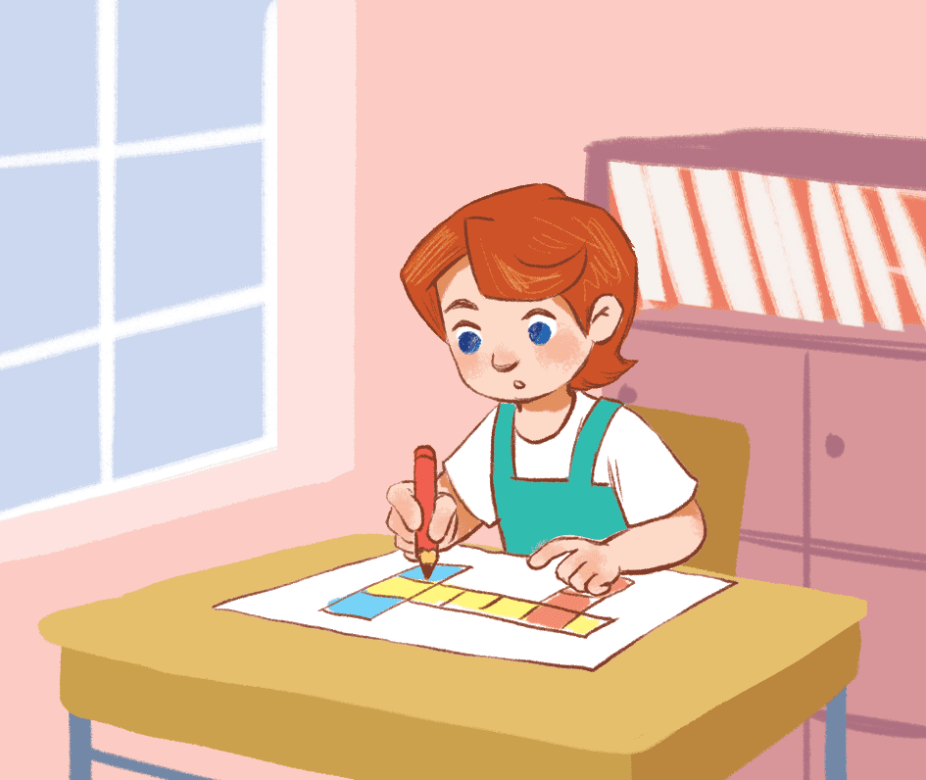
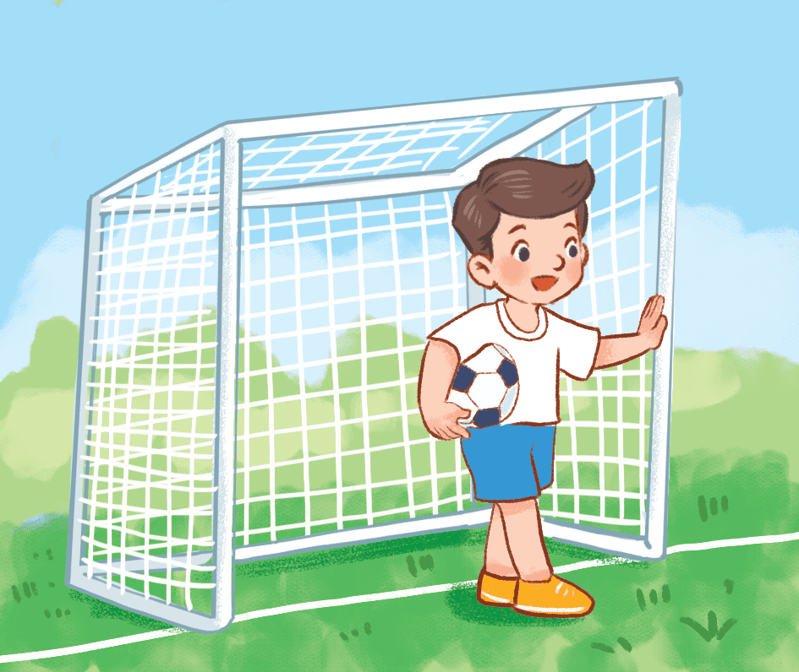
reading drawing playing football dancing

Slide 6

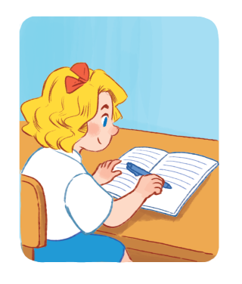
writing drawing playing football singing

Slide 7
2. Read and match.

Slide 8
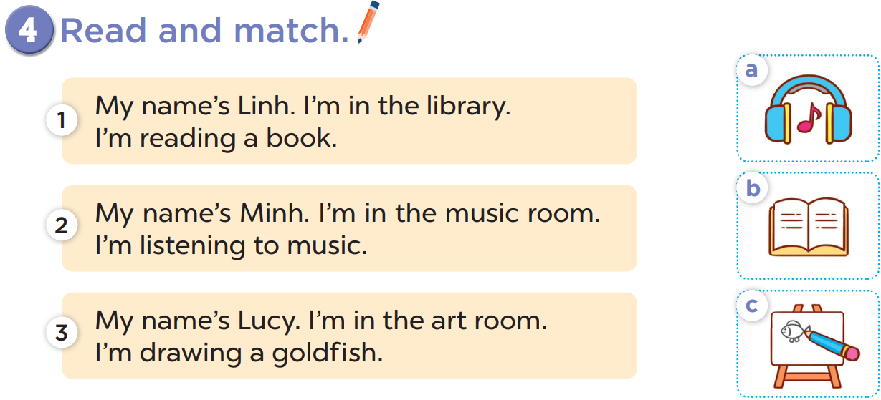

Slide 10
READ AND REMEMBER

Slide 11


Let’s choose and say!

Slide 12


Let’s choose and say!
1
2
3
4
5
6
7
8
Next
Notes:
Let’s choose and say!
Pupils choose a number then say the correct sentence.
Who can say it correctly will get points for the team. (ppt game).

Slide 13


My name is ___. I am in the library. I’m reading a book.
Linh
Minh

Slide 14
My name is ___. I am in the music room. I’m listening to music.
Linh
Minh

Slide 15
My name is ____. I am in the art room. I’m drawing a goldfish.
Nga
Lucy

Slide 16
3. Let’s write.

Slide 17
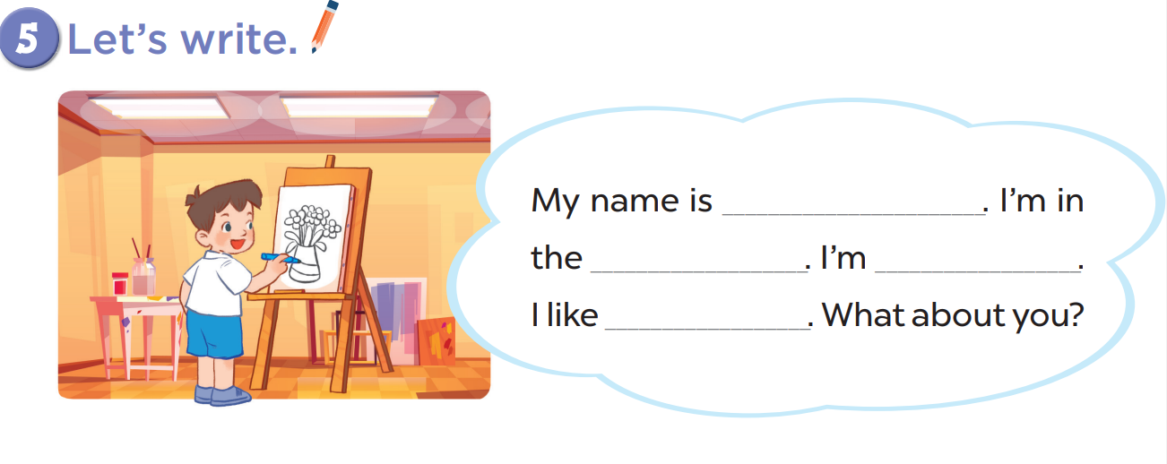

Slide 18

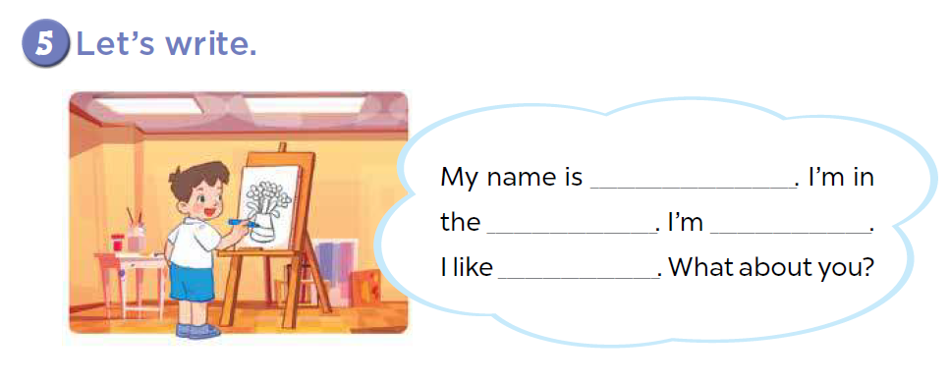
Come to the board and say!
Mary
library
reading
books

Slide 19
Come to the board and say!
Nam
music room
listening
music

Slide 20
4. Project

Slide 21
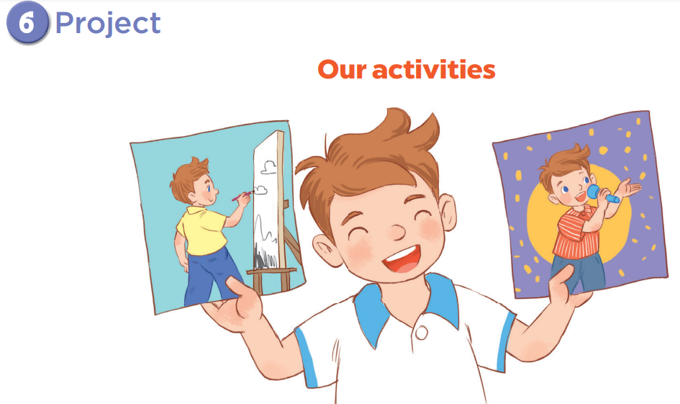

Slide 22
5. Fun corner and wrap-up

Slide 23
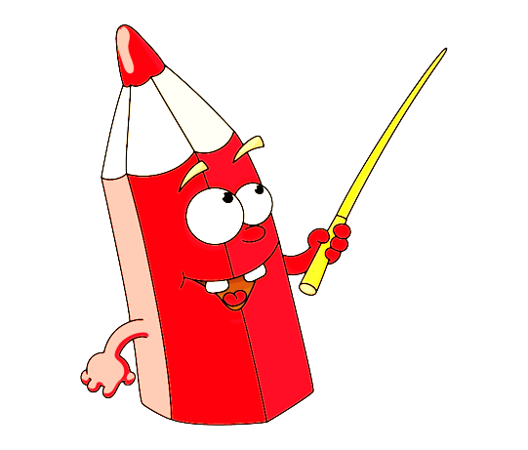


Game: Which is missing?
Notes:
Game: Which is missing?
T shows all the pictures and asks pupils to look at them carefully and find out which one is missing.
T shows again the pictures with one hidden and asks pupils to find out.

Slide 24
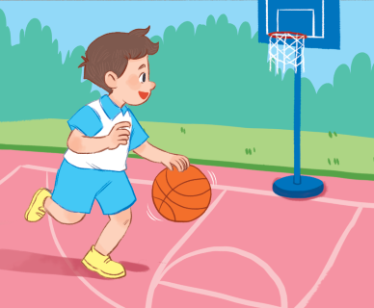

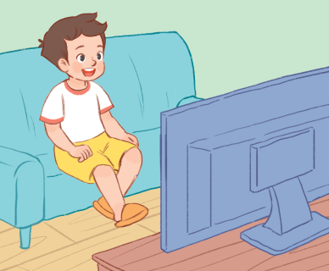

Slide 25
writing

