Slide 1
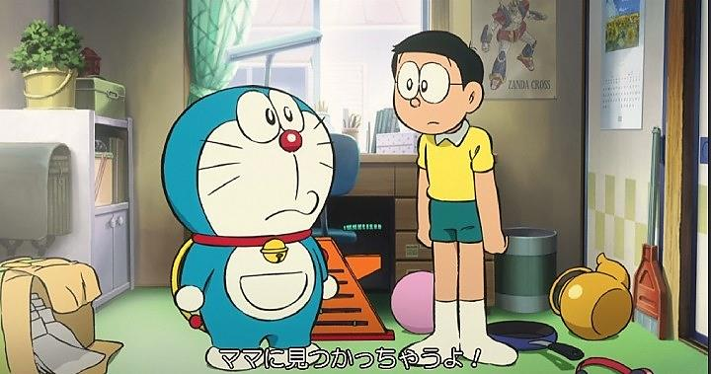
Clean your room

Slide 2

Clean your room

Slide 3
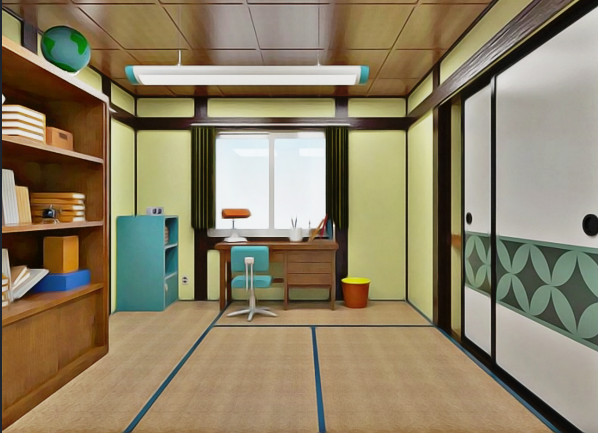
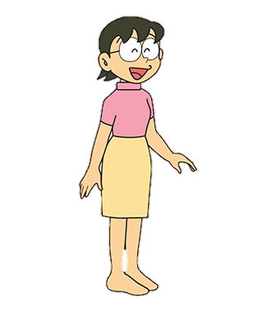
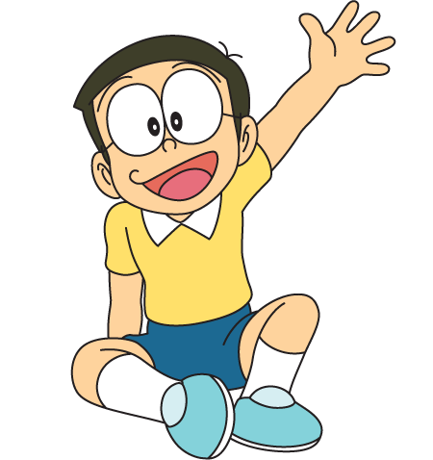



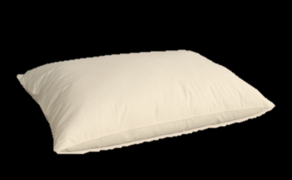


Finish
Do you clean your room, Nobita?
Well done!

Slide 4

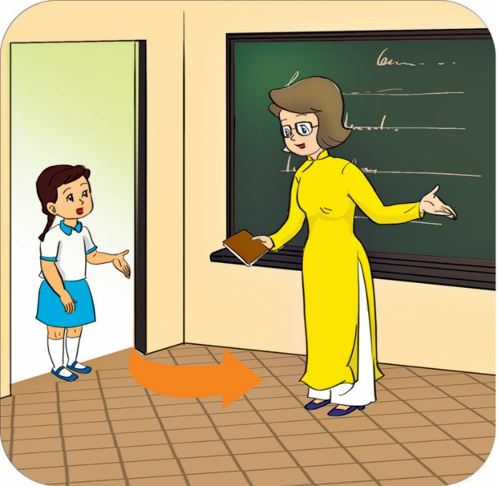
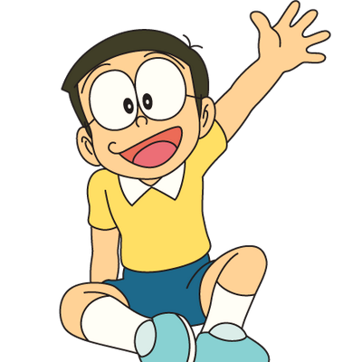

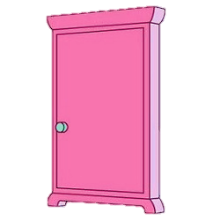
come in
May I……………………..?
- Yes, ………………………..
you can

Slide 5
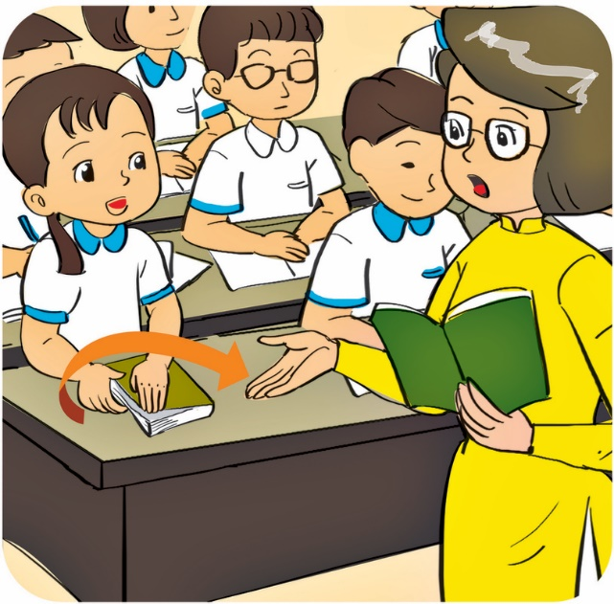

close your book?
May I………………………....?
- No, …………………….. .
you can’t

Slide 6
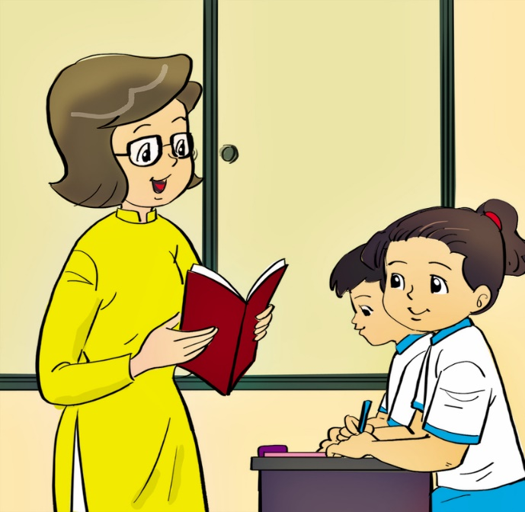
write
May I……………………..?
- ……………., you can.
Yes

Slide 7
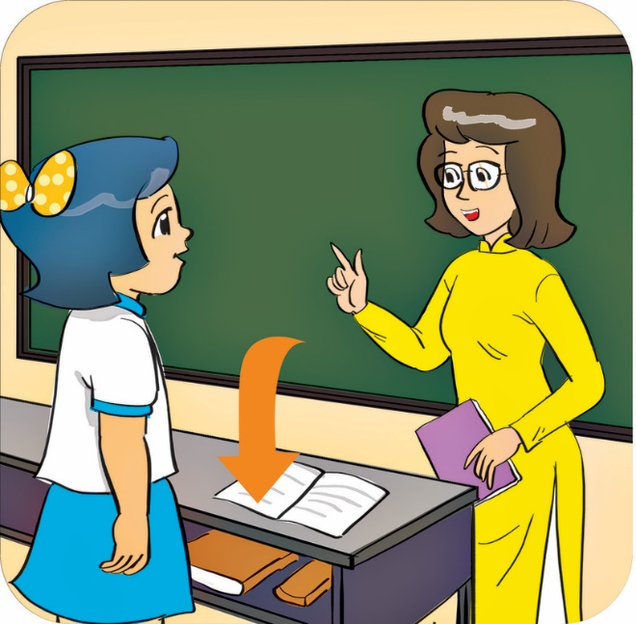
sit down
May I……………………..?
- …………………., you can’t.
No

Slide 8
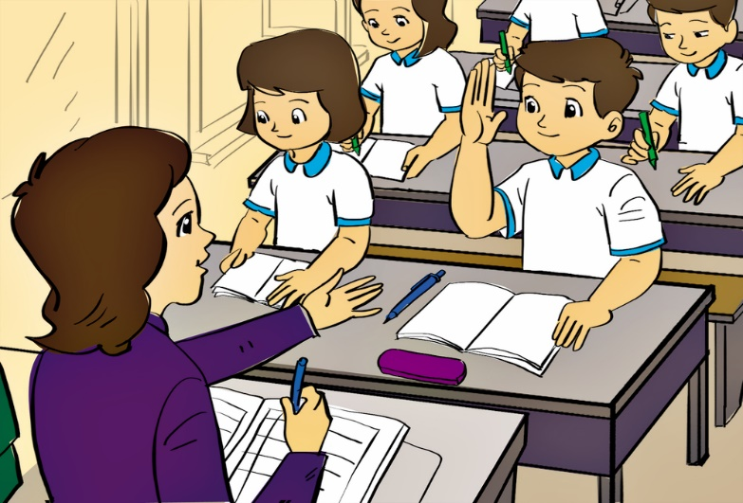
ask a question
May I…………………………....?
- Yes,………………………
you can

