Slide 1



19
The animal world
LESSON 3 - PERIOD 5

Slide 2
Table of Contents
01
02
Listen and repeat.
Review
03
Listen and circle.
04
Let’s chant.
05
Fun corner

Slide 3
1
Warm-up

Slide 4
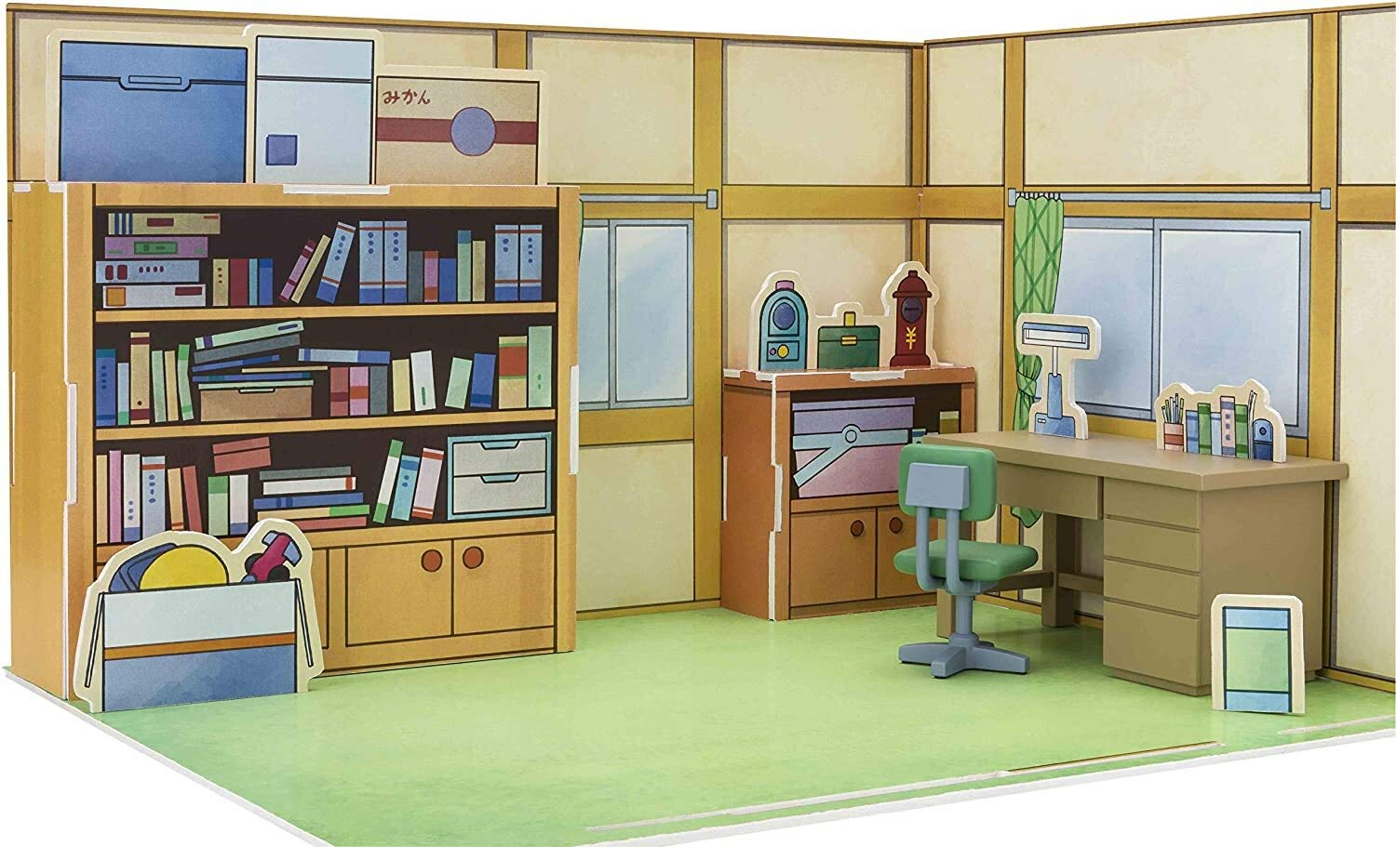

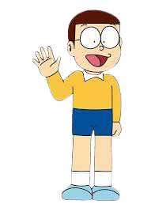
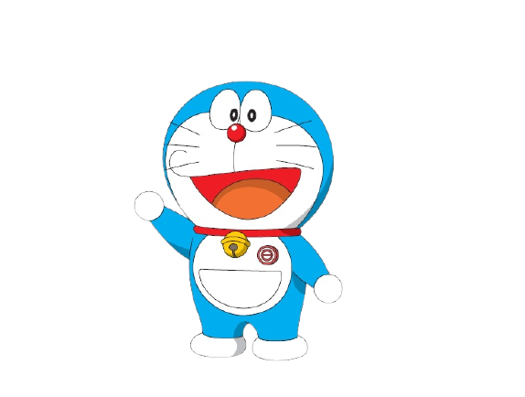
That door could be really fun. Let’s play a game to find out. Are you ready?

Slide 5
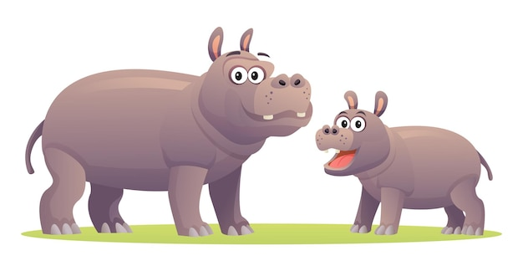
hippos

Slide 6
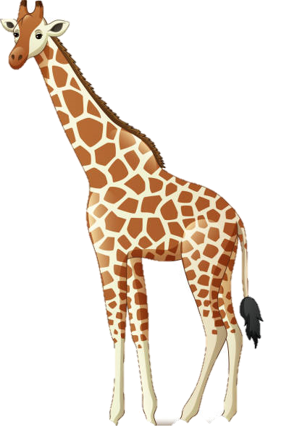
giraffes

Slide 7
Listen and repeat.
2

Slide 8
Well done boys and girls. Now let’s learn some things new. Listen and repeat.

Slide 9
Listen and repeat.
‘loudly | These animals are roaring ‘loudly.
‘quickly | Those animals are running ‘quickly.

Slide 10
Listen and circle.
3

Slide 11
Listen and circle.
1. These giraffes are moving ____.
a. quickly b. loudly 2. Those lions are roaring ____.
a. loudly b. quickly

Slide 12
4
Let’s chant.

Slide 13
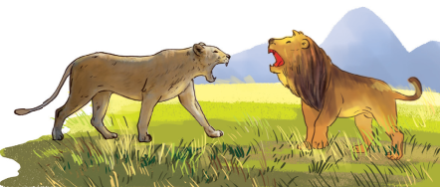
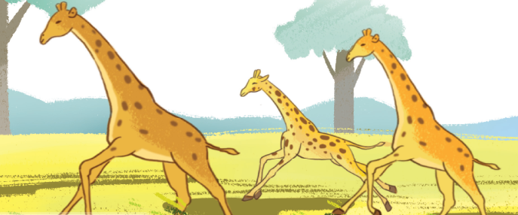
Let’s chant.
Loudly, loudly.
These lions are roaring loudly.
They are roaring loudly.
04
Quickly, quickly.
Those giraffes are running quickly.
They are running quickly.

Slide 14
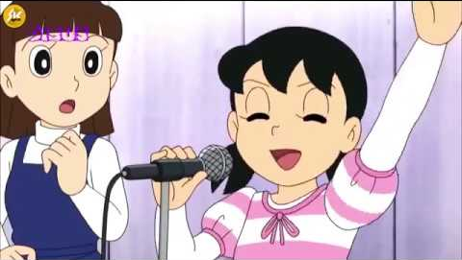
Chant like Shizuka does!

Slide 15
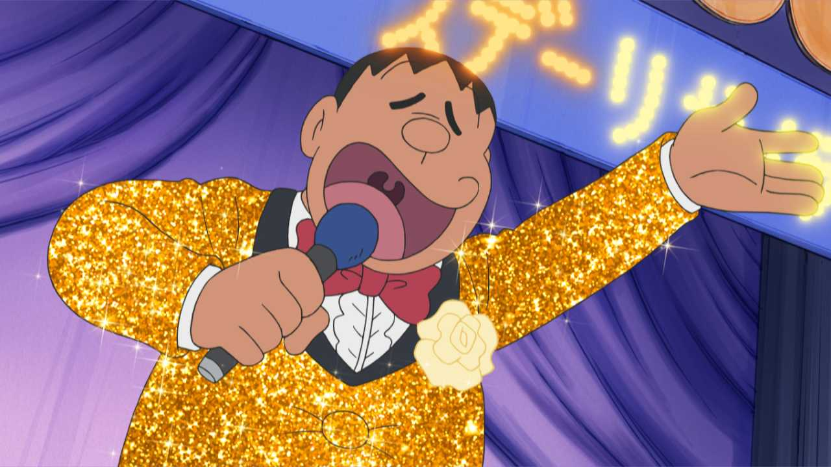
Chant like Jaian does!

Slide 16
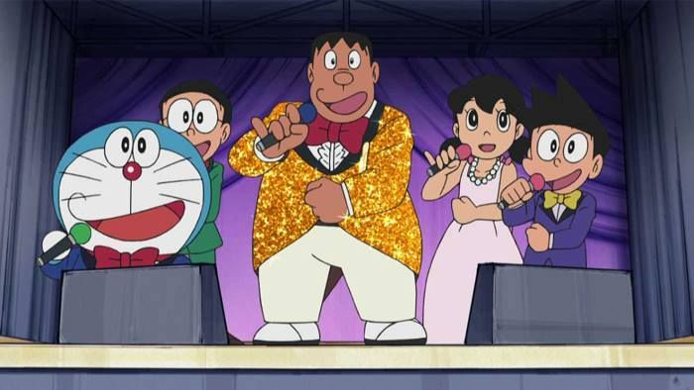
Let’s chant together!

Slide 17

Fun corner
5

