Slide 1
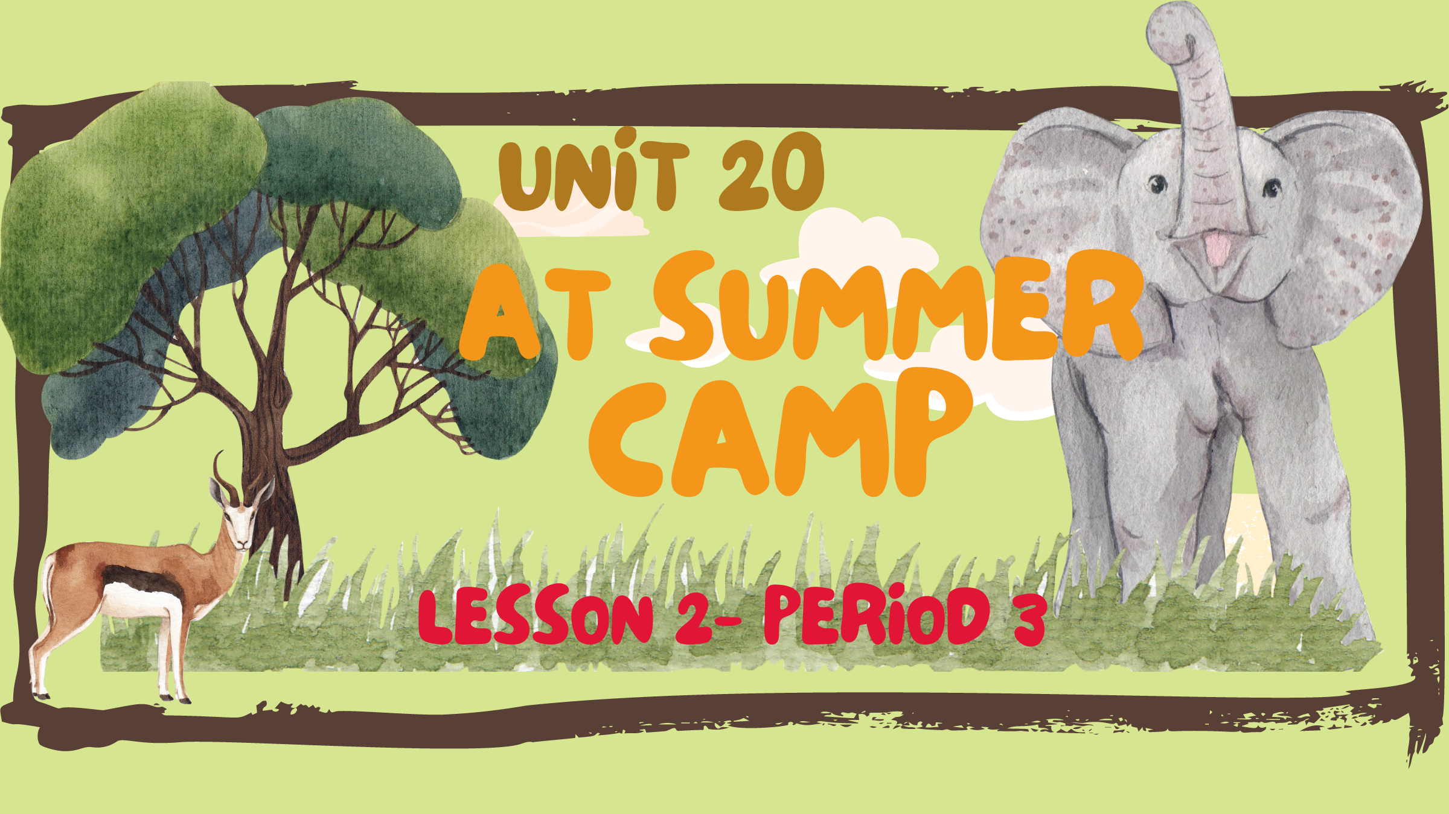

Slide 2


Table of contents
Look, listen and repeat.
Listen, point and say.
01
Warm-up
02
03
04
Let’s talk.
05
Fun corner

Slide 3
01
Warm-up

Slide 4
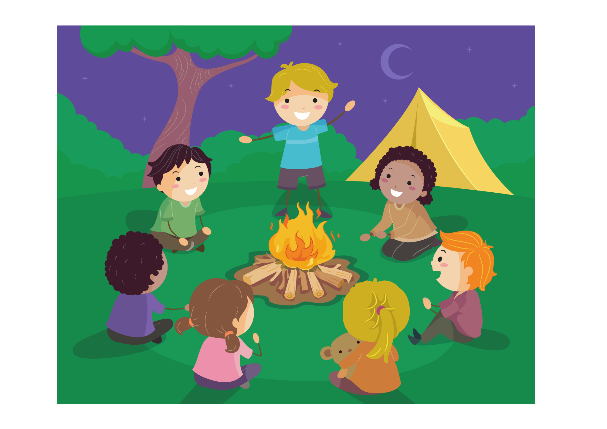
What’s he doing?
He’s telling a story.

Slide 5
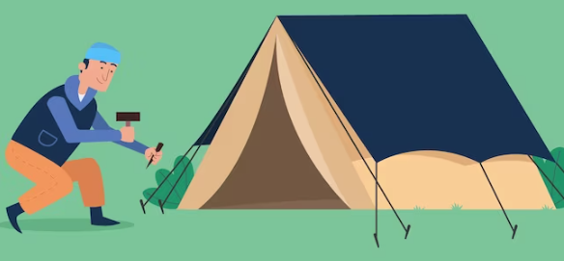
What’s he doing?
He’s putting up a tent.

Slide 6
02
Activity 1
Look, listen and repeat.

Slide 7
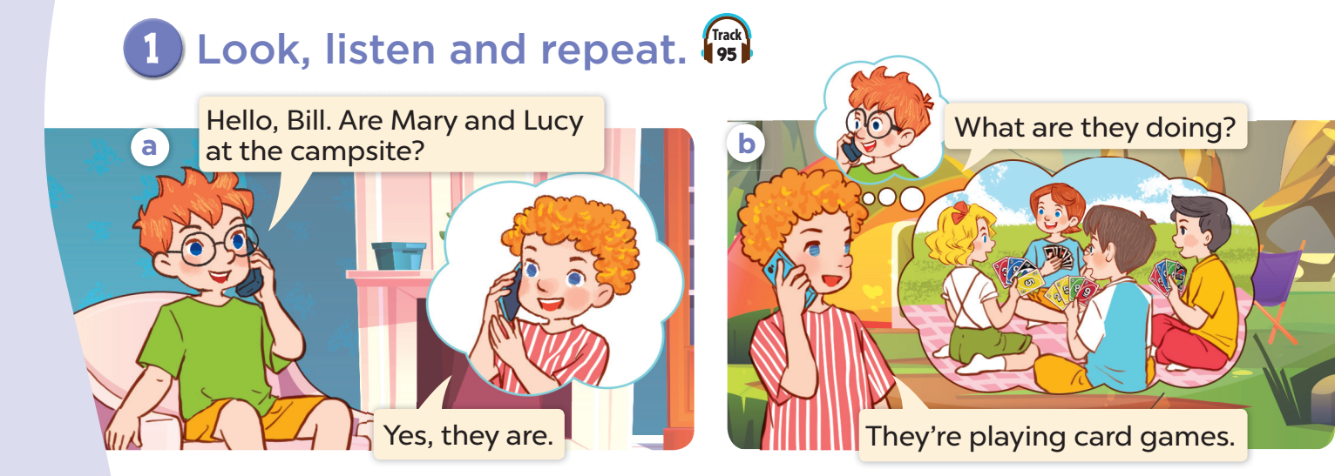

Slide 8
03
Activity 2
Listen, point and say.

Slide 9

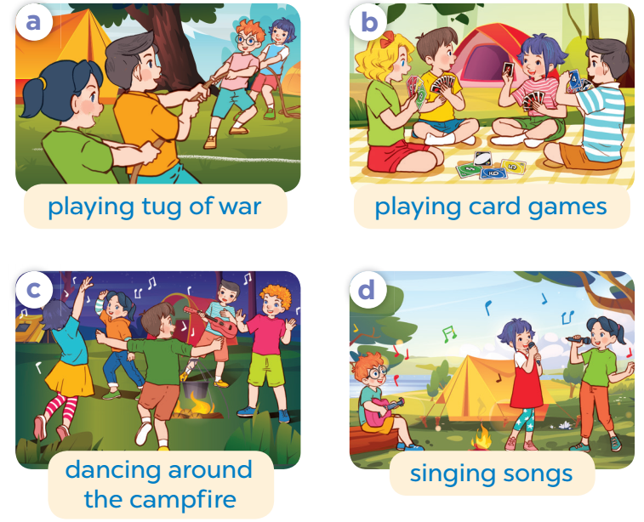
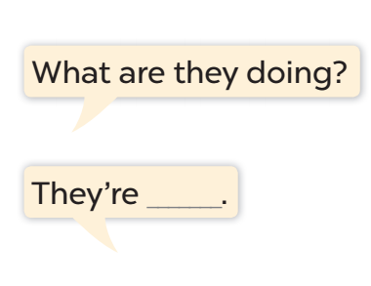

Slide 10

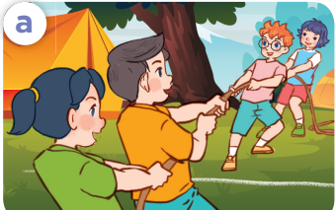
Work in pairs. Role-play.
What are they doing?
They are playing tug of war.

Slide 11
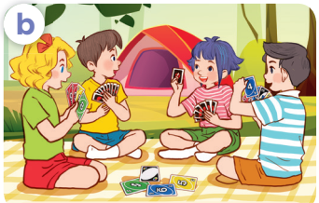
Work in pairs. Role-play.
What are they doing?
They are playing card games.

Slide 12
04
Activity 3
Let’s talk.

Slide 13
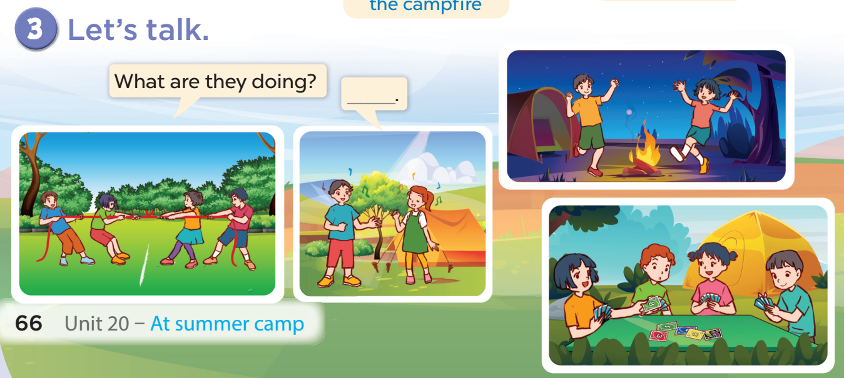


Slide 14
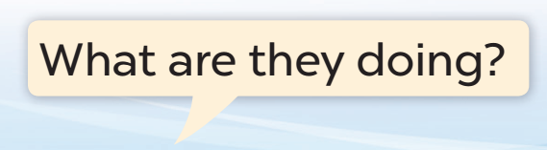
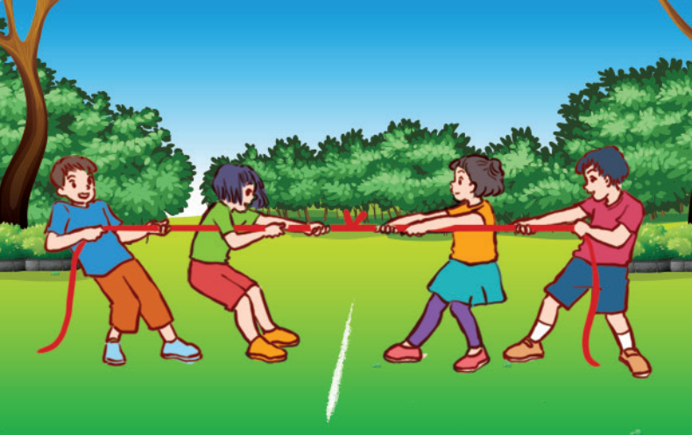

Slide 15
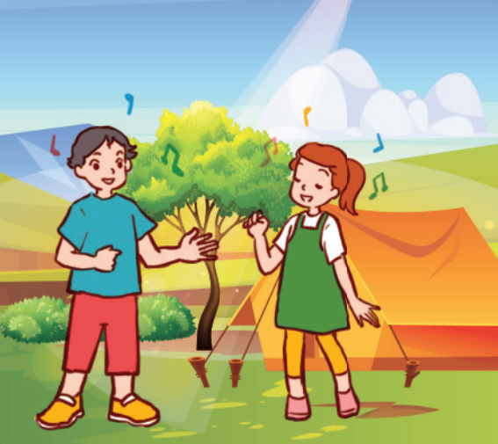

Slide 16
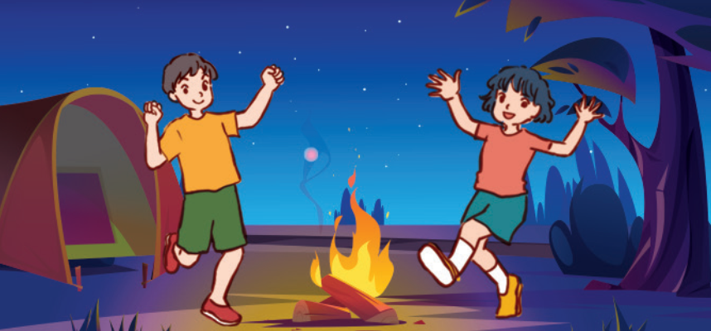

Slide 17
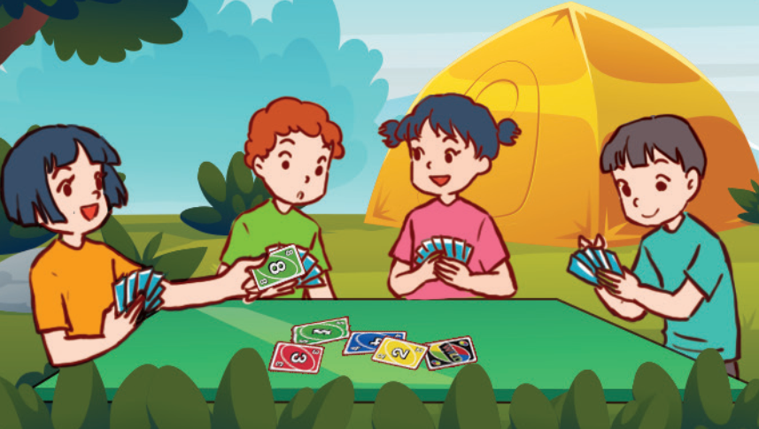

Slide 18
05
FUN CORNER

Slide 19
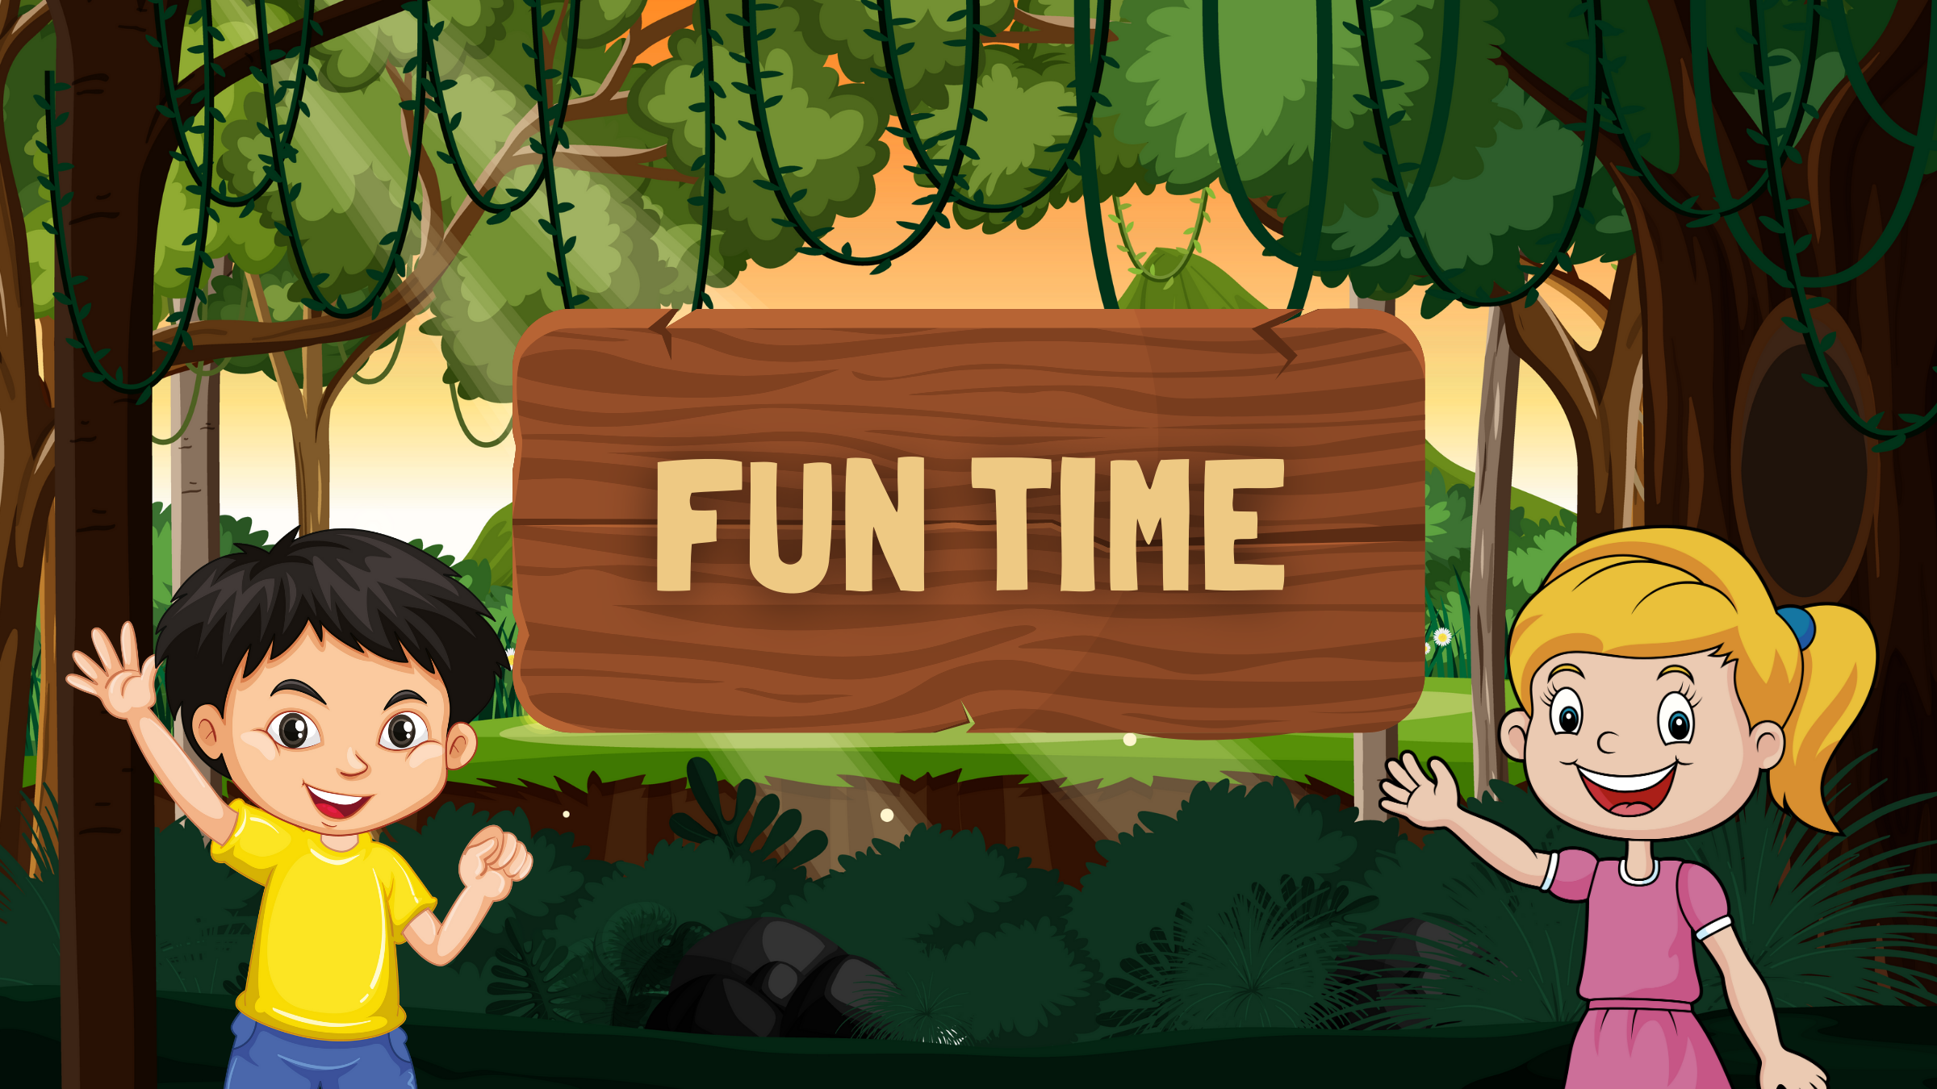
MIMING GAME
Notes:
Pick up some pupils to look at the pictures, then they mime in their own way to express the action.
Teacher asks What are they doing?
The rest say: They are …

