Slide 1







Our Summer Holidays
Lesson 1 - Period 1

Slide 2
Table of contents
01
Warm-up and Review
Look, listen and repeat.
02
Listen, point and say.
03
Let’s talk.
04
05
Fun corner and Wrap-up

Slide 3
01
Warm-up and Review
Let's play!

Slide 4

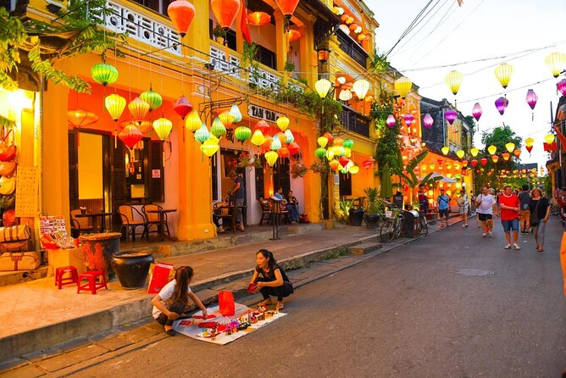
Guess the place
Hoi An Old Town
SHOW

Slide 5
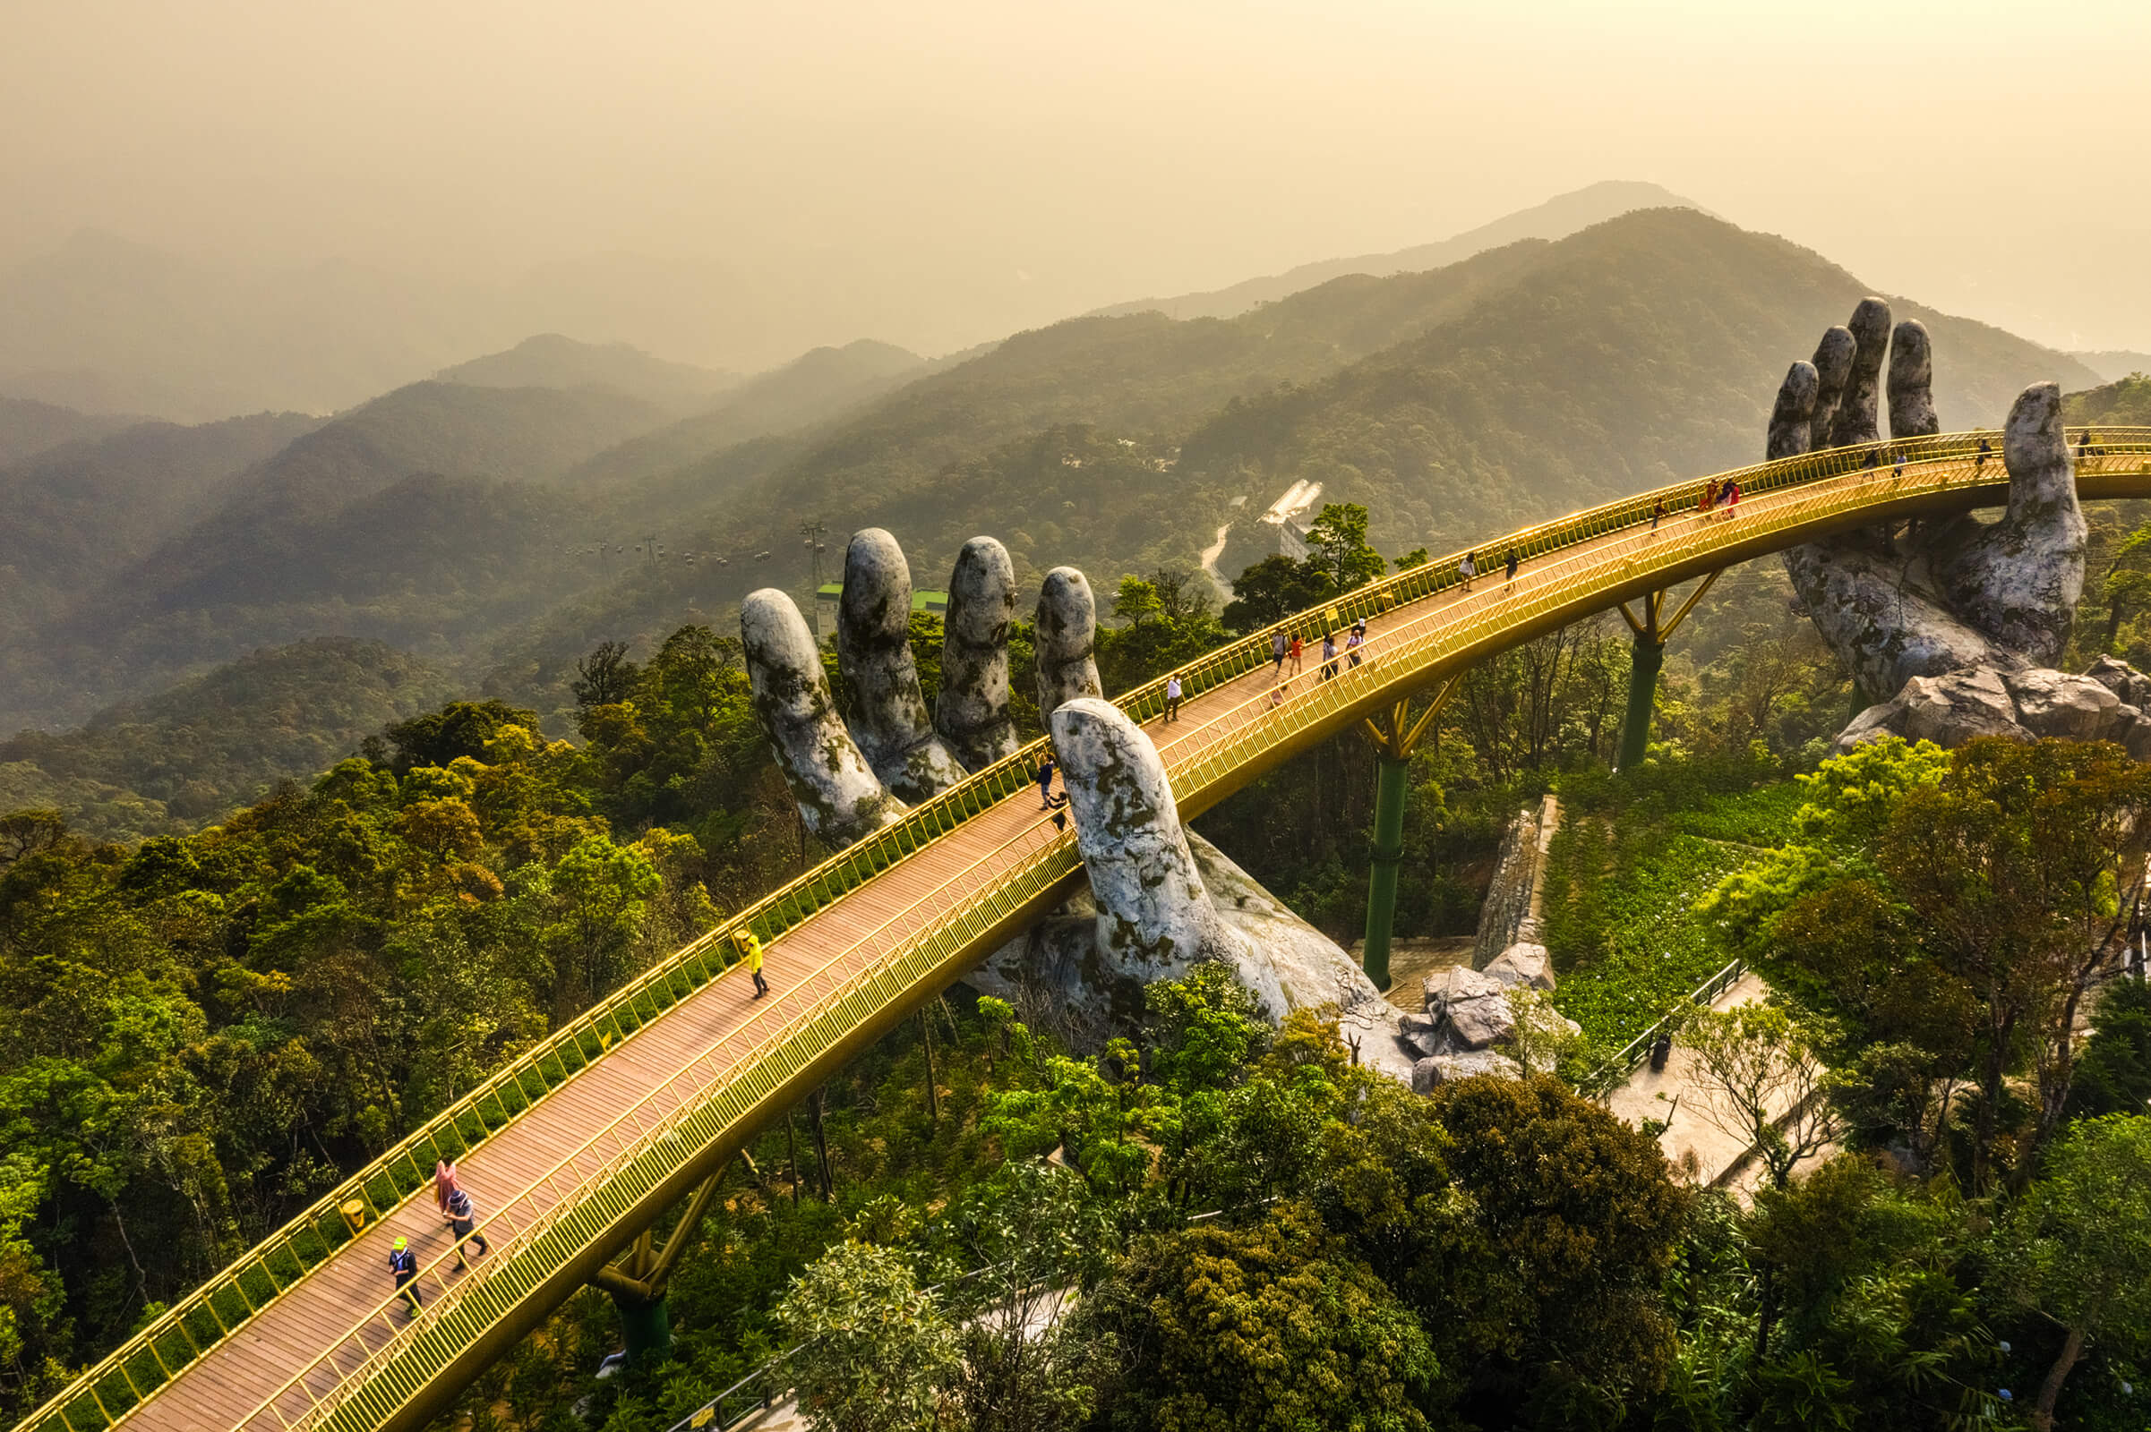
Guess the place
SHOW
Ba Na HillS

Slide 6
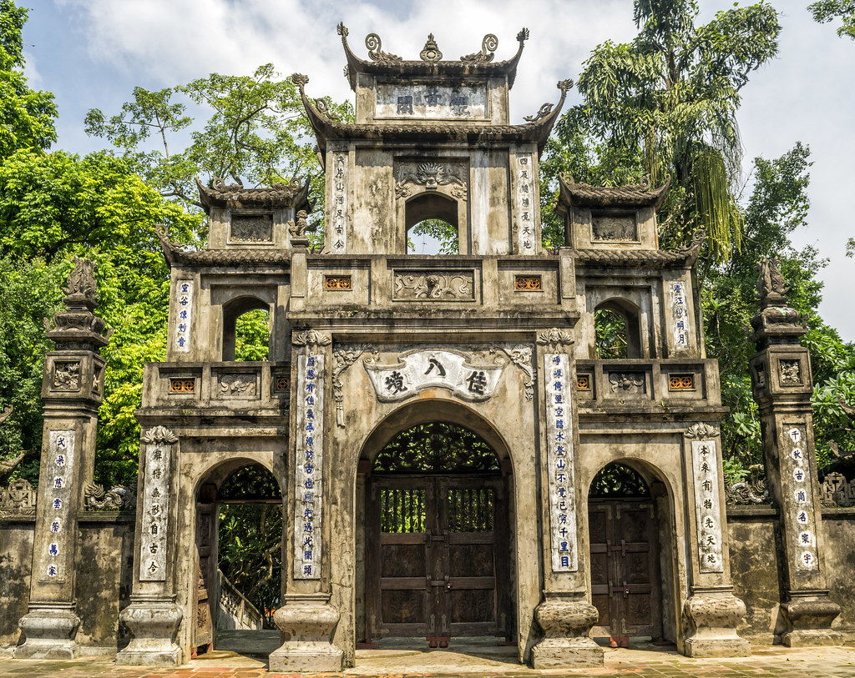
Guess the place
Huong Pagoda
SHOW

Slide 7
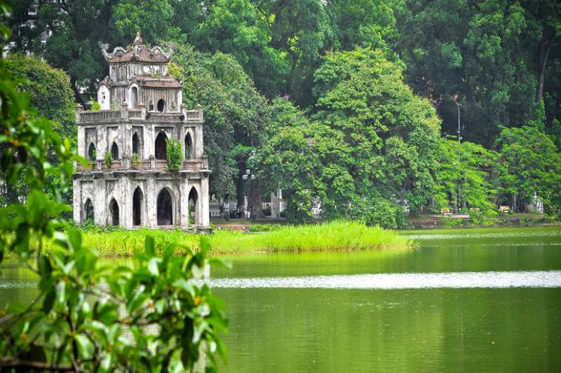
Guess the place
Hoam Kiem Lake
SHOW

Slide 8
02
Look, listen and repeat.

Slide 9
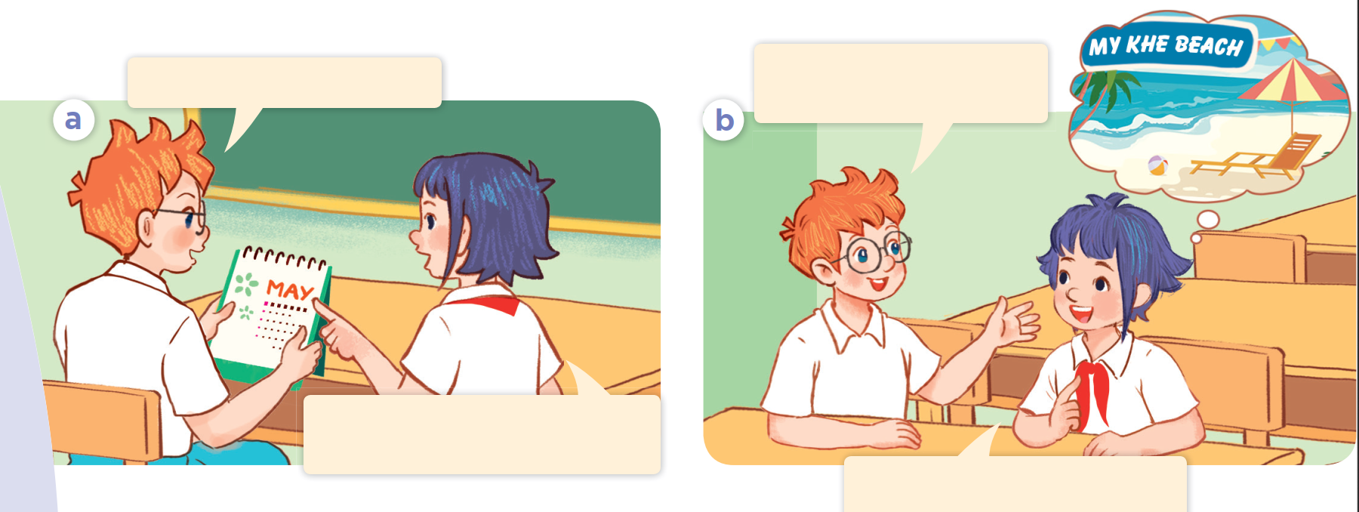
Look at the picture. Who are they?
What are they talking about?

Slide 10
Where are you going
to visit this summer?
Summer’s almost here!
Yes! Our summer holidays start next week.
I’m going to visit My Khe
Beach in Da Nang City.

Slide 11
03
Listen, point and say.

Slide 12
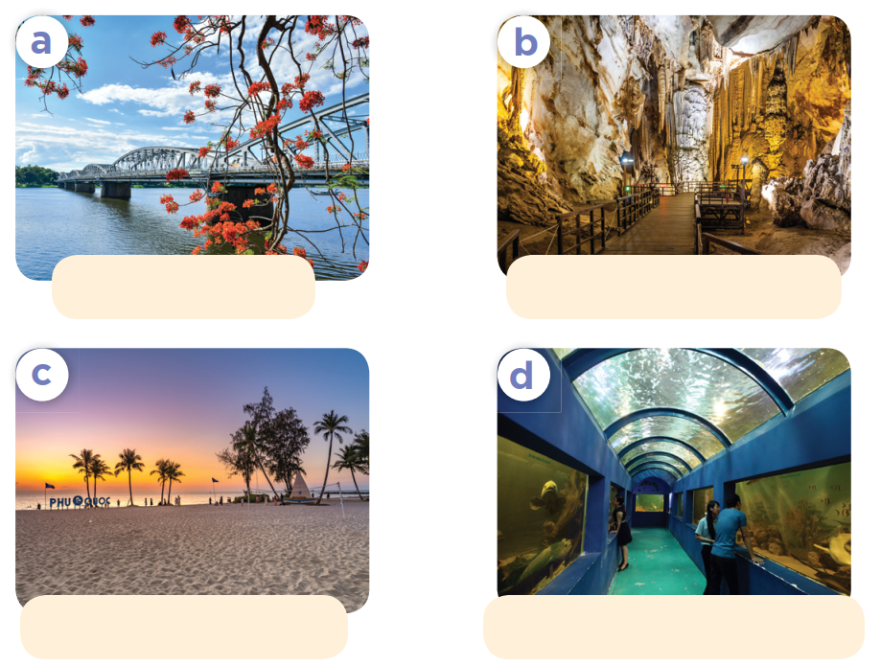
Look at the pictures. Listen and repeat.
Huong River
Phong Nha Cave
Phu Quoc Island
Dam Sen Aquarium

Slide 13

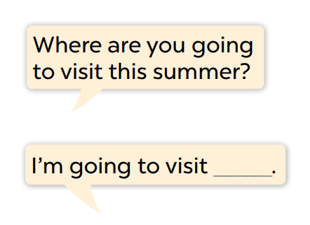
Look and read the question and answer.
Where are you going
to visit this summer?
Huong River
Phong Nha Cave
I’m going to visit ___.
Phu Quoc Island
Dam Sen Aquarium

Slide 14
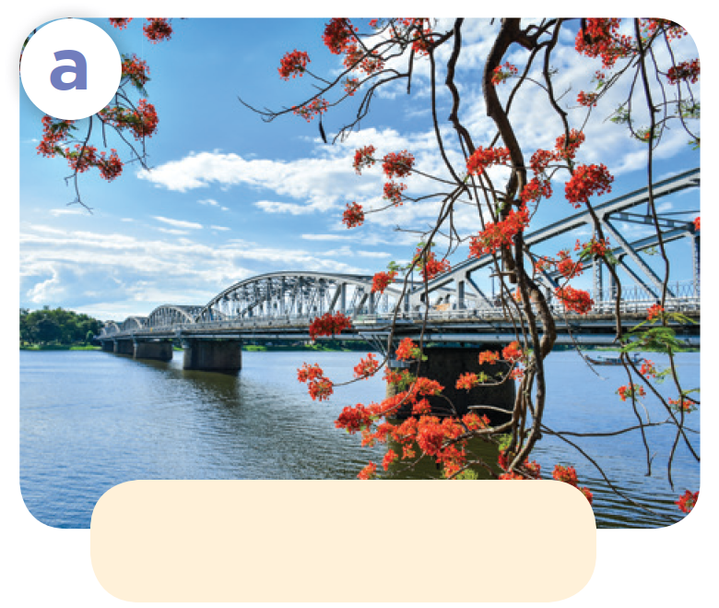
Where are you going to visit this summer?
Huong River
I’m going to visit Huong River.

Slide 15
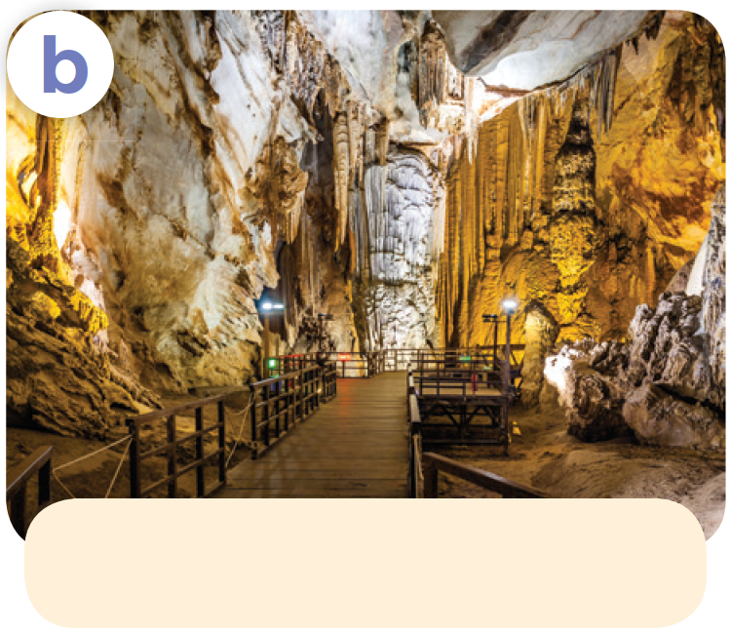
Where are you going to visit this summer?
Phong Nha Cave
I’m going to visit Phong Nha Cave.

Slide 16
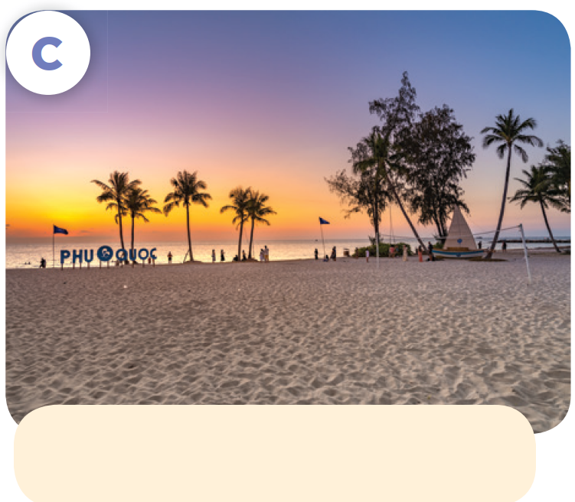
Where are you going to visit this summer?
Phu Quoc Island
I’m going to visit Phu Quoc Island.

Slide 17
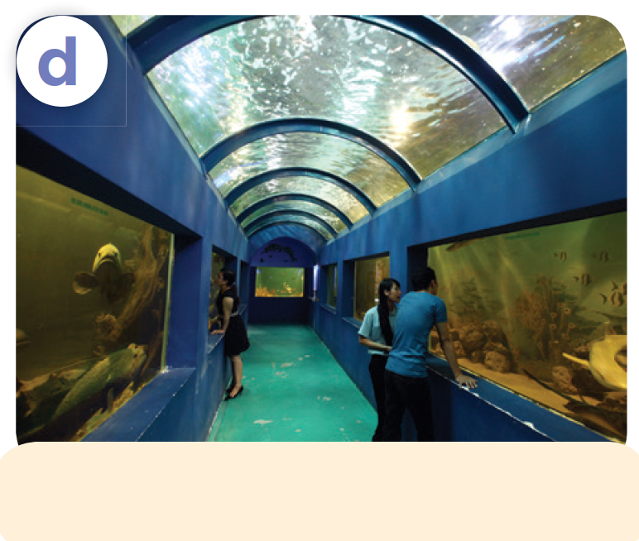
Where are you going to visit this summer?
Dam Sen Aquarium
I’m going to visit Dam Sen Aquarium.

Slide 18
Work in pairs. Ask and answer.
Listen and repeat.
Where are you going
to visit this summer?
Huong River
Phong Nha Cave
I’m going to visit ___.
Phu Quoc Island
Dam Sen Aquarium

Slide 19

04
Let's talk.

Slide 20

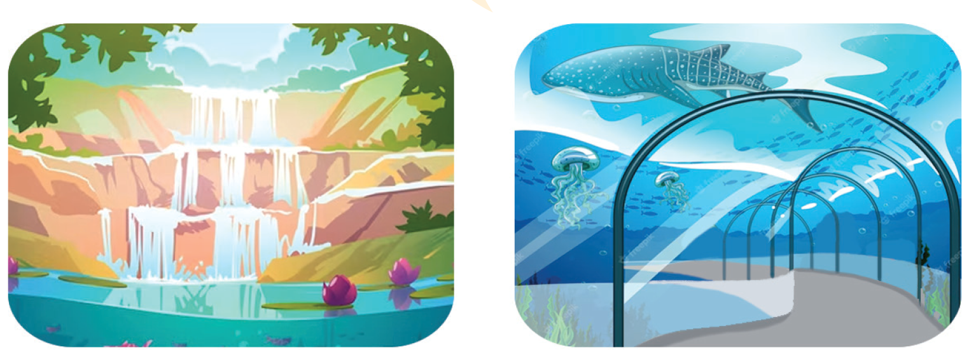
Look and say
Listen and repeat.
Work in pairs. Ask and answer.
Where are you going to visit this summer?
I’m going to visit ___.
river
cave
waterfall
aquarium

