Slide 1

Unit 1. All about me!
Lesson 2 - Period 3

Slide 2

Table of contents
01
Warm-up and review
02
Look, listen and repeat.
03
Listen, point and say.
04
Let’s talk.
05
Fun corner and wrap-up

Slide 3


01
Warm-up and review

Slide 4

Game

Slide 5
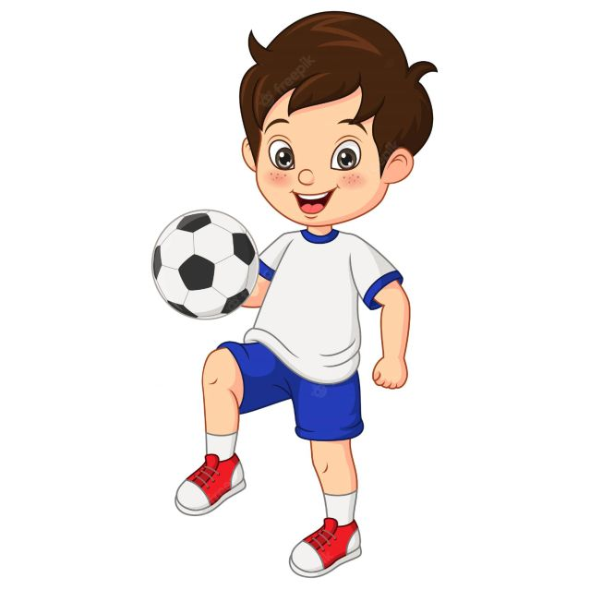

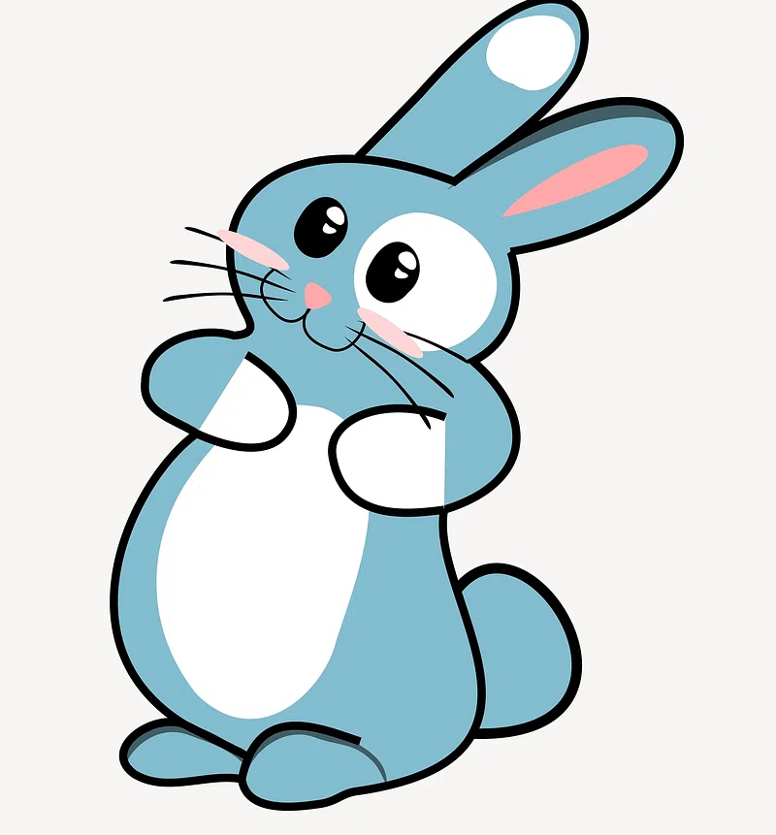


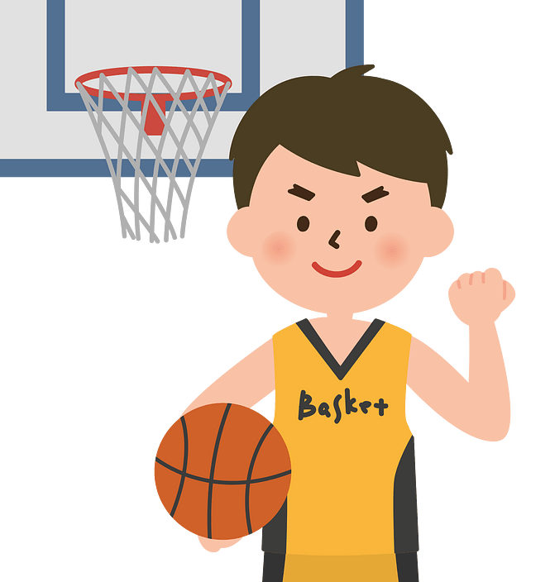


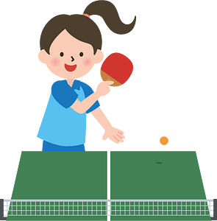

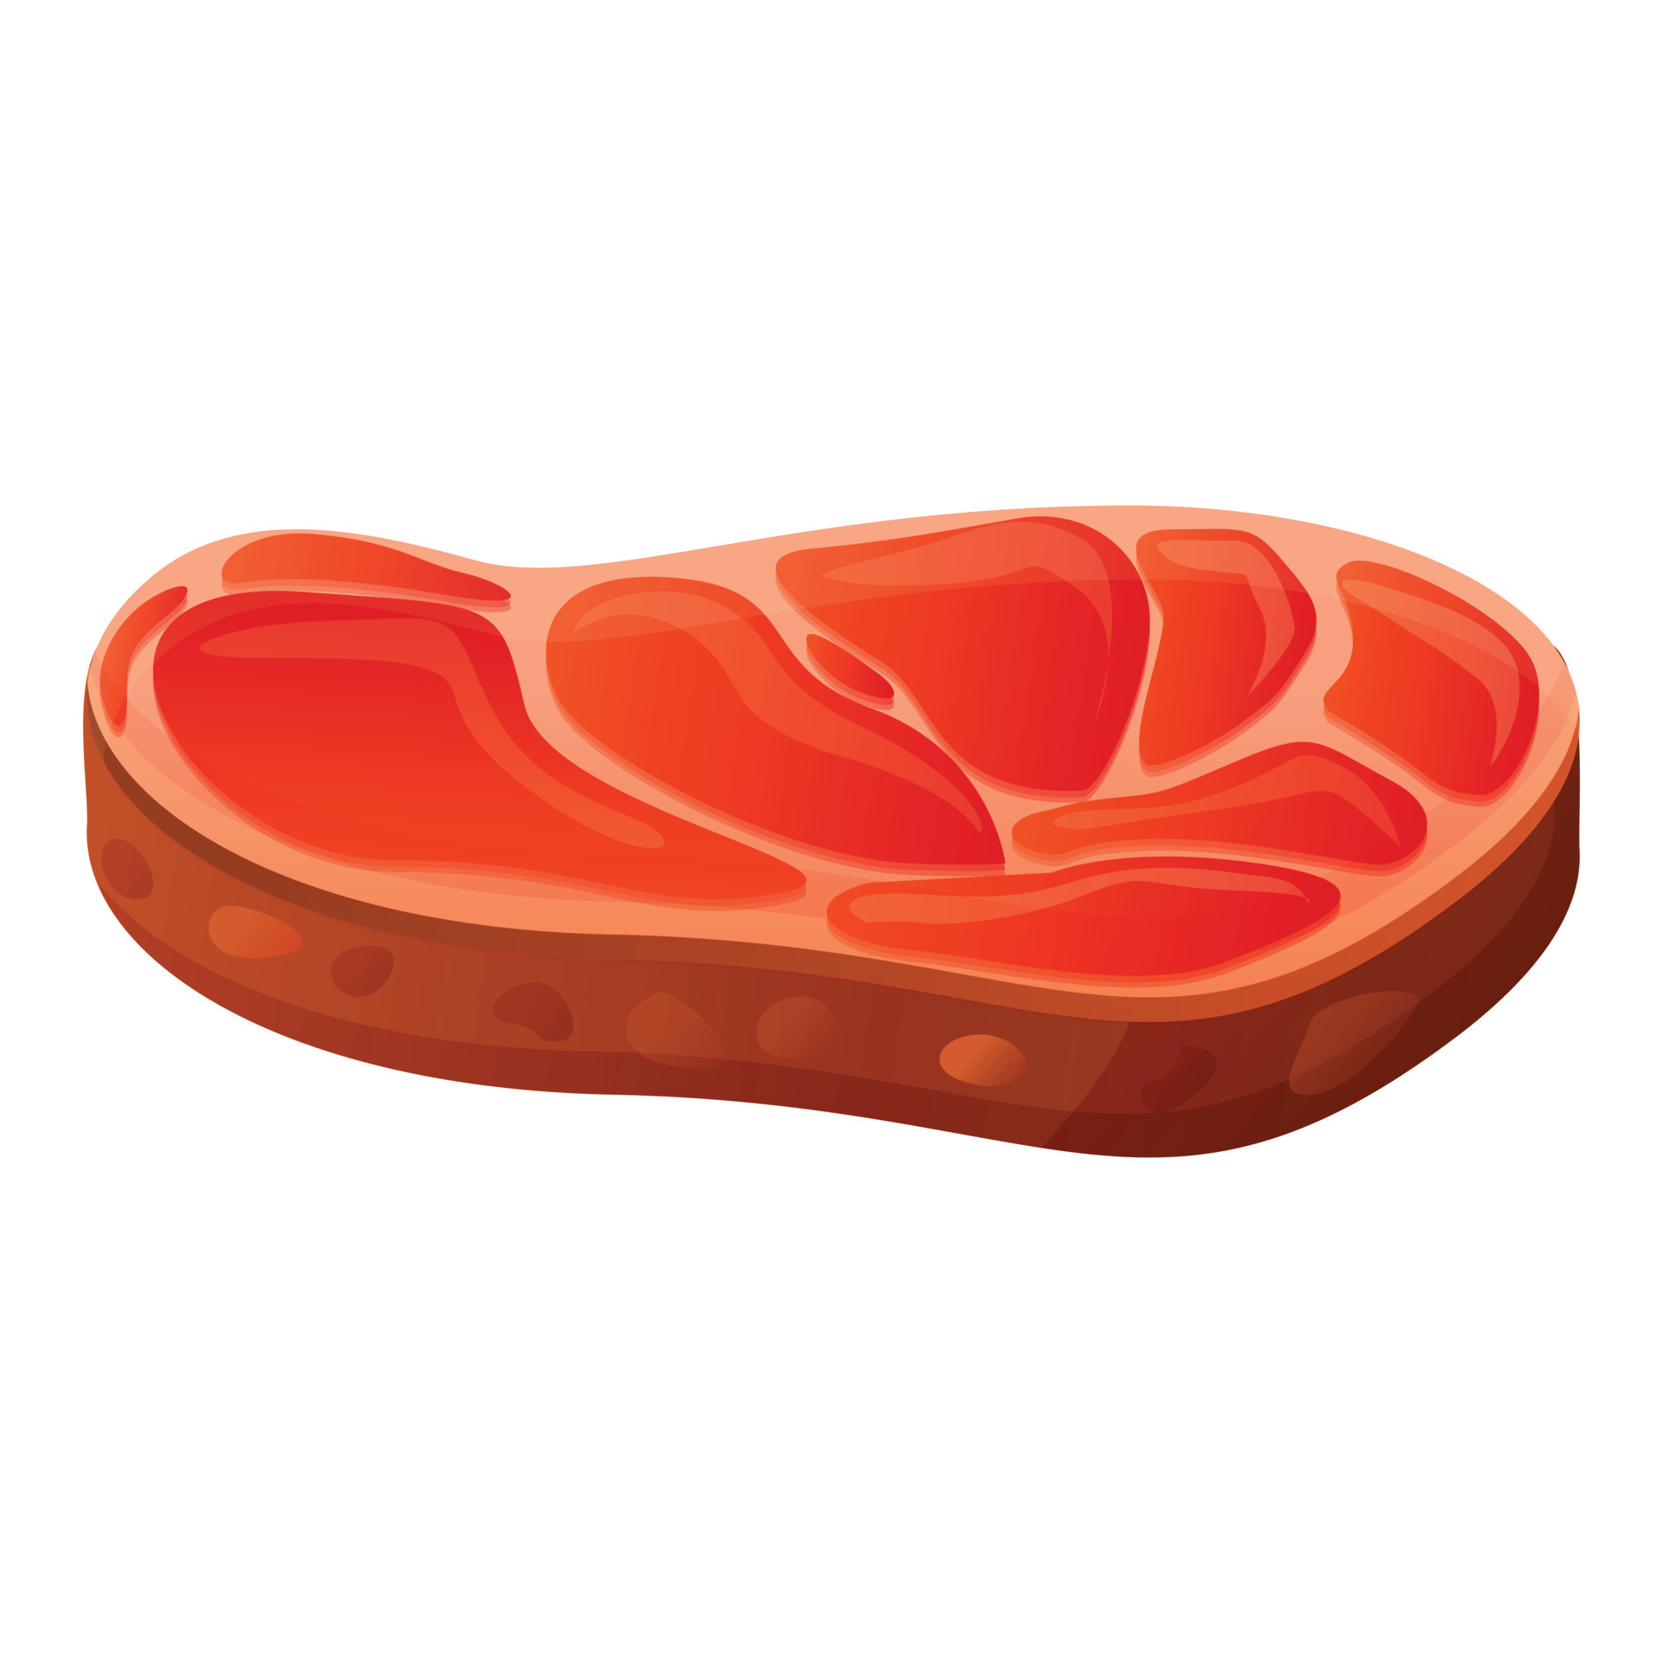






swim
Notes:
Nháy chuột để biến mất hình ảnh và xuất hiện hình ảnh tiếp theo

Slide 6



Slide 7
02
Look, listen and repeat.

Slide 8

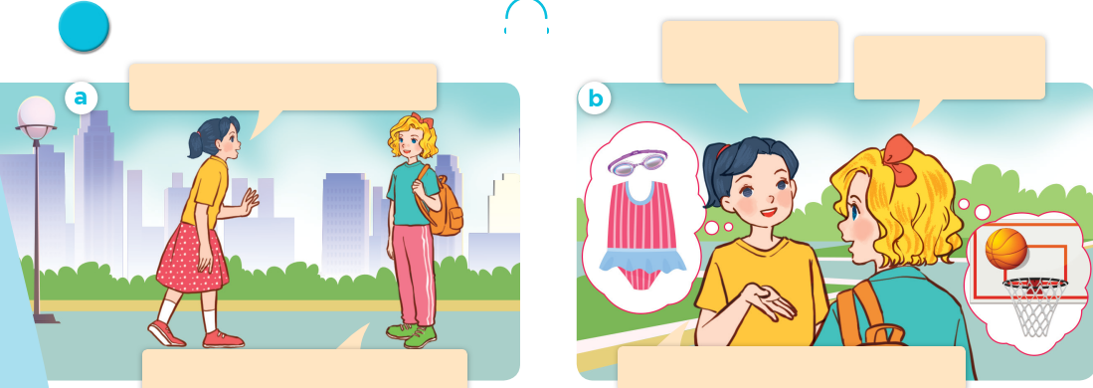
Look, listen and repeat.

Slide 9
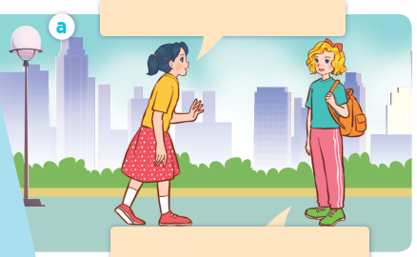
Look, listen and repeat.
Look, listen and repeat.
Where are you going, Mary?
I’m going to the sports centre.
Notes:
Nháy vào hội thoại để nghe lại âm thanh từng câu.

Slide 10
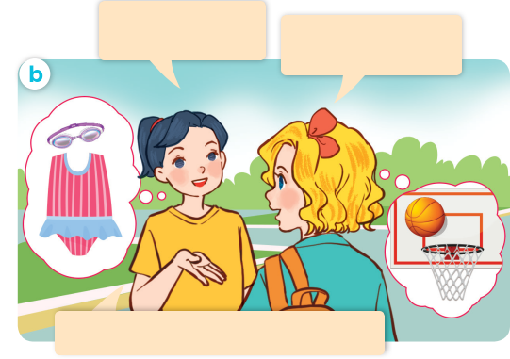
I’m going to the sports centre.
I’m going to the sports centre.
Look, listen and repeat.
Look, listen and repeat.
What’s your favourite sport?
It’s basketball. What about you?
My favourite sport is swimming.
Notes:
Nháy vào hội thoại để nghe lại âm thanh từng câu.

Slide 11
Look, listen and repeat.
Look, listen and repeat.
What’s your favourite sport?
It’s basketball. What about you?
Where are you going, Mary?
I’m going to the sports centre.
My favourite sport is swimming.

Slide 12

What’s your favourite sport?
It’s basketball.

Slide 13
03
Listen, point and say.

Slide 14
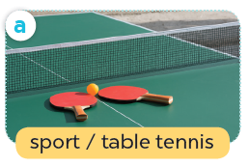
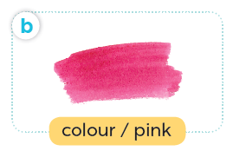
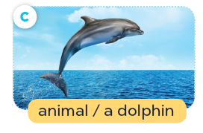
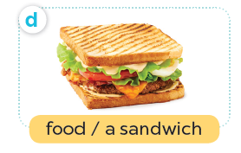
Listen, point and say.

Slide 15
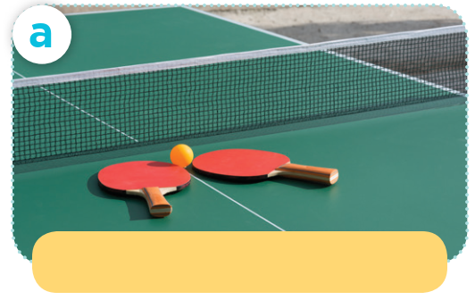
Listen, point and say.
sport / table tennis

Slide 16
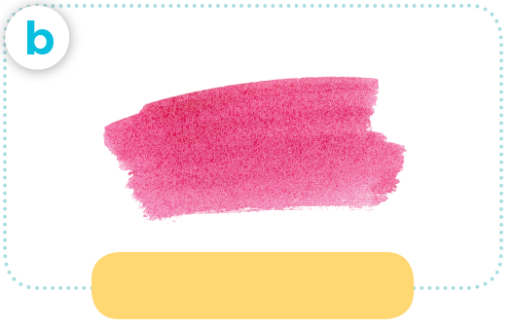
Listen, point and say.
colour / pink

Slide 17
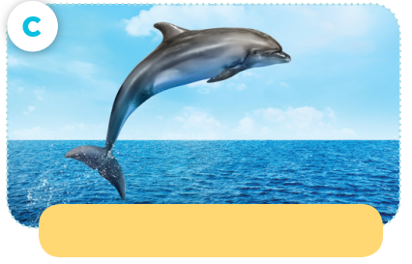
Listen, point and say.
animal / a dolphin

Slide 18
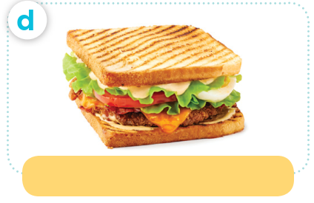
Listen, point and say.
food / a sandwich

Slide 19
https://wordwall.net/resource/95979866

Slide 20

What’s your favourite ____?
It’s ____.

Slide 21
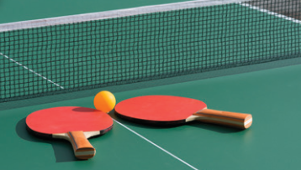
Listen, point and say.
What’s your favourite sport?
It’s table tennis.

Slide 22

Listen, point and say.
What’s your favourite colour?
It’s pink.

Slide 23
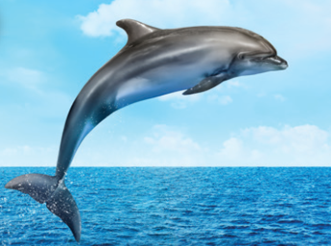
Listen, point and say.
What’s your favourite animal?
It’s a dolphin.

Slide 24
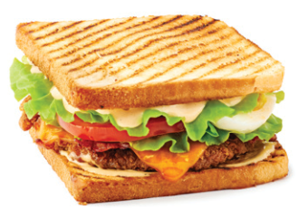
Listen, point and say.
What’s your favourite food?
It’s a sandwich.

Slide 25
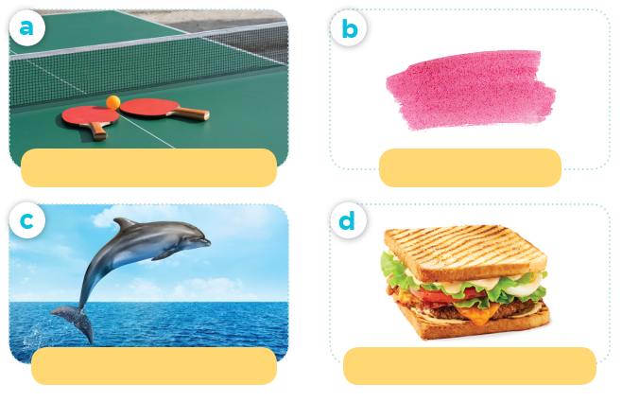
What’s your favourite ____?
sport / table tennis
colour / pink
It’s ____.
animal / a dolphin
food / a sandwich

Slide 26
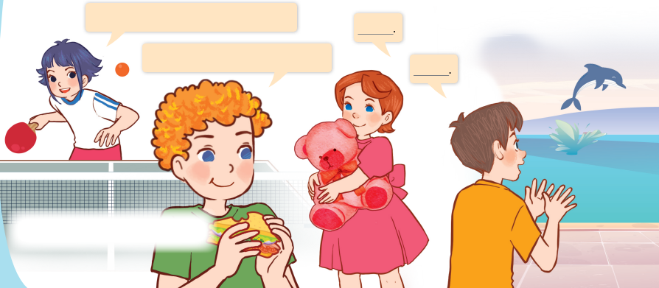
Let’s talk.
Can you tell me about yourself?
What’s your favourite ___?

Slide 27
Can you tell me about yourself?
It’s ____.
What’s your favourite ____?
____.

Slide 28
05
Fun corner and wrap-up

Slide 29

Flash card passing
Game

Slide 30
