Slide 1
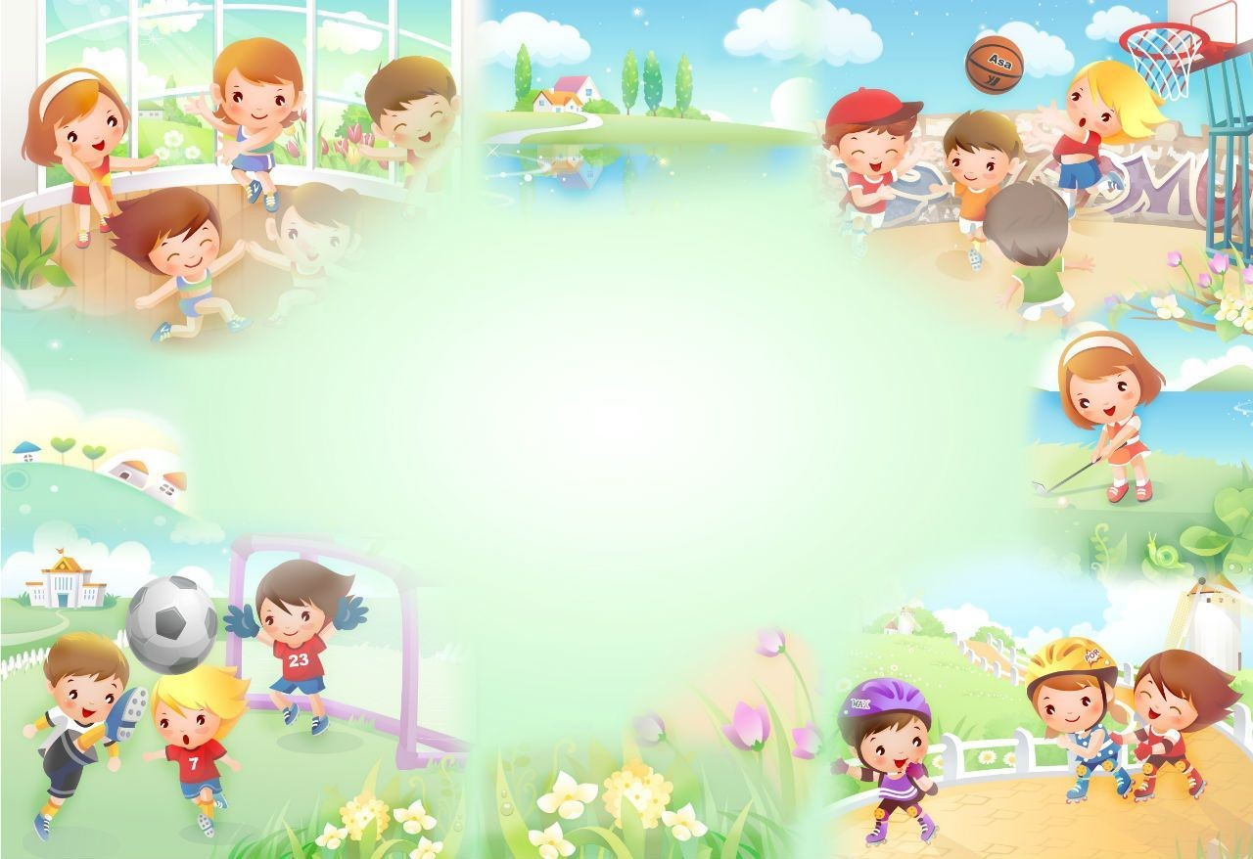
UNIT 4: Our free time activities
Lesson 1 Part 1,2,3

Slide 2

Warm-up
Notes:
Activity 1: Guessing game
How to play:
(dance, sing, play football). T shows on the screen and let Ss guess the activities which are behind those squares.
The team that has the right answer will get 1 point, if they guess wrong they lose their turn, and give a turn to the next team.
T asks questions with some Ss “what can you do?” - Ss answer “ I can (dance)”

Slide 3


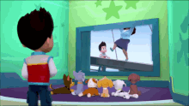
Watch a cartoon
Notes:
Vocabulary
T introduces new words (hippo, elephant, crocodile) (showing picture on the screen)
T pronounces those words (the words will appear after the pictures)
Ask the whole class to read loudly, have students read in chorus, then in groups and individuals. (each word 2-3 times).
After having all the words on the screen, have students read in chorus, then in groups and individuals.

Slide 4
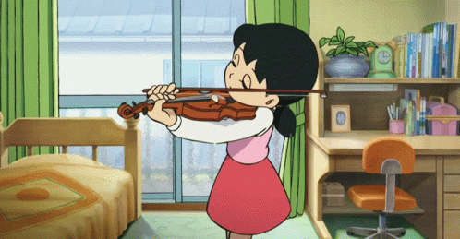
Play the violin

Slide 5


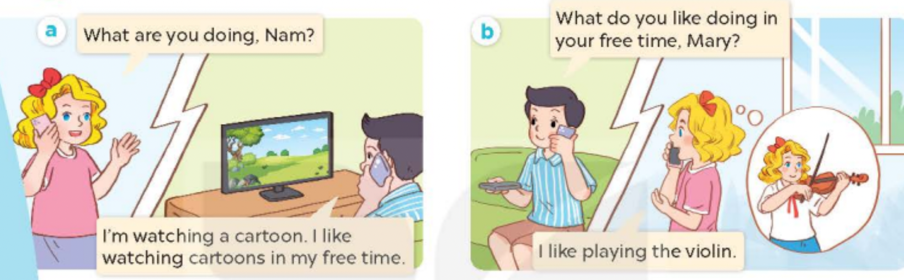

Slide 6
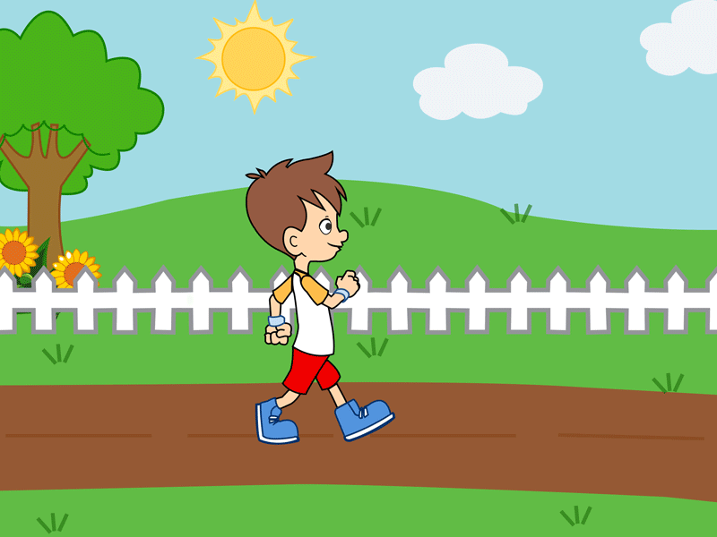
Go for a walk

Slide 7
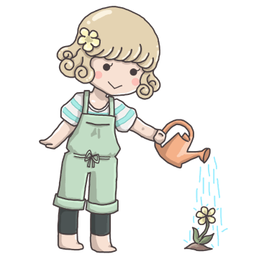
Water the flower

Slide 8

Surf the Internet

Slide 9
Warm-up
find the match
Notes:
Activity 1: Guessing game
How to play:
(dance, sing, play football). T shows on the screen and let Ss guess the activities which are behind those squares.
The team that has the right answer will get 1 point, if they guess wrong they lose their turn, and give a turn to the next team.
T asks questions with some Ss “what can you do?” - Ss answer “ I can (dance)”

Slide 10

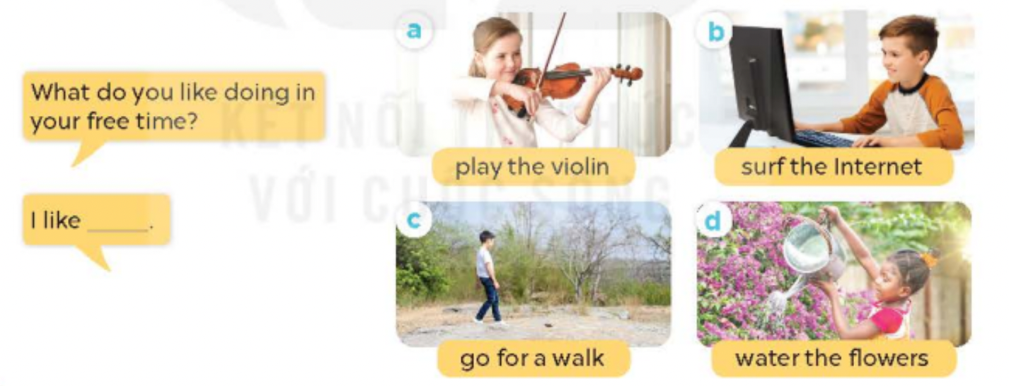

Slide 11


What do you like doing in your free time ?
I like + Ving

Slide 12


What do you like doing in your free time ?
I like watching a cartoon

Slide 13

What do you like doing in your free time ?
I like _____

Slide 14
Guessing GAME
Notes:
Activity 1: Guessing game
How to play:
(dance, sing, play football). T shows on the screen and let Ss guess the activities which are behind those squares.
The team that has the right answer will get 1 point, if they guess wrong they lose their turn, and give a turn to the next team.
T asks questions with some Ss “what can you do?” - Ss answer “ I can (dance)”

Slide 15
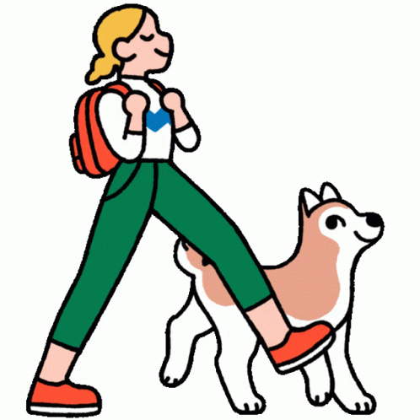

2
1
4
3
5
6

Slide 16
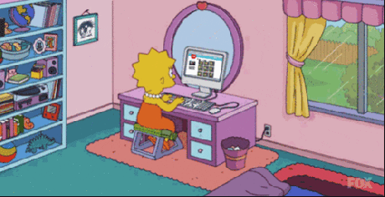
2
1
5
3
4
6

Slide 17
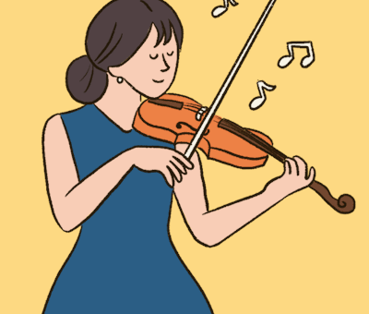
5
1
3
2
6
4

Slide 18

3
6
5
1
2
4

Slide 19


