Slide 1



GAME
little
The
bee

Slide 2

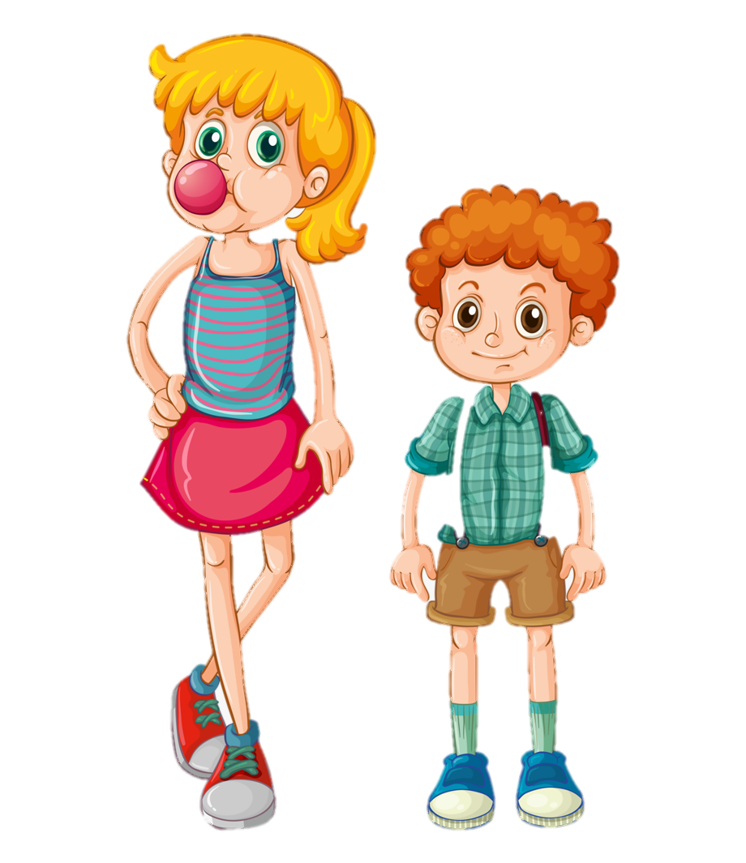


Question 1:
The boy is ………………… than the girl.
A. shorter
B. taller
C. older
Notes:
Click to the flower to check the answer.
Mouse click / enter to move to next question.

Slide 3
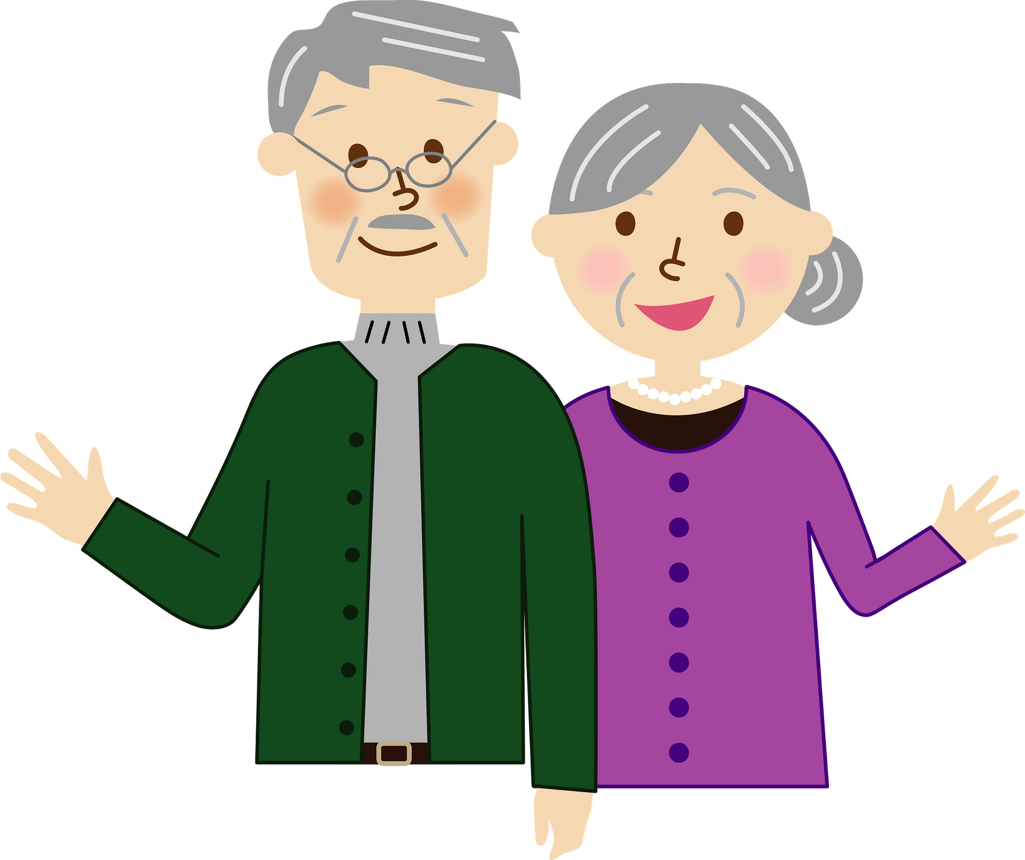
Question 2:
My grandparents are …………………. .
A. tall
B. old
C. young
Notes:
Click to the flower to check the answer.
Mouse click / enter to move to next question.

Slide 4
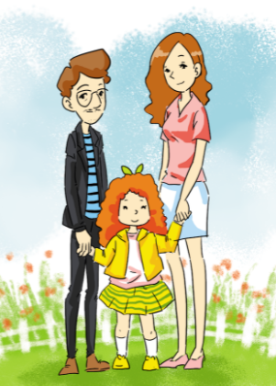
Question 3:
My dad is short and ……..…….. .
A. strong
B. slim
C. big
Notes:
Click to the flower to check the answer.
Mouse click / enter to move to next question.

Slide 5
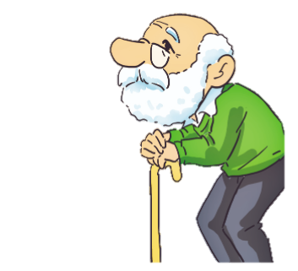
Question 4:
I am ……………… than my grandfather.
A. young
B. older
C. younger
Notes:
Click to the flower to check the answer.
Mouse click / enter to move to next question.

Slide 6


