Slide 1
Unit 1
My friends
Lesson 3 - Period 5

Slide 2
01
Warm-up
The Hangman Game: Country names
Notes:
Words used: Malaysia, America, Australia, Japan, England, Singapore
Setup the game by drawing a gallow and a underline for each letter in the unknown word.
As letters in the word are guessed, write them above the cooresponding underline. If a letter not in the word is guess, draw a picture of a person on the gallow–one part for each incorrect letter guess.
Most frequently, the person is drawn in 6 parts (for 6 letter guesses) in the order: head, body, left leg, right leg, left arm, right arm. If too many letters which do not appear in the word are guessed, the player is hanged (and loses).

Slide 3
02
Activity 1
Look, listen and repeat.

Slide 4
Australia
Look at the last letters.
a
America
They look similar.
But the sounds are different.
ia
ia
Malaysia

Slide 5
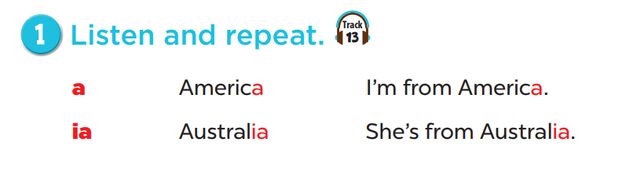
Listen and repeat.

Slide 6
Work in groups, practice.

Slide 7
03
Activity 2
Listen and circle.

Slide 8
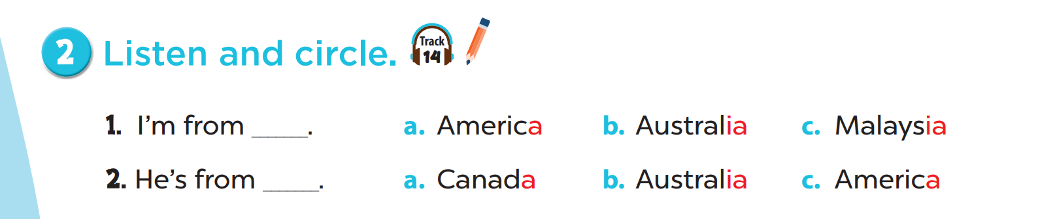

Slide 9
04
Activity 3
Let's chant.

Slide 10
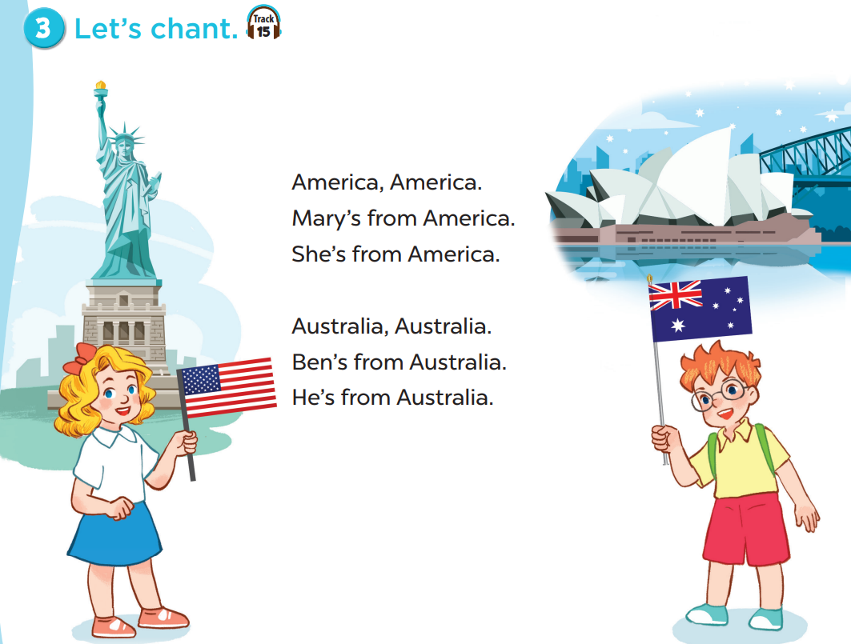

Slide 11
05
Fun time

Slide 12
More words
Country names

Slide 13
Slap the board!

Slide 14
Listen and choose.
a
ia
America

