Slide 1









Our home
Lesson 1 - Period 1

Slide 2



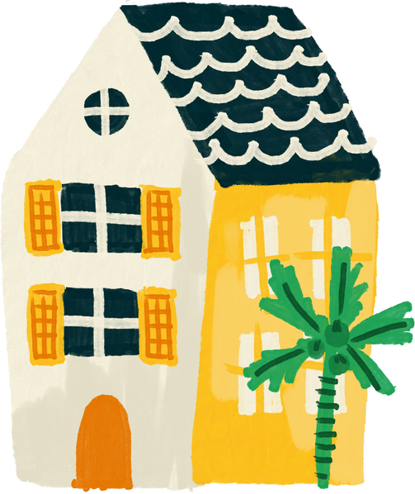

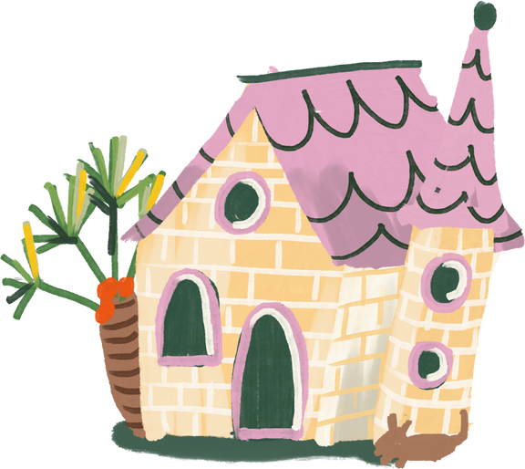
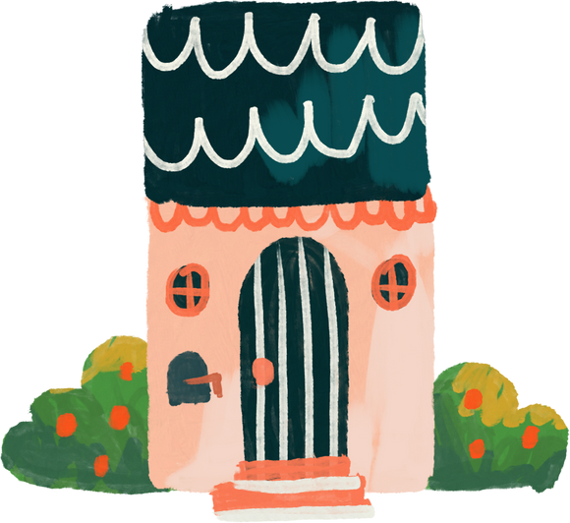
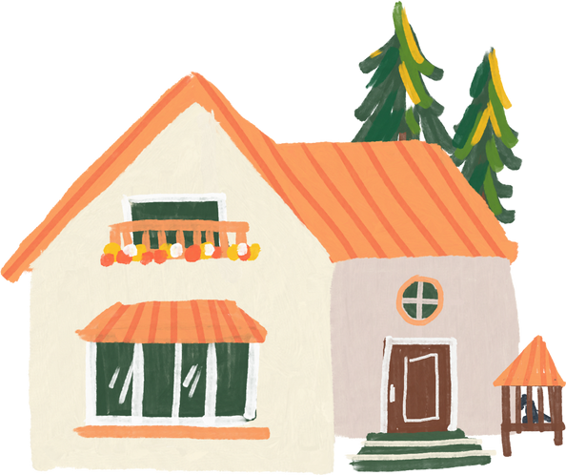
01
Warm-up and review

Slide 3




Guess the key word
Collect the letters.
E
O
HOME
M
H
Next Activity

Slide 4
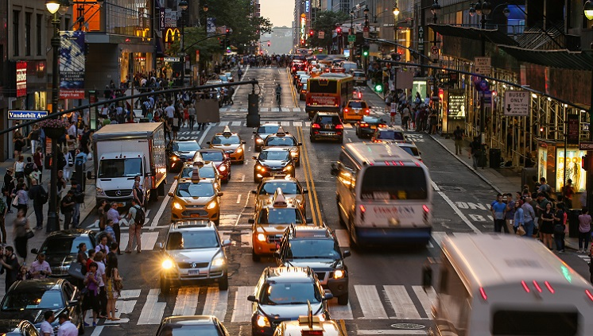
It's a busy .
st_ _e_
street

Slide 5
02
Look, listen and repeat.

Slide 6
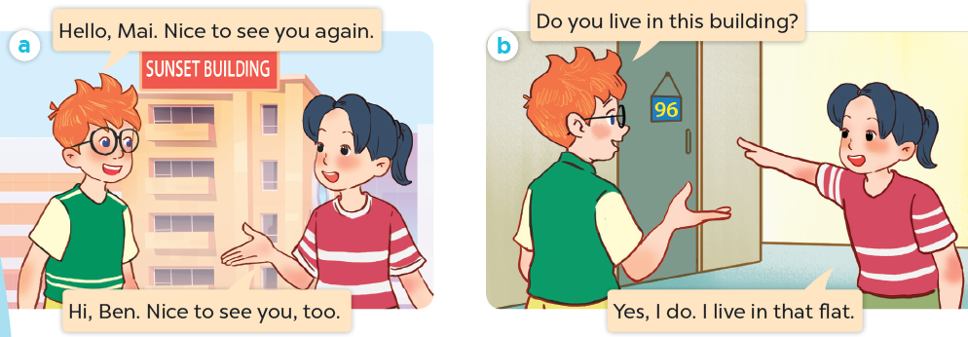
What are they talking about?
Where are they?
Who are they?

Slide 7
Look, listen and repeat.

Slide 8
03
Listen, point and say.

Slide 9
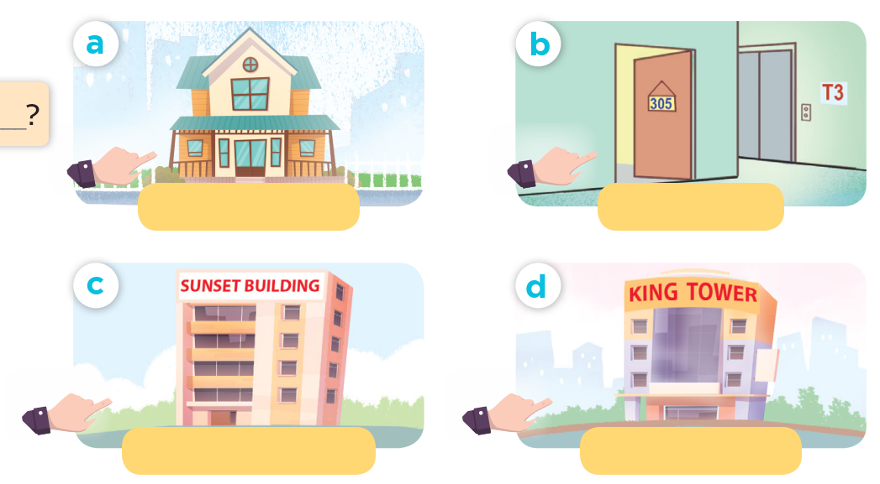
Look and say.

Slide 10
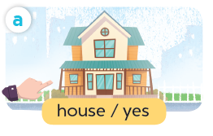
Listen, point and say.
house / yes

Slide 11
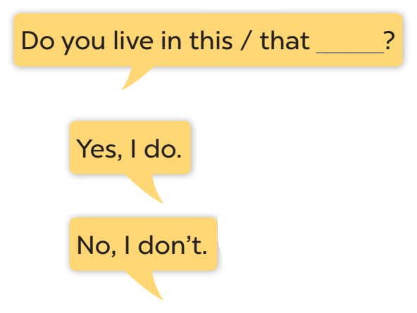




Slide 12
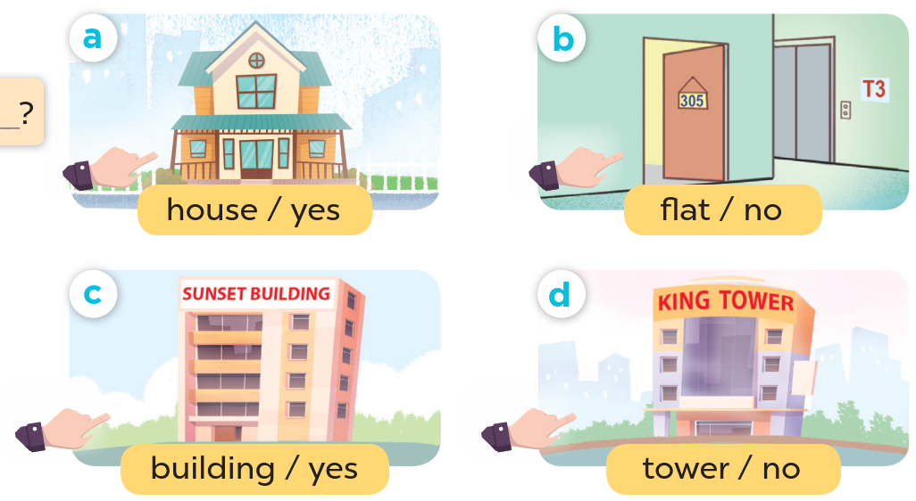
Look at the hands.

Slide 13
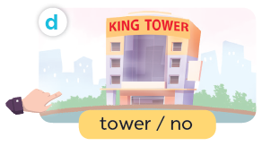
Listen, point and say.
Do you live in that tower?
No, I don't.
tower / no

