Slide 1


Slide 2
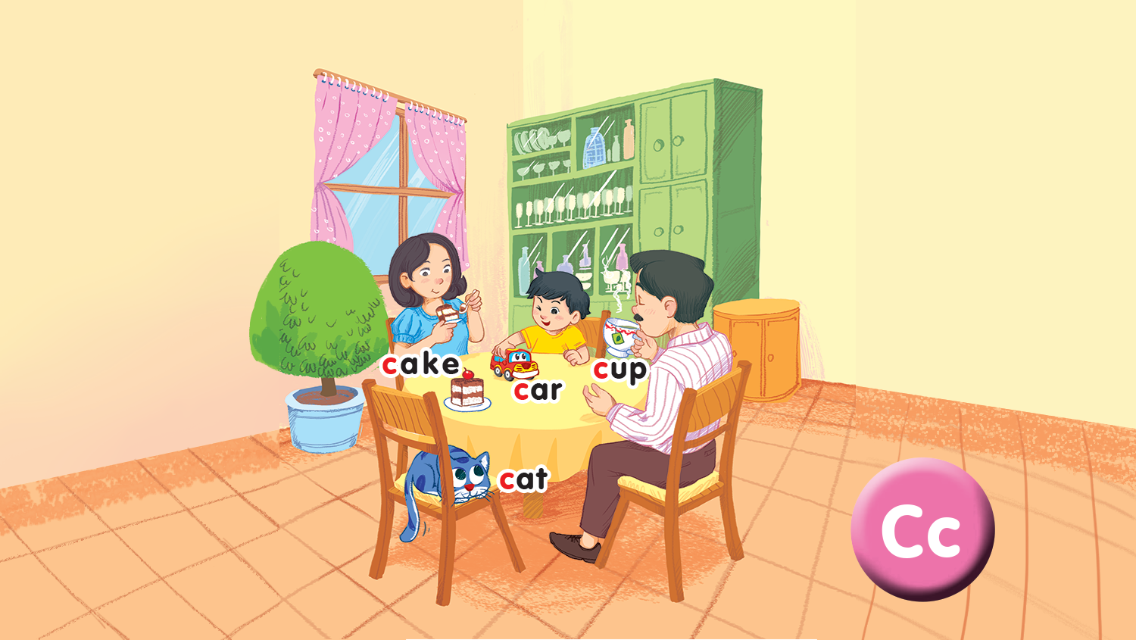
Unit 2 - Lesson 2
In the dining room
Notes:
Goals:
Pupils will be able to say the sound of the letter C/c and the words cake, car, cup, cat in a chant.
Pupils will be able to listen, recognize the words and tick the correct boxes.
Pupils will be able to trace the letter C/c (upper case and lower case).

Slide 3

Warm-up
Notes:
Goal: Warm up and revise the unit keywords.
Time: 3 minutes
Spinning Wheel
Have pupils play the game spinning wheel in groups. When the wheel stops, say the picture. For example, c, c (cup)
Click on Start/Stop to turn on and off the wheel.

Slide 4
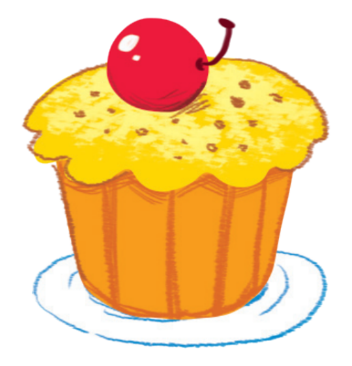
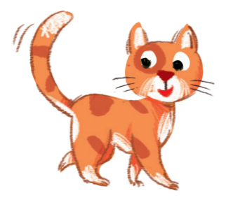




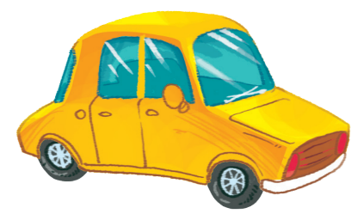
START/STOP

Slide 5
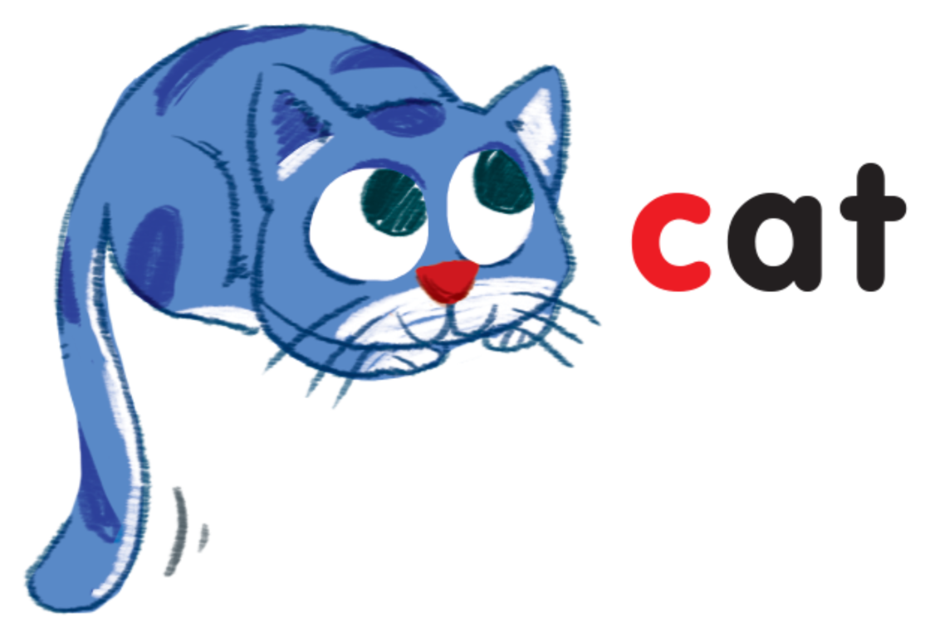





Slide 6
3.Listen and chant
C, c, a cup.
C, c, a cake.
A cup and a cake.
C, c, a cat.
C, c, a car.
A cat and a car.
Notes:
Step 2
Goal: Pupils will be able to chant and clap along.
Time: 3 minutes
Play the recording, have pupils listen and clap along.
Play the recording, have pupils listen, clap and chant along
+ Round 1. Have pupils listen and clap along.
+ Round 2. Have pupils listen and do the TPR actions with teacher.
+ Round 3. Have pupils listen and do the actions and chant along.
+ Repeat round 3 several times.
+ Revise the letter C/c by writing in the air.
Step 3
Goal: Pupils will be able to chant and clap along in pairs.
Time: 3 minutes
Have pupils chant along in pairs.

Slide 7
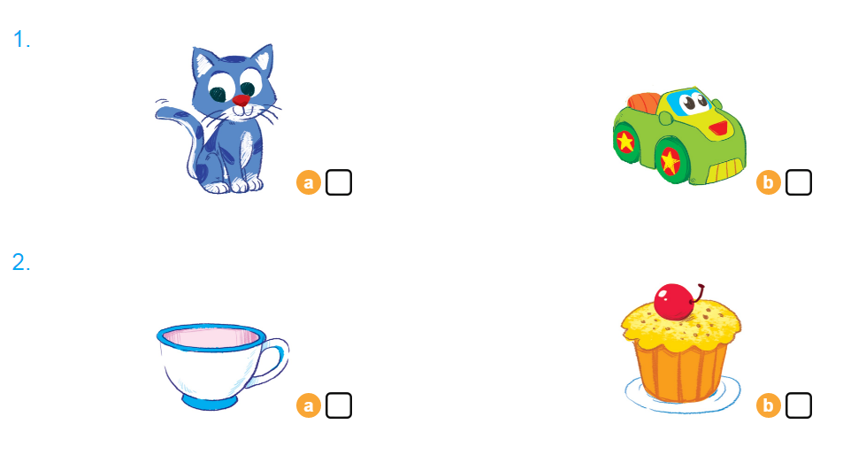

4. Listen and tick

Slide 8
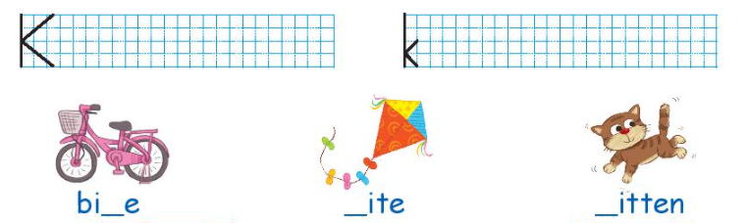
5. Look and write

Slide 9
Game
Notes:
Goal: Revise the words and chant.
Time: 5 minutes
Spinning Wheel
Have pupils play the game spinning wheel in groups.
When the wheel stops, say the picture. For example, c, c (cup).

Slide 10
Goodbye
Notes:
Goodbye
Time: 2 minutes
Repeat the words with TPR actions. Goodbye to the words.

Slide 11
Goodbye

Slide 12
Goodbye

Slide 13

Goodbye
cup

