Slide 1


Time and daily routines
2
Lesson 3 - Period 6

Slide 2
Table of contents
Warm-up and review
04
01
02
03
Project
05
Fun corner & wrap-up
Read and match.
Let’s write.

Slide 3
01
Warm-up & review

Slide 4

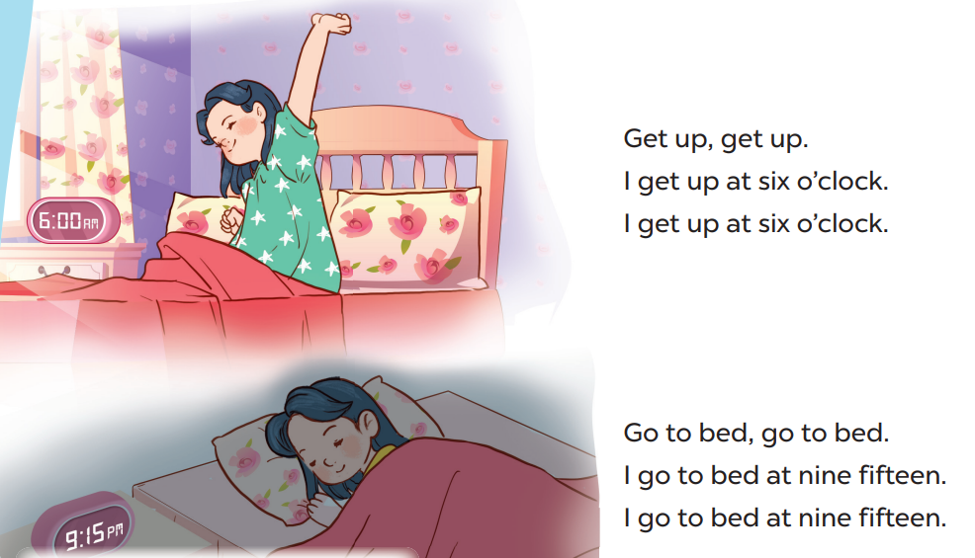

Slide 5
02
Read and match.

Slide 6
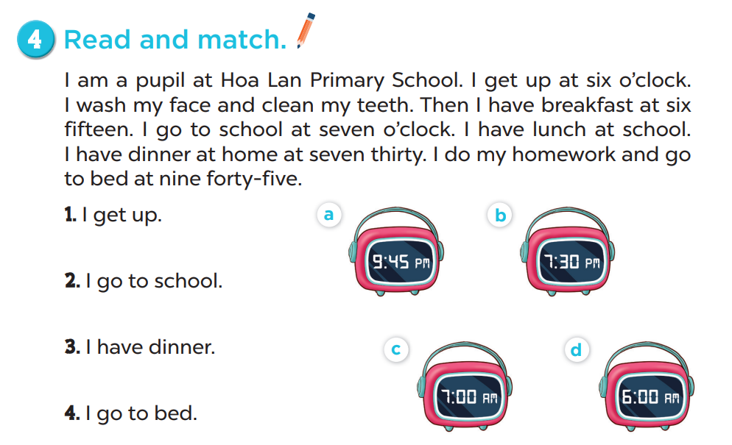

Slide 7
03
Let’s write.

Slide 8
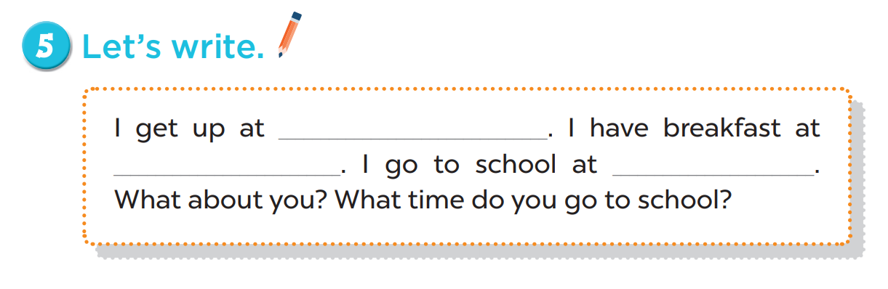
six o’clock
six thirty
seven o’clock

Slide 9
04
Project

Slide 10
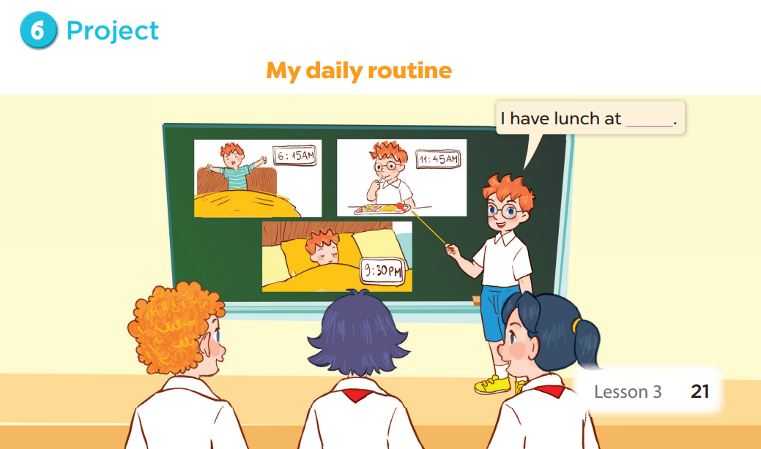

Slide 11
05
Fun corner & wrap-up

Slide 12






Slide 13

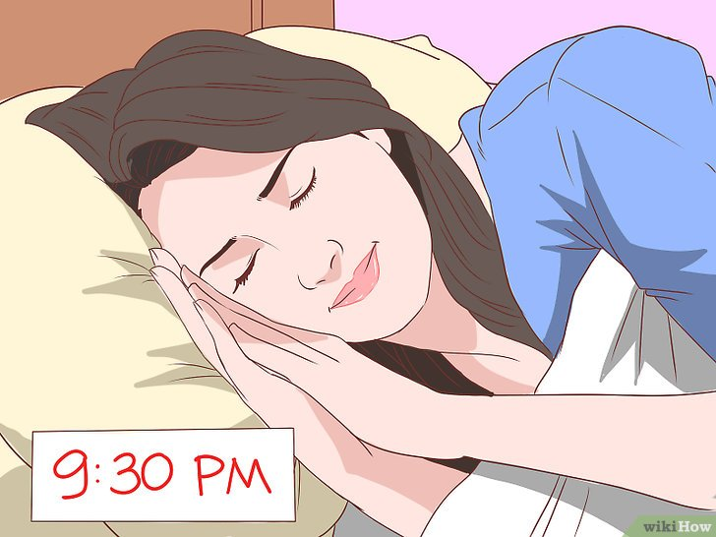



Câu hỏi 3
A. have breakfast
B. go to bed
+5
-1
-1
-1
C. go to school
D. get up

Slide 14
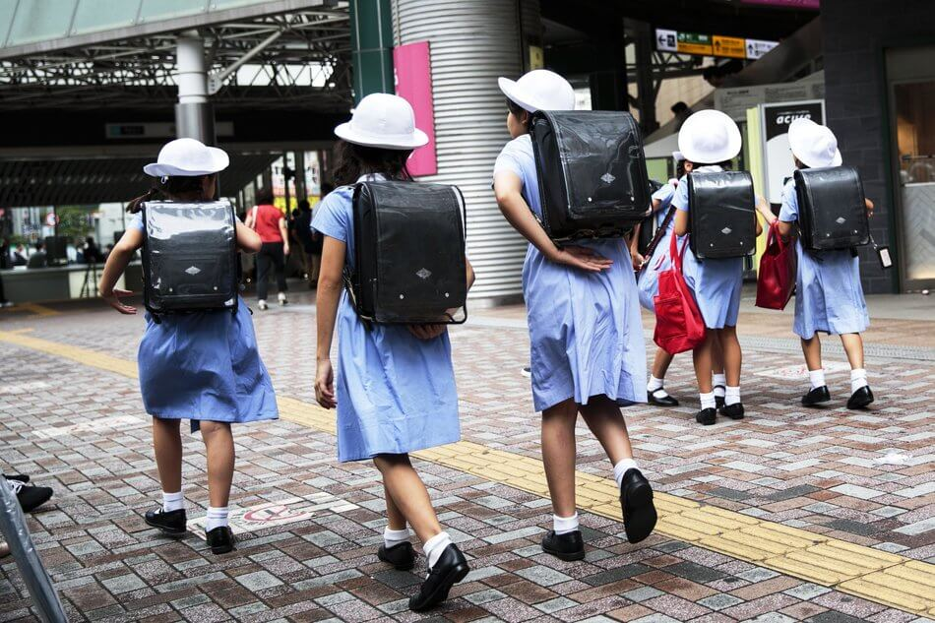

Câu hỏi 2
A. get up
B. have breakfast
+7
-1
-1
-1
C. go to school
D. go to bed

