Slide 1









Our Home
Lesson 2 - Period 4

Slide 2



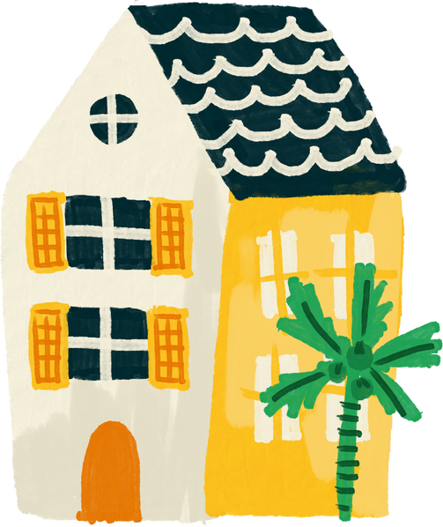


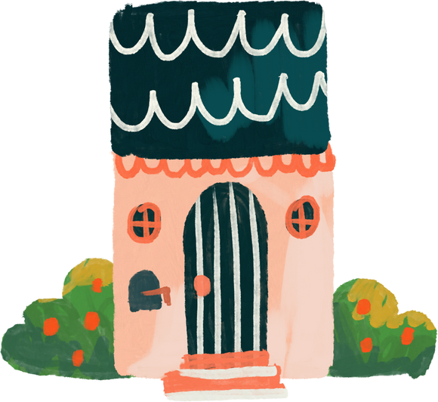
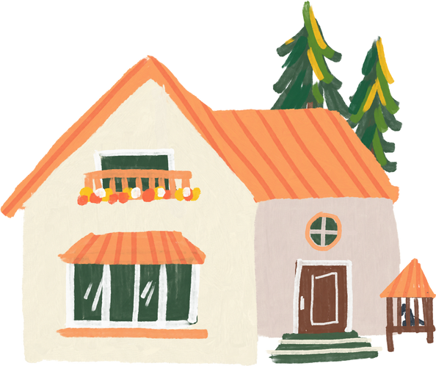
01
Warm-up and review

Slide 3

55
49
45

Slide 4
17
79
97

Slide 5
02
Listen and circle.

Slide 6
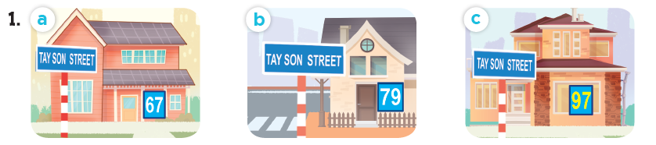
Look and say the number.
sixty-seven
seventy-nine
ninety-seven

Slide 7
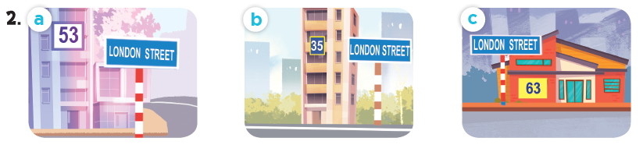
Look and say the number.
fifty-three
thirty-five
sixty-three

Slide 8
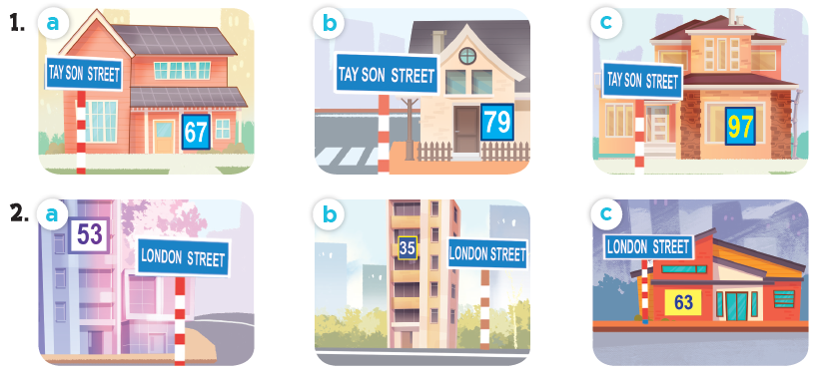
Listen and circle.

Slide 9
03
Read and complete.

Slide 10
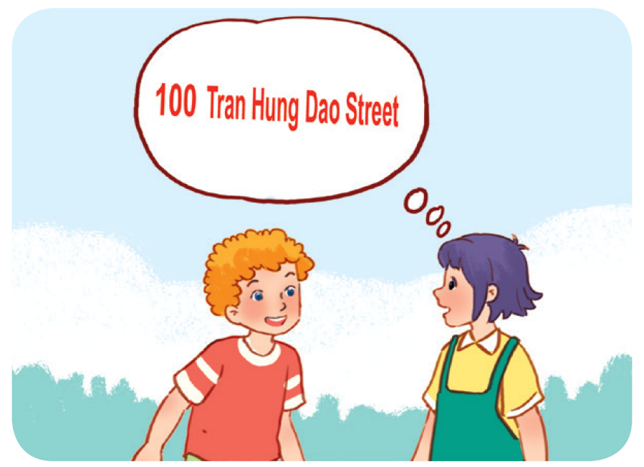
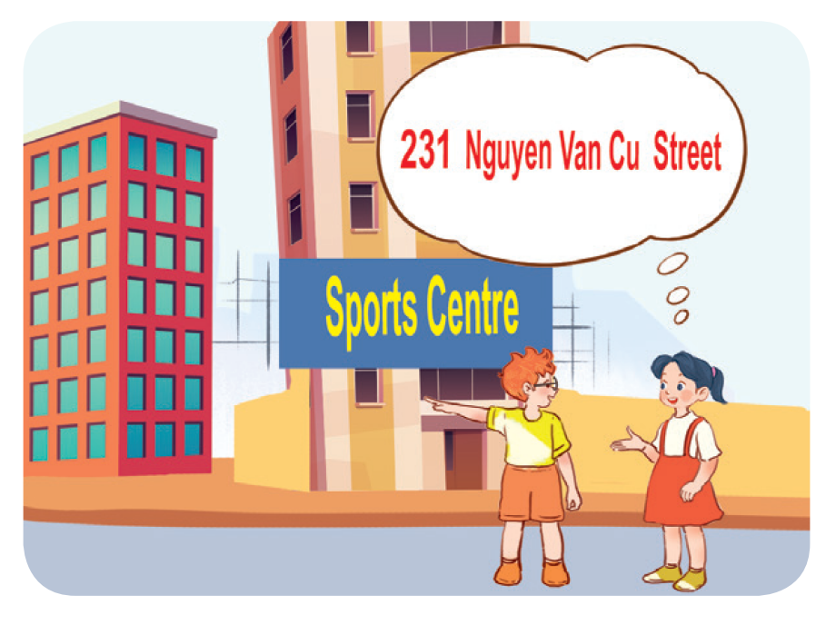
Work in pairs. Read and complete.
1. A: What’s your address?
B: It’s ________________.
A: Is it far ________________ here?
B: Yes, it is. It’s about ten kilometres from here.
2. A: I live in ________________ building over there.
B: Oh, it’s near the sports centre.
A: ________________ do you live?
B: I live far from here, in District 5.
A: ________________ your address?
B: It’s ________________.

Slide 11
Work in pairs. Read and complete.
1. A: What’s your address?
B: It’s ________________________.
A: Is it far ______ here?
B: Yes, it is. It’s about ten kilometres from here.
100 Tran Hung Dao Street
from

Slide 12
Work in pairs. Read and complete.
2. A: I live in ______________ building over there.
B: Oh, it’s near the sports centre.
A: _________ do you live?
B: I live far from here, in District 5.
A: ________ your address?
B: It’s _________________________.
that
Where
What’s
231 Nguyen Van Cu Street

Slide 13
04
Listen, complete and sing.

Slide 14

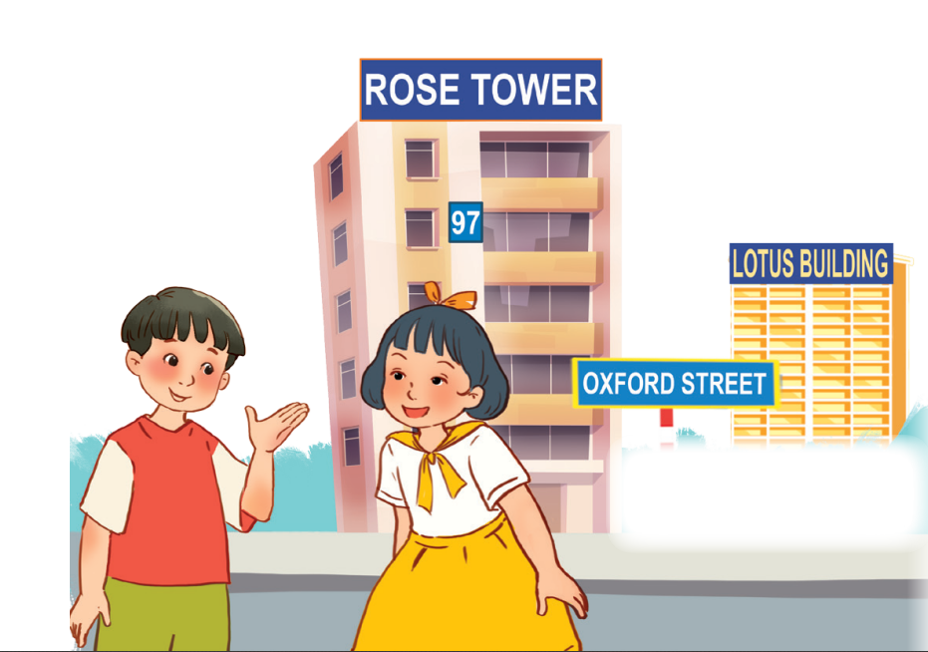
Let’s sing.
Look and read.
Listen and complete.
building
Do you live in that (1) _______?
No, I don’t.
Do you live in this (2) ______?
Yes, I do.
What’s your address?
It’s (3) _____ Oxford Street.
tower
19

Slide 15
05
Fun corner and wrap-up

Slide 16













boys
girls
Notes:
Teacher can insert a picture of her/ his address behind the puzzles. After the game, students know teacher’s address.

Slide 17


______ is your address?
What
It’s 23 London Street.

Slide 18




