Slide 1

UBND XÃ TÂN MINH
TRƯỜNG TIỂU HỌC CẤP TIẾN
CHUYÊN ĐỀ
CỤM TRƯỜNG XÃ TÂN MINH
ỨNG DỤNG TRÍ TUỆ NHÂN TẠO VÀ CHUYỂN ĐỐI SỐ TRONG DẠY HỌC MÔN TIẾNG ANH LỚP 4
Tân Minh, ngày 12 tháng 11 năm 2025

Slide 2






1
Warm up
Sing “ Weather“ song
Guess “ Weather“
Notes:
Play a small game “ Guess weather”
The teacher asks SS to listen the sound and guess what weather it is.
T calls Ss to answer and check their answers.
T asks Ss to repeat names of weather.

Slide 3
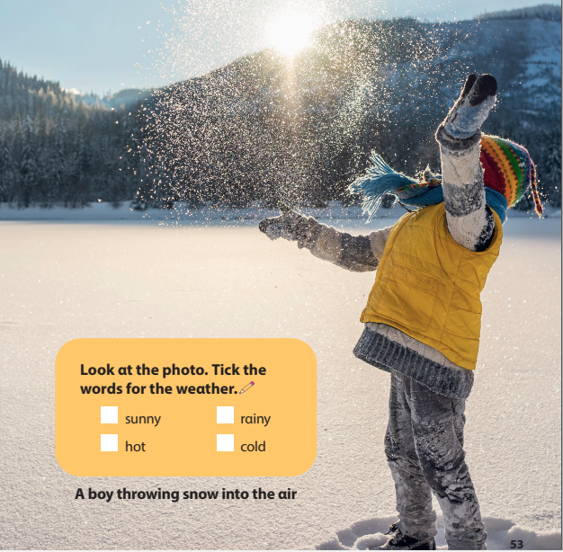
✓
✓
Notes:
Lead in: Photo time!
-T shows the picture about a boy throwing the snow into the air and gives students some questions: What can you see? What is he wearing? Is it sunny/ rainy/cold/ hot?
- T calls SS to answer and check their answers.
- T introduces that they will learn about “ Weathe” today.
- Write on the board “Leisure time” and introduce the lesson.

Slide 4









Unit 5: Leisure time
Lesson 1: Task 1, 2, 3

Slide 5
2
Presentation

Slide 6






1. Listen and point. Repeat
Notes:
- Play track 5.1 for the students to listen to, point to, and repeat the words in chorus and groups.

Slide 7



🌦️🕵️‍♂️ GAME: WEATHER DETECTIVE
It falls from the sky.
It’s white.
You can make a snowman.
SNOWY❄️

Slide 8
🌦️🕵️‍♂️ GAME: WEATHER DETECTIVE
It’s blowing.
You can feel it.
It moves the trees.
WINDY 🌬

Slide 9
🌦️🕵️‍♂️ GAME: WEATHER DETECTIVE
It’s loud.
It’s scary.
There’s lightning and thunder.
STORMY 🌩

Slide 10
🌦️🕵️‍♂️ GAME: WEATHER DETECTIVE
You can’t see the sun today.
The sky is not blue.
There are many white and grey things in the sky.
CLOUDY ☁️

Slide 11
3
Practice

Slide 12



2. Listen and read. Tick.
Jane: What’s the weather like today, Tom?
Tom: It’s cold and snowy. Look! Mum and Dad are making a snowman in the playground.
Jane: That’s interesting. Let’s go out!
Notes:
Task 2: Listen and read. Tick.
- Ask SS to identify names of charaters in the dialogue.
- play track 5.2 and let Sts listen to the dialogue, then repeat each sentences.
Note:each click can listen each sentence. Click on the speaker to listen whole dialogue.

Slide 13


The weather is _______.
cold hot windy snowy
Jane: What’s the weather like today, Tom?
Tom: It’s cold and snowy. Look! Mum and Dad are making a snowman in the playground.
Jane: That’s interesting. Let’s go out!

Slide 14
Windy
Cloudy
Snowy
Stormy
……
It’s

Slide 15



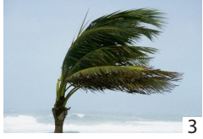
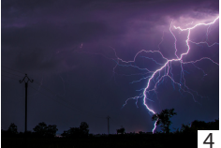
3. Look and say.
Notes:
Task 3: Look and say :
- Look at the picture and let SS write the sentences and say these sentences like the example.
- Call SS to say aloud in front of the class.

Slide 16
3. Look and say.
It’s
Notes:
Task 3: Look and say :
- Look at the picture and let SS write the sentences and say these sentences like the example.
- Call SS to say aloud in front of the class.

Slide 17
3. Look and say.
It’s
Notes:
Task 3: Look and say :
- Look at the picture and let SS write the sentences and say these sentences like the example.
- Call SS to say aloud in front of the class.

Slide 18
3. Look and say.
It’s
Notes:
Task 3: Look and say :
- Look at the picture and let SS write the sentences and say these sentences like the example.
- Call SS to say aloud in front of the class.

Slide 19
3. Look and say.
It’s
Notes:
Task 3: Look and say :
- Look at the picture and let SS write the sentences and say these sentences like the example.
- Call SS to say aloud in front of the class.

Slide 20

Mystery Weather
Mystery Weather
WHAT IS THE WEATHER LIKE?

Slide 21


What’s the weather like?
It’s snowy

Slide 22
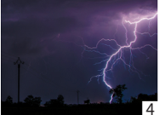
What’s the weather like?
It’s stormy.

Slide 23

What’s the weather like?
It’s cloudy.

Slide 24

What’s the weather like?
It’s windy.

Slide 25
4
Production

Slide 26

5
Assessment

Slide 27
UNIT 5: LEISURE TIME
LESSON 1 – PERIOD 1
What we learnt today
Vocabulary
cloudy
windy
stormy
snowy
Structure
It’s cloudy.

Slide 28




Thank you & goodbye!

