Slide 1




















Notes:
Để nguyên trang bìa như này, chỉ thay đổi tên bài trong quá trình làm. Logo của sách Wonderful World

Slide 2










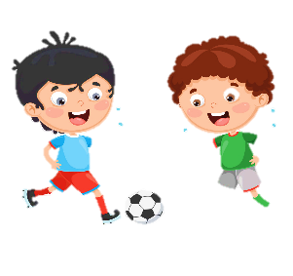


Unit 1:
MY FAMILY
AND FRIENDS
Lesson 2 – Task 7,8,9

Slide 3



Slide 4

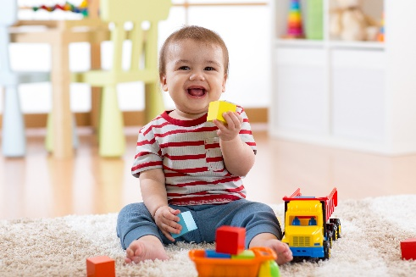
teuc
2
cute

Slide 5
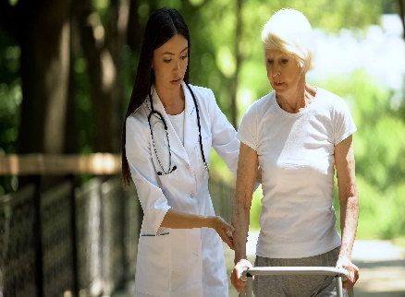
indk
4
kind

Slide 6
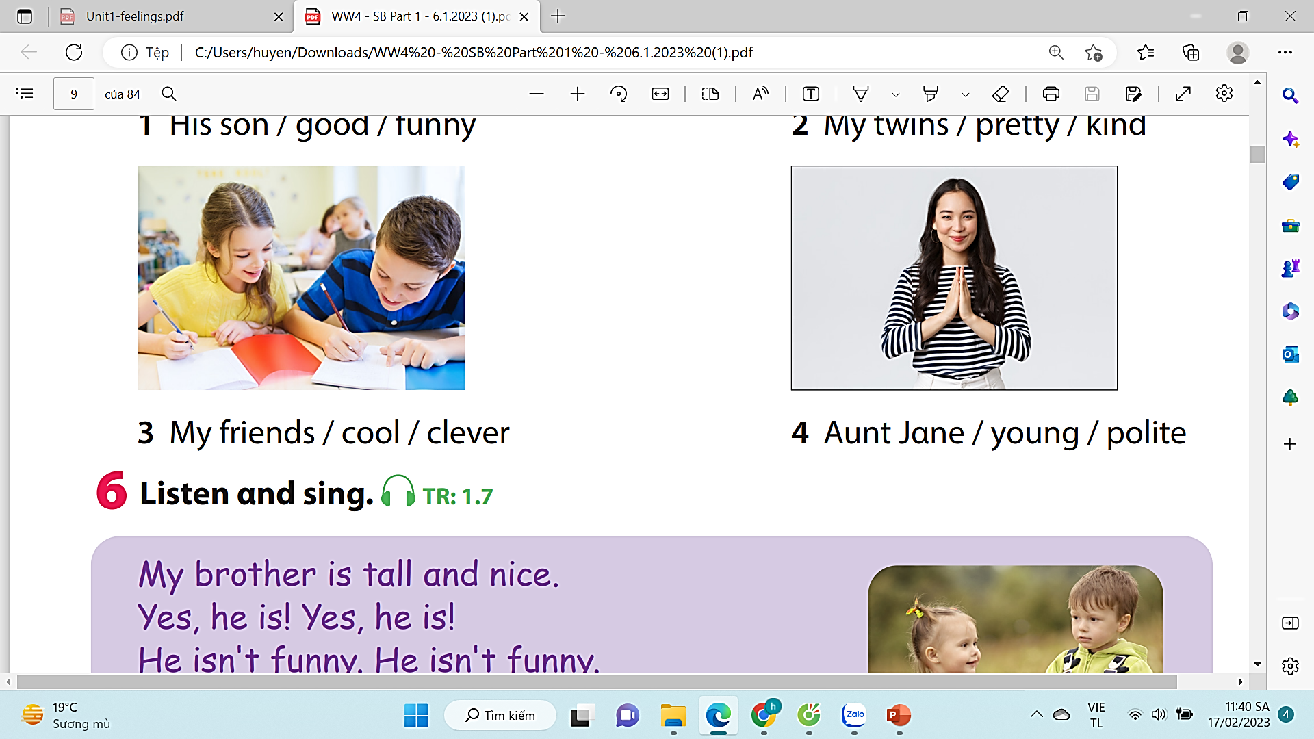
uonyg
6
young

Slide 7

levrce
5
clever

Slide 8

reyttp
5
pretty

Slide 9
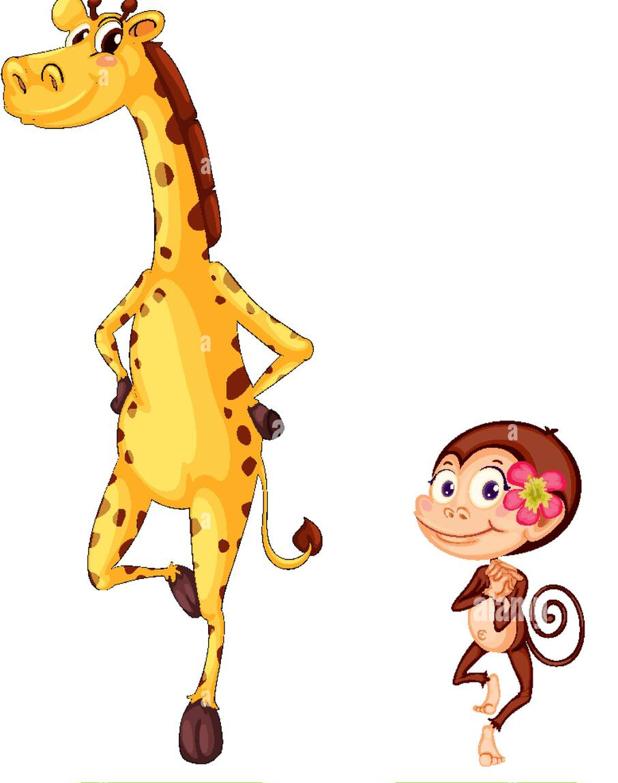
orsht
3
short

Slide 10

atll
2
tall

Slide 11
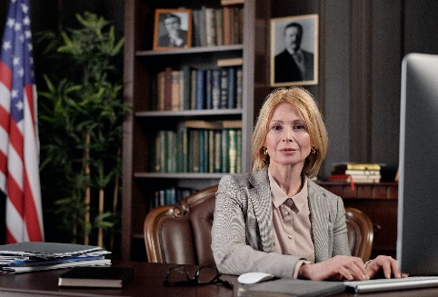
lpoeti
10
polite

Slide 12
02
PRESENTATION
Task 7: Listen and write the names.

Slide 13
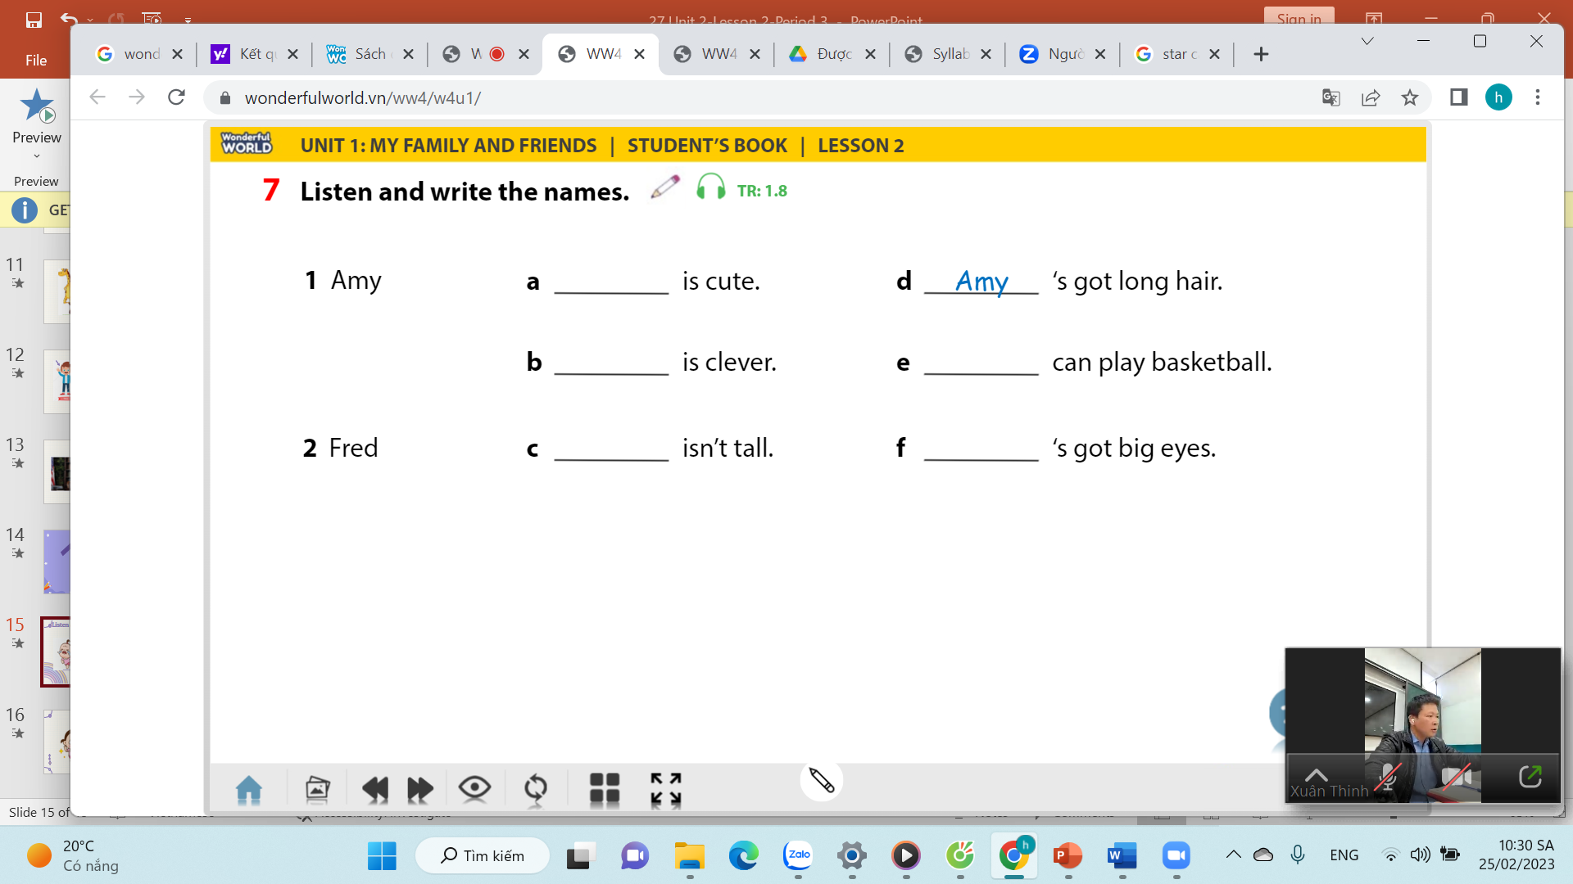
Fred
Amy
Fred
Fred
Amy
Notes:
-Let the sts read 1 by 1 the options from 1-4

Slide 14
03
PRACTICE
Task 8: Look and say.

Slide 15
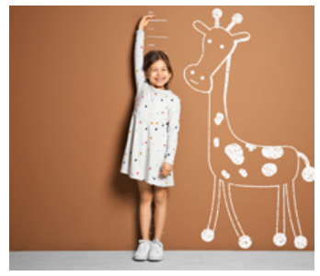



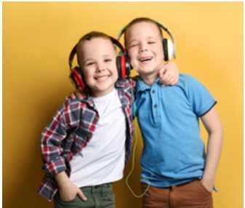
Look and say
1 My friend / ugly (✘) / pretty (✓) / tαll (✓).
2 His father / funny (✘) / polite (✓) / clever (✓).
His father isn’t funny. He’s polite and clever.
3 Her grαndmα / young (✘) / old (✓) / kind (✓)
Her grandma isn’t young. She’s old and kind.
4 His twin brother / short (✘) / tαll (✓) / cute (✓)
His twin brother isn’t short. He’s tall and cute.

Slide 16

Game Time

Slide 17









Slide 18


12
1
2
11
10
3
4
9
5
8
7
6
Notes:
Bấm spin để quay
Bấm stop để dừng
Slide cuối cùng là slide chỉ đến số 7

Slide 19
My friend/ ugly.(X)
My friend isn’t ugly.
WHEEL
CHECK
Notes:
Bấm check để kiểm tra đáp án và hiện chữ wheel
Bấm chữ wheel để quay lại vòng quay

Slide 20
12
1
2
11
10
3
4
9
5
8
7
6

Slide 21

She/ pretty/ tall.( )
She is pretty and tall.
WHEEL
CHECK

Slide 22
12
1
2
11
10
3
4
9
5
8
7
6

Slide 23
+ 2
WHEEL
CHECK

Slide 24
12
1
2
11
10
3
4
9
5
8
7
6

Slide 25
His son/ funny. (X)
His son isn’t funny.
WHEEL
CHECK

Slide 26
12
1
2
11
10
3
4
9
5
8
7
6

Slide 27
+ 1
WHEEL
CHECK

Slide 28
12
1
2
11
10
3
4
9
5
8
7
6

Slide 29
+ 3
WHEEL
CHECK

Slide 30
12
1
2
11
10
3
4
9
5
8
7
6

Slide 31
He/ polite/clever.
He is polite and clever.
WHEEL
CHECK

Slide 32
12
1
2
11
10
3
4
9
5
8
7
6

Slide 33
Her grandma/ young. ( X)
Her grandma isn’t young.
WHEEL
CHECK

Slide 34
12
1
2
11
10
3
4
9
5
8
7
6

Slide 35
+ 2
WHEEL
CHECK

Slide 36
12
1
2
11
10
3
4
9
5
8
7
6

Slide 37
She/ old/ kind ( )
She is old and kind.
WHEEL
CHECK

Slide 38
12
1
2
11
10
3
4
9
5
8
7
6

Slide 39
His twin brother/ short.( X)
His twin brother isn’t short.
WHEEL
CHECK

Slide 40
12
1
2
11
10
3
4
9
5
8
7
6

Slide 41
+ 5
EXIT
CHECK
Notes:
Bấm check để hiện từ exit

Slide 42
12
1
2
11
10
3
4
9
5
8
7
6

Slide 43
He/tall/cute( )
He is tall and cute.
WHEEL
CHECK

Slide 44
04
PRODUCTION
Task 9: Let’s talk

Slide 45
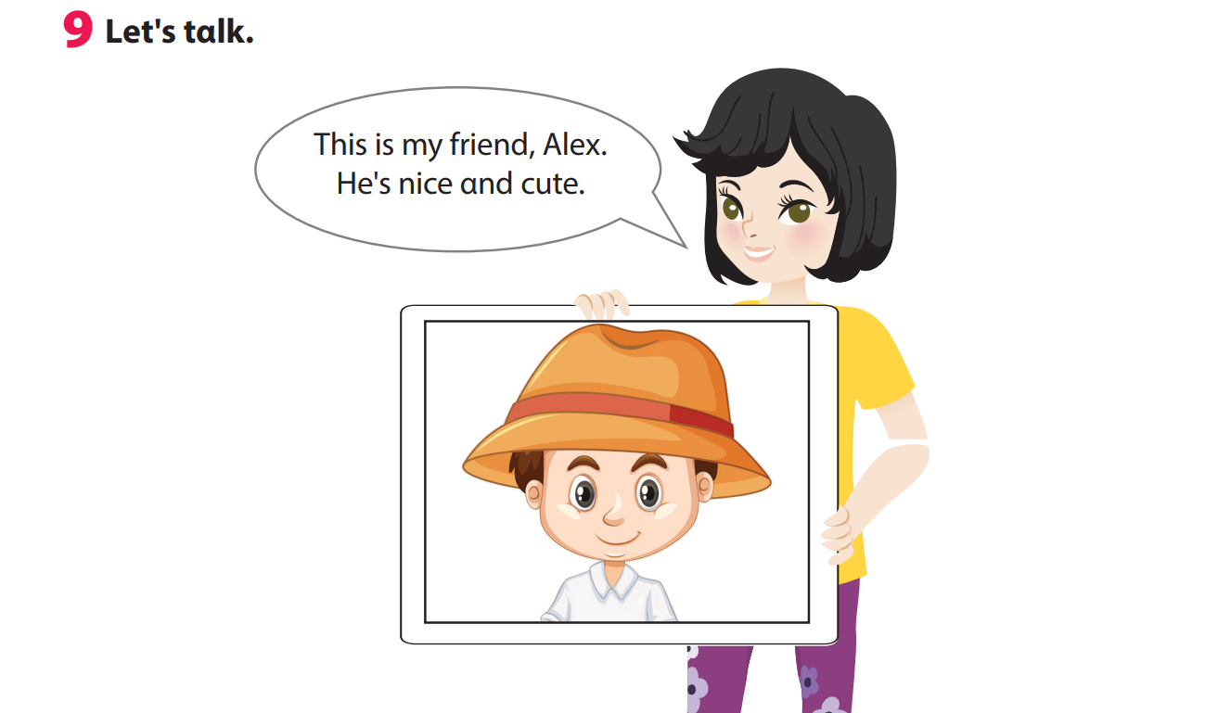

Slide 46


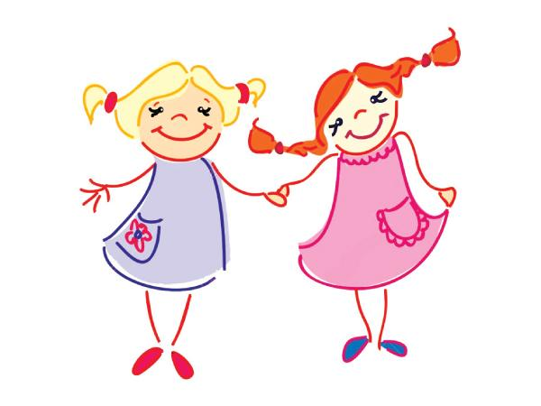

This is my friend, Hoa. She is cute and kind.
Notes:
My favourite person
- Tell students they’re going to draw their favourite person ( a family member or a friend)
- Ask student to draw . Then write the information about him/her.
E.g.: This is my ______
He/She is cute and kind.

Slide 47

05
ASSESSMENT

Slide 48
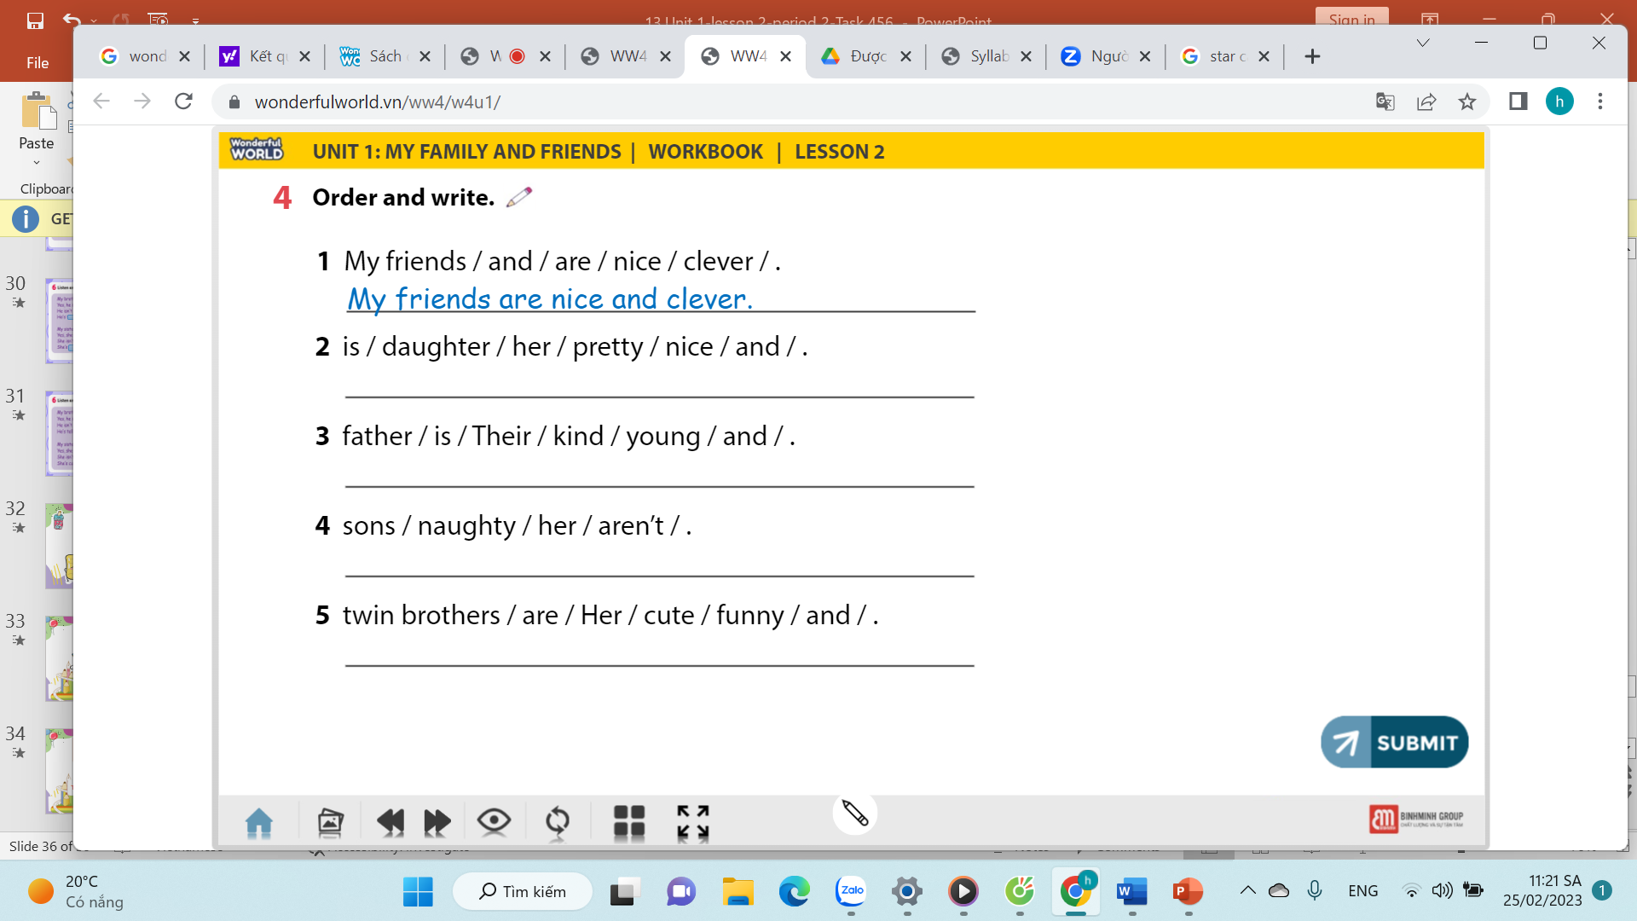
Her daughter is pretty and nice.
Their father is young and kind.
Her sons aren’t naughty.
Her twin brothers are cute and funny.
Notes:
HOẠT ĐỘNG TƯƠNG TÁC: 4 CÂU. ĐÁP ÁN LÀ CHỮ MÀU ĐỎ.

Slide 49

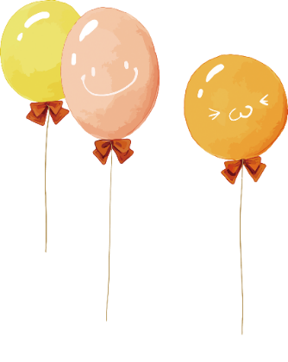
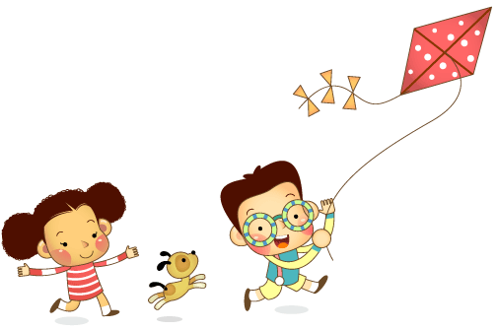
Remember
Vocabulary: review
old, young, tall, short, clever, cute, ugly, nice, pretty, funny, kind, cool, polite
Structure: review
My friend isn't ugly. She's pretty αnd tαll.

Slide 50




Thank you & goodbye!

