Slide 1









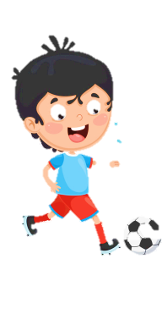













Slide 2




Unit 3:
SCHOOL LIFE
Lesson 1 – Task 1, 2, 3

Slide 3

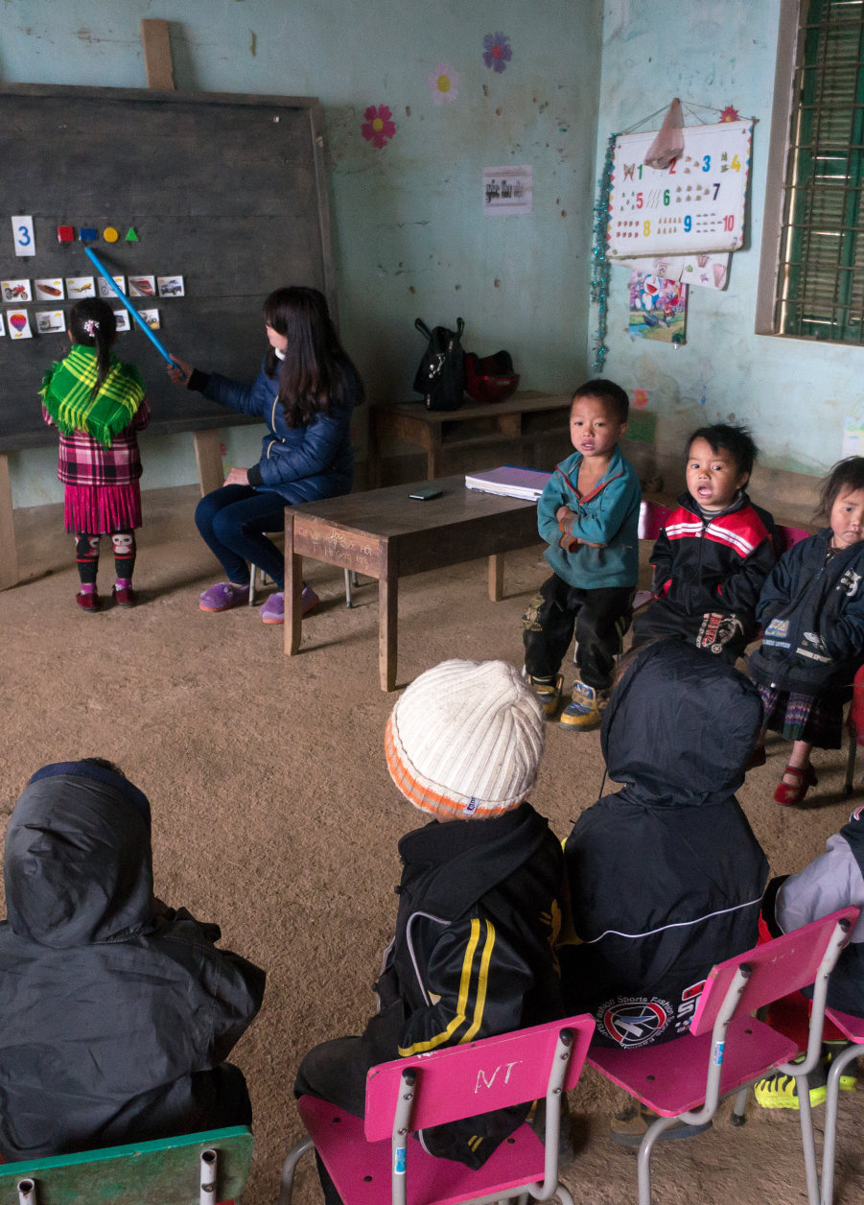
1 Look at the photo. Answer.
Where are these children?
A primary school in the highland province of Ha Giang, Vietnam

Slide 4
1 What can you see? Look, point and tick.
✓
✓
✓
teacher
book
purple
✓
✓
✓
student
blackboard
pink
✓
✓
desk
clock
blue
✓
chair
table
2 Where are these children? Look and say.
A primary school in the highland province of Ha Giang, Vietnam

Slide 5

02
PRESENTATION
1 Listen and read.

Slide 6




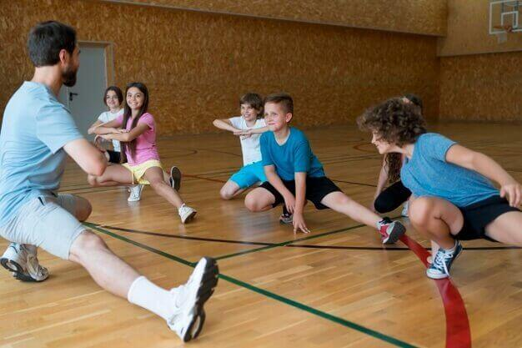
exercise
/ˈeksərsaɪz/

Slide 7
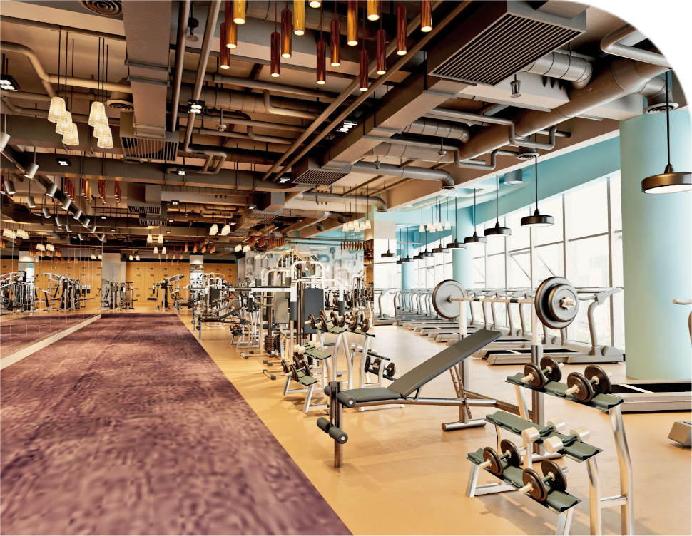
fitness centre
/ˈfɪtnəs sentər/

Slide 8

practise
/ˈpræktɪs/

Slide 9

problem
/ˈprɑːbləm/

Slide 10

solution
/səˈluːʃn/

Slide 11

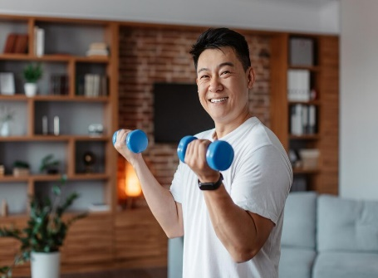
Listen, point and repeat.
Listen, point and repeat.
exercise fitness centre practise problem solution

Slide 12
Mini-game: zoomed–in picture
problem

Slide 13
Mini-game: zoomed–in picture
exercise

Slide 14
Mini-game: zoomed–in picture
practise

Slide 15
Mini-game: zoomed–in picture
fitness centre

