Slide 1













Unit 9:
Places In Town
Fun time & Projects

Slide 2
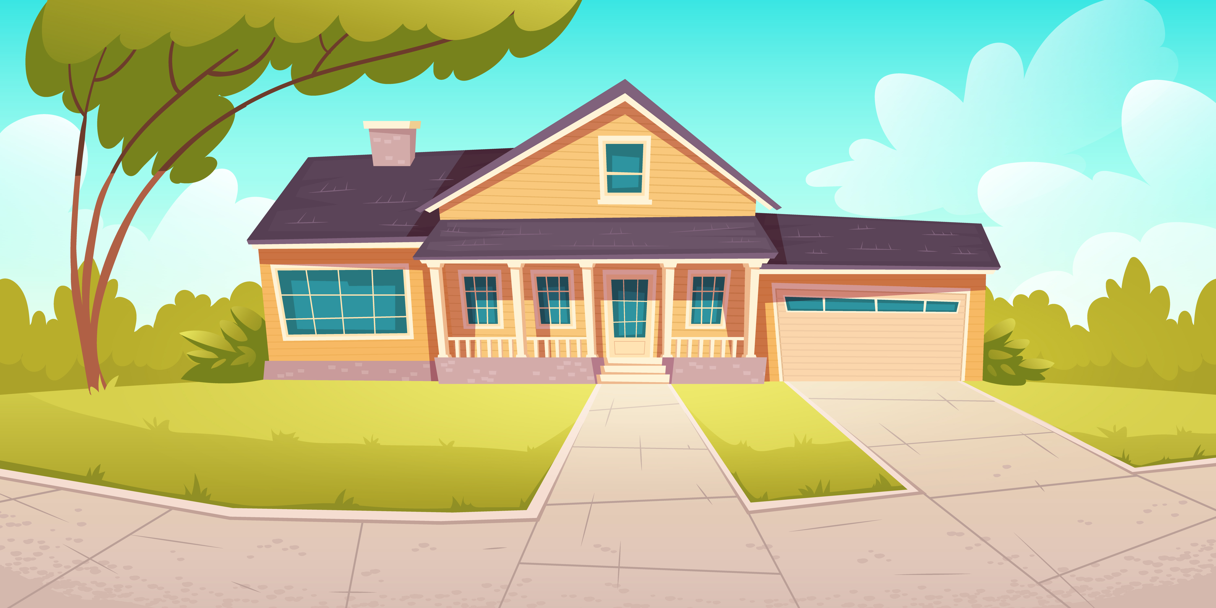
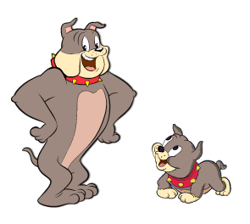
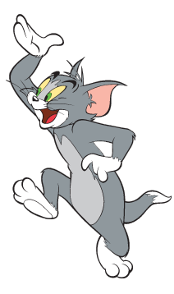
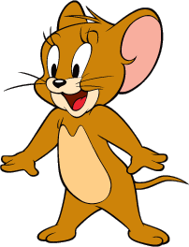
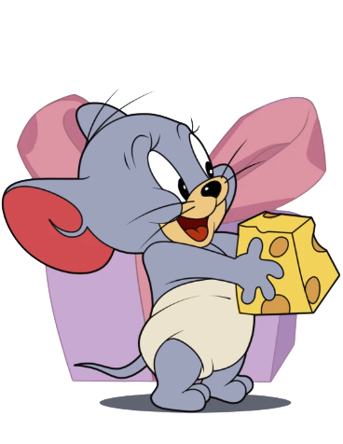
Tom and Jerry Puzzle!

Slide 3
Pick A Character!
Next

Slide 4
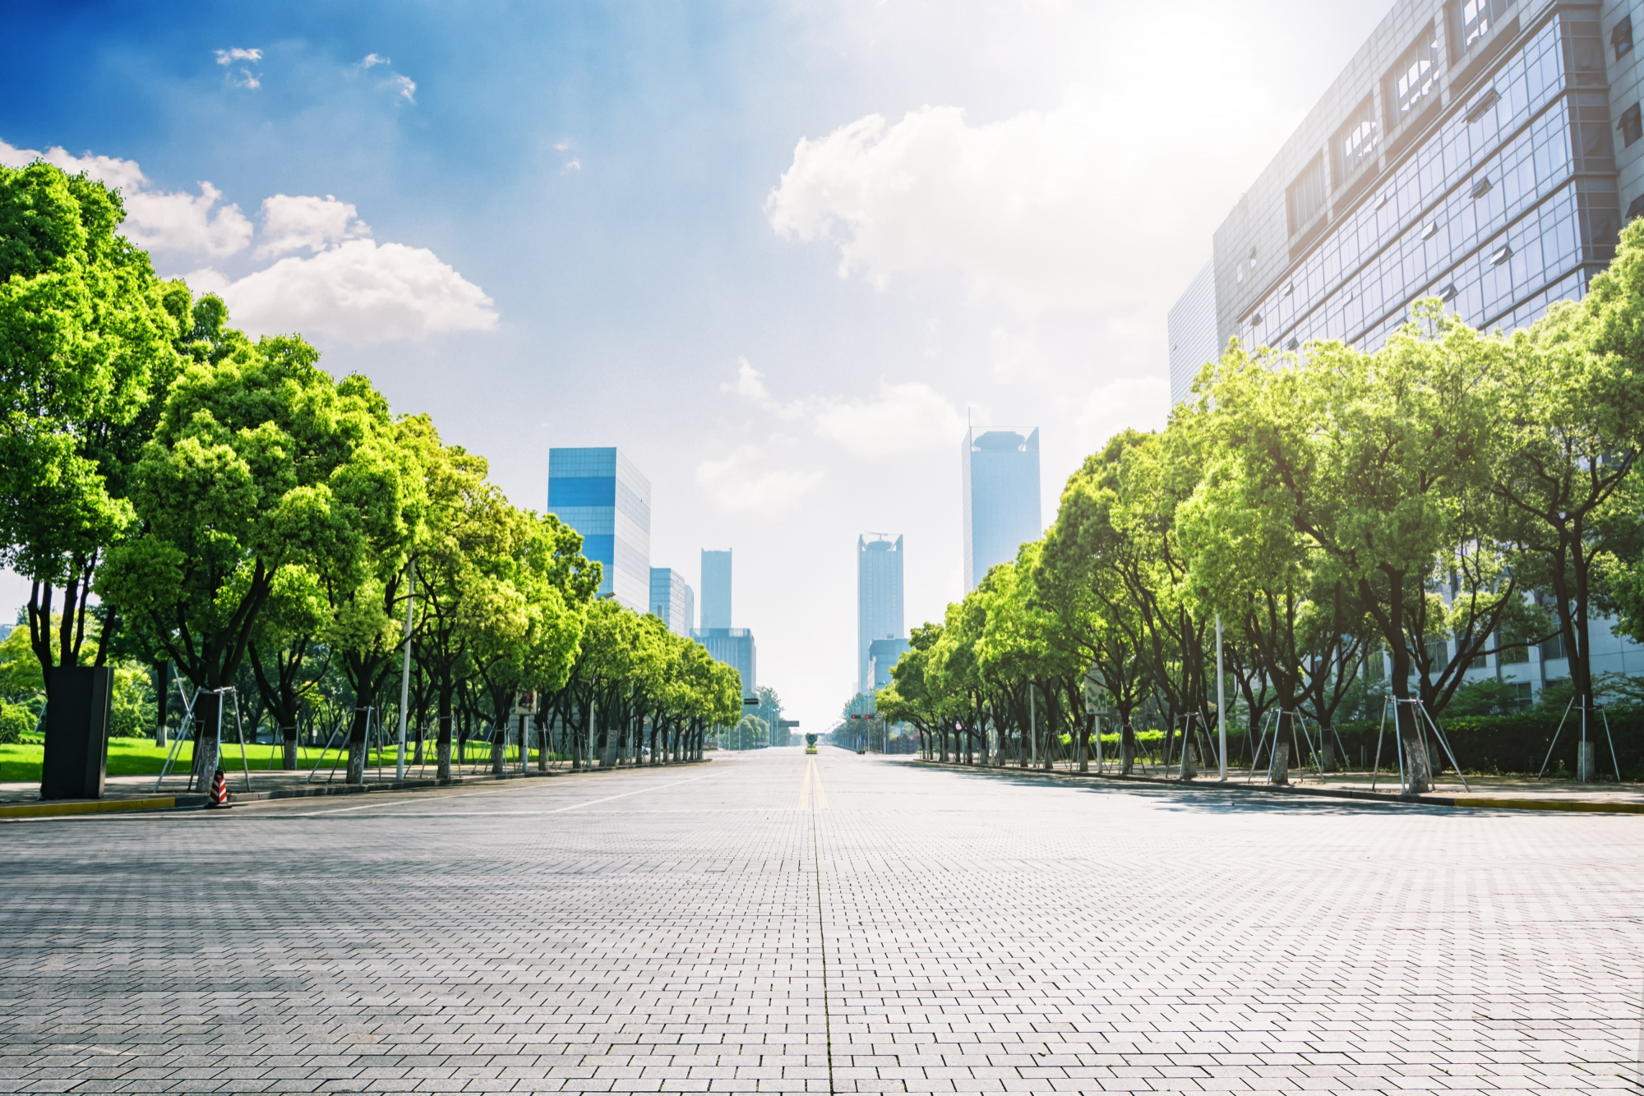
m s u e k t a r p r e
  supermarket
back

Slide 5
s r e t e t
  street
back

Slide 6
r a b r y l i
  library
back

Slide 7
s m m u u e
  museum
back

