Slide 1



Unit 9. Places in town
Lesson 2. Task 1, 2, 3

Slide 2


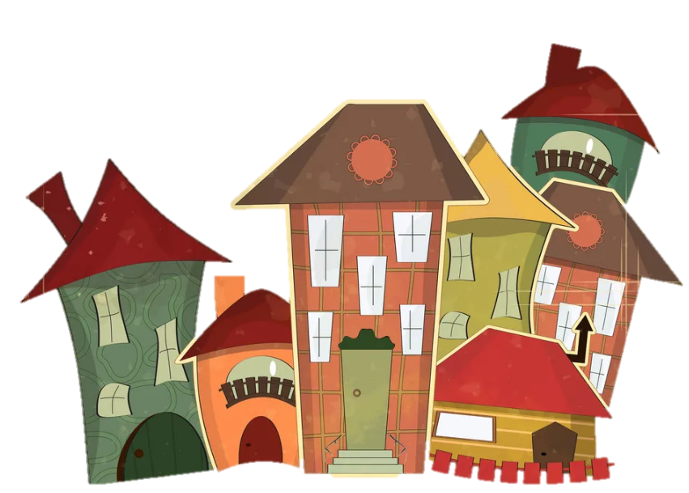

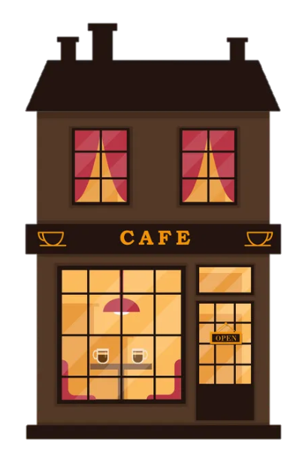
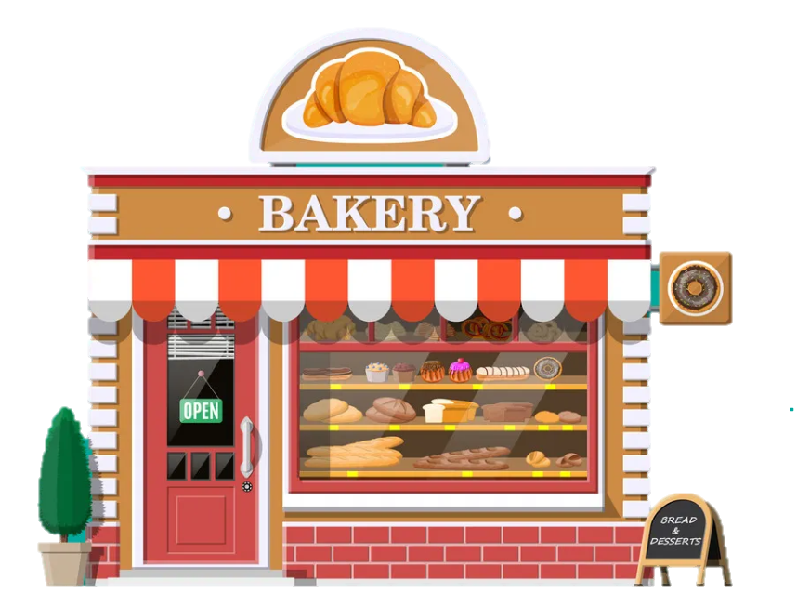


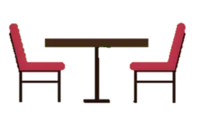
3
Practice

Slide 3
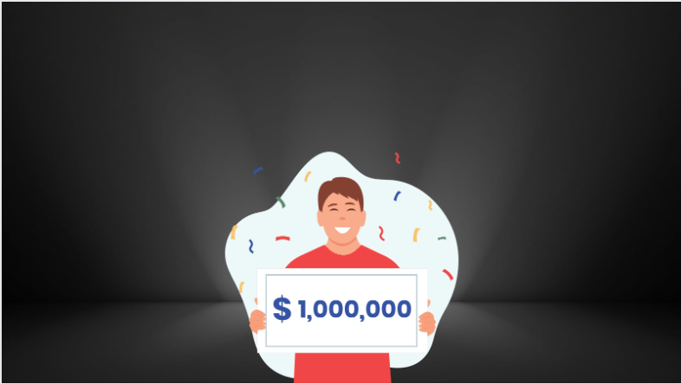

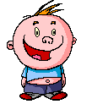
Who Wants To Be A Millionaire?

Slide 4

Question 1

Slide 5
Where do we buy food ?
A. at the bus stop
B. at the toy shop
C. at the supermarket
D. at the zoo

Slide 6
Where do we buy food ?
A. at the bus stop
B. at the toy shop
C. at the supermarket
D. at the zoo

Slide 7
£100

Slide 8
Question 2

Slide 9
Where do we see many shops ?
A. at the bus stop
B. at the shopping centre
C. at the post office
D. at the fountain

Slide 10

Where do we see many shops ?
A. at the bus stop
B. At the shopping centre
C. at the post office
D. at the fountain

Slide 11
£200

Slide 12
Question 3

Slide 13
Where do we get a bus?
A. at the supermarket
B. at the bus stop
C. at the zoo
D. at the restaurant

Slide 14
Where do we get a bus ?
A. at the supermarket
B. at the bus stop
C. at the zoo
D. at the restaurant

Slide 15
£300

Slide 16
Question 4

Slide 17
Where do we buy stamps ?
A. At the shopping centre.
B. At the bus stop.
C. At the fountain.
D. At the post office.

Slide 18
Where do we buy stamps ?
A. At the shopping centre
B. At the bus stop.
C. At the fountain.
D. At the post office.

Slide 19
£500

Slide 20
Question 5

Slide 21

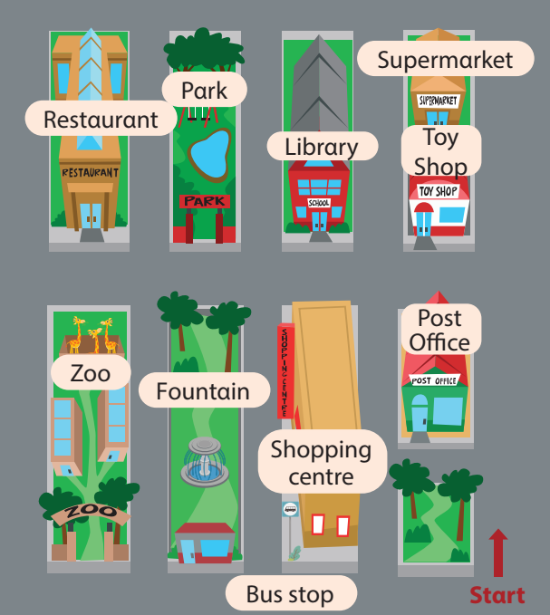
3 Look αnd sαy. Use the mαp in 2.
Is the post office behind or in front of the toy shop?
It’s in front of the toy shop.
1 behind / in front of/ toy shop

Slide 22
£1,000

Slide 23
Question 6

Slide 24
3 Look αnd sαy. Use the mαp in 2.
Is the bus stop next to or in front of the fountain ?
It’s next to the fountain.
2 next to / in front of/ fountαin

Slide 25
£2,000

Slide 26
Question 7

Slide 27
3 Look αnd sαy. Use the mαp in 2.
Is the supermarket behind or in front of the toy shop?
It’s behind the toy shop.
3 behind / in front of / toy shop

Slide 28
£4,000

Slide 29
Question 8

Slide 30
3 Look αnd sαy. Use the mαp in 2.
Is the shopping centre opposite or behind the library ?
It’s opposite the library.
4 opposite/ behind/ library

Slide 31
£1,000,000

Slide 32
WELL DONE!!!

Slide 33


Thank You
Goodbye!

