Slide 1


Slide 2



Slide 3


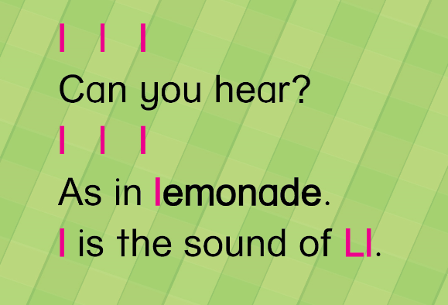
Warm - up
Let’s chant.
Notes:
- Audio: letter A, /a/, apple, ant

Slide 4

Unit 12
Lesson 3

Slide 5



Unit 12:
Lesson 3
Revision
lemon
lemonade

Slide 6
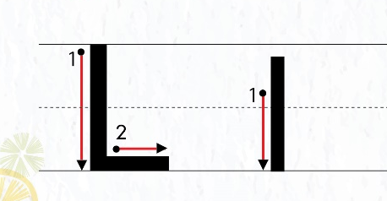
Unit 12:
Lesson 3
1. Trace the letters

Slide 7

Unit 12:
Lesson 3
Let’s write letter L in the air.
Notes:
- Video

Slide 8

Unit 12:
Lesson 3
1. Trace the letters.
Notes:
- Video

Slide 9

Unit 12: Lesson 3
1. Trace the letters.
Let’s write letter Ll on your board.
L
l
L
L
l
Notes:
-Teacher says one item (small L, big L), Ss write on their small boards quickly and say BINGO when they finish then raise their boards up.

Slide 10
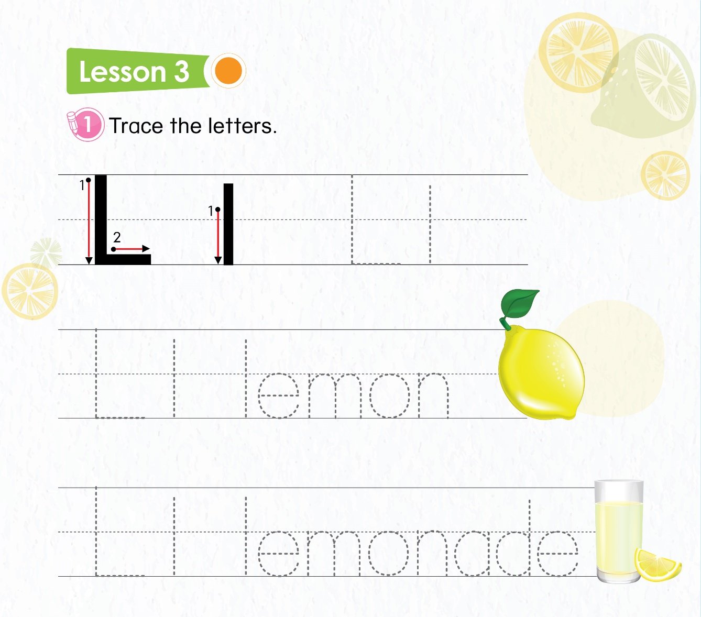


Unit 12:
Lesson 3
1. Trace the letters.
54

Slide 11
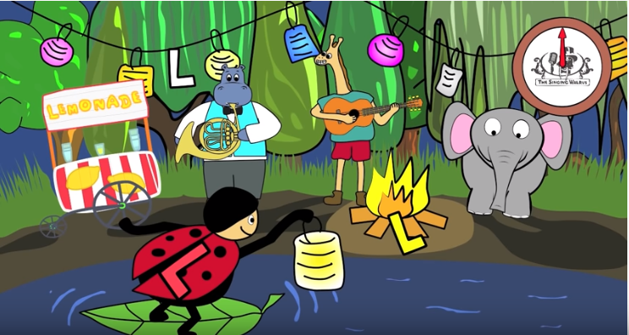
Find the big L

Slide 12
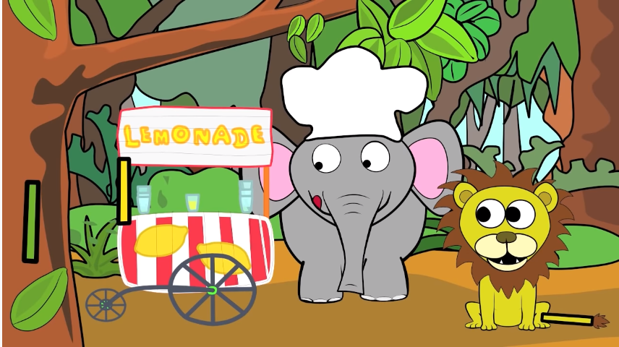
Find the small l

Slide 13
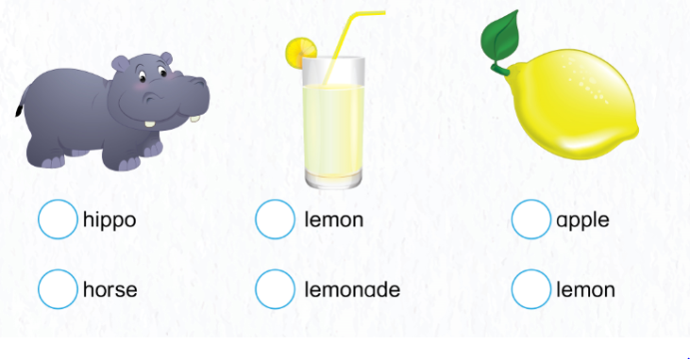
Unit 12:
Lesson 3
1. Trace the letters.
2. Look, tick and say.




Slide 14



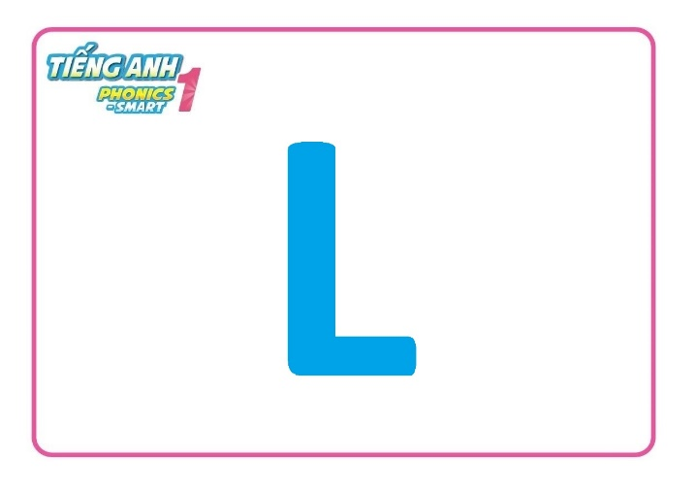
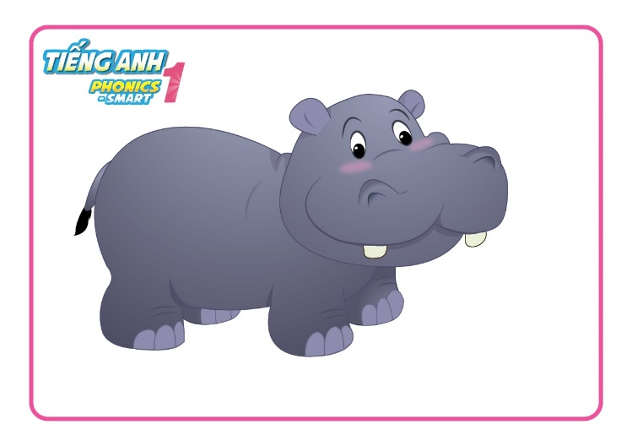
Let’s play What's missing?

Slide 15
Let’s play What's missing?
???

Slide 16

Let’s play What's missing?
???

Slide 17
Let’s play What's missing?
???

Slide 18
Let’s play What's missing?
???

Slide 19
Let’s play What's missing?
???

Slide 20
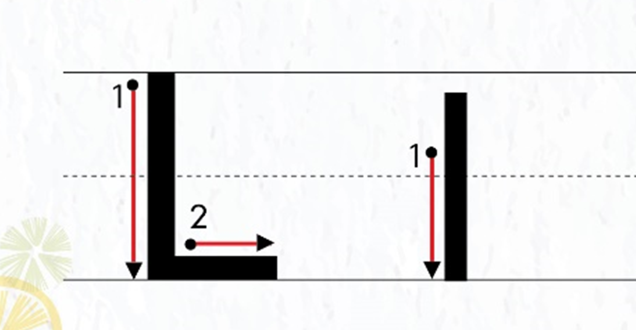
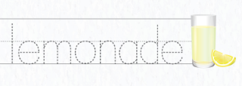
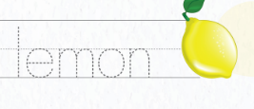
Unit 12:
Lesson 3
1. Trace the letters.
2. Look, tick and say.

Slide 21


