Slide 1





















Slide 2





Unit 9. Places in town
Lesson 1. Task 1, 2, 3

Slide 3

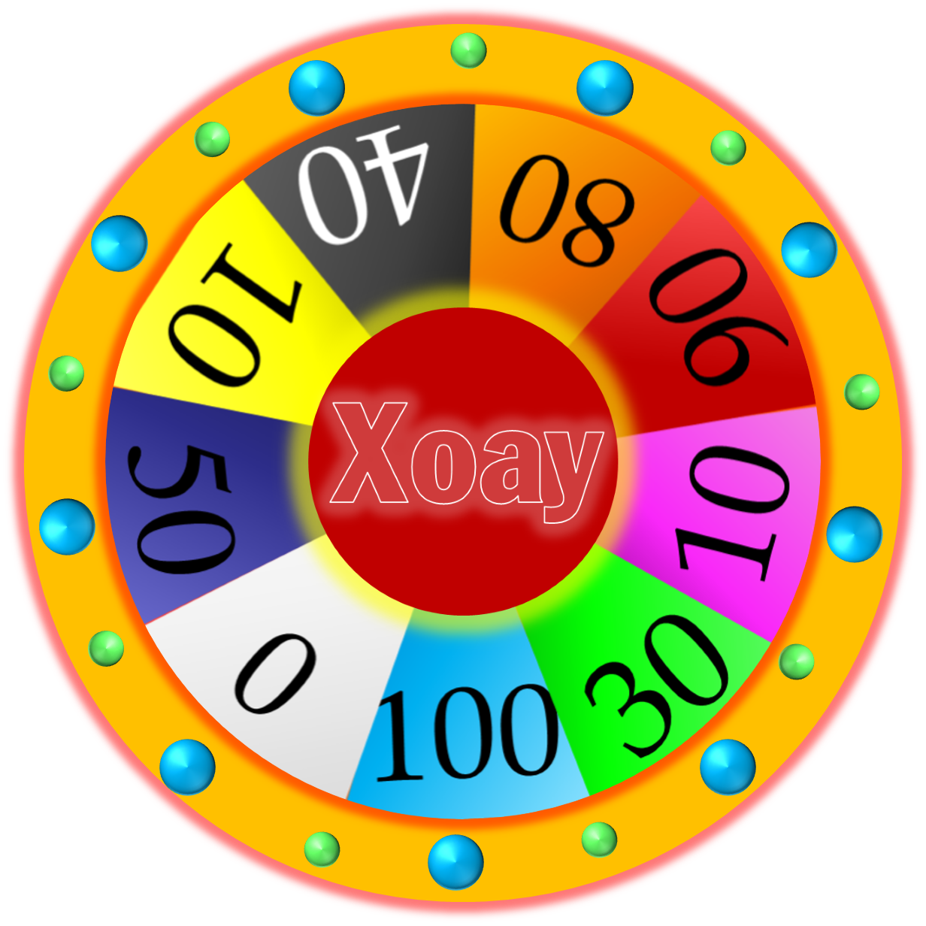




WHEEL OF FORTUNE
30
20
40
10
1
2
3
50
80
60
70
4
5
Next
START
Notes:
CLICK Start để quay => click vào vòng quay/dấu cách để dừng.

Slide 4

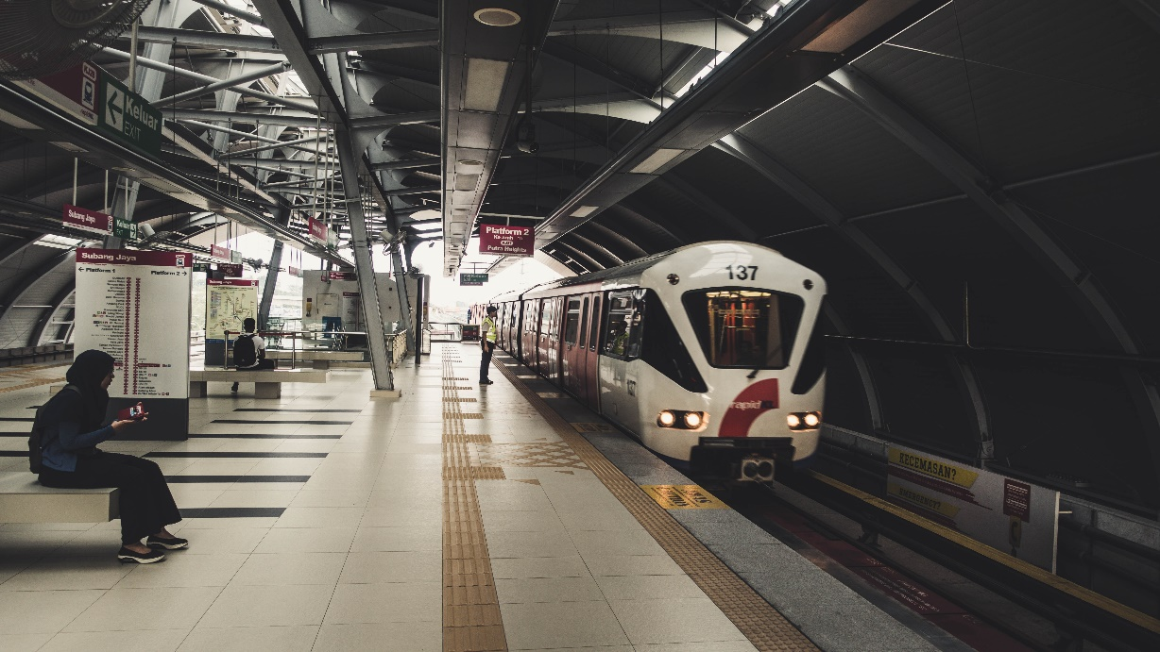


3 Look and say
The trαin stαtion is on Elizαbeth street.
1 trαin stαtion / on / Elizαbeth street

Slide 5


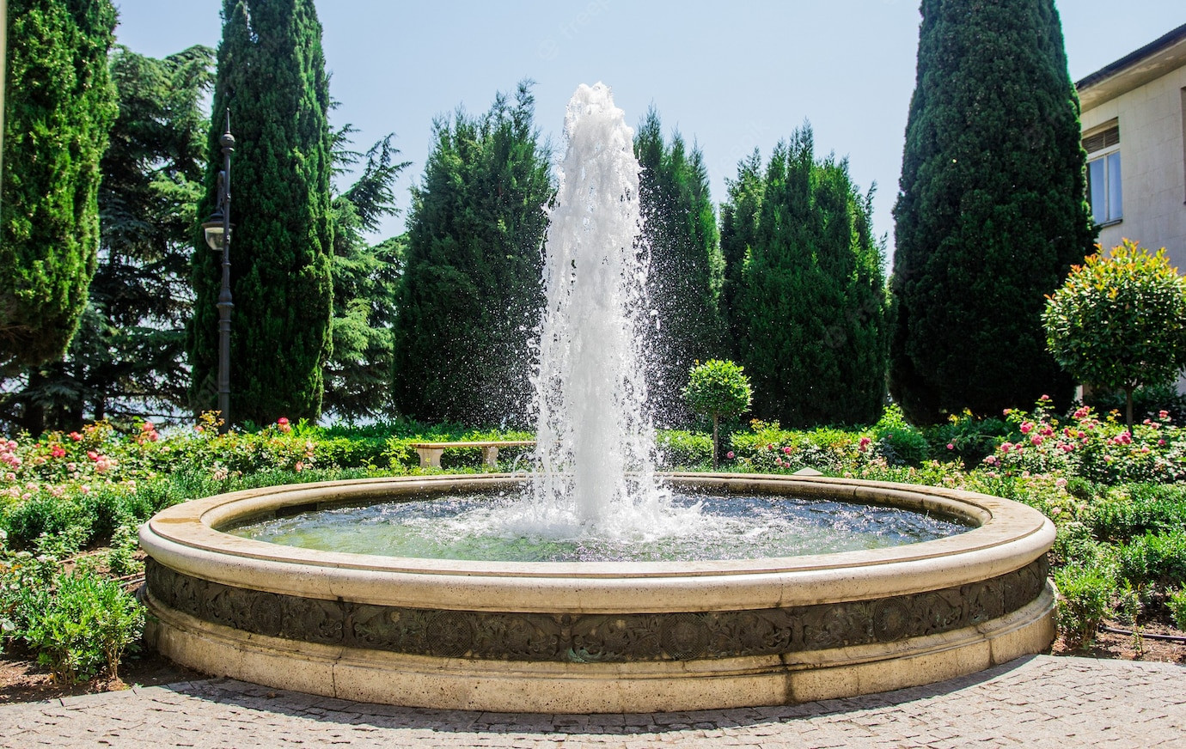
3 Look and say
The fountain is in front of the bookshop.
2 fountαin / in front of/ bookshop

Slide 6
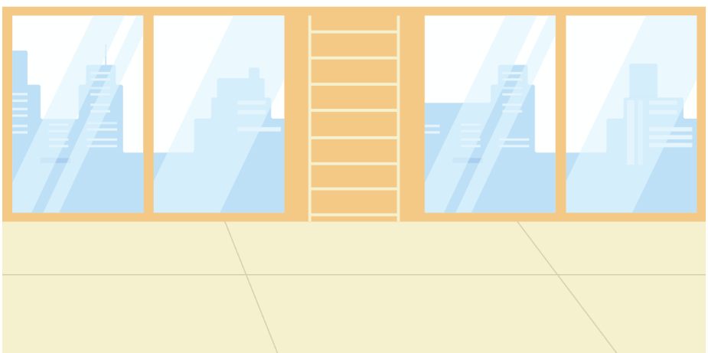
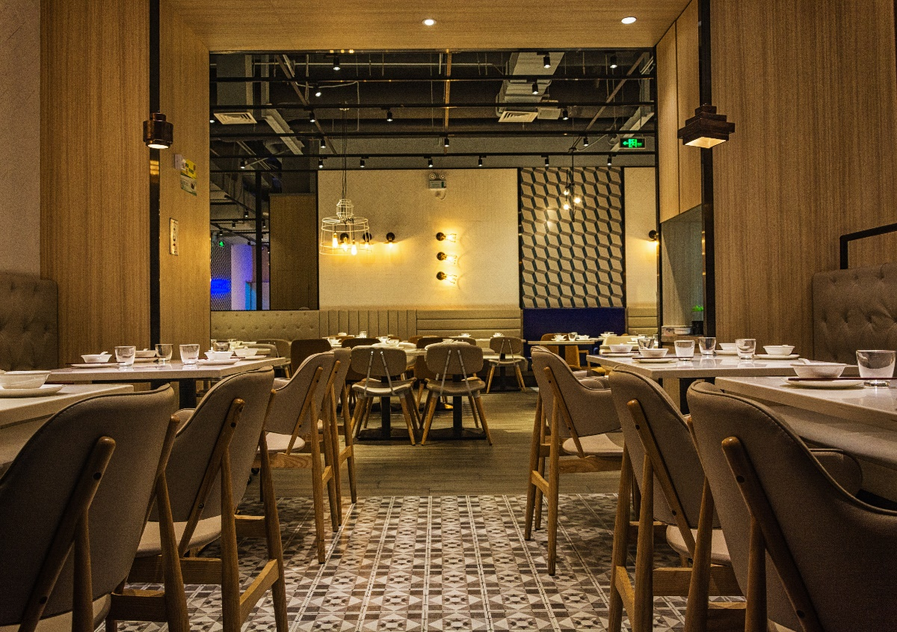

3 Look and say
The restaurant is behind the park.
3 restαurαnt / behind / pαrk

Slide 7

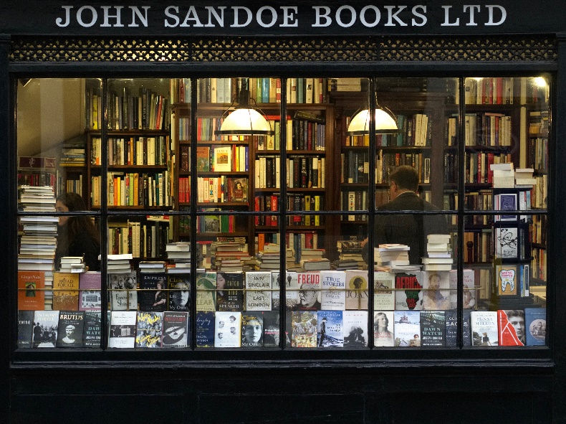

3 Look and say
4 bookshop / between / toy shop αnd museum
The bookshop is between the toy shop and the museum.

Slide 8
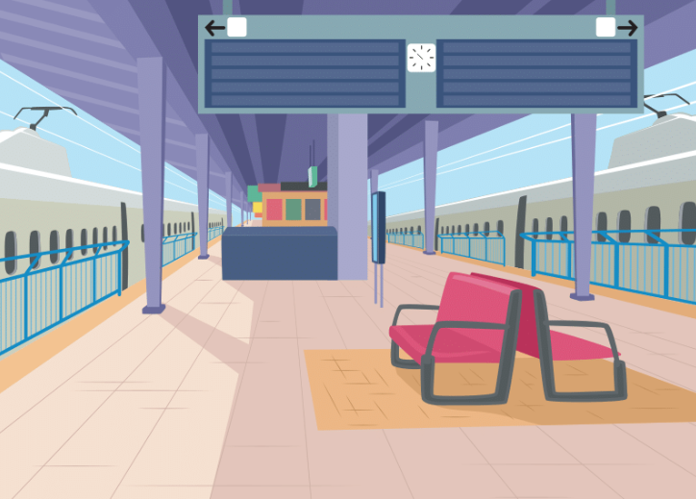
3 Look and say
Tran Hung Dao street is in front of the train station.
5 Tran Hung Dao street / in front of / train station

