Slide 1






















Slide 2
Unit 9. Places in town
Lesson 3. Task 1, 2, 3

Slide 3
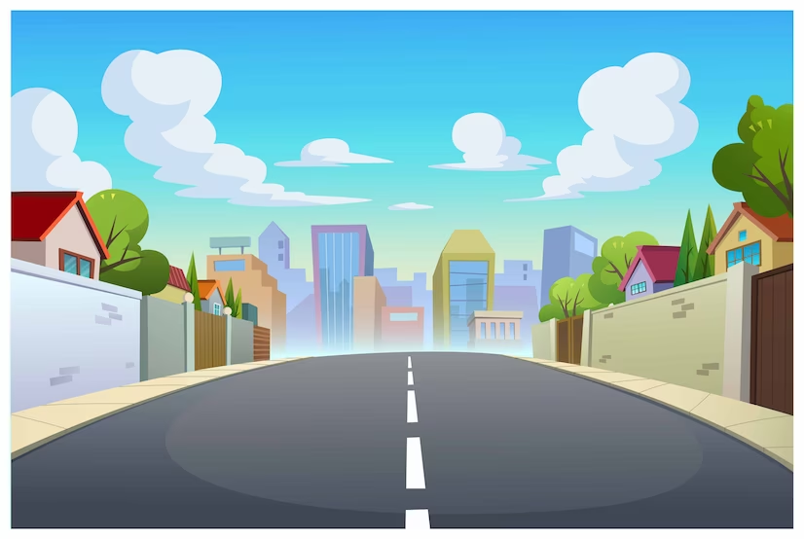


VOCABULARY CHECKING

Slide 4

WHERE´S THE FIRE?
START
Drive the fire engine to the fire

Slide 5

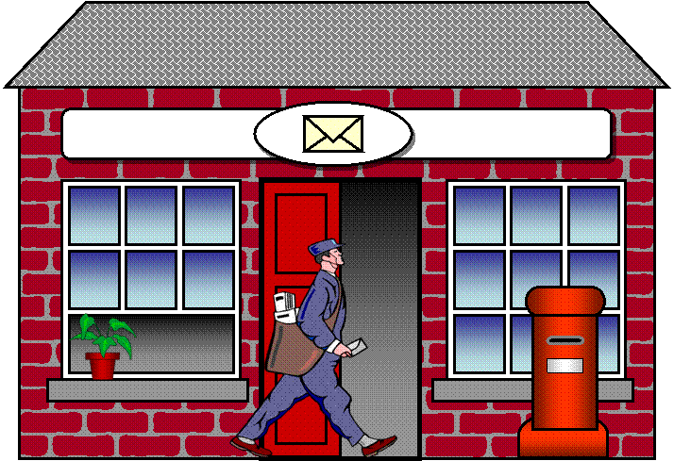
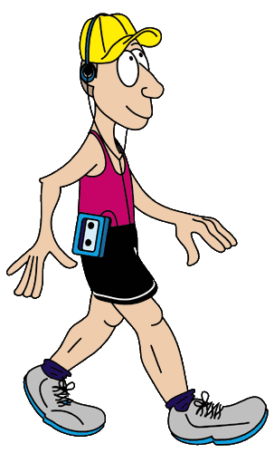
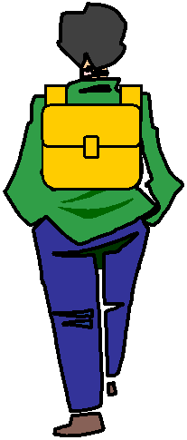


GPS
TURN RIGHT
Click on the arrows
Click on the arrows

Slide 6
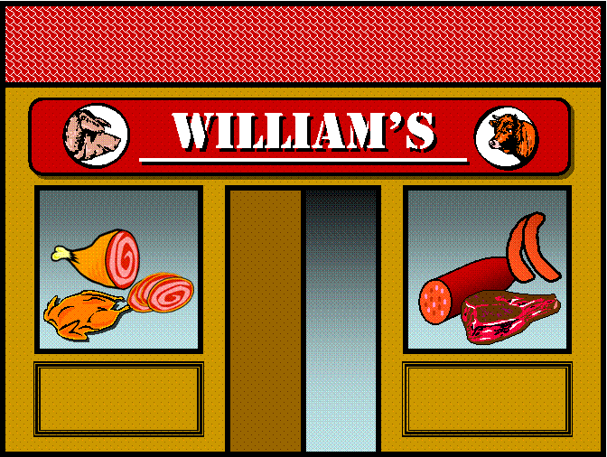
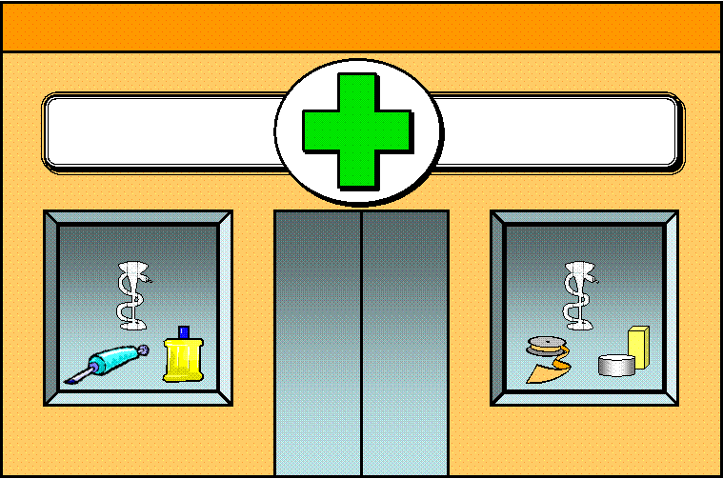
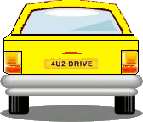

GPS
GO STRAIGHT
Click on the arrows

Slide 7




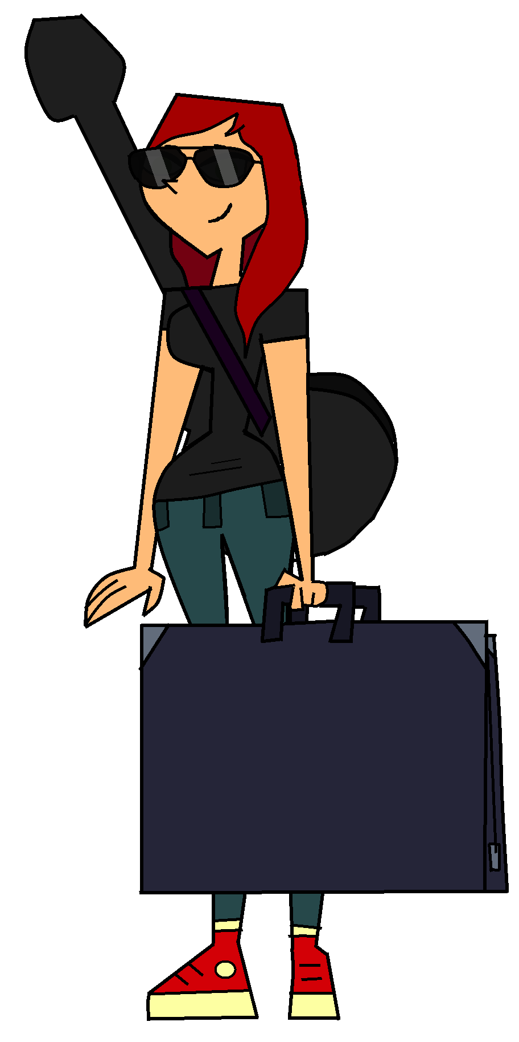
GPS
TURN LEFT
Click on the arrows

Slide 8

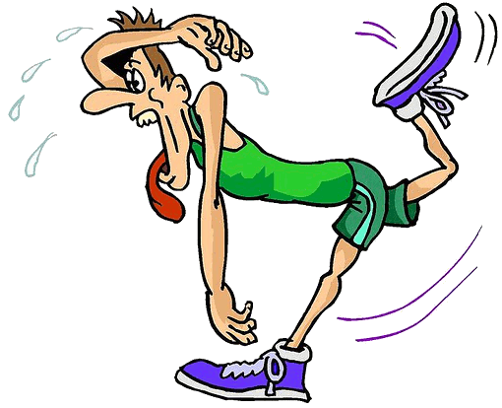
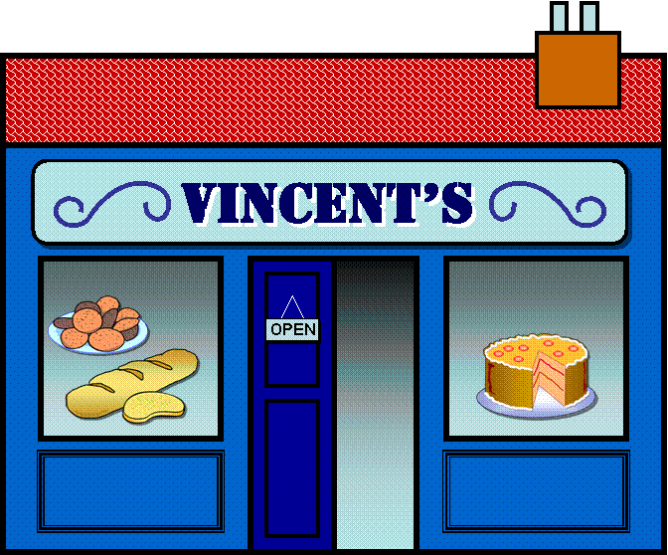
GPS
TURN RIGHT
Click on the arrows

Slide 9

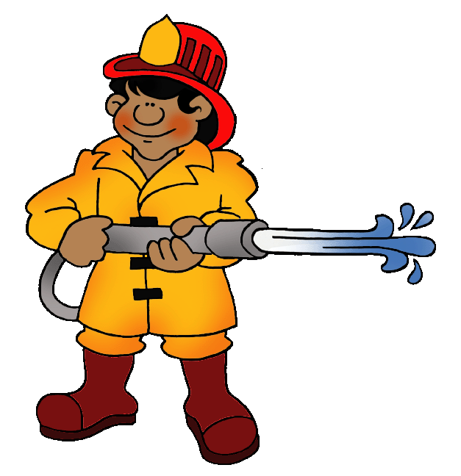


GPS
HERE WE ARE!

