Slide 1
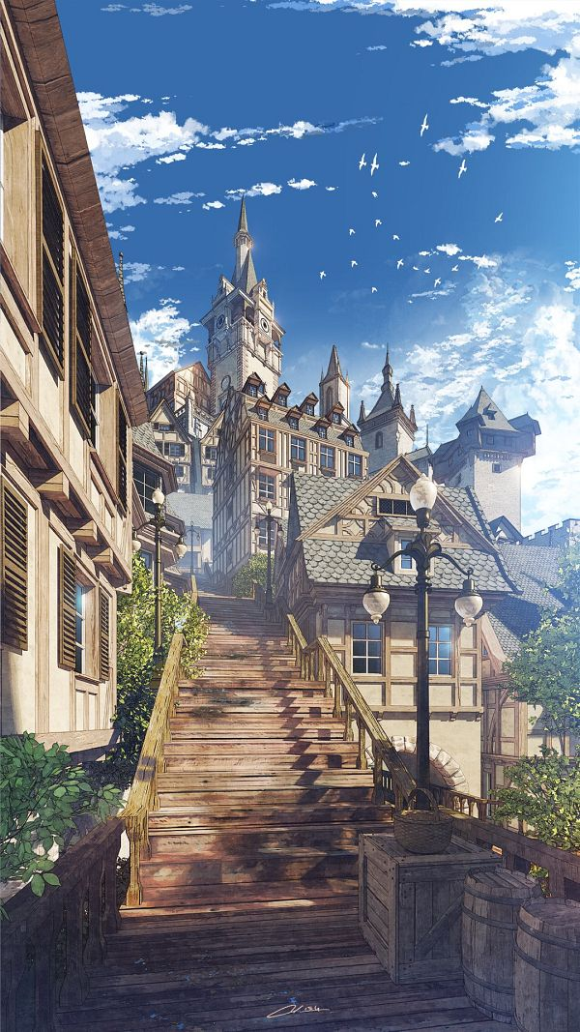
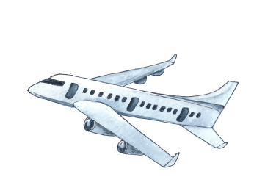


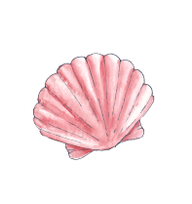
Unit 12: Cool places
Lesson 1 – Task 1, 2, 3

Slide 2

01
Warm-up
Frog jumping

Slide 3





2
1
3
4
Notes:
Click finish để chuyển qua phần 2

Slide 4
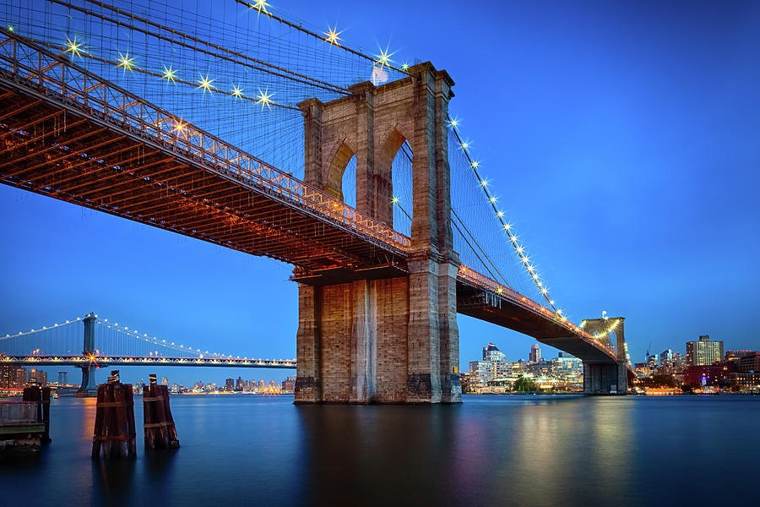
QUESTION NUMBER 1
Spell the word:
What is this?
Click to reveal the answer

Slide 5
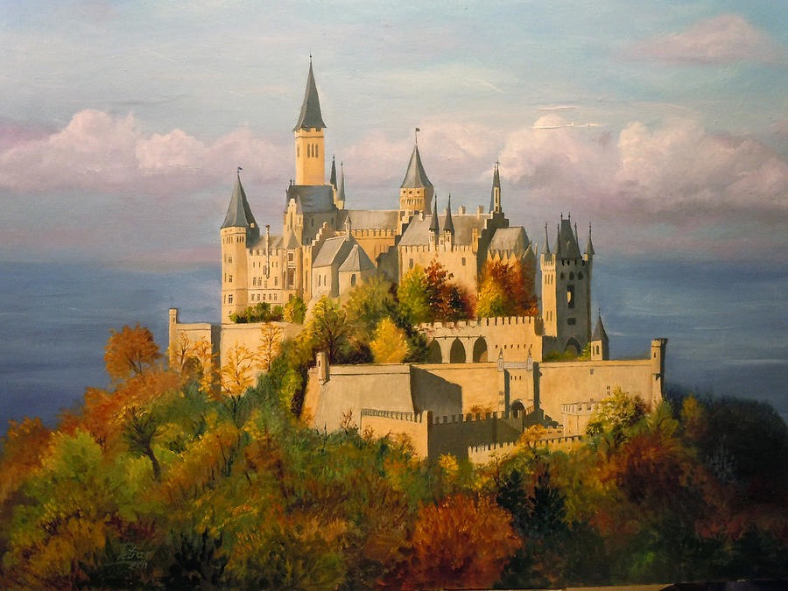
QUESTION NUMBER 2
Spell the word:
What is this?
Click to reveal the answer

Slide 6
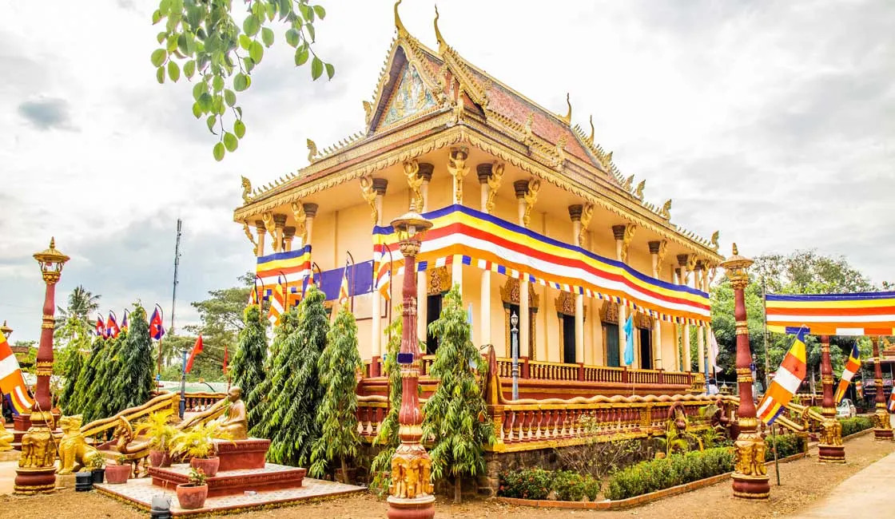
QUESTION NUMBER 3
Spell the word:
What is this?
Click to reveal the answer

Slide 7
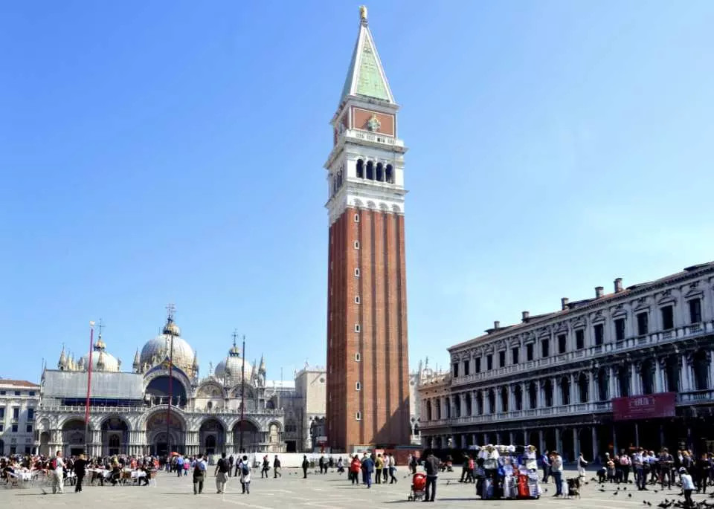
QUESTION NUMBER 4
Spell the word:
What is this?
Click to reveal the answer

Slide 8
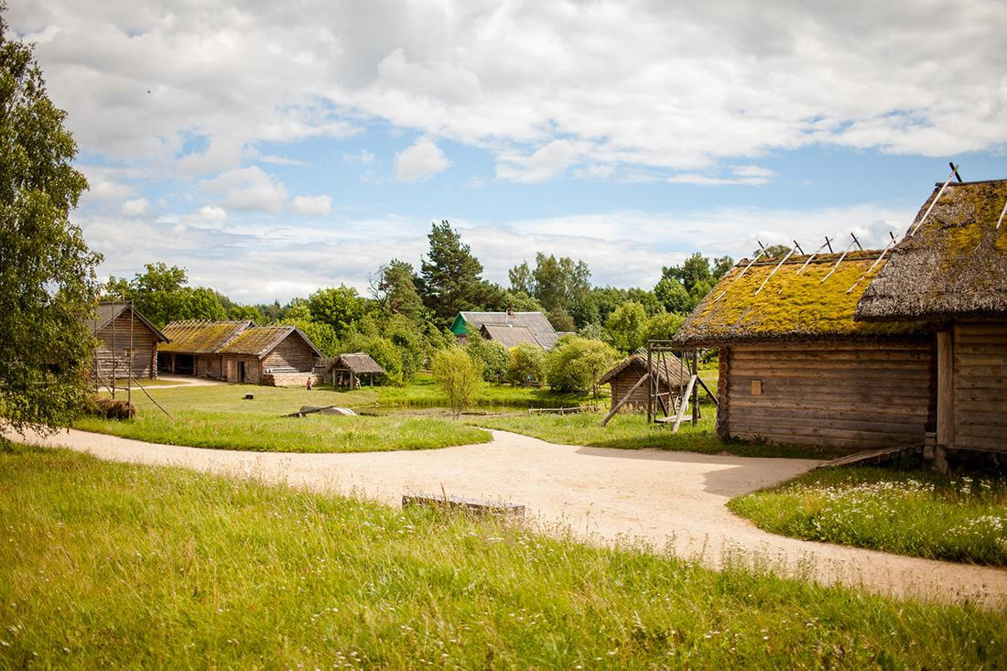
QUESTION NUMBER 5
Spell the word:
What is this?
Click to reveal the answer

Slide 9

ANSWER NUMBER 1
Listen and repeat
B-r-i-d-g-e
Click to go back to the question

Slide 10
ANSWER NUMBER 2
Listen and repeat
Listen and repeat
C-a-s-t-l-e
Click to go back to the question

Slide 11
ANSWER NUMBER 3
Listen and repeat
T-e-m-p-l-e
Click to go back to the question

Slide 12
ANSWER NUMBER 4
Listen and repeat
T-o-w-e-r
Click to go back to the question

Slide 13
ANSWER NUMBER 5
Listen and repeat
V-i-l-l-a-g-e
Click to go back to the question

Slide 14
Let’s play
True or
False

Slide 15
Next
Notes:
Ấn next để qua phần tiếp theo

Slide 16
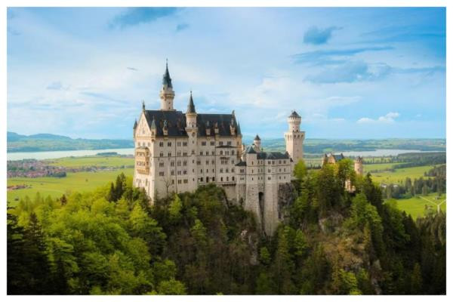
Number 1: 5 points
1
Were they in the village?
No, they weren’t.
Notes:
Click tick/x để chọn đáp án

Slide 17

Yes, it is TRUE!
They were not in the village. They were at the castle.
Notes:
Bấm nút quay về để quay về các ngôi sao

Slide 18
No, it is not FALSE!
They were not in the village. They were at the castle.

Slide 19
Number 2: 8 points
2
Where was Peter yesterday?
He was at the temple.

Slide 20
No, it is not TRUE!
Peter was at the tower.

Slide 21

Yes, it is FALSE!
Peter was at the tower.

Slide 22
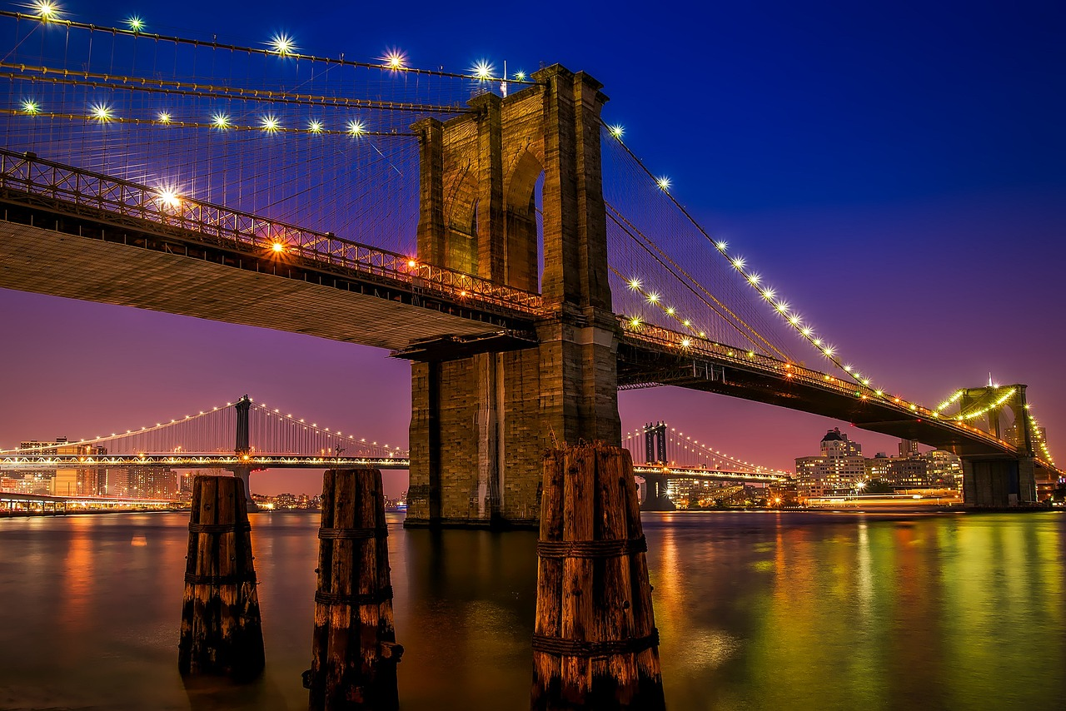
Number 3: 12 points
3
Lily’s grandfather went to New York last month. He was at the museum.

Slide 23
No, it is not TRUE!
Lily’s grandfather was not at the museum.
He was at the bridge.

Slide 24
Yes, it is FALSE
Lily’s grandfather was not at the museum.
He was at the bridge.

Slide 25
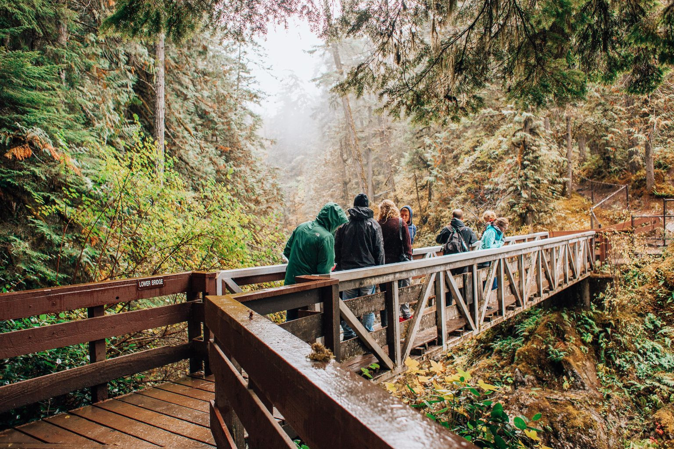
Number 4: 3 points
4
My friends were at the bridge last year.

Slide 26
Yes, it is
My friends were at the bridge last year.

Slide 27
No, it is not FALSE!
My friends were at the bridge last year.

Slide 28
Number 5: 11 points
5
This is the photo of a temple. Rose was here yesterday.

Slide 29
Yes, it is
Rose was at the temple yesterday.

Slide 30
No, it is not FALSE!
Rose was at the temple yesterday.

Slide 31
Number 6: 6 points
6
Chris was at the tower.

Slide 32
No, it is not TRUE!
Chris was not at the tower.
He was in the village.

Slide 33
Yes, it is.
Chris was not at the tower.
He was in the village.

Slide 34
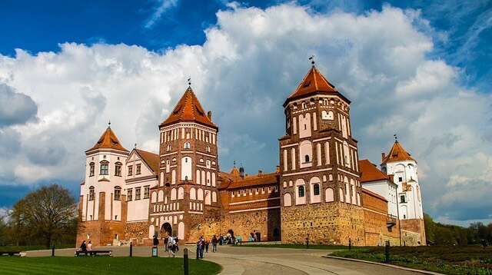
Number 7: 1 point
7
They were at the castle last year.

Slide 35
Yes, it is.
They were at the castle last year.

Slide 36
No, it is not FALSE!
They were at the castle last year.

Slide 37

Number 8: 15 points
8
Are the words in the correct order?
was/school/at/yesterday/she/.
=> She at were school yesterday.

Slide 38
No, it is not TRUE!
The correct order is: She was at school yesterday.

Slide 39
Yes, it is.
The correct order is: She was at school yesterday.

Slide 40
Number 9: 4 points
9
Lisa’s sister was at the bridge.

Slide 41
Yes, it is.
Lisa’s sister was at the bridge.

Slide 42
No, it is not FALSE!
Lisa’s sister was at the bridge.

Slide 43
Number 10: 10 points
10
Are the words in the correct order?
The/tourists/the/at/tower/were/
year/last.
=>The tourists were at the tower last year.

Slide 44
Yes, it is.
The tourists were at the tower last year.

Slide 45
No, it is not FALSE!
The tourists were at the tower last year.

Slide 46
Number 11: 2 points
11
Was Max on the mountain?
Yes, he was.

Slide 47
No, it is not TRUE!
No, he wasn’t. He was at the castle.

Slide 48
Yes, it is FALSE.
No, he wasn’t. He was at the castle.

Slide 49
Number 12: 14 points
12
Jenny went to Cambodia last month. She was at the tower.

Slide 50
No, it is not TRUE!
Jenny was not at the tower. She was at the temple.

Slide 51
Yes, it is FALSE.
Jenny was not at the tower. She was at the temple.

Slide 52
Number 13: 7 points
13
John wasn’t at school yesterday. He was at the bridge.

Slide 53
Yes, it is.
John was at the bridge yesterday.

Slide 54
No, it is not FALSE!
John was at the bridge yesterday.

Slide 55
Number 14: 14 points
14
Mizuki’s trip was amazing. She was on the mountain.

Slide 56
No, it is not TRUE!
Mizuki was in the village.

Slide 57
Yes, it is
FALSE.
Mizuki was in the village.

Slide 58
Number 15: 13 points
15
They were not at school. They were at the park.

Slide 59
No, it is not TRUE!
They were at school. They were not at the park.

Slide 60
Yes, it is
FALSE.
They were at school. They were not at the park.

