Slide 1



Unit 12: Cool places
Lesson 3
Task 1, 2, 3

Slide 2

WARM UP
Let’s sing a song!
Notes:
https://www.youtube.com/watch?v=BrHbvgNbRpQ&ab_channel=JunyTony-SongsandStories

Slide 3
2. PRESENTATION

Slide 4




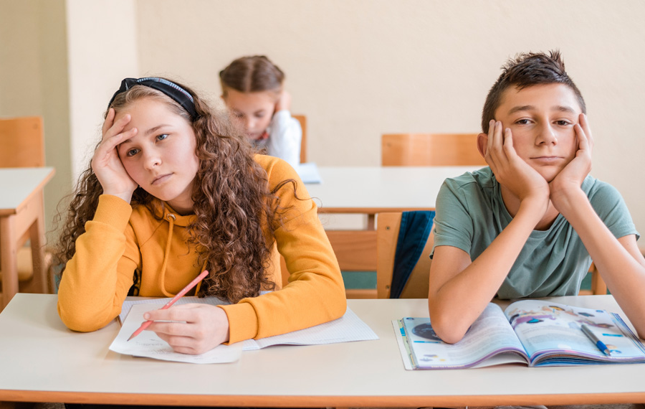
exciting
boring
awesome
wonderful

Slide 5
1. Listen and repeat.
awesome
wonderful
exciting
boring

Slide 6
3. PRACTICE

Slide 7
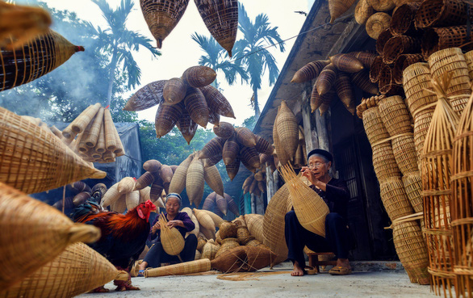

2. Listen and tick.
Sam was in the last week.
His trip to village was .
village city
exciting boring awesome

Slide 8
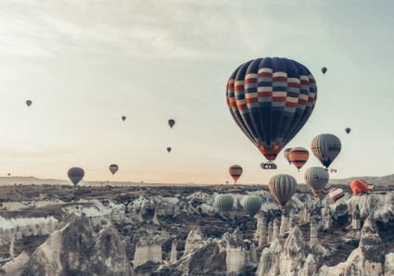


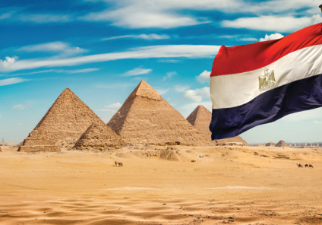


3. Look and say.
Where were you last week?
We were in England.
1. last week / England
2. last month / America

Slide 9
3. Look and say.
Where were you … ?
We were in ….
3. last year / Vietnam
4. last year / Turkey

Slide 10
4. PRODUCTION

Slide 11



How was your trip?

Slide 12
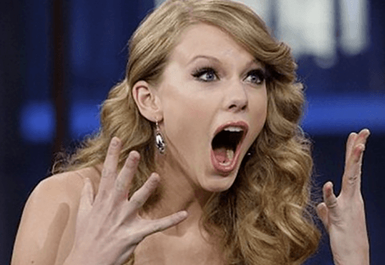

It was ______.
awesome
boring
wondering

Slide 13

It was ______.
happy
boring
exciting

Slide 14
It was ______.
busy
wonderful
dull

Slide 15
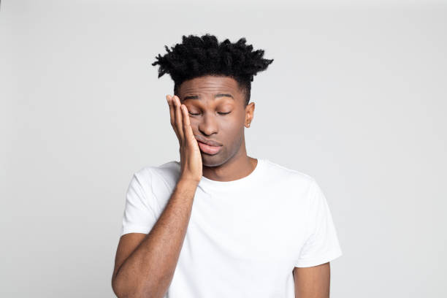
It was ______.
strange
fantastic
tiring

Slide 16

It was ______.
fantastic
digusting
suprising

Slide 17
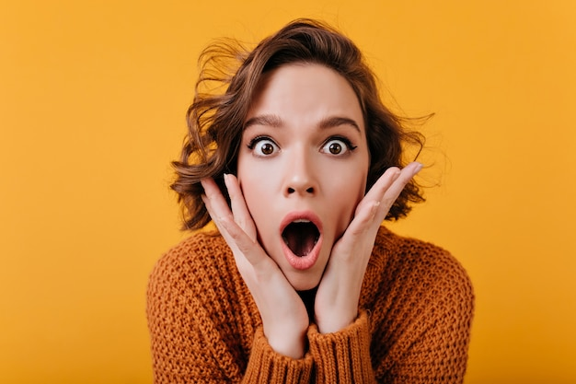
It was ______.
happy
surprising
annoying

Slide 18
5. ASSESSMENT

Slide 19


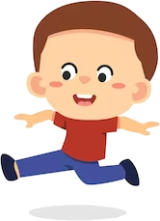
Read and write
My trip to England was w__________.
Our trip to the old village in Vietnam was ex_______
His trip to Egypt was am________.
Her trip to the farm in Turkey was bo______.
onderful
citing
azing
ring

