Slide 1

Unit 12
Cool places
Lesson 2: Task 4, 5, 6

Slide 2
01
Warm-up
Spelling bee game

Slide 3















SPELLING BEE GAME
5
Notes:
Bấm vào số để chọn câu hỏi
Bấm vào hũ để mở sao
Bấm vào Exit để thoát game

Slide 4



SPELLING BEE GAME
A-m-e-r-i-c-a
Time
over
02
04
03
05
01
28
12
27
24
19
08
09
26
14
15
23
13
21
10
20
06
07
22
17
25
18
11
30
16
29
START
Notes:
Bấm vào start để chạy đồng hồ
Bấm vào back để quay lại trang chủ

Slide 5

SPELLING BEE GAME
E-g-y-p-t
Time
over
02
04
03
05
01
28
12
27
24
19
08
09
26
14
15
23
13
21
10
20
06
07
22
17
25
18
11
30
16
29
START
Notes:
Bấm vào start để chạy đồng hồ
Bấm vào back để quay lại trang chủ

Slide 6

SPELLING BEE GAME
E-n-g-l-a-n-d
Time
over
02
04
03
05
01
28
12
27
24
19
08
09
26
14
15
23
13
21
10
20
06
07
22
17
25
18
11
30
16
29
START
Notes:
Bấm vào start để chạy đồng hồ
Bấm vào back để quay lại trang chủ

Slide 7

SPELLING BEE GAME
T-u-r-k-e-y
Time
over
02
04
03
05
01
28
12
27
24
19
08
09
26
14
15
23
13
21
10
20
06
07
22
17
25
18
11
30
16
29
START
Notes:
Bấm vào start để chạy đồng hồ
Bấm vào back để quay lại trangchủ

Slide 8

SPELLING BEE GAME
V-i-e-t-n-a-m
Time
over
02
04
03
05
01
28
12
27
24
19
08
09
26
14
15
23
13
21
10
20
06
07
22
17
25
18
11
30
16
29
START
Notes:
Bấm vào start để chạy đồng hồ
Bấm vào back để quay lại trang chủ

Slide 9
02
Presentation

Slide 10
Task 4: Listen and repeat
Where was he last week?
He was in Egypt.

Slide 11
Task 4: Listen and repeat
Where were you last month?
- We were in Vietnam.

Slide 12
03
Practice
Look and say

Slide 13
Task 5: Look and say
1. My father/ last week.
Where was your father last week ?
My father was in Turkey.
He was in Turkey.

Slide 14
Task 5: Look and say
2. I/ last month.
Where were you last month?
I was in America.

Slide 15
Task 5: Look and say
3. My cousins/ last year.
Where were your cousins last year?
They were in England.
My cousins were in England.

Slide 16
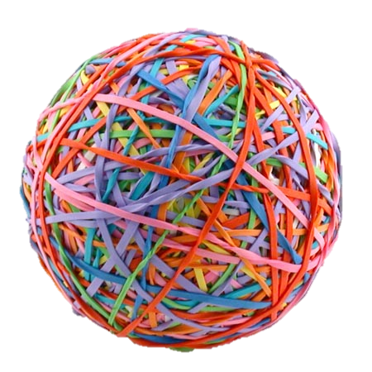

PASS THE BALL GAME
Notes:
Pass the ball. When the music stops – whoever has the ball must answer the question

Slide 17

Pass the BALL!

Slide 18
Were they in Vietnam?
✓
Yes, they were.

Slide 19
Pass the BALL!

Slide 20
Where was Jenny ?
She was in England.

Slide 21
Pass the BALL!

Slide 22
Were you in America ?
x
No, I wasn’t.

Slide 23
Pass the BALL!

Slide 24
Where were Maria and friends ?
They were in Turkey.

Slide 25
Pass the BALL!

Slide 26
Was John in Egypt ?
✓
Yes, he was.

Slide 27
Pass the BALL!

Slide 28

Lily was in America. Was she at the bridge?
Yes, she was.

Slide 29
Pass the BALL!

Slide 30
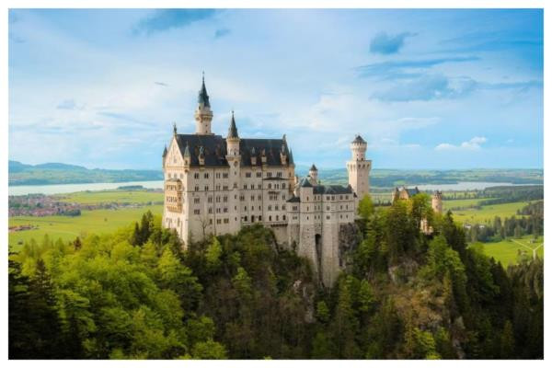
Where was Helen ?
She was at the castle.

