Slide 1



Unit 2 - My Home
Lesson 2 – Period 1

Slide 2
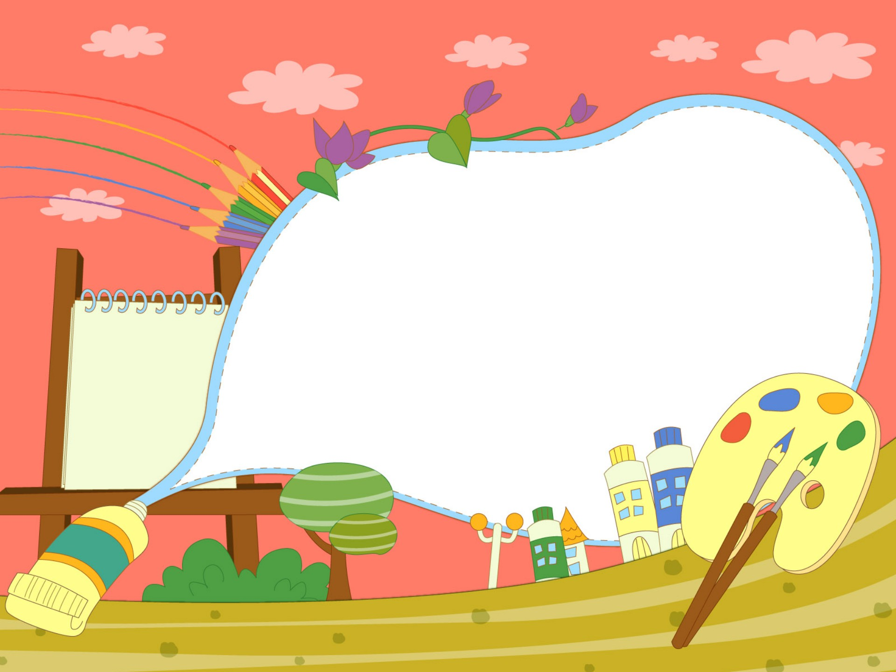

Warm up
Guessing Game

Slide 3
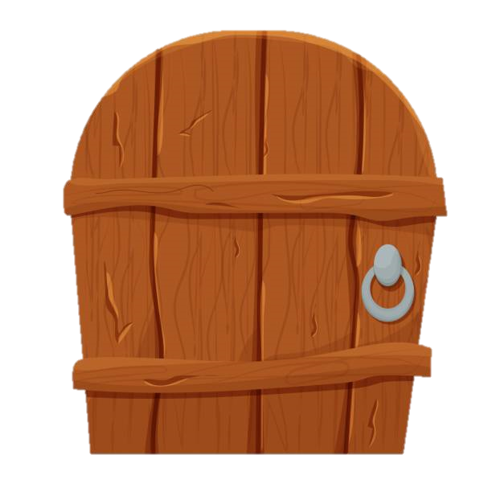

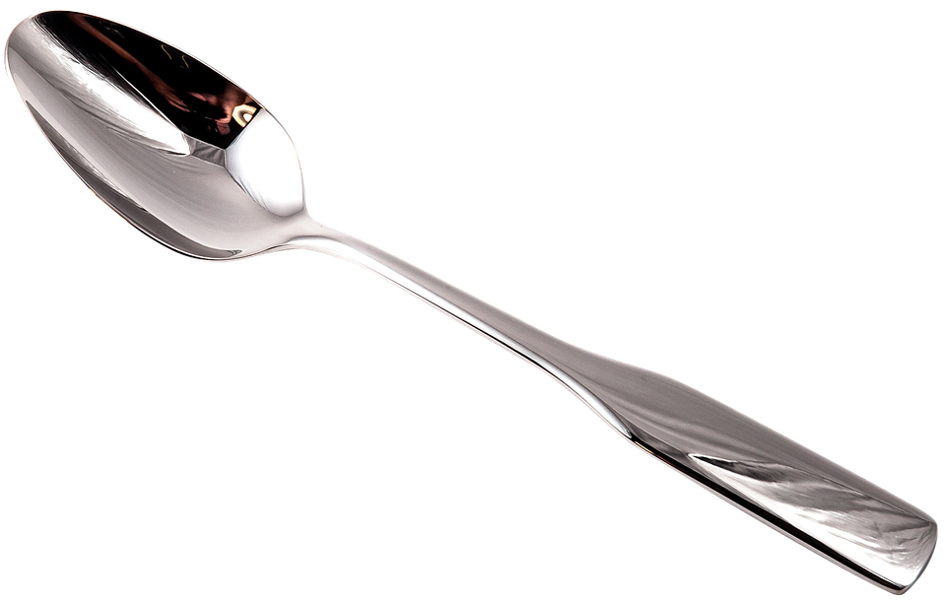
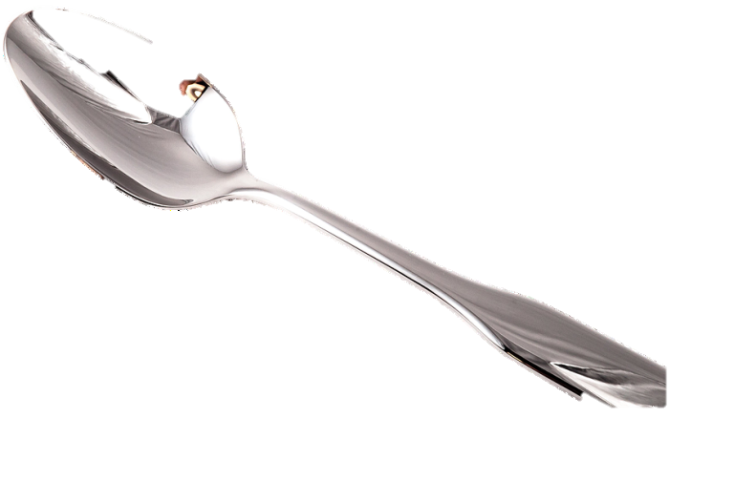
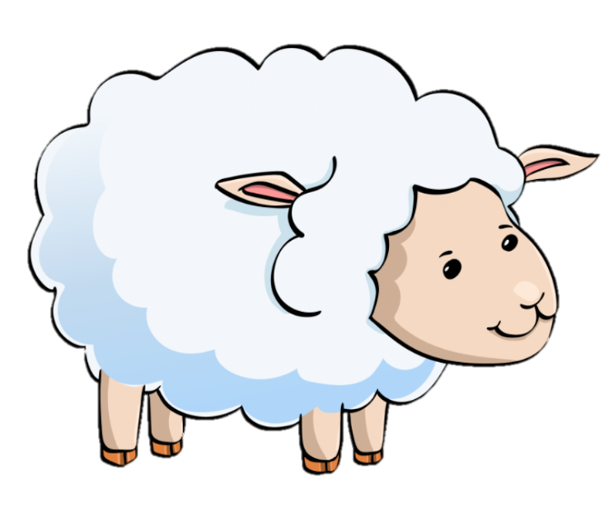
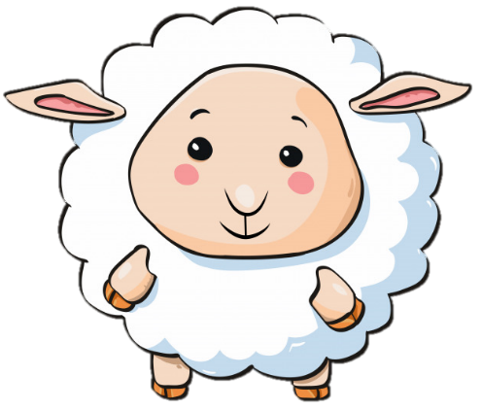
5 stars
What is it?
It’s a spoon.

Slide 4
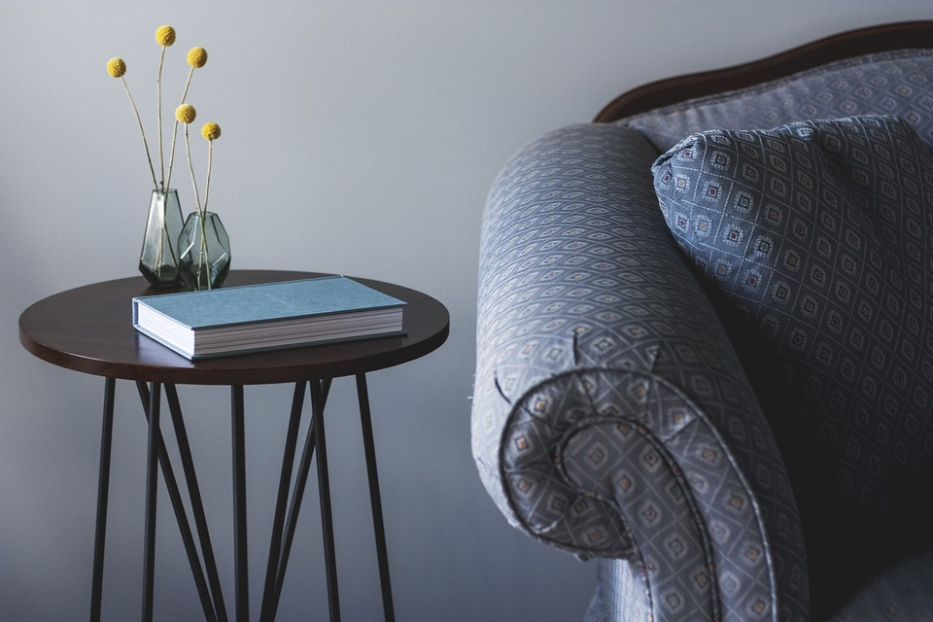
3 stars
It’s their ____.
It’s their table.
Notes:
Dấu chấm câu

Slide 5
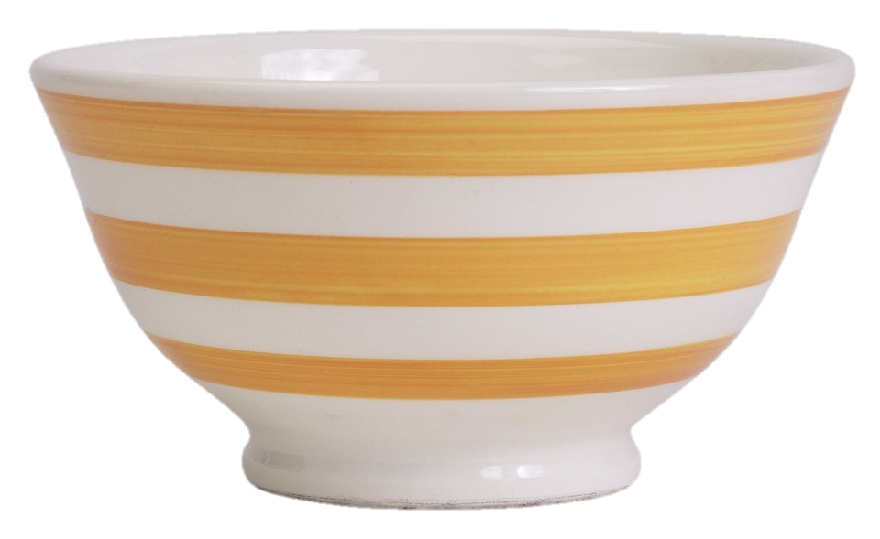
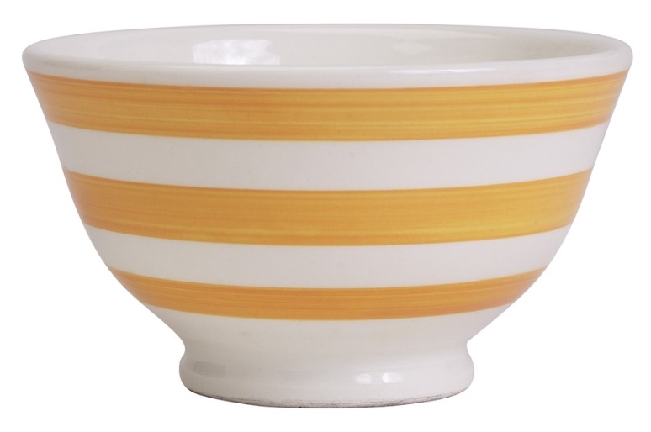
4 stars
It’s her _____.
It’s her bowl.

Slide 6
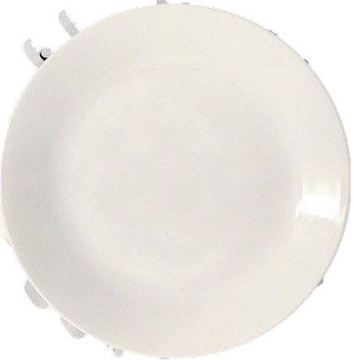
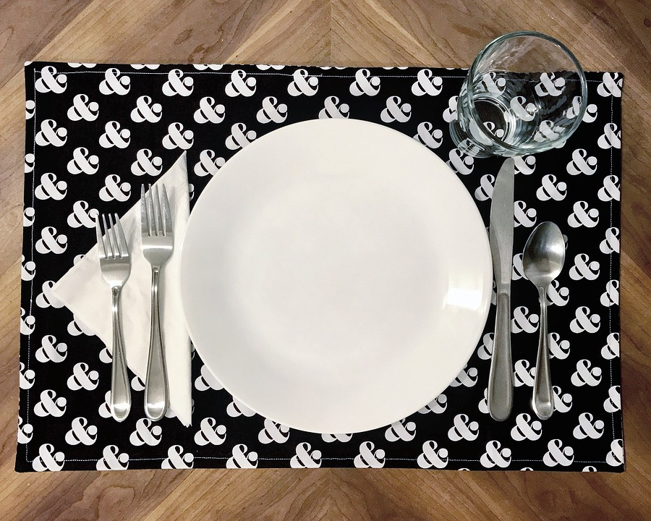

5 stars
Look at my ____.
Look at my plate.

Slide 7

Presentation
1
Listen and point. Repeat.

Slide 8


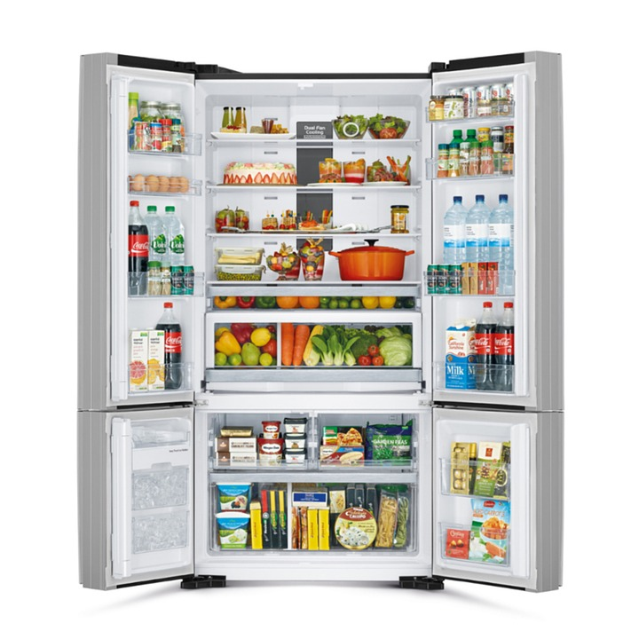
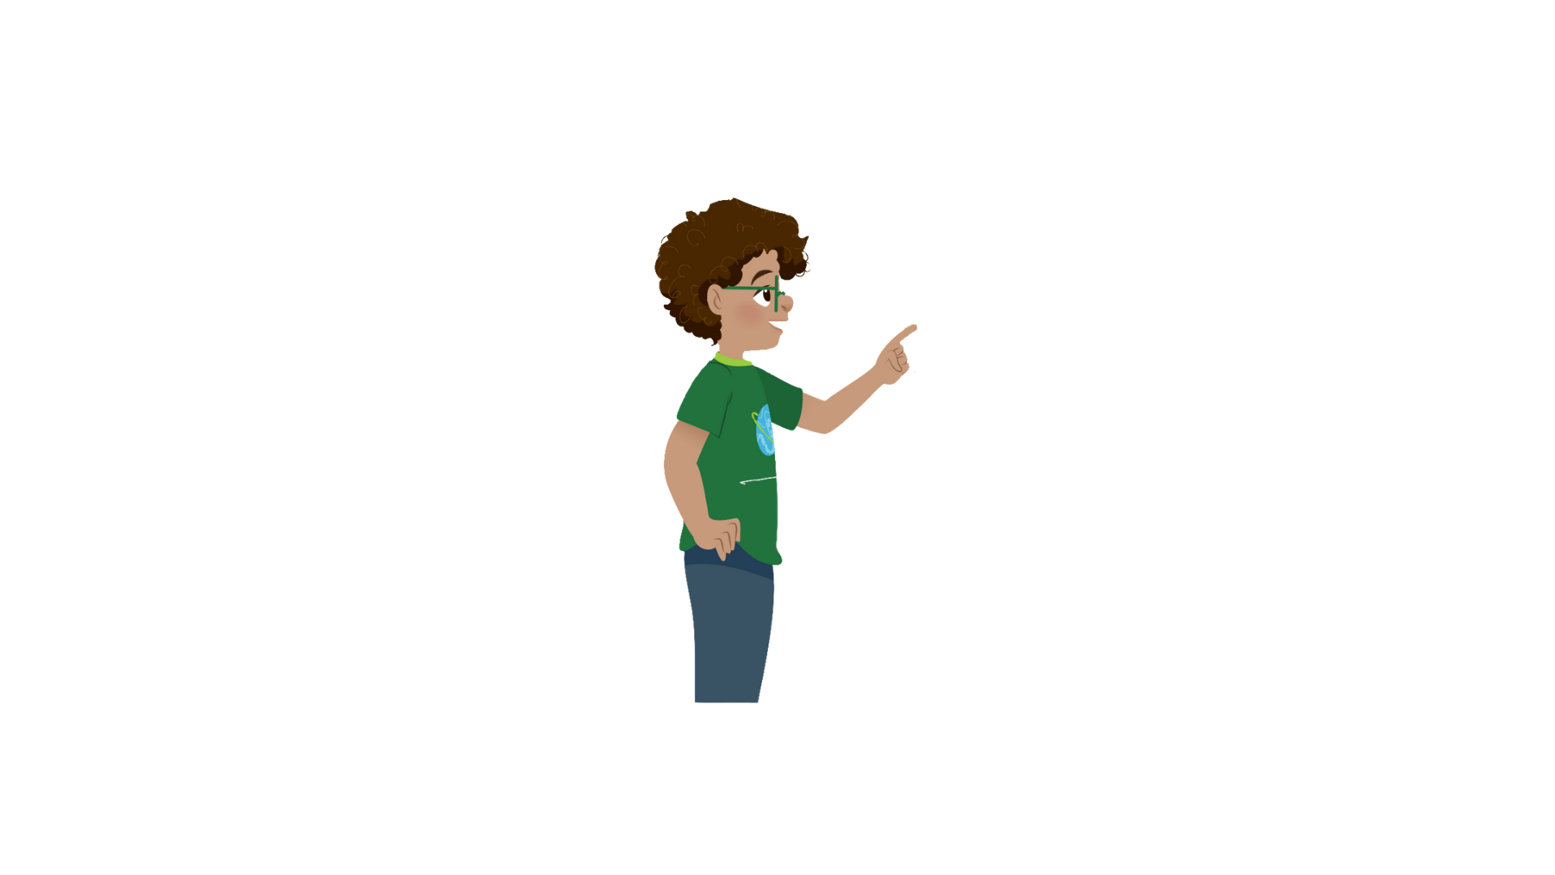


1
Listen and point. Repeat.
fridge

Slide 9
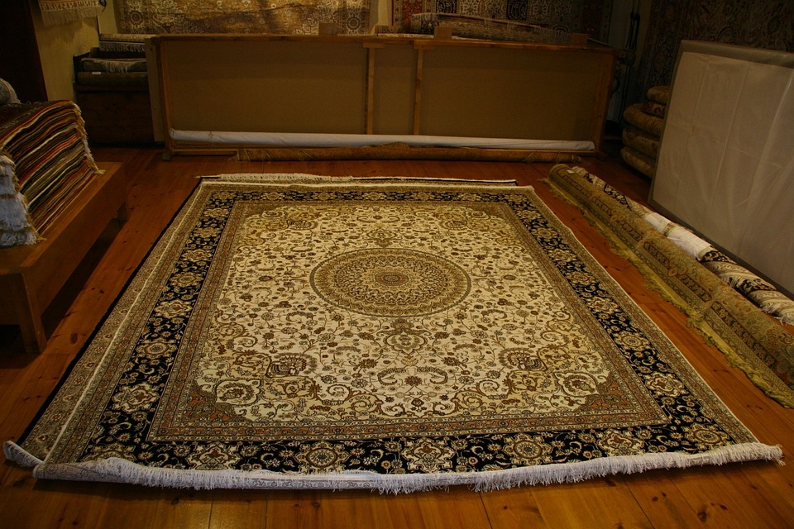

rug

Slide 10
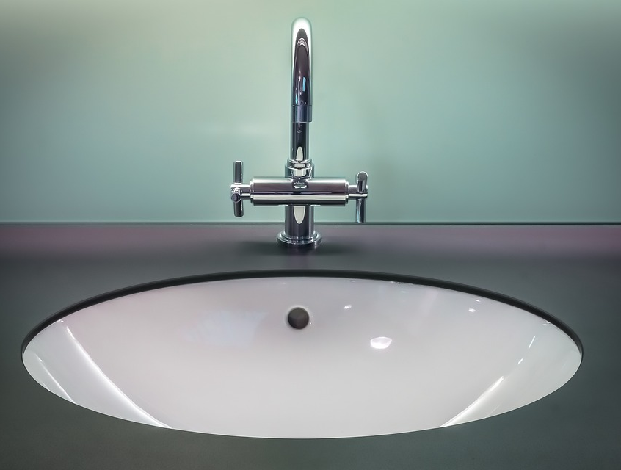

sink

Slide 11
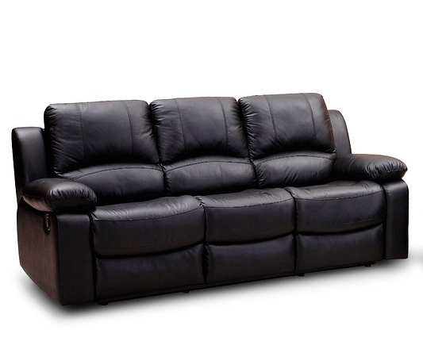

sofa

Slide 12
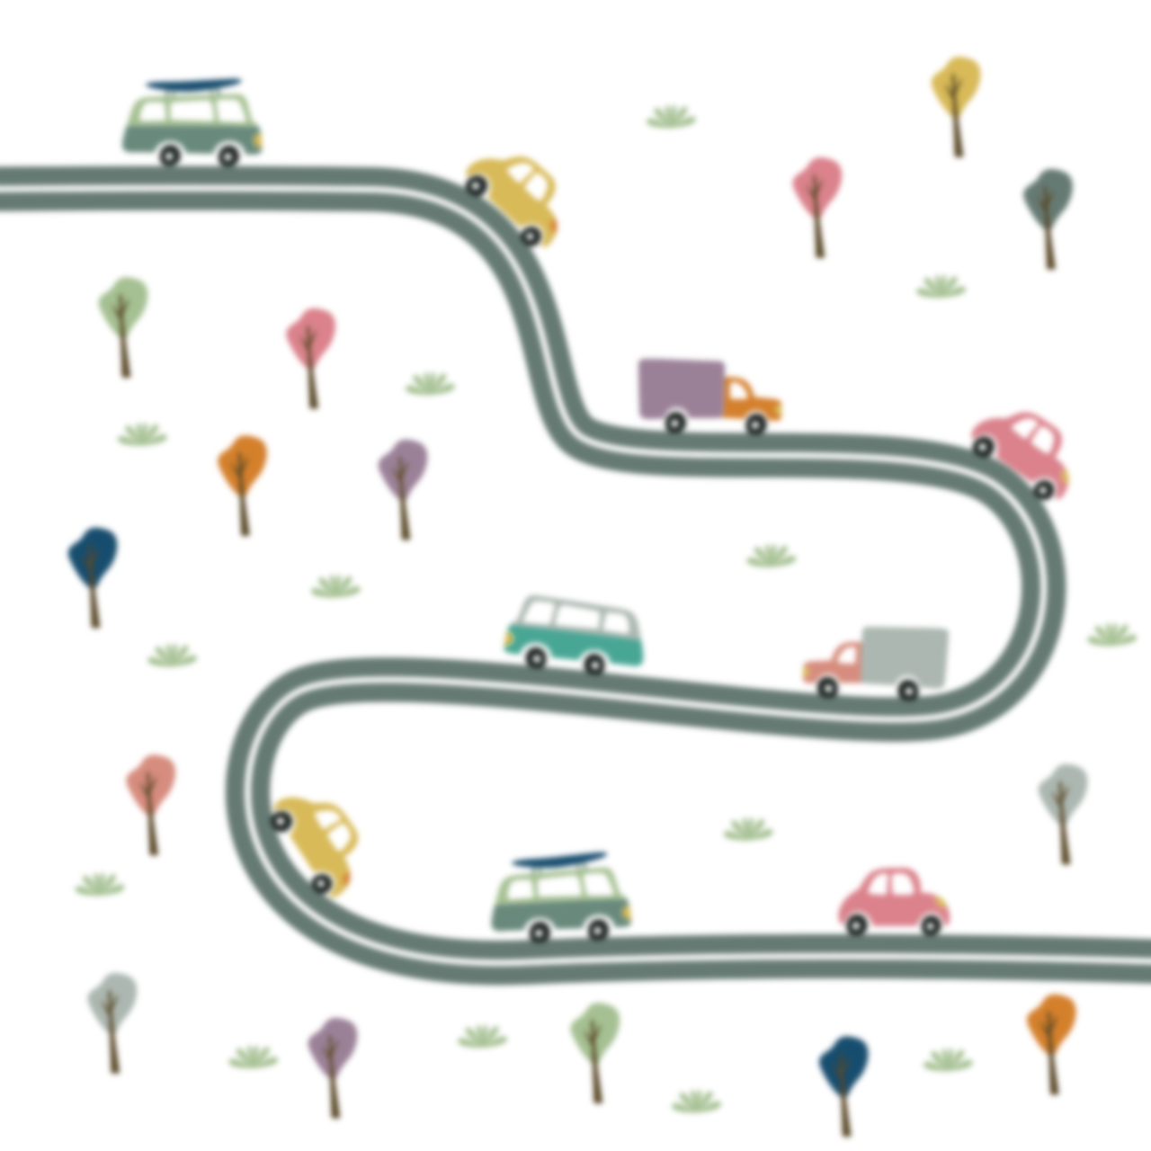
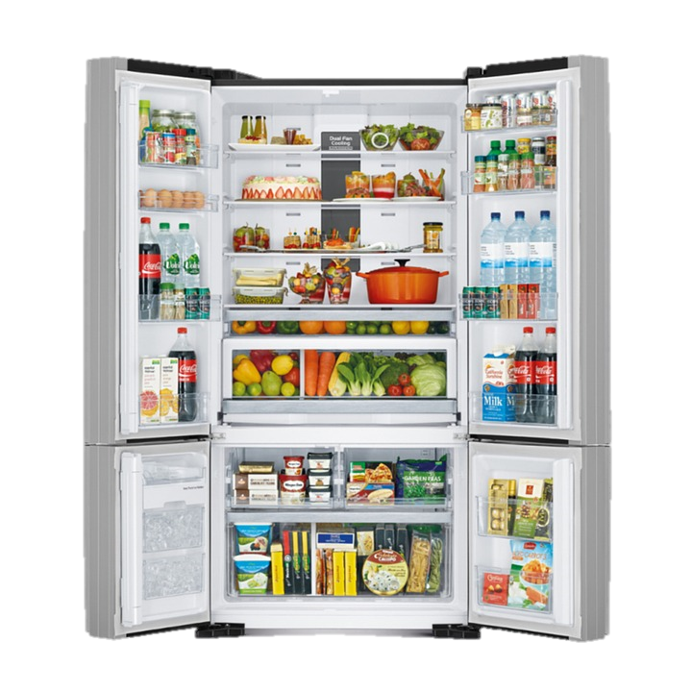
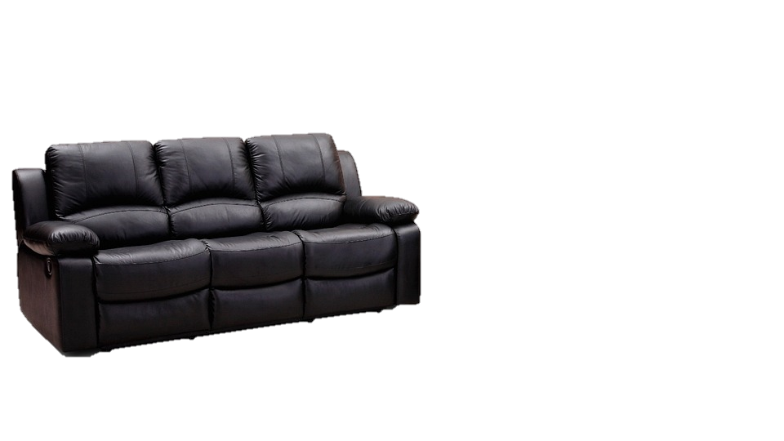
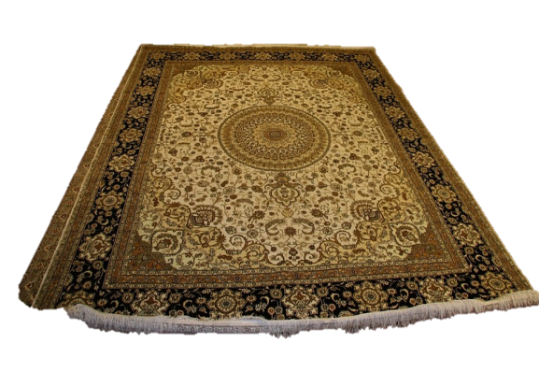

1
Listen and point. Repeat.
fridge
rug
sink
sofa

Slide 13
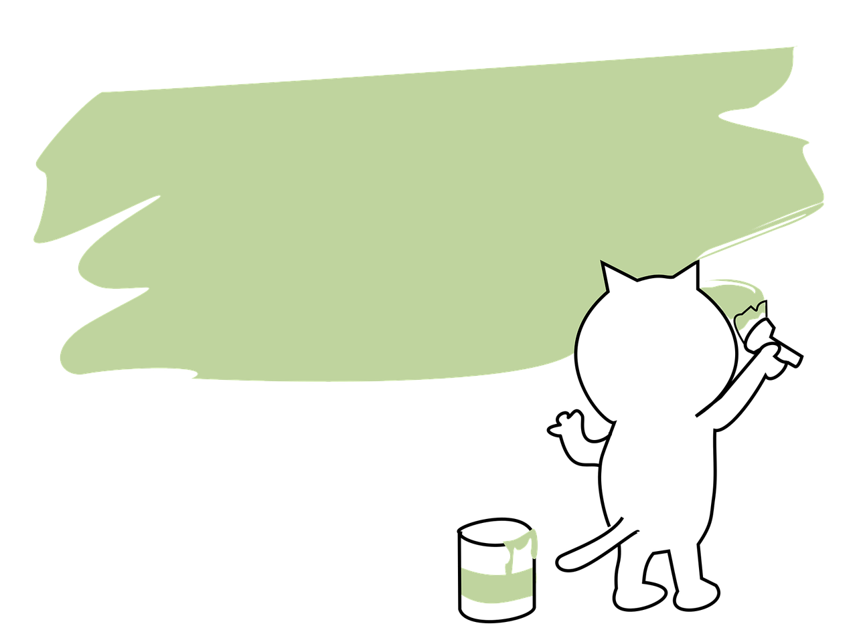
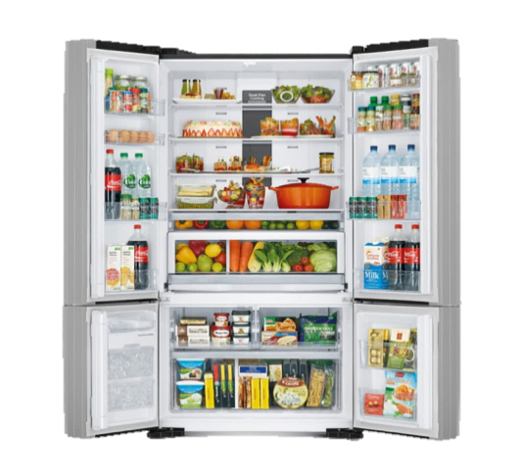

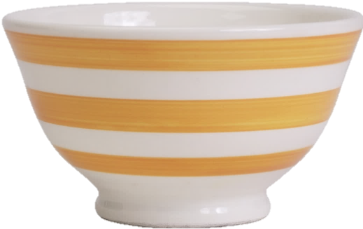

SLAP THE BOARD GAME
Notes:
- T asks some pairs to come to the board
- T reads the words and asks ss to slap the correct pictures

Slide 14

Practice
2
Listen and read. Tick

Slide 15


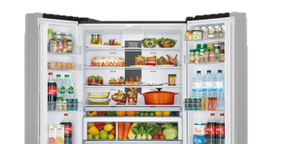
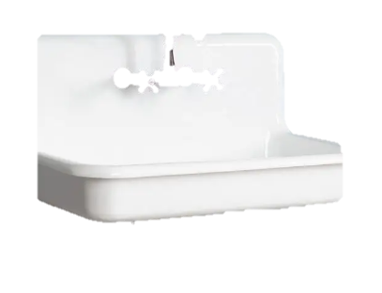
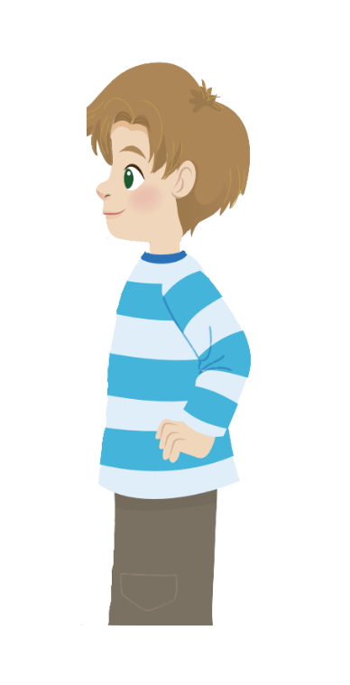
2
Listen and read.Tick.
This is our new house.
Great!
Dad
Jack
This is our living room.
Look! There’s a big rug under the table.
There is a in the living room.
chair
✓
table

Slide 16
2
Listen and repeat.Tick.
2. There is a in the kitchen.
✓
fridge
sofa
Dad
Jack
And is that our kitchen?
Yes, it is.
Where is the fridge?
Over there. It’s
next to the sink.
Cool!

Slide 17

Production

Slide 18
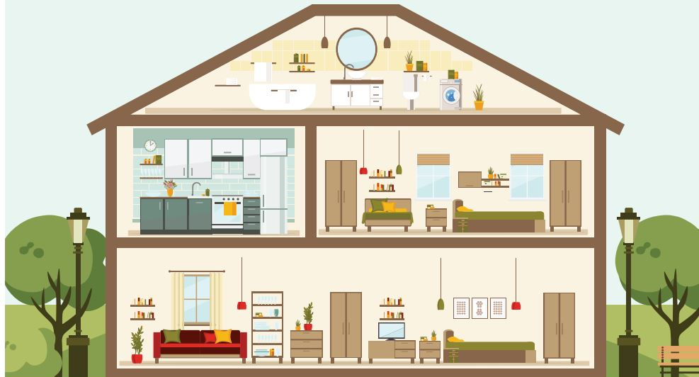


3
Look and say.
What room is it?
It’s a living room.

Slide 19
3
Look and say.
No, it isn’t.
It’s a kitchen.
Is it the bedroom?

Slide 20

Assessment

